Slide 1
H1B-VISA PETITION 2011-2016 ANALYSIS
ITMD 527: Data Analytics
Group number : 101
Arpit Khandekar(A20409171)
Devavrat Bapat(A20405650)

Slide 2
Introduction
What is H1-B Visa ?
H1b is the most popular employment authorized, non-immigrant visa category.
For whom ?
Enables U.S. employers to hire foreign workers for some special occupations.
Important factors of the H1-B Visa
Employer name, area of work, prevailing wages, job type, etc.

Slide 3
Understanding the Data
The United States Department of Labor discloses the data for different visa types annually and can be used for analysis.
1] CASE_STATUS: DOL give the status “Certified”, “Certified-Withdrawn,” Denied,” or “Withdrawn”.
2] EMPLOYER_NAME: Employer submitting LCA.
3] SOC_NAME: Department type associated with the job.
4] JOB_TITLE: Designation of the employee
5] FULL_TIME_POSITION: Type of job – full time or not.
6] PREVAILING_WAGE: Wages of the job being requested. Determined from the wages offered to similarly employed workers in the intended field of employment.
7] YEAR: Year in which H1-B visa petition was filed.
8] WORKSITE: City and State where foreign worker intends to work.
9] REGION: Categorization of the worksites into areas like North, South, East, West, etc.
9] LAT: latitude of Worksite.
10] LON: longitude of Worksite

Slide 4
Data Pre-Processing
Data Cleaning: Multiple records with NA values.
-> na.omit(h1bdataset)
Random sampling: 1048575 records found.
-> H1B_Data = h1bdataset[sample(nrow(h1bdataset),30000),]
To implement KNN classification algorithm, transformed Categorical features into Binary features.
CERTIFIED -> 1000
DENIED -> 0100
WITHDRAWN -> 0010
CERTIFIED WITHDRAWN -> 0001

Slide 5
Problems
To analyze the percentage of Case status for H1-B Visa petitions filed.
To analyze the states applying most H1-B visa petitions
To analyze common job titles for which most applications are filed.
To analyze wages for job titles such as Data Scientist and Software Engineers
To analyze employers who file most H1-B visa petitions.
To analyze Job positions and case status – full time or not.
Discover trend to find important factors influencing H1B denials and build a predictive model.

Slide 6
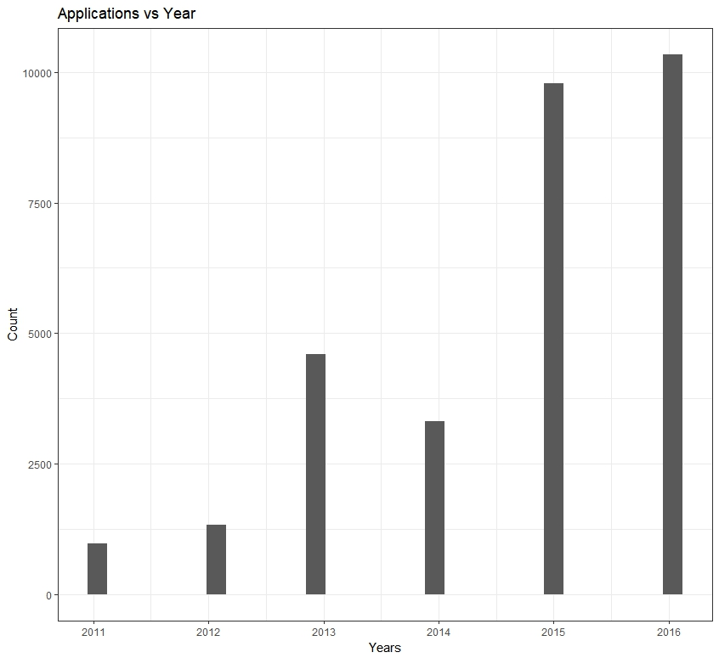
NUMBER OF APPLICATION VS YEARS
H1-B visa applications have been increasing every year.
Significant increase since the year 2016.

Slide 7
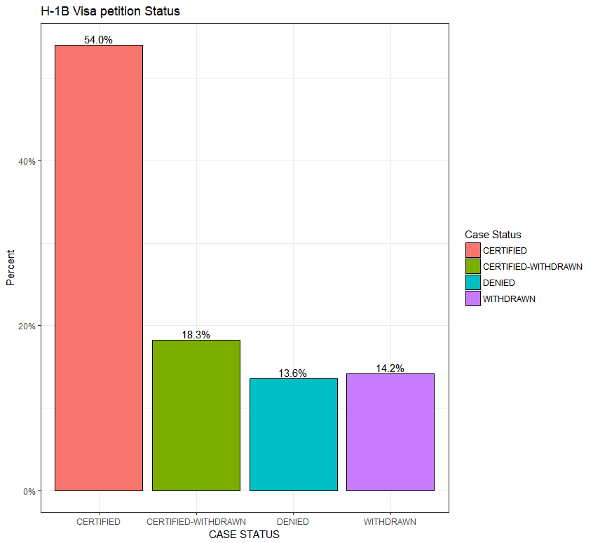
CASE STATUS VS PERCENTAGE VALUE
Figure shows H-1B Visa petition Case Status percentage wise from our dataset, such as : CERTIFIED = 54.0% , CERTIFIED WITHDRAWN = 18.3%, DENIED = 13.6 %, WITHDRAWN = 14.2%
From this figure we can infer that more than 50% H1B visa status was CERTIFIED during 2011-2016.

Slide 8
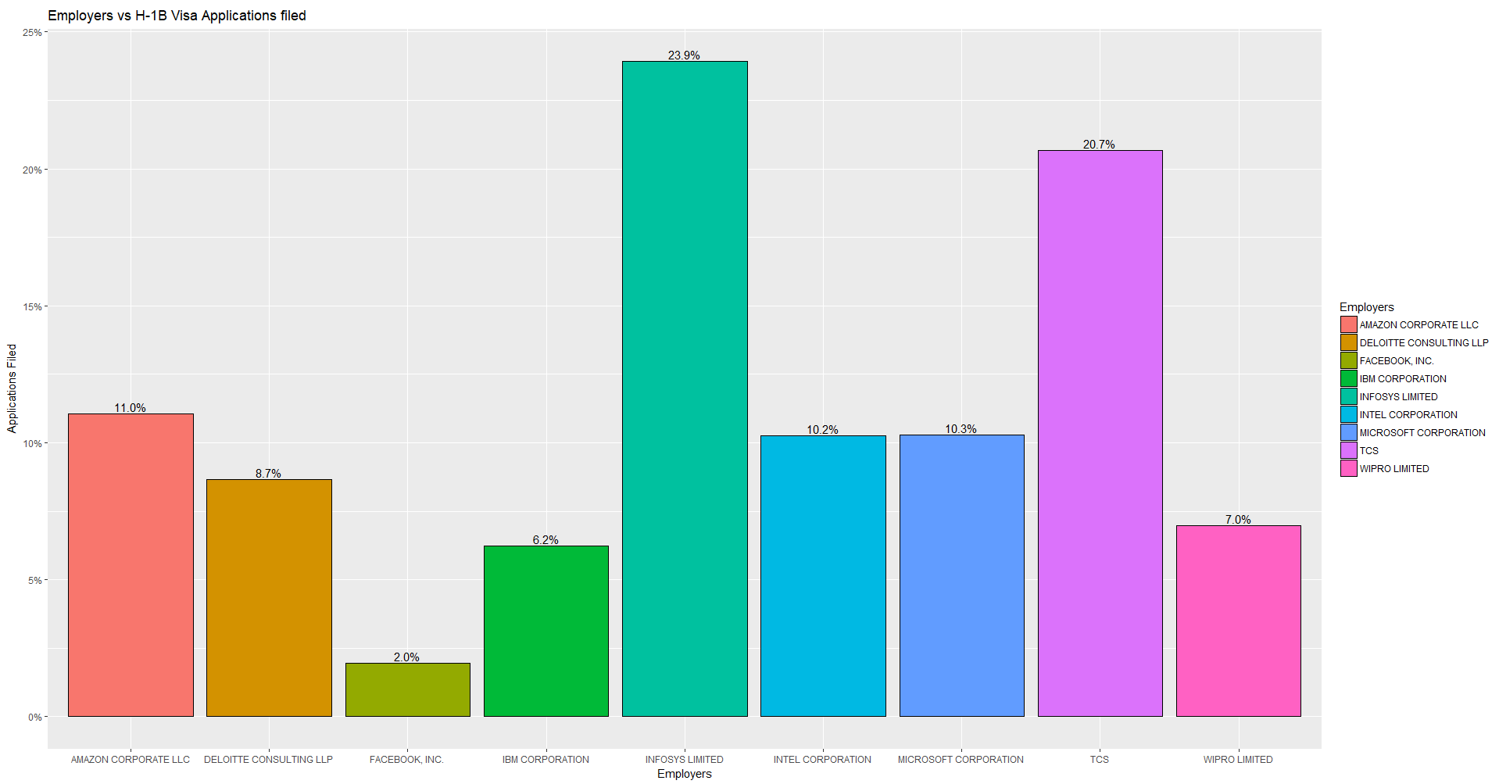
EMPLOYER VS APPLICATION FILLED
Figure tell us about the employer having most number of applications.
From the figure we can say that INFOSYS and TCS (TATA CONSULTANT SERVICES) tops the chart having highest number of H1B petition filled more than 20 % of all of applications.

Slide 9
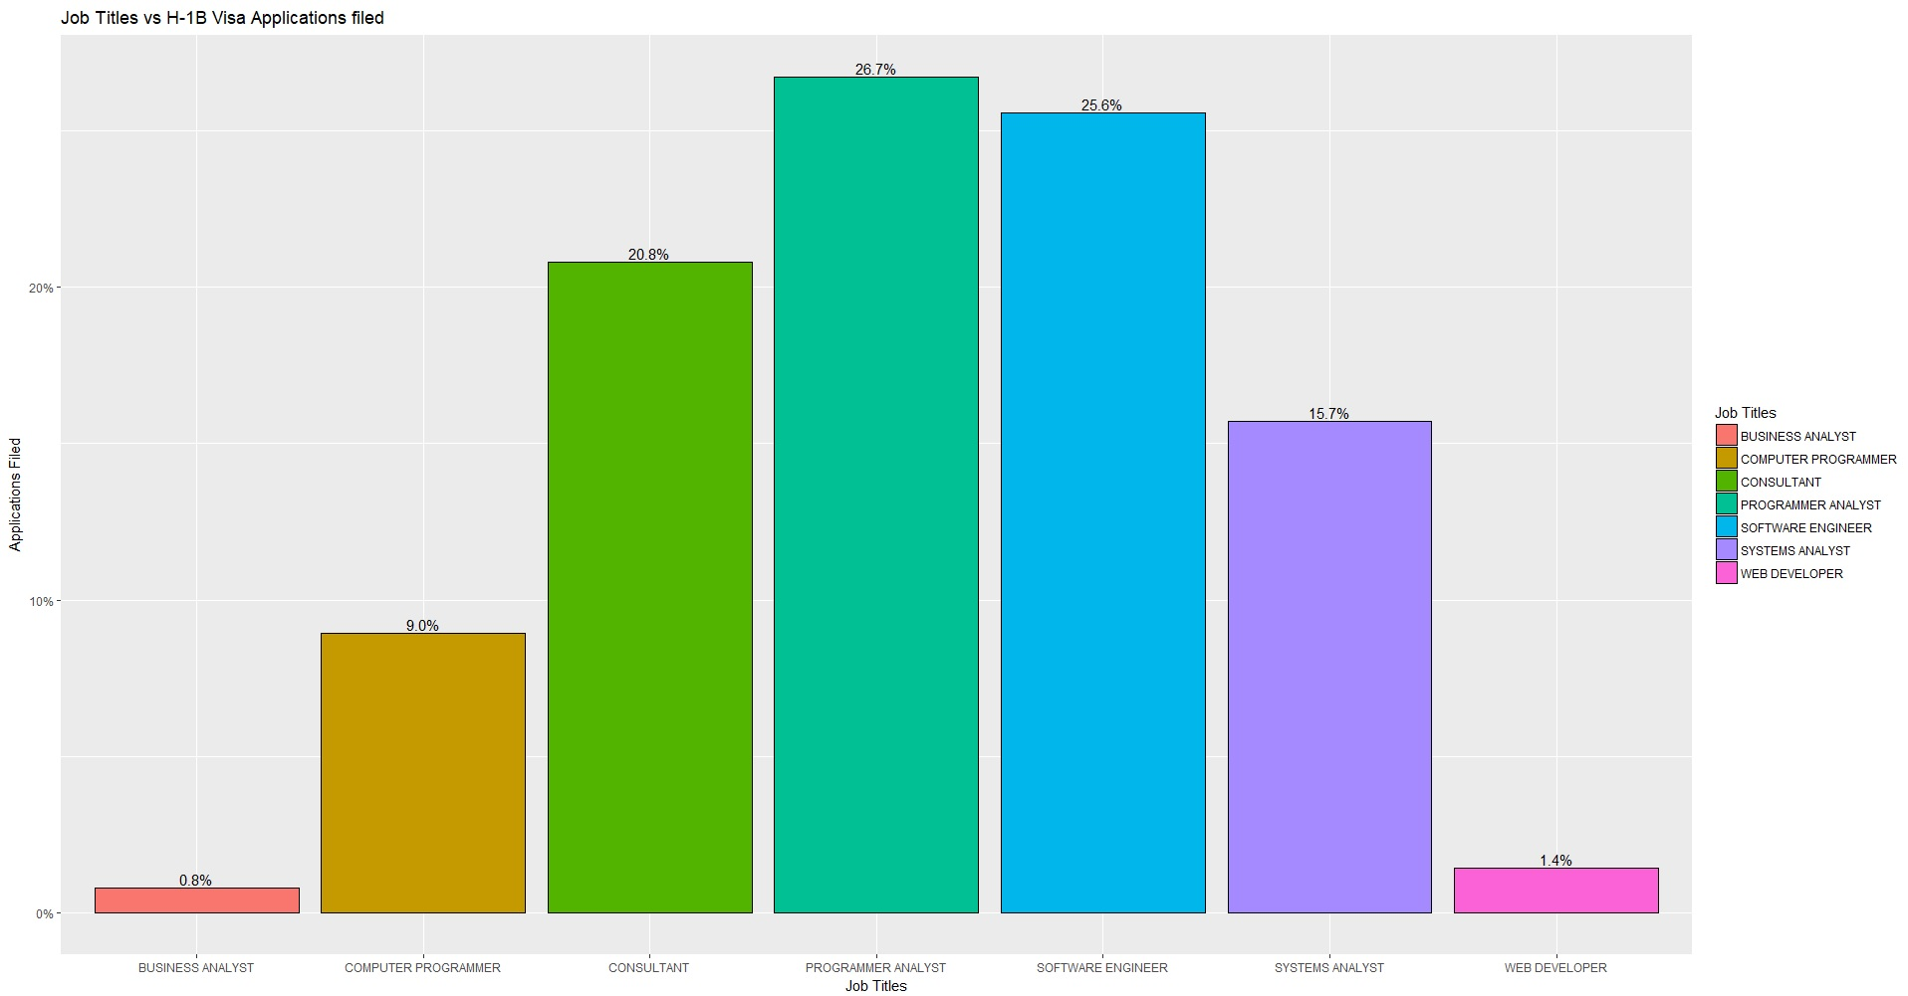
JOB TITLE VS NO. OF APPLICATIONS
Figure shows H-1B Visa Petition filed with respect to JOB TITLE.
From the graph we can infer that Programmer Analyst and Software Developer have highest number of petition filed - more than 25% of all applications.

Slide 10
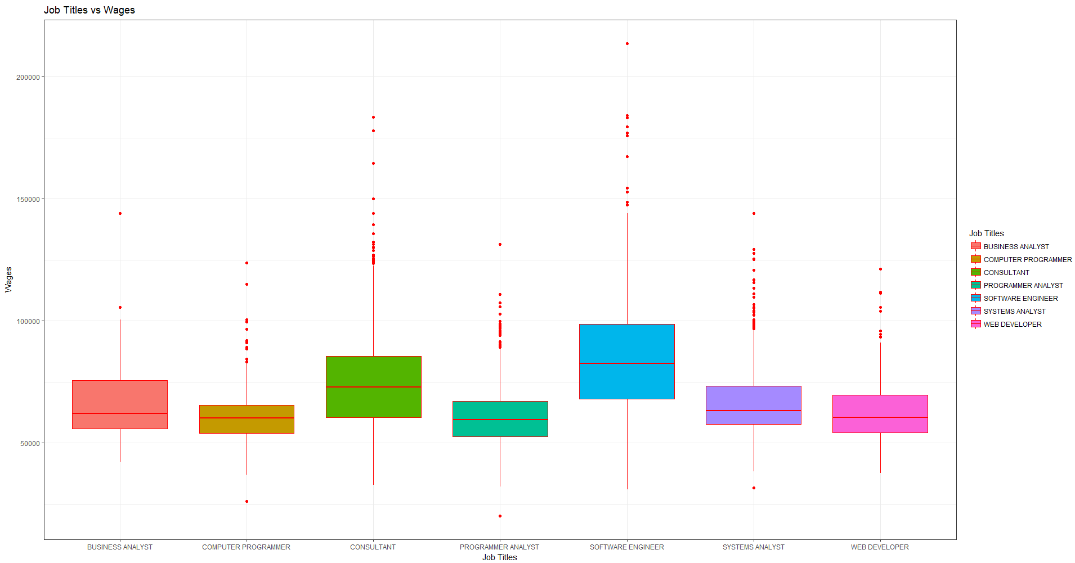
JOB TITLE VS WAGES
Adjacent graph represents Job titles with maximum wages.
From the graph we can infer that jobs with Software Engineer title has the highest wages.

Slide 11
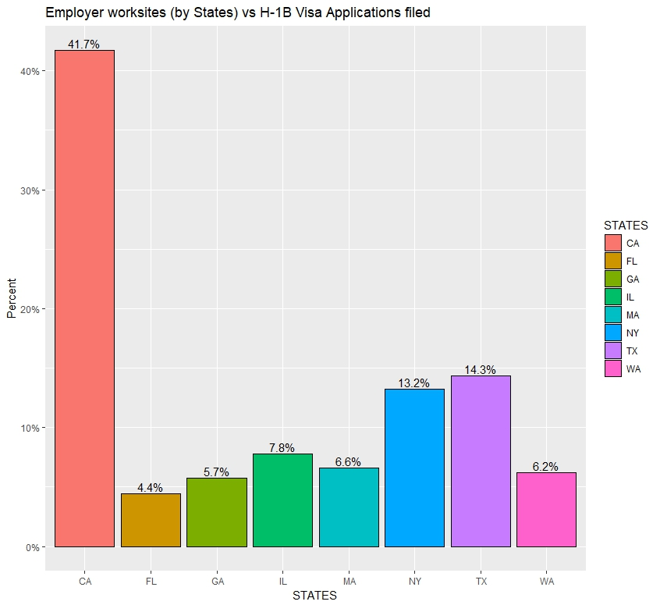
WORKSITE VS PETTITION FILLED
Graph shows H-1B Visa Petition filed with respect to Employer worksites(by states)
From the graph we can see that California(CA) has highest number of petition filed - more than 40%.
TEXAS(TX) and NEWYORK(NY) share 14.3 % and 13.2% petition respectively. Rest all states have less than 10% of H1B applications filled.

Slide 12
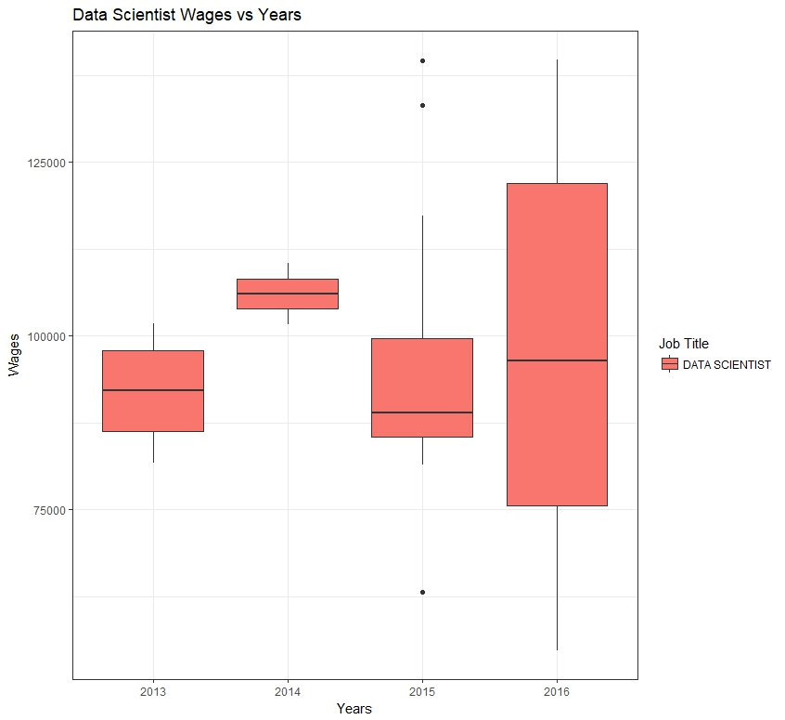
Data Scientist Wages VS APPLICATIONS
Comparing wages of Data Scientist over the duration of 2013 to 2016.
Significant increase in wages from 2013 (Max value: $100000) to 2016(Max value:$140000).

Slide 13
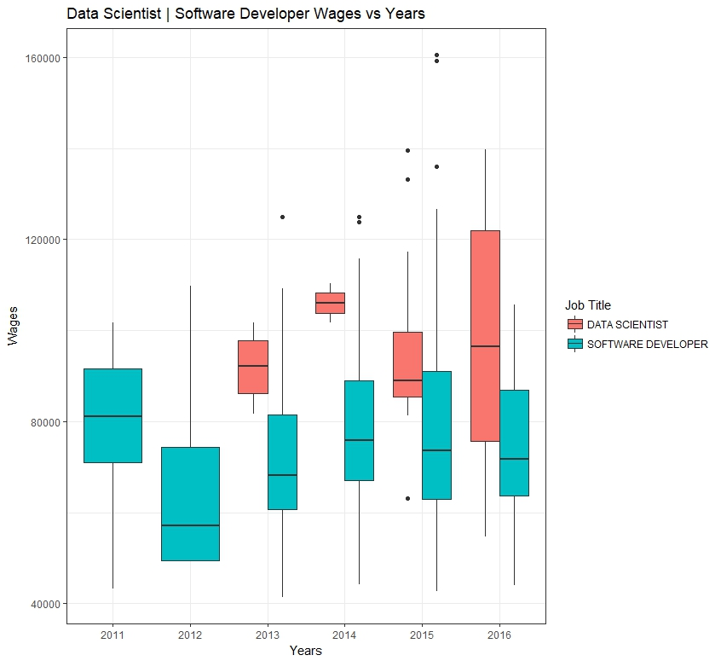
Comparison of Data Scientist Wages VS Software Developer Wages over years
Comparing wages for as Data Scientist and Software Developer over the duration of 2011 to 2016.
Data Scientist wages vary more than Software Developer.

Slide 14
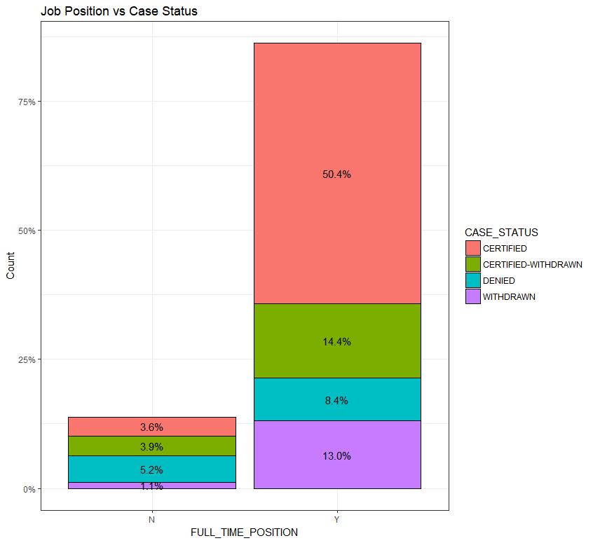
JOB POSITION VS CASE STATUS
Figure tell us about the CASE STATUS for respective JOB POSITION.
From the figure we can infer that FULL TIME POSITION has maximum number of applications certified whereas PART TIME POSITION has maximum number of application which are denied.

Slide 15
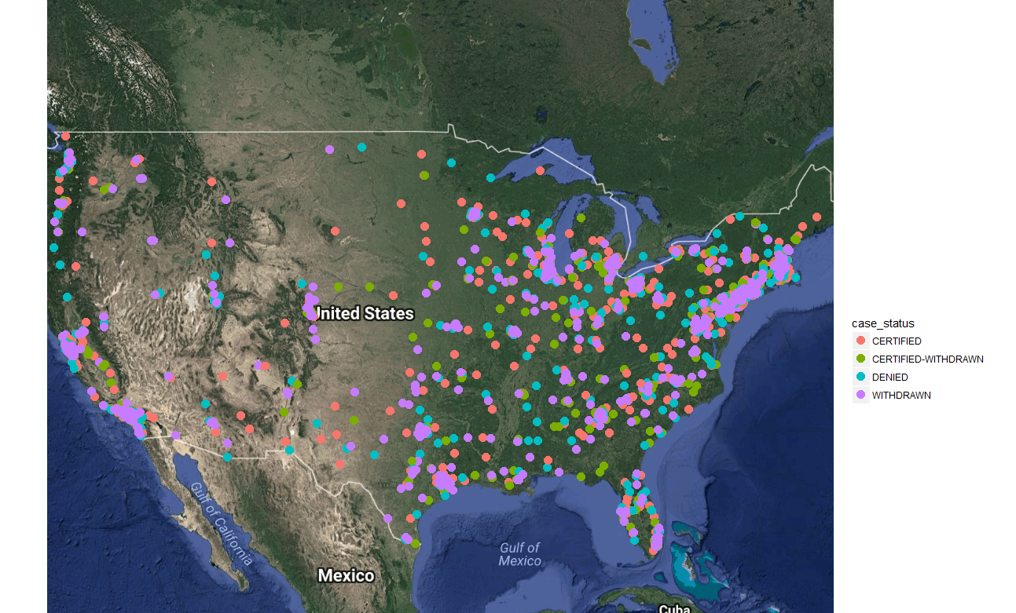
CASE STATUS ON USA MAP
Map tell us about the CASE STATUS on USA map.
From the MAP we can infer that most number of application is filled for EAST of USA.

Slide 16
Hypothesis Testing

Slide 17
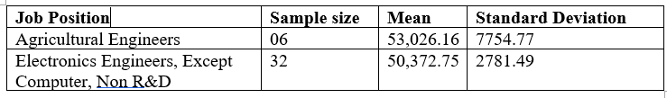
Hypothesis testing Problem : Wages for Job Position Agricultural Engineers and Electronics Engineers are similar
This is two sample hypothesis testing having two independent samples.
Ho=Null hypothesis = Wages of Agricultural Engineers and Electronics Engineers, Except Computer, Non R&D are similar μae =μee
HA =Alternative hypothesis= Wages for Agricultural Engineers is greater than Electronics Engineers μae>μee.
We are taking 0.05 as level of significance.
Z Statistics is calculated by using this formula (X1-X2)/ Sqrt (Sp1/n1+Sp2/n2)
After calculation Z statistic value is 1,598.43

Slide 18
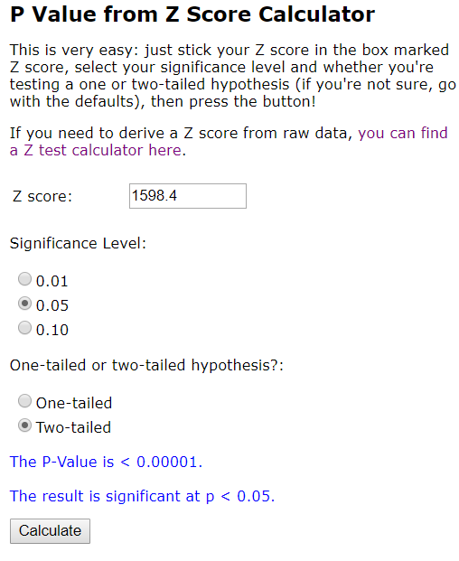
We know that, If the p-value < α we reject Ho and accept Ha.
If Z statistic value is 1,598.43, then P value at 0.05 significant level is < 0.00001
Hence p-value < α i.e 0.00001 < 0.05 we reject Ho and accept Ha.
Therefore, we can conclude that mean wages of Agricultural Engineers is greater than the mean wages of Electronics Engineers.

Slide 19
Building a Model

Slide 20

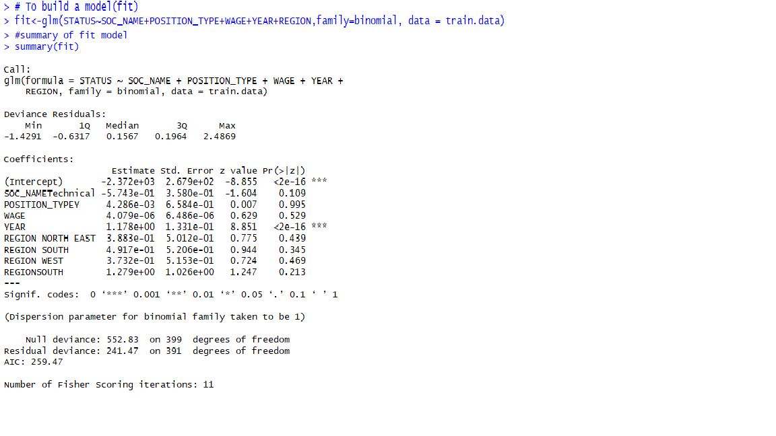
Building a model taking independent variables
From this model we can infer that only an independent YEAR variable is significant as there P value is less than 0.05, rest all other variables are not significant.

Slide 21
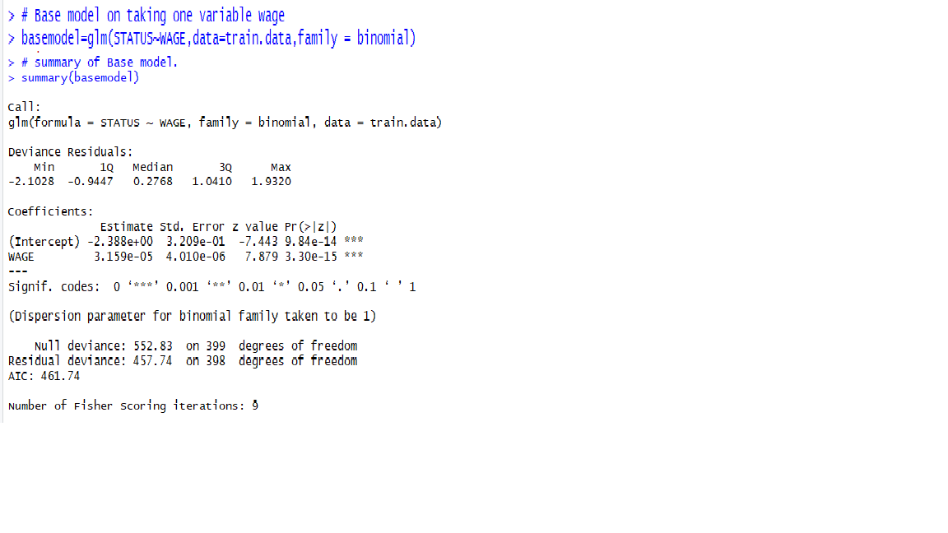
Base model
We have build base model taking using WAGE as a single independent variable. This model will be used to build a Forward model.

Slide 22
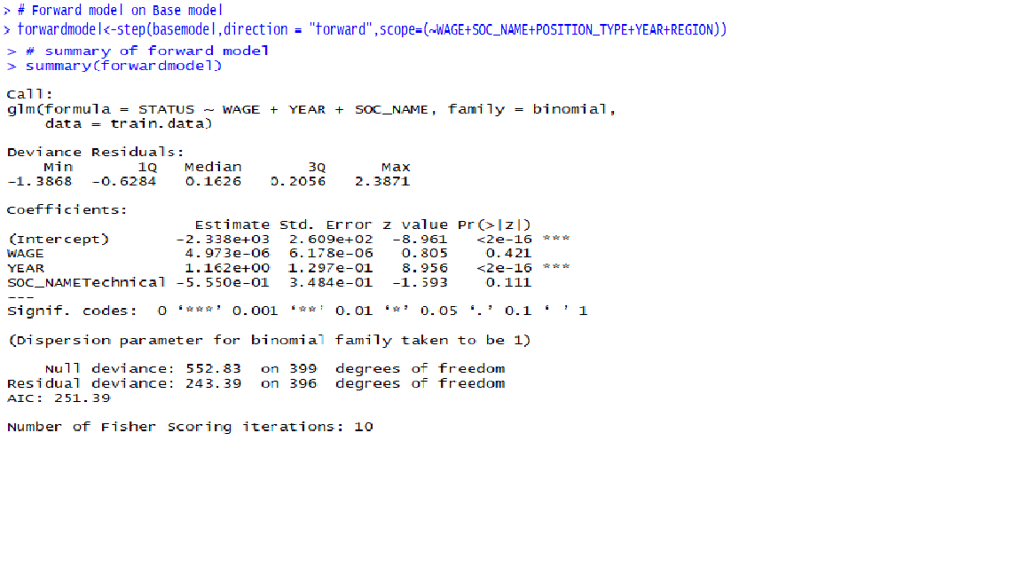
Forward Selection model
We have build a forward model using step function(), which is having AIC value: 251.39

Slide 23
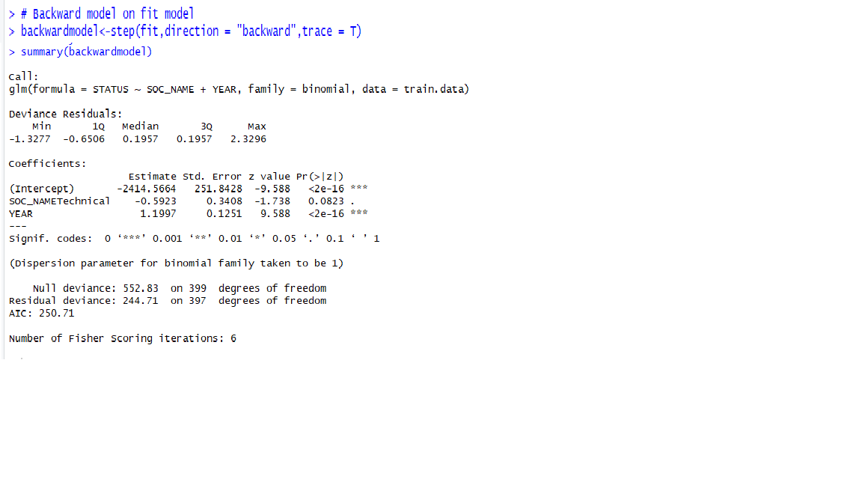
Backward Selection Model.
We have build a backward model using step function(), which is having AIC value: 250.71

Slide 24
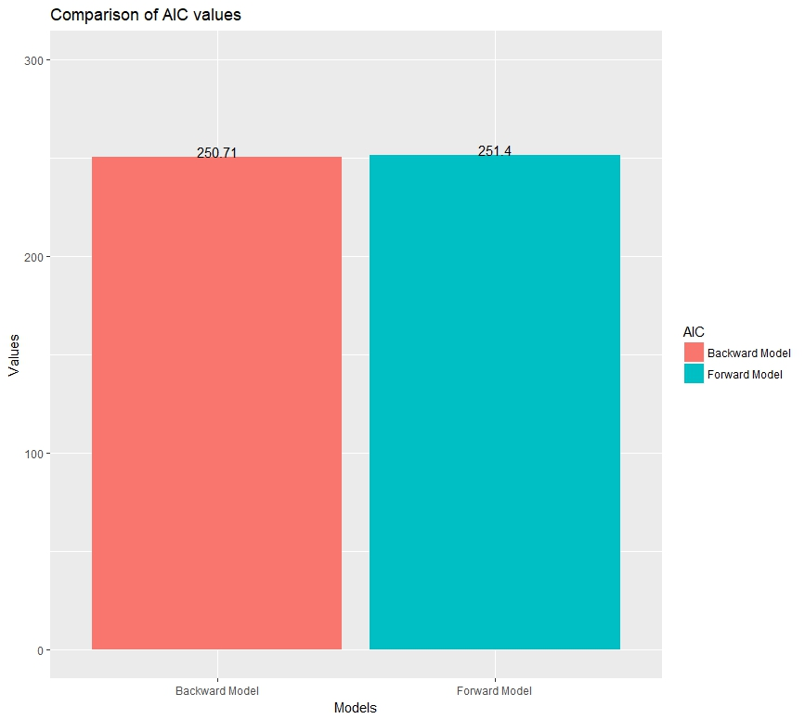
AIC Comparison Chart
AIC value(250.7) is least for Backward model, hence it is better than Forward model whose AIC value is 251.4

Slide 25
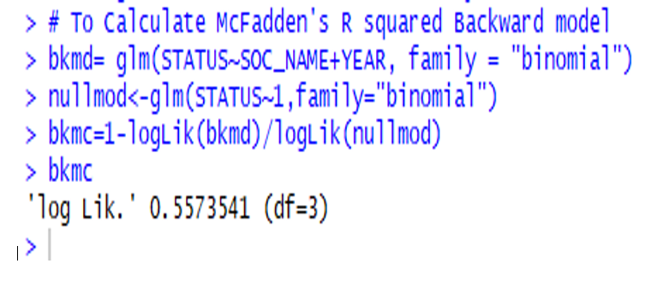
Backward Model McFadden's R square
MacFadden’s R square value for Backward model is 0.5573541

Slide 26
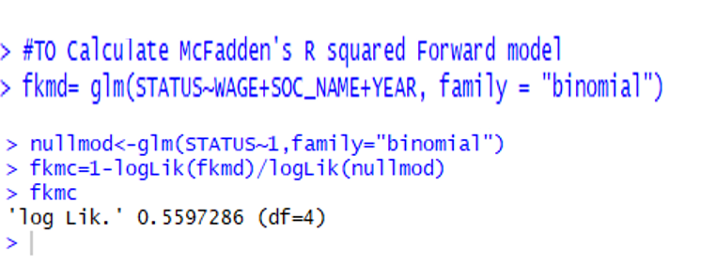
Forward Model McFadden's R square
MacFadden’s R square value for Forward model is 0.5597286
We can infer that the value for McFadden's R squared is greater or closer to 1 in case of Forwards selection comparatively and therefore we can infer that it is a better Logistic regression model than backward.

Slide 27
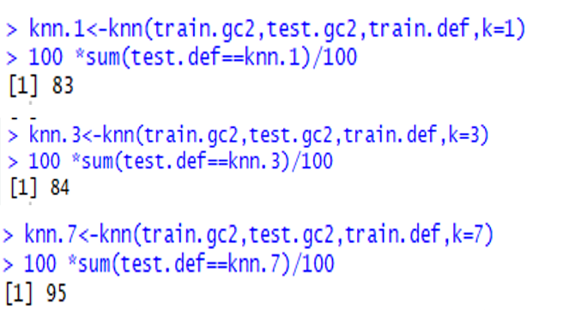
(KNN) Classifier: Evaluation Based on Accuracy
Since we have taken 100 examples as testing set in total, therefore the accuracy will be 83% , 84% and 95% for k=1 , K =3 and k =7 respectively.

Slide 28
Thank You!

