Slide 1
Network & Communication
Introduction to Data Communication

Slide 2
Data Communications
The term telecommunication means communication at a distance.
The word data refers to information presented in whatever form is agreed upon by the parties creating and using the data.
Data communications are the exchange of data between two devices via some form of transmission medium such as a wire cable.

Slide 3
Fundamental Characteristics
The effectiveness of a data communication system depend on four fundamental characteristics:
  Delivery
  Accuracy
  Timelines
  Jitter

Slide 4
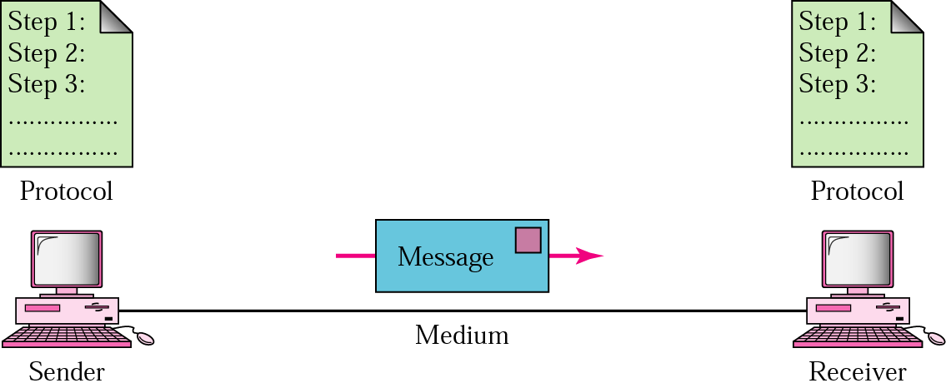
Five Components of Data Communication
Message
Sender
Receiver
Medium
Protocol

Slide 5
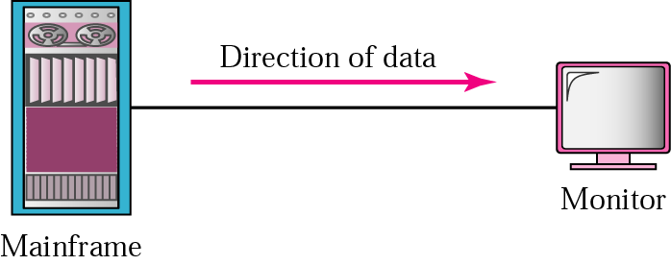
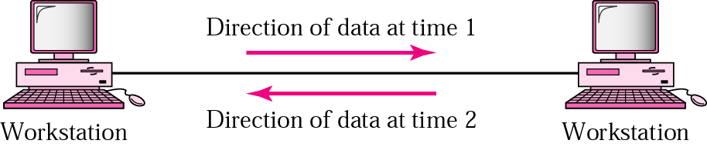
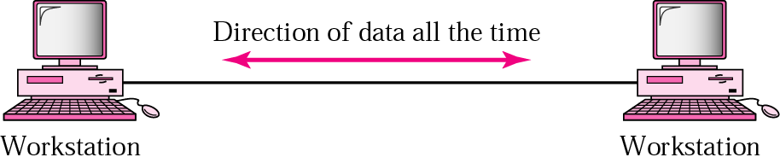
Direction of data flow
Simplex
Half Duplex
Full Duplex

Slide 6
Networks: key issues
Network criteria
  Performance
    Throughput
    Delay
  Reliability
    Data transmitted are identical to data received.
    Measured by the frequency of failure
    The time it takes a link to recover from a failure
  Security
    Protecting data from unauthorized access

Slide 7
Terminology
The throughput or bandwidth of a channel is the number of bits it can transfer per second
The latency or delay of a channel is the time that elapses between sending information and the earliest possible reception of it

Slide 8
Network topologies
Topology defines the way hosts are connected to the network

Slide 9
Network topology issues
a goal of any topology
1. high throughput (bandwidth)
2. low latency

Slide 10
Bandwidth and Latency
Bandwidth
1. telecommunications: range of radio frequencies: a range of radio frequencies used in radio or telecommunications transmission and reception
2. computing: communications capacity: the capacity of a communications channel, for example, a connection to the Internet, often measured in bits per second
3. a data transmission rate; the maximum amount of information (bits/second) that can be transmitted along a channel
Latency
A synonym for delay, is an expression of how much time it takes for transmission from one designated point to another

Slide 11

Categories of Topology

Slide 12
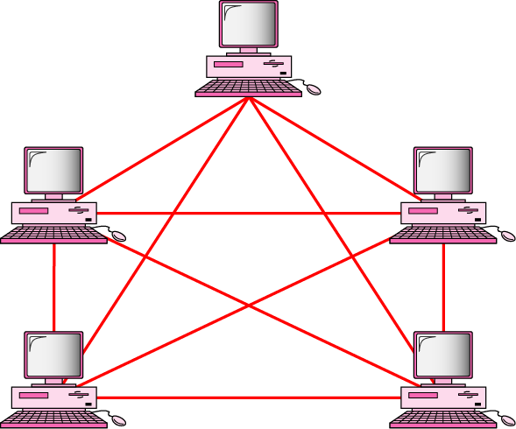
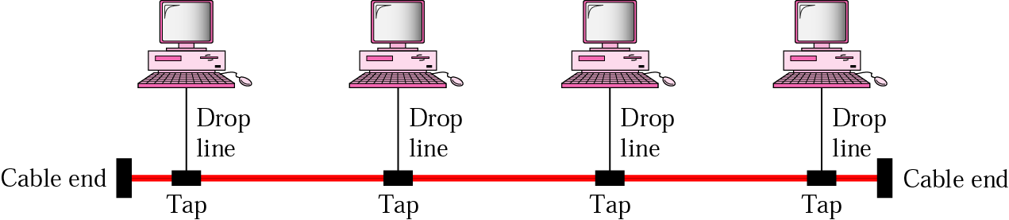
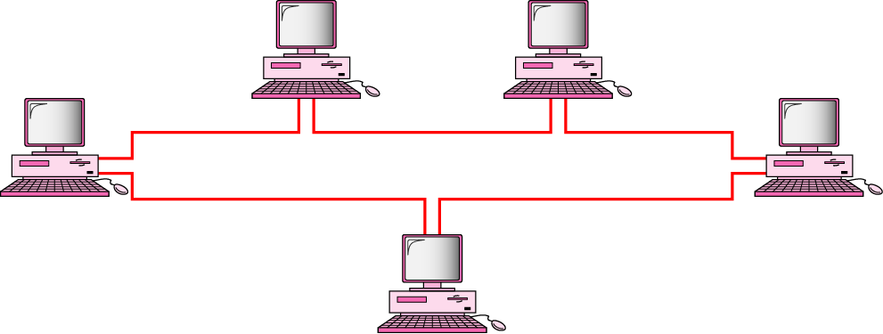
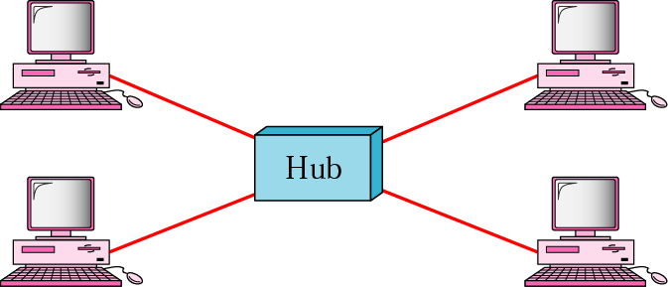
Mostly used network topologies
bus
mesh
ring
star

Slide 13

A hybrid topology: a star backbone with three bus networks

Slide 14

Hierarchical organization of the Internet

Slide 15
Layering & Protocol Stacks

Slide 16
What’s a protocol?
human protocols:
“what’s the time?”
“I have a question”
introductions
… specific msgs sent
… specific actions taken when msgs received, or other events
network protocols:
machines rather than humans
all communication activity in Internet governed by protocols

Slide 17



Protocol
protocols define format, order of msgs sent and received among network entities, and actions taken on msg transmission, receipt
a human protocol and a computer network protocol:
time
Hi
TCP connection
req.
Hi
TCP connection
reply.
Got the
time?
Get http://gaia.cs.umass.edu/index.htm
<file>

Slide 18
Standard
Essential in creating and maintaining an open and competitive market for equipment manufacturers
Guaranteeing national & international interoperability of data & telecommunication technology & process.

