Slide 1

Phonebook App
By Arpitkumar Soni
SID: 991550760

Slide 2
Functions :
addContact();
retrieveContact();
deleteContact();
printList();
readFromFile();
writeToTheFile();

Slide 3
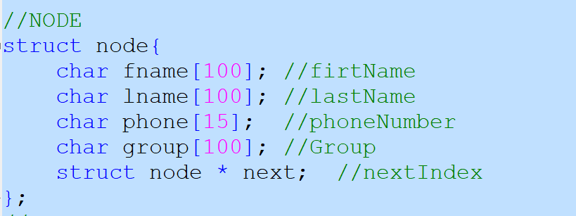
Structure :

Slide 4
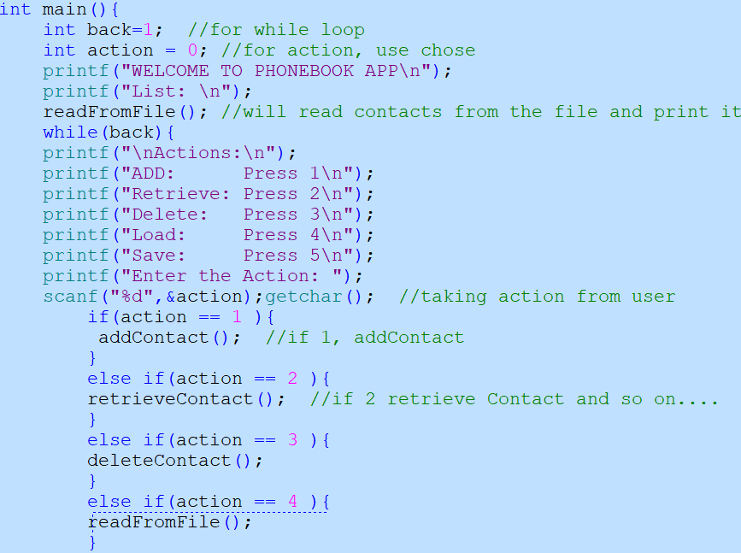
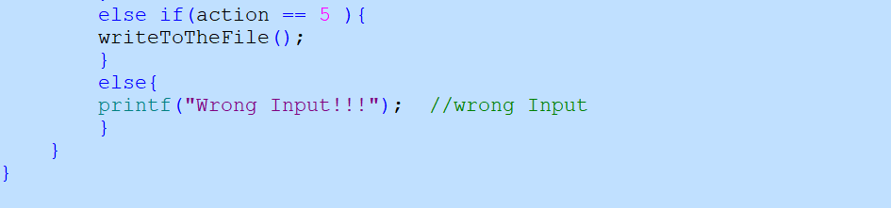
main();
This function will start the app it will print the data from the file and print it
It asks the user to chose the action.
Will call the function as per user input.

Slide 5
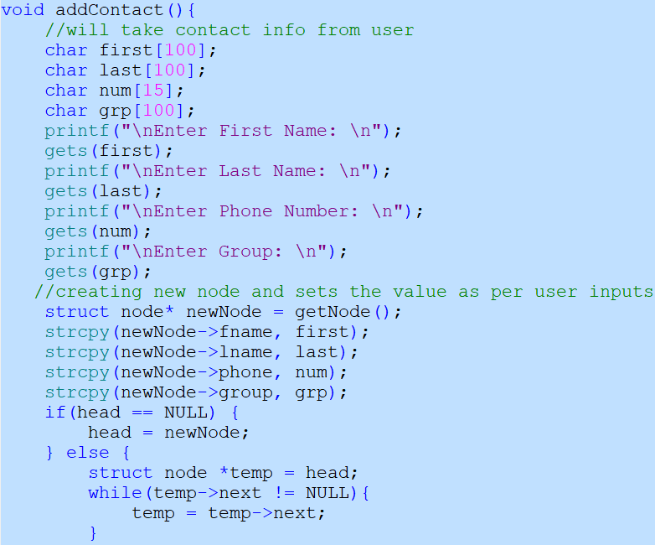

addContact();
Will take user input as per structure.
Create a newNode and add that in the end of the List.

Slide 6
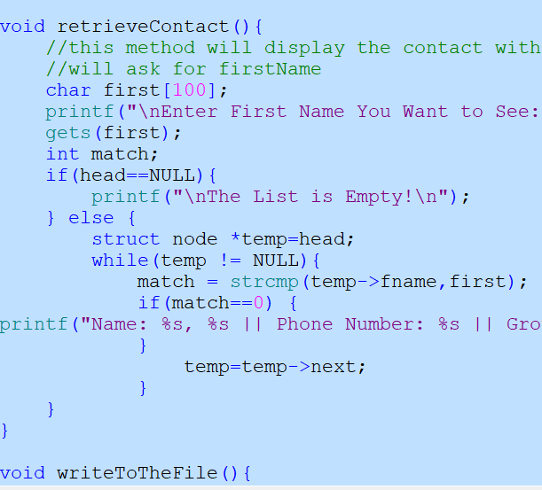
retrieveContact();
Will ask for first name
Search the name in the list
Display the contacts if there any.

Slide 7
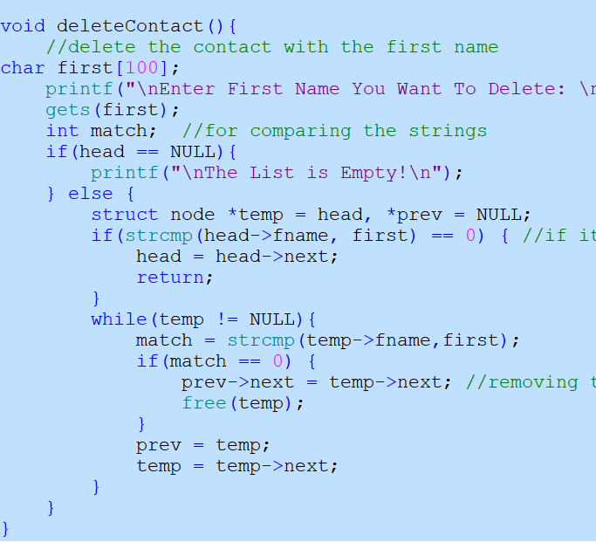
deleteContact();
Will ask for first name
Will search for that name in the list
Will keep track of the current node and the previous node
If the contact found then set the previous node`s next to current`s next and free the current.

Slide 8
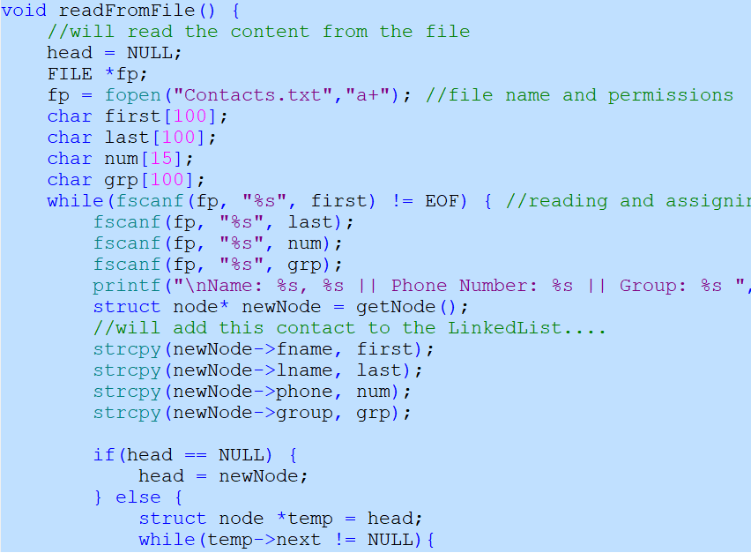
readFromFile();
Will read the file
Take the values
Print it
Also add it to the linkedlist.

Slide 9
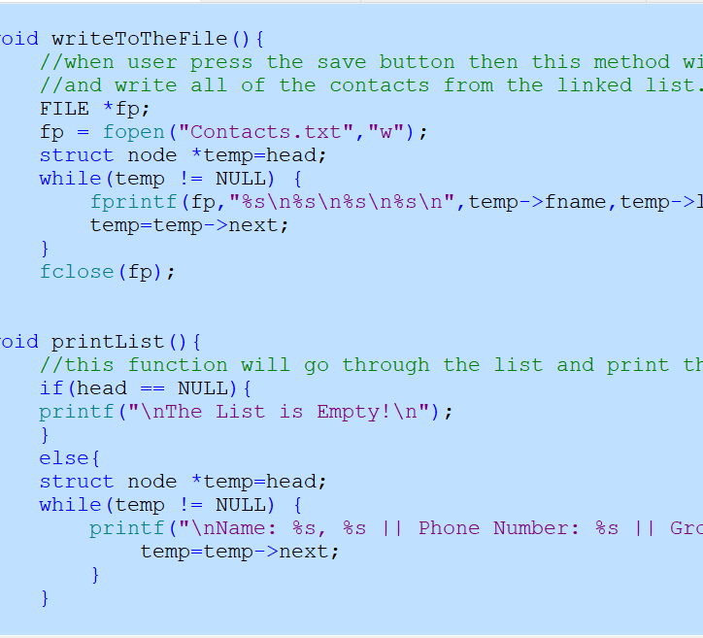
writeToTheFile();
Will read the linked list
Add the data to the file, if the user chose to save it.

Slide 10
Output:

Slide 11
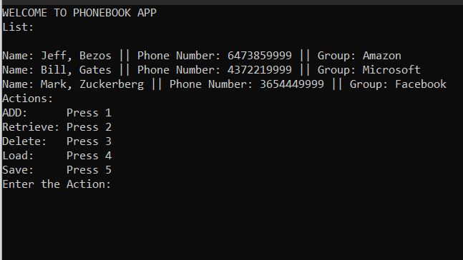

Slide 12
1: Add Contact

Slide 13
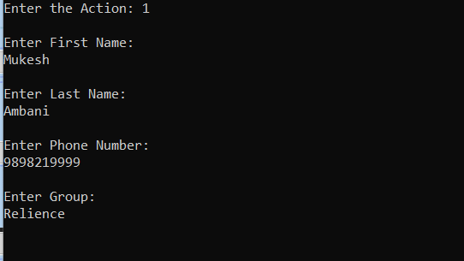

Slide 14
2: retrieve Contact

Slide 15
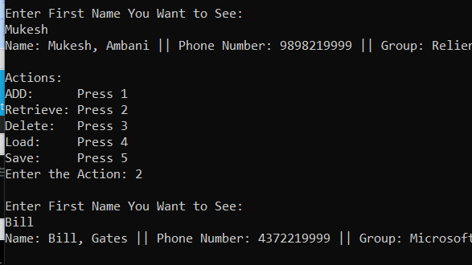

Slide 16
3: Delete Contact

Slide 17
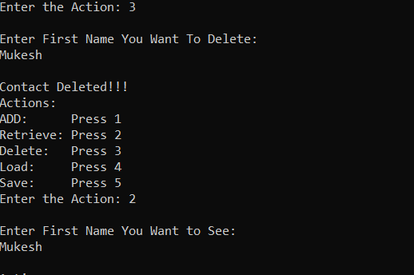

Slide 18
4: Load Contact

Slide 19
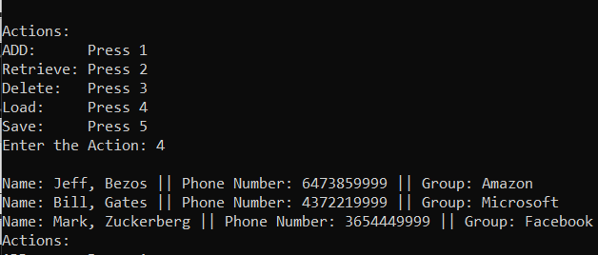

Slide 20
5:Save

Slide 21
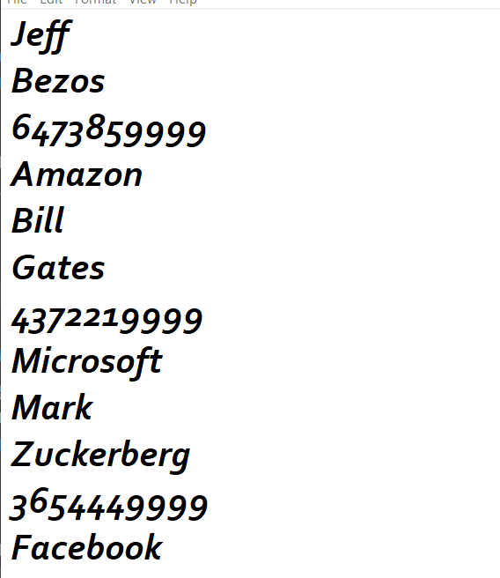
Saved to the file!!!

Slide 22

Thank You !!!
Arpitkumar Soni
Sheridan College

