Slide 1

TOPIC MODELING
DISSERTATION
Submitted in partial fulfilment of the
Requirements for the award of the degree
Of
Bachelor of Technology
In
Information Technology & Engineering
By:
Arpit Singh (417/IT3/2018)
Data Analysis:
Topic Modelling
Topic Modelling
Department of Information Technology & Engineering
Guru Tegh Bahadur Institute of Technology
Guru Gobind Singh Indraprastha University
Dwarka, New Delhi
Year 2018-2022

Slide 2

Project Summary
This project is all about the Data Visualization and wrapping up those visualization in the format of useful TOPICS so that we can get the most spread and least spread news in the our country(INDIA).
The data is collected form various sources like newspapers, articles and magazines and then converted into JSON(JavaScript Object Notation) format so that it can be used easily by the PYTHON libraries and meaningful information can be collected.
Natural language processing (NLP) is a subfield of linguistics, computer science, and artificial intelligence concerned with the interactions between computers and human language, in particular how to program computers to process and analyze large amounts of natural language data. I used this technique to analyse the data along with some other techniques like Word2Vec, Gensim and LDA(Latent Dirichlet Allocation) to understand the most frequently used and least frequently used words in order to find as many useful topics as I can so that the corporation can use those topics and do the desired changes in the website and also spread the underrated news to the people.
Topic Modelling

Slide 3
Gensim
Gensim is a popular open source natural language processing library used for unsupervised topic modeling. It uses top academic models and modern statistical machine learning to perform various complex tasks such as Building document or word vectors, Corpora, performing topic identification, performing document comparison (retrieving semantically similar documents), analyzing plain-text documents for semantic structure.
Word2Vec
Word2vec is a technique for natural language processing. The word2vec algorithm uses a neural network model to learn word associations from a large corpus of text. Once trained, such a model can detect synonymous words or suggest additional words for a partial sentence.

Slide 4
Topic Modeling
Q. What exactly a topic is?
Topic, as name implies, is underlying ideas or the themes represented in our text. To give you an example, the corpus containing newspaper articles would have the topics related to finance, weather, politics, sports, various states news and so on.
Q. What is the importance of topic models in text processing?
As we know that, in order to identify similarity in text, we can do information retrieval and searching techniques by using words. But, with the help of topic models, now we can search and arrange our text files using topics rather than words.
Goals:
. They can be used to organize the documents. For example, we can use topic modeling to group news articles together into an organized/ interconnected section such as organizing all the news articles related to cricket.
. Topic models can be used for text summarization.

Slide 5
LDA(Latent Dirichlet Allocation)
LDA is a probabilistic topic modeling technique. The main goal of probabilistic topic modeling is to discover the hidden topic structure for collection of interrelated documents.
LDA works in an unsupervised way. It is because, LDA use conditional probabilities to discover the hidden topic structure. It assumes that the topics are unevenly distributed throughout the collection of interrelated documents.
Latent Dirichlet allocation (LDA) is the most common and popular technique currently in use for topic modeling. It is the one that the Facebook researchers used in their research paper published in 2013. It was first proposed by David Blei, Andrew Ng, and Michael Jordan in 2003. They proposed LDA in their paper that was entitled simply Latent Dirichlet allocation.

Slide 6
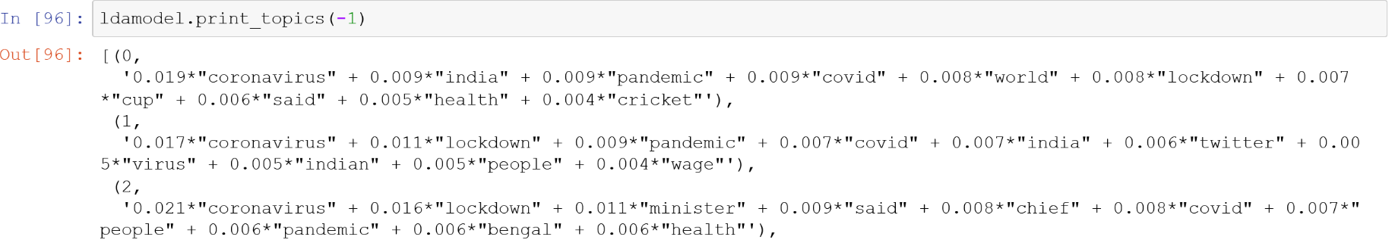
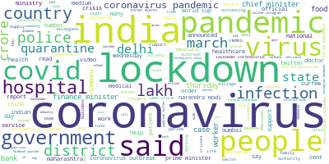
My Analysis

Slide 7
Conclusion
A set of statements or facts is said to be coherent, if they support each other. Thus, a coherent fact set can be interpreted in a context that covers all or most of the facts. An example of a coherent fact set is “the game is a team sport”, “the game is played with a ball”, “the game demands great physical efforts”. The good Coherence Score should lie between 0.3-0.6 ( 0.7 is the best score)
First by using the base model I was able to get the Coherence Score of 0.342 with 8 topics. But after the tuning of the model I was able to get the Coherence Score of 0.440 with 20 topics. Which is an increase of 28% !
pyLDAvis

Slide 8
“ The simplicities of natural laws arise through the complexities of the language we use for their expression. ”
Thank You

