Slide 1
HITS Hypertext-Induced Topic Selection
Arpit Khurana
15BCE0353

Slide 2
Ranking
Today’s search engines may return millions
of pages for a certain query
It is not possible for a user to preview all the returned results
So, ranking is helpful

Slide 3
HITS
Kleinberg's hypertext-induced topic selection (HITS) algorithm is developed for ranking documents based on the link information among a set of documents.

Slide 4
Authorities and hubs
The algorithm produces two types of pages:
- Authority: pages that provide an important, trustworthy information on a given topic
- Hub: pages that contain links to authorities
Authorities and hubs exhibit a mutually reinforcing relationship: a better hub points to many good authorities, and a better authority is pointed to by many good hubs

Slide 5
Authorities and hubs
a(1) = h(2) + h(3) + h(4) h(1) = a(5) + a(6) + a(7)
5
2
5
1
1
1
6
3
6
7
4
7

Slide 6
Definitions
Authority: pages that provide an important, trustworthy information on a given topic
Hubs: pages that contain links to authorities
Indegree: number of incoming links to a given node, used to measure the authoritativeness
Outdegree: number of outgoing links from a given node, here it is used to measure the hubness

Slide 7

HITS Algorithm
Hubs point to lots of authorities.
Authorities are pointed to by lots of hubs.
Together they form a bipartite graph:
Hubs Authorities

Slide 8
HITS Algorithm
Given a broad search query, q, HITS collects a set of pages as follows:
It sends the query q to a search engine.
It then collects t (t = 200 is used in the HITS paper) highest ranked pages. This set is called the root set W.
It then grows W by including any page pointed to by a page in W and any page that points to a page in W. This gives a larger set S, base set.

Slide 9
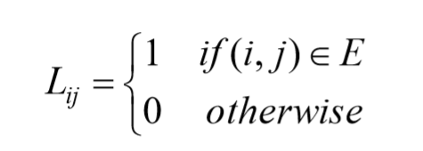
HITS Algorithm
HITS works on the pages in S, and assigns every page in S an authority score and a hub score.
Let the number of pages in S be n.
We again use G = (V, E) to denote the hyperlink graph of S.
We use L to denote the adjacency matrix of the graph.

Slide 10
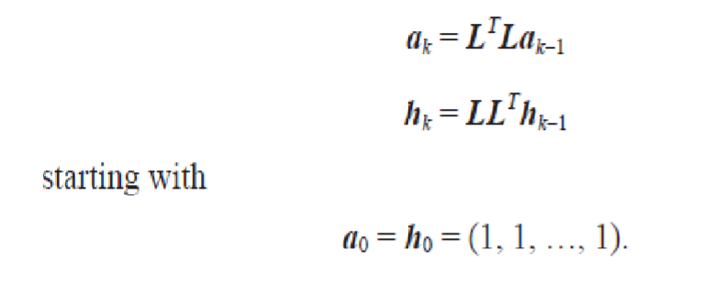
HITS Algorithm
The computation of authority scores and hub scores is the same as the computation of the PageRank scores, using power iteration.
If we use ak and hk to denote authority and hub vectors at the kth iteration, the iterations for generating the final solutions are

Slide 11
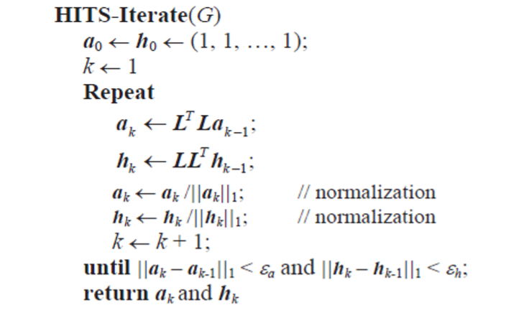
Pseudocode

Slide 12
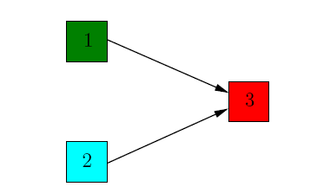
Example:
Let us consider a very simple graph:

Slide 13
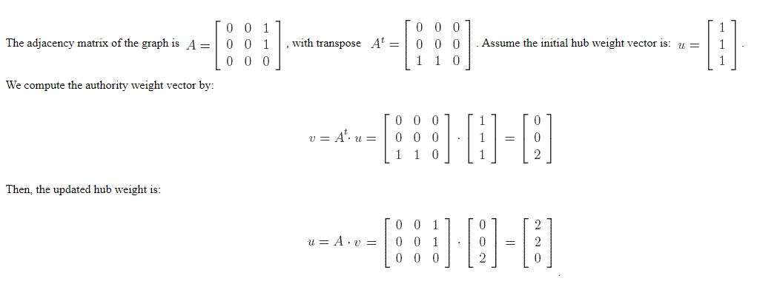
This already corresponds to our intuition that node 3 is the most authoritative, since it is the only one with incoming edges, and that nodes 1 and 2 are equally important hubs. If we repeat the process further, we will only obtain scalar multiples of the vectors v and u computed at step 1. So the relative weights of the nodes remain the same.

Slide 14
Code and Implementation

