Slide 1

GASP–I can't breathe!
How statistics can be used to study pollution control
Peter Guttorp
Statistics
University of Washington

Slide 2
Acknowledgements
Joint work with
Sofia Åberg
David Caccia
Laura Knudsen
Paul Sampson
Mary Lou Thompson
Larry Cox

Slide 3
Outline
Smog
Health effects ot air pollution
Setting standards
A water pollution standard
An air quality standard
International comparison
A statistician’s take on a standard
How bad can it be?

Slide 4
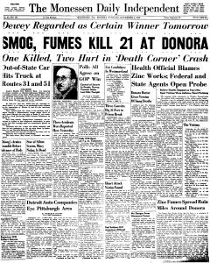

Slide 5
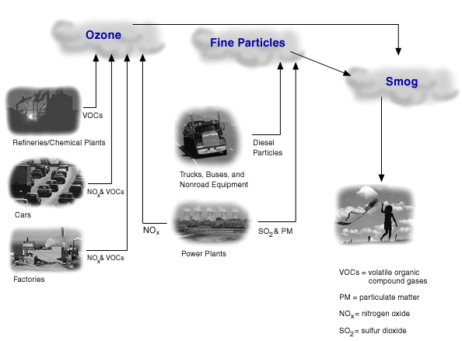

Slide 6
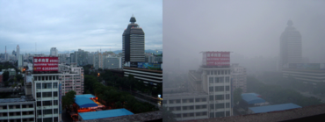
Smog in Beijing

Slide 7
Health effects of ozone
Decreased lung capacity
Irritation of respiratory system
Increased asthma hospital admissions
Children particularly at risk
How do we find this out?

Slide 8
Exposure issues for particulate matter (PM)
Personal exposures vs. outdoor and central measurements
Composition of PM (size and sources)
PM vs. co-pollutants (gases/vapors)
Susceptible vs. general population

Slide 9
Seattle health effects study
2 years, 26 10-day sessions
Total of 167 subjects
  56 COPD subjects
  40 CHD subjects
  38 healthy subjects
    (over 65 years old, non-smokers)
  33 asthmatic kids
Total of 108 residences
  55 private homes
  23 private apartments
  30 group homes

Slide 10
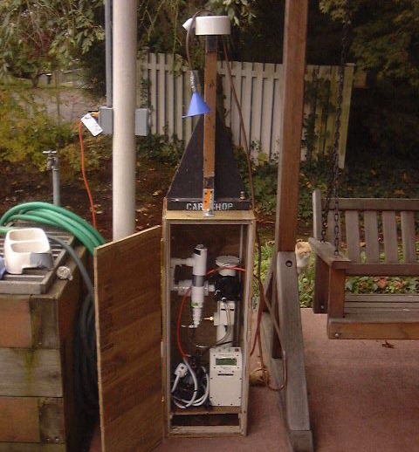

Slide 11
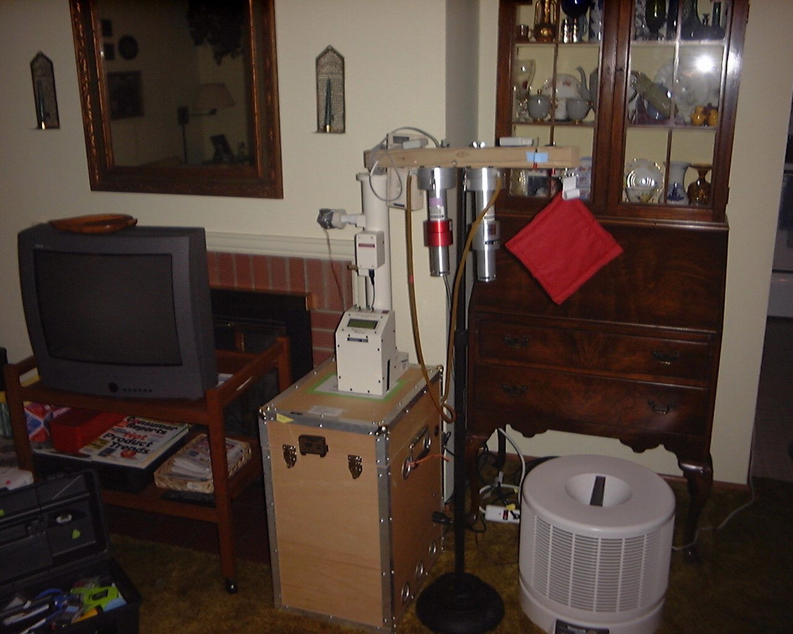
CO₂ monitor
T/RH logger
Ogawa
sampler
Nephelometer
CAT
HI
Quiet
Pump Box

Slide 12
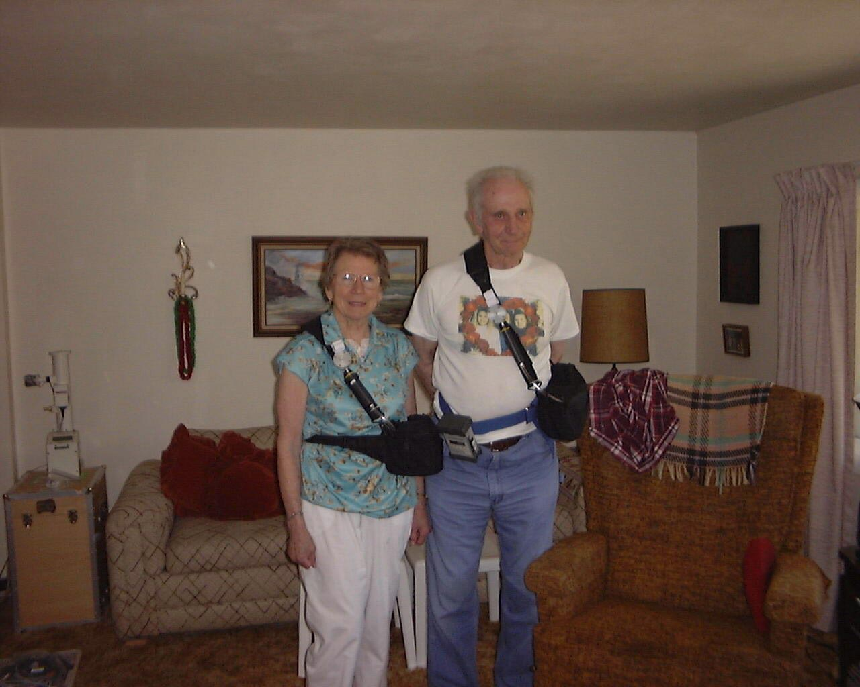
Ogawa sampler
PUF
HPEM
pDR

Slide 13
Personal exposure vs. central site PM_{2.5}
corr (pers exp, central site) = 0.24
corr (central site, local outdoor) = 0.80

Slide 14
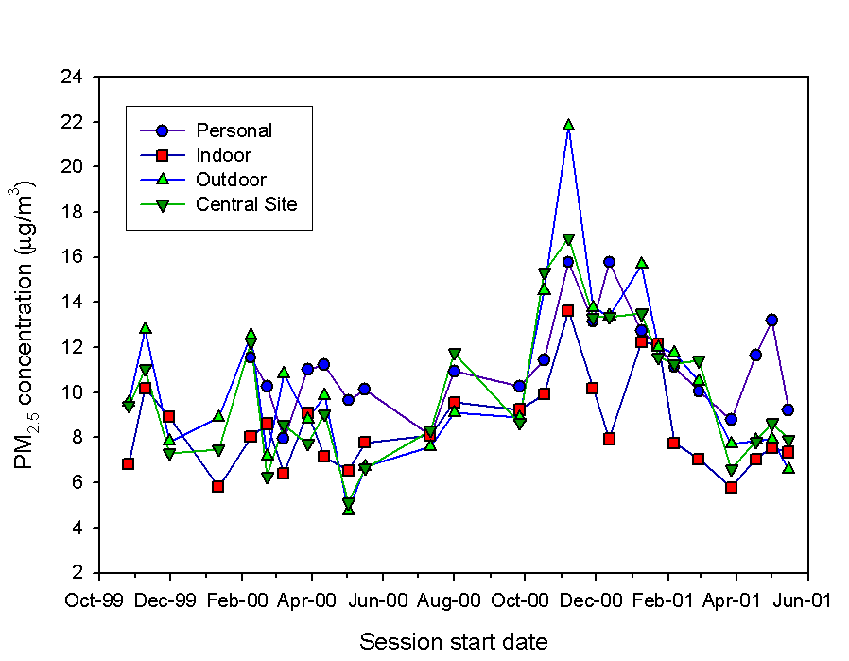
PM_{2.5} measurements

Slide 15
WHO health effects estimates for ozone
10% most sensitive healthy children get 5% reduction in lung capacity at .125 ppm hourly average
Double inflammatory response for healthy children at .09 ppm 8-hr average
Minimal public health effect at .06 ppm 8-hr average

Slide 16
Task for authorities
Translate health effects into limit values for standard
Determine implementation rules for standard
Devise strategies for pollution reduction

Slide 17
Drinking water standard
Maximum microbiological contaminant levels:
1. Arithmetic mean coliform count of all standard samples examined per month shall not exceed 1/100 ml
2. The number of coliform bacteria shall not exceed 4/100 ml in
  (a) more than one sample when less than 20 are examined
  (b) more than 5% of the sample if at least 20 are examined

Slide 18
A statistical setup
N_{i} = # coliforms per 100 ml in sample i
Y_{i}=1(N_{i} > 4)
The criteria are then
(a)
(b) If n < 20
If n ≥ 20

Slide 19
A simple calculation
If we assume N_{i} ~ LN(μ,σ²) (Carbonez et al., 1999), a large n calculation yields
(a) μ + σ² / 2 ≤ 0
(b) μ + 1.64 σ ≤ 1.39
Thus, the second condition is irrelevant under these assumptions
σ
μ

Slide 20
Drinking water
Not always regulated by environmental authorities
Bottled water is becoming a substantial waste problem

Slide 21
Some air quality standards
 | Ozone | PM_{2.5}
WHO | 100 μg/m³ ^{(46.7 ppb)} | 25 μg/m³
USA | 80 ppb | 35 μg/m³
EU | 60 ppb | 50 μg/m³
Australia | 80/100* ppb | 50 μg/m³
Max 8 hr average
* Max 4/1 hr avg
24 hr ave

Slide 22
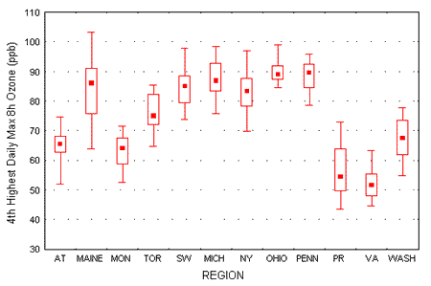
North American ozone measurements 94-96
USA
EU
WHO
Notes:
Monitoring sites were assigned to the following regions: AT - Canadian Atlantic Provinces, Maine - State of Maine, MON - Montreal Urban Community, TO - Greater Meropolitan Toronto, SW - south-western Ontario, MICH - State of Michigan, NY - State of New York, OHIO - State of Ohio, PENN - State of Pennsylvania, PR - Prairie cities in Manitoba, Saskatchewan, and Alberta, VA - Greater Vancouver Regional District, WASH - State of Washingtion.

Slide 23
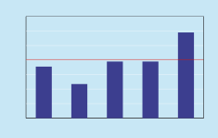
Australian ozone 2001
ppm
0.140
0.080
Brisbane Canberra Melbourne Perth Sydney
Second highest 4hr average ozone readings

Slide 24
US 1-hr ozone standard
In each region the expected number of daily maximum 1-hr ozone concentrations in excess of 0.12 ppm shall be no higher than one per year
Implementation: A region is in violation if 0.12 ppm is exceeded at any approved monitoring site in the region more than 3 times in 3 years

Slide 25
A hypothesis testing framework
The US EPA is required to protect human health. Hence the more serious error is to declare a region in compliance when it is not.
The correct null hypothesis therefore is that the region is violating the standard.

Slide 26
How would I do the test?
One day either exceeds .12 ppm or not
Number of exceedances in a year is binomial, n=365, p=?
If mean number of exceedances is 1, then p=1/365
In three years the probability of no exceedances (when p=1/365) is 0.05
So REJECT the null hypothesis of violation if there are NO violations in three years.

Slide 27
How does the EPA perform the test?
They reject the null hypothesis if there are less than 3 violations in 3 years.
The probability of that when p=1/365 is 0.647.
I never would do a test at level 0.647.
Flipping a coin would have smaller error probability.
US EPA are not protecting the public with their rule!

Slide 28
Some other issues
Measurements are not always taken where people live
Measurement error is not taken into account
The “natural” background is not the same everywhere
People are not exposed to a single pollutant–it is a soup!

Slide 29
A conditional calculation
Given an observation of .120 ppm in the Houston region, what is the probability that an individual in that region is subjected to more that .120 ppm?
About 2/3!

Slide 30
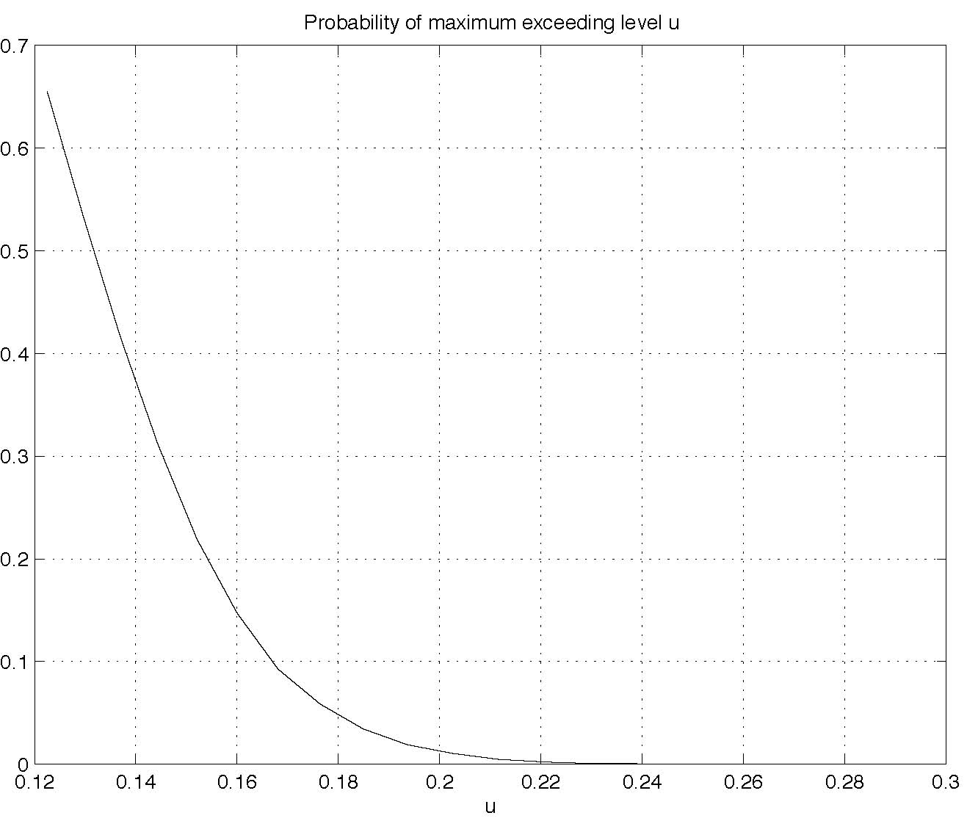

Slide 31
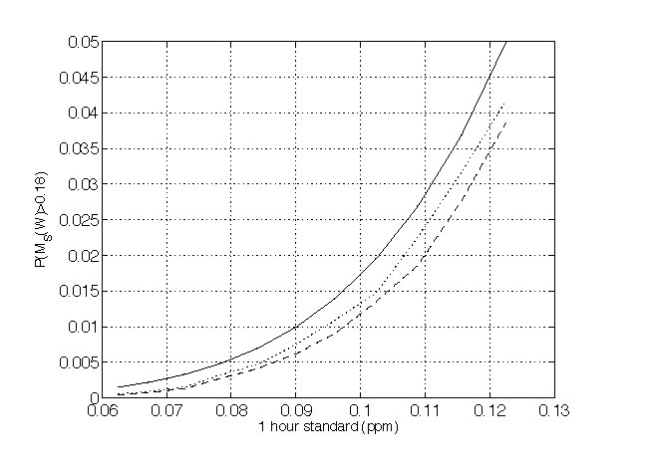
Level of standard to protect against 0.18 ppm

Slide 32
General setup
Given measurements of a Gaussian field observed with error, find c_{[t]} such that
where [t] denotes season and the mean of equals the γ-quantile of the estimated health effects distribution.

