Slide 1
MERN STACK DEVELOPMENT PROJECT
Submitted by: Sk.Nisar
Roll no: 215420
Reg no: K2102520

Slide 2
MERN stands for
M stands MongoDB
E stands for Express.Js
R stands for React
N stands for Node.js

Slide 3
My Project in Mern stack
To-Do-list website
Frontend done with React.js/html/JS
Backend done with MongoDB
And API are Express Js and Node js

Slide 4
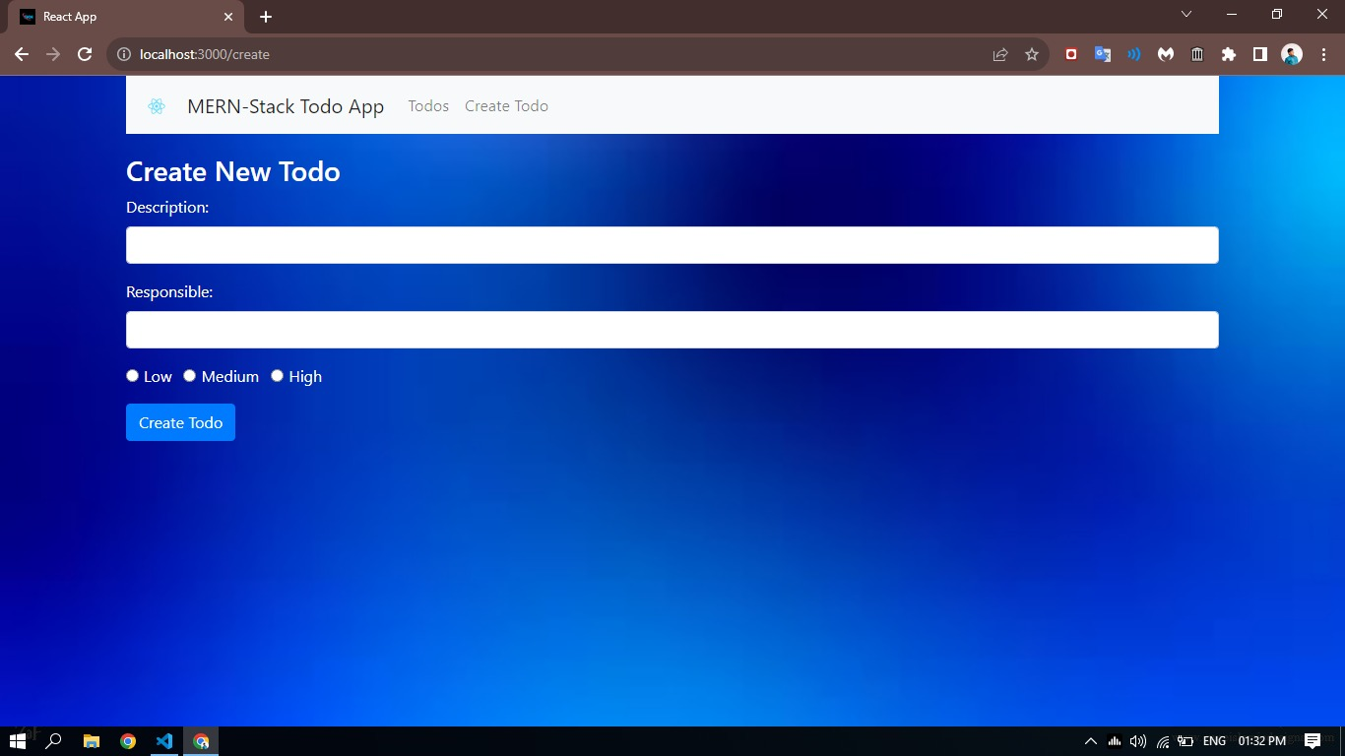
To-Do-List
Home page

Slide 5
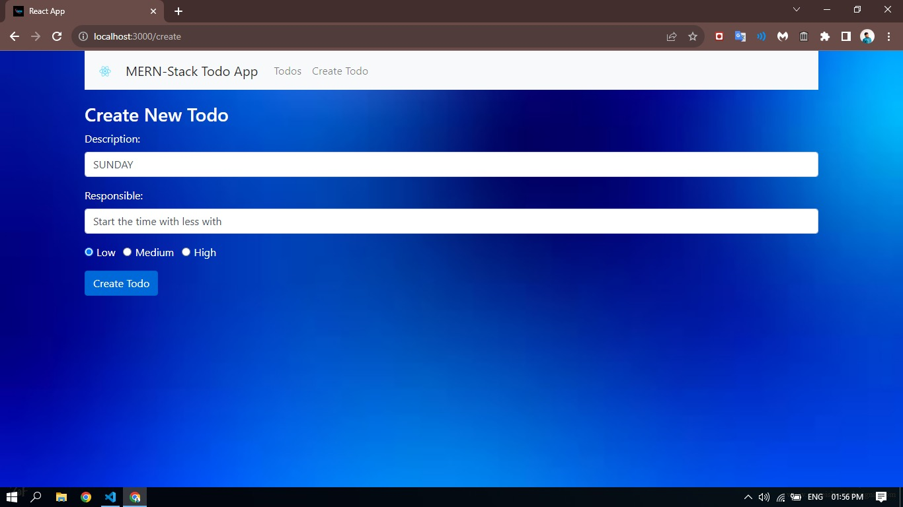
Add page Enter details

Slide 6
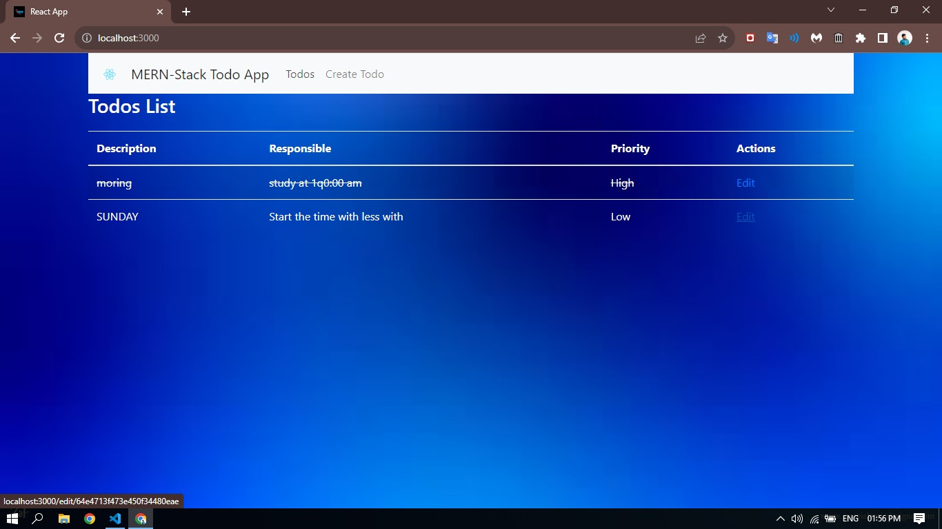
Description details

Slide 7
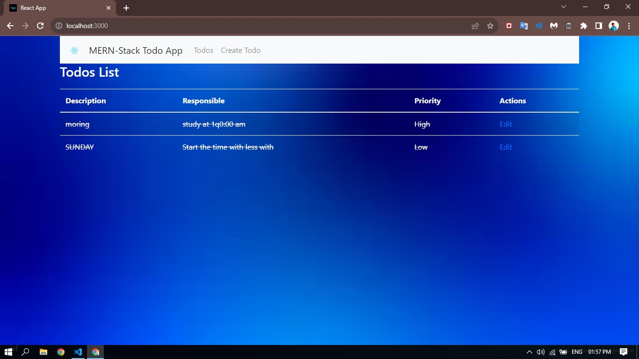
Completed todo’s

Slide 8
THANK YOU

