Slide 1




NETFLIX MOVIES AND TV SHOWS DATA ANALYSIS
USING SQL
NOVEMBER 14, 2024
PROJECT DONE BY
TICKET $15
ARPITA CHAKROBORTY

Slide 2


OVERVIEW :
THIS PROJECT INVOLVES A COMPREHENSIVE ANALYSIS OF NETFLIX'S MOVIES AND TV SHOWS DATA USING SQL. THE GOAL IS TO EXTRACT VALUABLE INSIGHTS AND ANSWER VARIOUS BUSINESS QUESTIONS BASED ON THE DATASET. THE FOLLOWING README PROVIDES A DETAILED ACCOUNT OF THE PROJECT'S OBJECTIVES, BUSINESS PROBLEMS, SOLUTIONS, FINDINGS, AND CONCLUSIONS

Slide 3
OBJECTIVES :
ANALYZE THE DISTRIBUTION OF CONTENT TYPES (MOVIES VS TV SHOWS).
IDENTIFY THE MOST COMMON RATINGS FOR MOVIES AND TV SHOWS.
LIST AND ANALYZE CONTENT BASED ON RELEASE YEARS, COUNTRIES, AND DURATIONS.
EXPLORE AND CATEGORIZE CONTENT BASED ON SPECIFIC CRITERIA AND KEYWORDS.

Slide 4
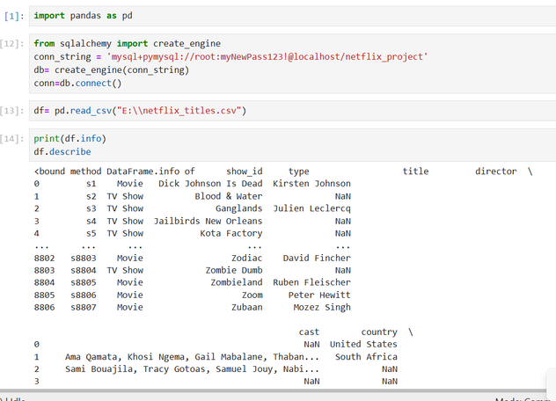
DATA IMPORT USING PANDAS

Slide 5




BUSINESS PROBLEMS AND SOLUTIONS
1. COUNT THE NUMBER OF MOVIES VS TV SHOWS
2. LIST ALL MOVIES RELEASED IN A SPECIFIC YEAR (E.G., 2020)

Slide 6
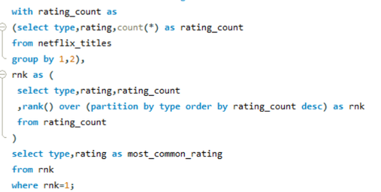

3. FIND THE MOST COMMON RATING FOR MOVIES AND TV SHOWS

Slide 7
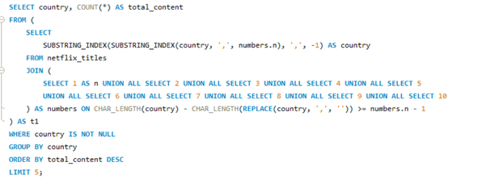
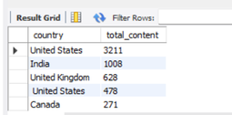
4. FIND THE TOP 5 COUNTRIES WITH THE MOST CONTENT ON NETFLIX

Slide 8
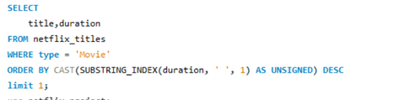


5. IDENTIFY THE LONGEST MOVIE
6. FIND CONTENT ADDED IN THE LAST 5 YEARS

Slide 9

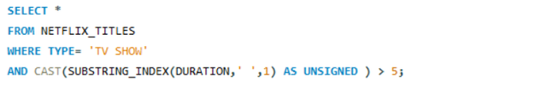
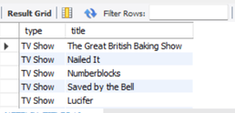
7. FIND ALL MOVIES/TV SHOWS BY DIRECTOR 'RAJIV CHILAKA'
8. LIST ALL TV SHOWS WITH MORE THAN 5 SEASONS

Slide 10
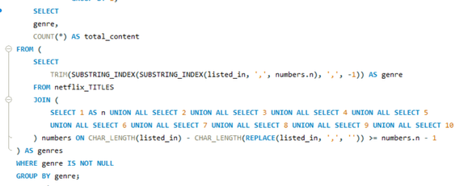
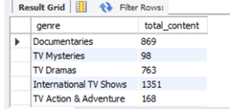
9. COUNT THE NUMBER OF CONTENT ITEMS IN EACH GENRE

Slide 11
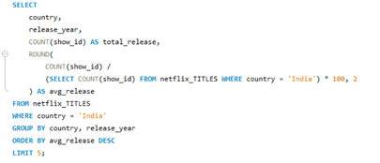
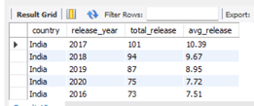
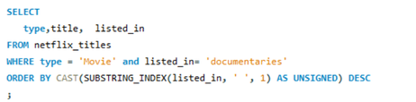

10.FIND EACH YEAR AND THE AVERAGE NUMBERS OF CONTENT RELEASE IN INDIA ON NETFLIX
11. LIST ALL MOVIES THAT ARE DOCUMENTARIES

Slide 12

12. FIND ALL CONTENT WITHOUT A DIRECTOR

Slide 13

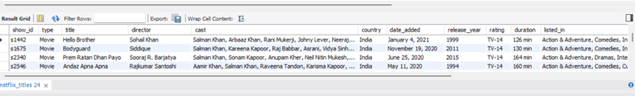
13. FIND HOW MANY MOVIES ACTOR 'SALMAN KHAN' APPEARED IN THE LAST 10 YEARS

Slide 14
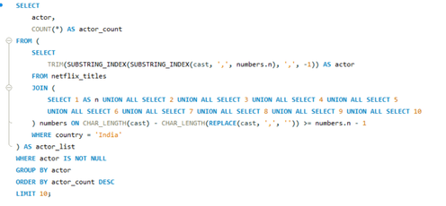
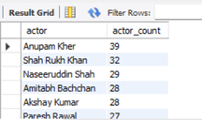
14. FIND THE TOP 10 ACTORS WHO HAVE APPEARED IN THE HIGHEST NUMBER OF MOVIES PRODUCED IN INDIA

Slide 15
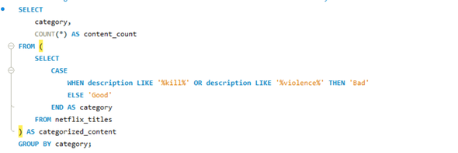

15. CATEGORIZE CONTENT BASED ON THE PRESENCE OF 'KILL' AND 'VIOLENCE' KEYWORDS

Slide 16
FINDINGS AND CONCLUSION
CONTENT DISTRIBUTION: THE DATASET CONTAINS A DIVERSE RANGE OF MOVIES AND TV SHOWS WITH VARYING RATINGS AND GENRES.
COMMON RATINGS: INSIGHTS INTO THE MOST COMMON RATINGS PROVIDE AN UNDERSTANDING OF THE CONTENT'S TARGET AUDIENCE.
GEOGRAPHICAL INSIGHTS: THE TOP COUNTRIES AND THE AVERAGE CONTENT RELEASES BY INDIA HIGHLIGHT REGIONAL CONTENT DISTRIBUTION.
CONTENT CATEGORIZATION: CATEGORIZING CONTENT BASED ON SPECIFIC KEYWORDS HELPS IN UNDERSTANDING THE NATURE OF CONTENT AVAILABLE ON NETFLIX.

