Slide 1

Presentation on
AMBIGUITY IN NATURAL LANGUAGE PROCESSING
By :-
Arpita Prasad (202300045)
Under the supervision of :
Mr. Sital Sharma
AI&DS
SMIT, SMU

Slide 2

AMBIGUITY IN NATURAL LANGUAGE PROCESSING
CONTENTS
SL.no | TITLE | Page no.
1. | Introduction to Ambiguity in Language | 1
2. | Types of Ambiguity in NLP | 2-4
3. | How and Why Ambiguity Occurs | 5
4. | Transformer Architecture | 6
5. | BERT and Multilingual BERT (mBERT) | 7
6. | Fine-Tuning for Ambiguity Detection | 8
7. | Training Data and Dataset Design | 9
8. | ArthaBot | 10-11
9. | ArthaBot Sample Output | 12
10. | Running the Project & Conclusion | 13
11. | Future Work | 14
2
ii
Department of AI&DS
Sikkim Manipal Institute of Technology, SMU
Notes:
QoS aware Named Data Wireless Sensor Network

Slide 3
AMBIGUITY IN NATURAL LANGUAGE PROCESSING
Introduction to Ambiguity in Language
What is Ambiguity?
A word/phrase/sentence is ambiguous when it has multiple valid interpretations.
NLP systems cannot rely on intuition, tone, or non-verbal cues.
Why Ambiguity Matters in NLP:
Wrong interpretations cause incorrect translations and bad chatbot responses.
Hindi/Hinglish: rich morphology, flexible word order, code-switching.
Required for: Machine Translation, Sentiment Analysis, Info Extraction.
Special Challenges in Hindi:
Pro-drop language: subjects/objects can be omitted.
SOV word order (unlike English SVO).
'kal' means BOTH 'yesterday' AND 'tomorrow’ – lexical temporal ambiguity.
'aam' means 'mango' AND 'common/ordinary'.
Hinglish Roman transliteration creates phonological ambiguity.
3
1
Department of AI&DS
Sikkim Manipal Institute of Technology, SMU

Slide 4
AMBIGUITY IN NATURAL LANGUAGE PROCESSING
Types of Ambiguity
8 Primary Types Studied in Computational Linguistics
1. Lexical Ambiguity
Single word, multiple meanings via polysemy or homonymy.
'aam' = mango OR common | 'note' = banknote OR written note.
NLP Task: Word Sense Disambiguation (WSD).
2. Syntactic / Structural Ambiguity
Sentence has multiple valid grammatical parse trees.
'Ram aur Shyam ki bahan aayi' = 1 person coming OR 2 people?
NLP Task: Parsing / Constituent Analysis.
3. Semantic Ambiguity
Figurative vs. literal meaning (idioms, metaphors).
'mera dil toot gaya' = heart physically broke OR heartbreak.
NLP Task: Semantic Role Labeling.
4
2
Department of AI&DS
Sikkim Manipal Institute of Technology, SMU

Slide 5
AMBIGUITY IN NATURAL LANGUAGE PROCESSING
Types of Ambiguity (contd.)
4. Pragmatic Ambiguity
Speaker intent differs from literal sentence meaning.
‘paani lao' = polite request OR urgent command OR sarcasm.
5. Referential / Anaphoric Ambiguity
Pronoun/noun phrase has multiple possible referents.
'Ram ne Shyam ko mara aur vo chala gaya’ – who left?
NLP Task: Coreference Resolution.
6. Scope Ambiguity
Negation/quantifiers take different logical scopes.
'Sab log nahi aaye' = Not all came OR Nobody came at all?
NLP Task: Semantic Parsing.
5
3
Department of AI&DS
Sikkim Manipal Institute of Technology, SMU

Slide 6
AMBIGUITY IN NATURAL LANGUAGE PROCESSING
Types of Ambiguity (contd.)
7. Phonological Ambiguity
Same Roman spelling maps to different Devanagari words.
'haar' = necklace OR defeat | 'kal' = yesterday OR tomorrow.
NLP Task: Transliteration Normalization.
8. Morphological Ambiguity
Same word form functions as different parts of speech.
'padha' = verb 'read' (past) OR adjective 'educated'.
NLP Task: POS Tagging / Morphological Analysis.
6
4
Department of AI&DS
Sikkim Manipal Institute of Technology, SMU

Slide 7
AMBIGUITY IN NATURAL LANGUAGE PROCESSING
How and Why Ambiguity Occurs
Ambiguity is a feature of language not a flaw.
A finite vocabulary must express an infinite range of meanings.
4 Primary Linguistic Sources:
1. Underspecification
Speakers rely on shared world knowledge to fill information gaps.
Hindi 'vo' = he / she / it – deliberate underspecification.
2. Polysemy & Historical Semantic Drift
Words accumulate meanings via metaphor, borrowing, cultural change.
NLP uses Hindi WordNet to track multi-sense lexicons.
3. Structural Economy
Languages prefer shorter sentences, creating parse ambiguity.
Coordination ('aur'), relative clauses ('jo'), PP attachment.
4. Code-switching (Hinglish)
Hindi-English mixing introduces script-level and phonological issues.
Monolingual NLP systems cannot handle Hinglish input.
7
5
Department of AI&DS
Sikkim Manipal Institute of Technology, SMU

Slide 8
AMBIGUITY IN NATURAL LANGUAGE PROCESSING
Transformer Architecture
Evolution of NLP Models:
1980s-2000s Rule-based / n-gram Brittle, no generalization
2000s-2010s SVMs, CRFs Limited context, no semantics
2013-2017 Word2Vec, GloVe Static – one vector per word
2017-2018 BiLSTM, ELMo Sequential, limited range
2018-now BERT, GPT, Transformers Full bidirectional context
The Transformer (Vaswani et al., 2017 – 'Attention Is All You Need'):
Replaces recurrent units entirely with Self-Attention.
Any two positions in a sequence directly attend to each other.
Self-Attention Formula:
Attention(Q, K, V) = softmax( Q x Kt / sqrt(dk) ) x V
Q = Query ('what am I looking for?')
K = Key ('what do I represent?')
V = Value ('what information do I carry?')
8
6
Department of AI&DS
Sikkim Manipal Institute of Technology, SMU

Slide 9
AMBIGUITY IN NATURAL LANGUAGE PROCESSING
BERT and Multilingual BERT (mBERT)
BERT – Bidirectional Encoder Representations from Transformers
Reads full sentence simultaneously using left AND right context.
Produces different embeddings for 'aam' (mango) vs 'aam' (common).
Pre-trained on billions of words – transfers world knowledge.
WordPiece tokenization handles Out-of-Vocabulary and morphology.
bert-base-multilingual-cased (mBERT) Properties:
Parameters: 178 million
Transformer Layers: 12 | Hidden Size: 768 | Heads: 12
Vocabulary: 119,547 tokens across 104 languages
Max Sequence: 512 tokens
Training: Masked LM (MLM) + Next Sentence Prediction (NSP)
Hindi Coverage: ~10,000 Devanagari vocabulary tokens
Multi-Head Attention: 12 heads capture different linguistic signals
Head 1: syntax | Head 2: semantics | Head 3: coreference
9
7
Department of AI&DS
Sikkim Manipal Institute of Technology, SMU

Slide 10
AMBIGUITY IN NATURAL LANGUAGE PROCESSING
Fine-Tuning for Ambiguity Detection
Task: Multi-Label Classification (not multi-class)
Input: Hindi/Hinglish sentence
Output: Binary vector length 8 – one flag per ambiguity type
A single sentence can trigger multiple types simultaneously.
Architecture:
Sentence -> Tokenizer -> [CLS] token1 ... tokenN [SEP]
-> 12 Transformer Layers -> [CLS] 768-dim vector
-> Dropout(0.1) -> Linear(768->8) -> Sigmoid -> [p1..p8]
Training Setup:
Loss: BCEWithLogitsLoss (sigmoid + binary cross-entropy)
Optimizer: AdamW | LR: 2e-5 | weight_decay: 0.01
Schedule: Linear warmup (10%) then linear decay to 0
Epochs: 15 | Batch: 4 | Max Length: 128 | Threshold: 0.35
Gradient Clipping: max norm = 1.0
10
8
Department of AI&DS
Sikkim Manipal Institute of Technology, SMU

Slide 11
AMBIGUITY IN NATURAL LANGUAGE PROCESSING
Training Data and Dataset Design
Dataset Overview:
Total sentences: 25 hand-annotated examples
Hindi (Devanagari): 17 | Hinglish (Roman): 8
With ambiguity: 21 | Unambiguous (control): 4
Multi-label (2+ types): 2 | All 8 types covered: YES
Type Distribution:
Lexical: 3 Syntactic: 3 Semantic: 2 Pragmatic: 4
Referential: 4 Scope: 4 Phonological: 2 Morphological: 2
Why Small Datasets Work with BERT:
BERT already understands Hindi grammar from 178M-param pre-training.
Fine-tuning only teaches it WHICH patterns to focus on.
This is Transfer Learning – pre-training knowledge transfers.
Even 25 examples generalize well because model isn't learning from scratch.
11
9
Department of AI&DS
Sikkim Manipal Institute of Technology, SMU

Slide 12
AMBIGUITY IN NATURAL LANGUAGE PROCESSING
ArthaBot
End-to-end NLP system that detects and explains all 8 ambiguity types.
3 Components:
Training Pipeline: Python + PyTorch + HuggingFace Transformers
Backend API: FastAPI + Uvicorn (localhost:8000)
Frontend UI: React + Vite + Lucide Icons (localhost:5173)
Training Steps:
1. Load 25-sentence JSON dataset
2. Tokenize with mBERT WordPiece tokenizer
3. BertForSequenceClassification (num_labels=8)
4. Train 15 epochs with BCEWithLogitsLoss + AdamW
5. Save model + tokenizer + label names to ./saved_model/
API Endpoints:
GET / Health check, returns model info
POST /analyze Returns full ambiguity JSON for any sentence
12
10
Department of AI&DS
Sikkim Manipal Institute of Technology, SMU

Slide 13
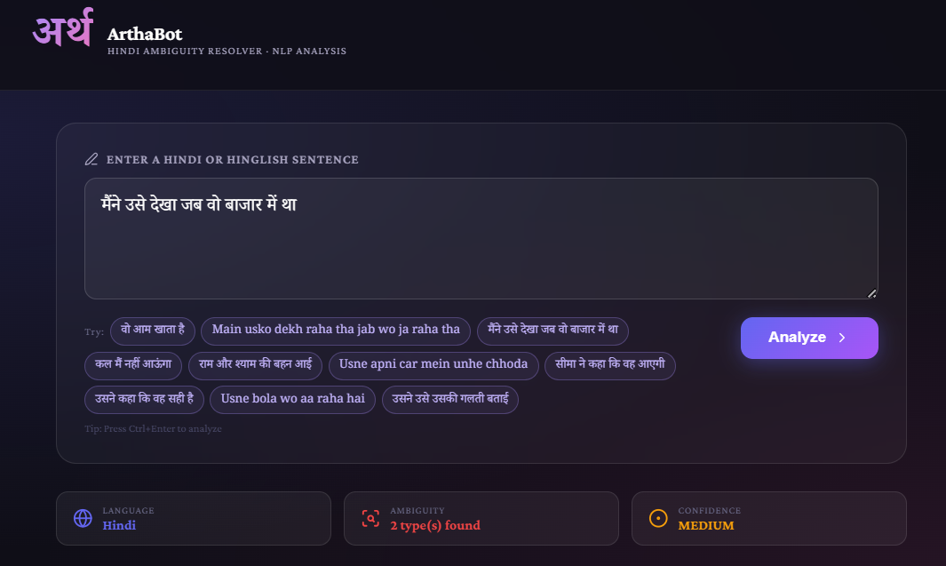
AMBIGUITY IN NATURAL LANGUAGE PROCESSING
ArthaBot (contd.)
Fig 1: User Interface of ArthaBot
13
11
Department of AI&DS
Sikkim Manipal Institute of Technology, SMU

Slide 14
AMBIGUITY IN NATURAL LANGUAGE PROCESSING
ArthaBot Sample Output
Input: 'vo aam khata hai'
Language Detected: Hindi
Ambiguity Found: YES – 1 type detected
Ambiguity Type: LEXICAL AMBIGUITY
NLP Concept: Polysemy / Homonymy
Severity: HIGH
Confidence Score: 87%
Interpretation 1: He eats mango. [Most natural reading]
Interpretation 2: He does ordinary things. [Adjectival reading]
Most Likely: He eats mango — the fruit-eating interpretation is
more natural in everyday Hindi speech.
Frontend: React dark-themed UI, confidence badges, color-coded cards.
14
12
Department of AI&DS
Sikkim Manipal Institute of Technology, SMU

Slide 15
AMBIGUITY IN NATURAL LANGUAGE PROCESSING
Running the Project and Challenges
Prerequisites:
Python 3.9+ | Node.js 18+ | 4GB RAM | Internet (~700MB)
Setup Commands:
cd arthabot-backend
pip install -r requirements.txt
python train_model.py # trains model (~10 mins on CPU)
python server.py # starts API at localhost:8000
cd hindi-ambiguity-resolver && npm install && npm run dev
Current Limitations:
Small dataset (25 examples) – limited generalization ability.
No GPU by default – training takes 5-10 minutes on CPU.
Rule-based meaning templates – not generative or creative.
Single-sentence only – no discourse or coreference context.
Hinglish spelling variation – inconsistent Roman transliteration.
15
13
Department of AI&DS
Sikkim Manipal Institute of Technology, SMU

Slide 16
AMBIGUITY IN NATURAL LANGUAGE PROCESSING
Future Work
Proposed Future Enhancements:
1. Expand dataset to 500-1000 examples across Hindi dialects.
2. Replace mBERT with IndicBERT or MuRIL (Indian-language models).
3. Add multi-sentence input for discourse-level coreference.
4. Use mT5 / IndicBART for generative natural-language explanations.
5. Active Learning: auto-flag uncertain predictions for annotation.
16
14
Department of AI&DS
Sikkim Manipal Institute of Technology, SMU

