Slide 1
Blind (Un-Informed)
and
Heuristic (informed) Strategies

Slide 2
Blind vs. Heuristic Strategies
Blind (or un-informed) strategies have no additional information except available in problem definition
Distinguish a goal state from a non goal state.
Heuristic (or informed) strategies know whether one non goal state is more promising than others.

Slide 3
Example: 8-puzzle
For a blind strategy, N1
and N2 are just two nodes
(at some depth in the search
tree)
For a heuristic strategy
counting the number of
misplaced tiles, N2 is more
promising than N1
8
2
3
4
7
STATE
N1
5
1
6
1
2
3
1
2
3
4
5
6
4
5
STATE
7
8
N2
7
8
6
Goal state

Slide 4
Blind Strategies
Breadth-first
Bidirectional
Depth-first
Depth-limited
Iterative deepening
Uniform-Cost
Step cost = 1
Step cost = c ≥ ε > 0

Slide 5
Breadth-First Strategy
Expand shallowest unexpanded node.
New nodes are inserted at the end of FRINGE.
1
2
3
FRINGE = (1)
4
5
6
7
FRINGE:
Set of search nodes that have not been expanded yet
The ordering of the nodes in FRINGE defines the search strategy

Slide 6
Breadth-First Strategy
Expand shallowest unexpanded node.
New nodes are inserted at the end of FRINGE.
1
2
3
FRINGE = (2, 3)
4
5
6
7

Slide 7
Breadth-First Strategy
Expand shallowest unexpanded node.
New nodes are inserted at the end of FRINGE.
1
2
3
FRINGE = (3, 4, 5)
4
5
6
7

Slide 8
Breadth-First Strategy
Expand shallowest unexpanded node.
New nodes are inserted at the end of FRINGE.
1
2
3
FRINGE = (4, 5, 6, 7)
4
5
6
7

Slide 9
Bidirectional search
Run two simultaneous searches-one forward from the initial state and the other backward from the goal state.
It is implemented by checking each node before it is expanded to see if it is in the fringe of the other search tree.
Otherwise Stop when two searches meet in the middle.

Slide 10
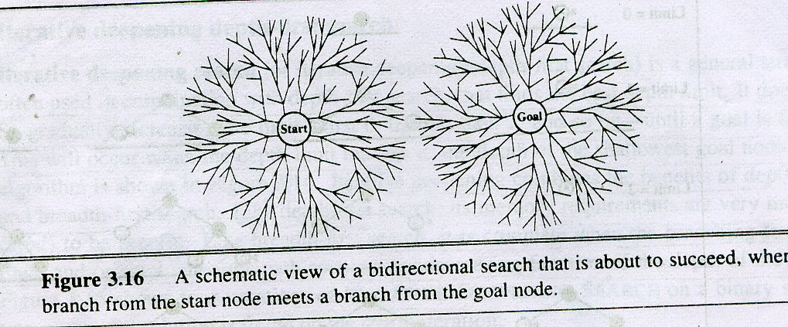
Bidirectional Strategy

Slide 11
Bidirectional Strategy
2 fringe queues: FRINGE1 and FRINGE2
d
d/2
d/2

Slide 12
Depth-First Strategy
Expand deepest unexpanded node
New nodes are inserted at the front of FRINGE
1
2
3
4
5

Slide 13
Depth-First Strategy
Expand deepest unexpanded node
New nodes are inserted at the front of FRINGE
1
2
3
4
5

Slide 14
Depth-First Strategy
Expand deepest unexpanded node
New nodes are inserted at the front of FRINGE
1
2
3
4
5

Slide 15
Depth-First Strategy
Expand deepest unexpanded node
New nodes are inserted at the front of FRINGE
1
2
3
4
5

Slide 16
Depth-First Strategy
Expand deepest unexpanded node
New nodes are inserted at the front of FRINGE
1
2
3
4
5

Slide 17
Depth-First Strategy
Expand deepest unexpanded node
New nodes are inserted at the front of FRINGE
1
2
3
4
5

Slide 18
Depth-First Strategy
Expand deepest unexpanded node
New nodes are inserted at the front of FRINGE
1
2
3
4
5

Slide 19
Depth-First Strategy
Expand deepest unexpanded node
New nodes are inserted at the front of FRINGE
1
2
3
4
5

Slide 20
Depth-First Strategy
Expand deepest unexpanded node
New nodes are inserted at the front of FRINGE
1
2
3
4
5

Slide 21
Depth-First Strategy
Expand deepest unexpanded node
New nodes are inserted at the front of FRINGE
1
2
3
4
5

Slide 22
Depth-First Strategy
Expand deepest unexpanded node
New nodes are inserted at the front of FRINGE
1
2
3
4
5

Slide 23
Problem
If one subtree were of unbounded depth but contained no solution, it would never terminate.
To overcome this depth limited search is used.

Slide 24
Depth-Limited Strategy
Depth-first with depth limit k (maximal depth below which nodes are not expanded)
Three possible outcomes:
Solution
Failure (no solution)
Cutoff (no solution within depth limit)

Slide 25
Iterative Deepening Search
IDDFS combines depth-first search’s space-efficiency and breadth-first search’s fast search.
IDDFS calls DFS for different depths starting from an initial value. In every call, DFS is restricted from going beyond given depth.
So, it performs DFS in a BFS fashion.

Slide 26
Iterative Deepening Search
A
B
C
D
E
F
G
H
I
J

Slide 27
Iterative Deepening Search
A
LO
Fringe: A

Slide 28
Iterative Deepening Search
A
L1
B
C
D
Fringe: A,B,C,D

Slide 29
Iterative Deepening Search
A
L2
B
C
D
E
F
G
H
Fringe: A,B,E,C,F,G,D,H

Slide 30
Iterative Deepening Search
A
L3
B
C
D
E
F
G
H
I
J
Fringe: A,B,E,C,F,I,G,J,D,H

Slide 31
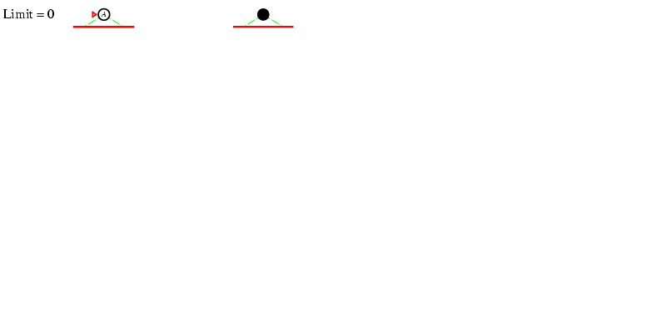
Iterative deepening search l =0

Slide 32
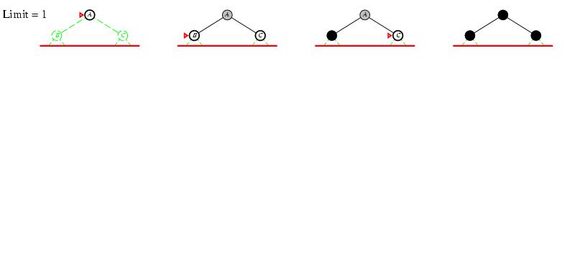
Iterative deepening search l =1

Slide 33
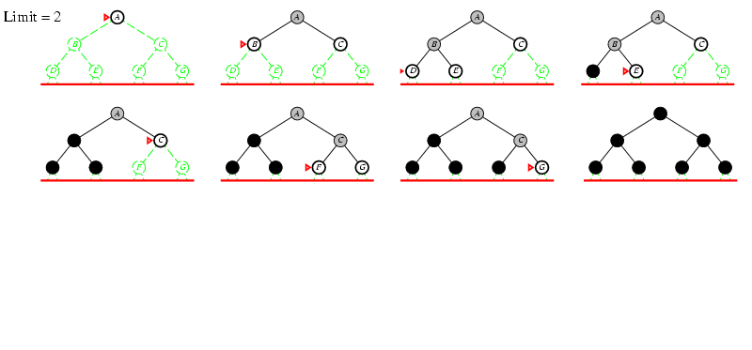
Iterative deepening search l =2

Slide 34
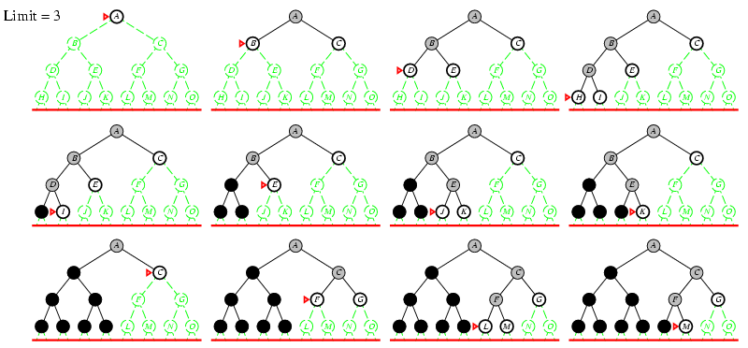
Iterative deepening search l =3

Slide 35
Uniform-Cost Strategy
Each step has some cost ≥ ε > 0.
The cost of the path to each fringe node N is
g(N) = Σ costs of all steps.
The goal is to generate a solution path of minimal cost.
The FRINGE is sorted in increasing cost.
A
S
0
1
10
S
5
B
5
G
A
B
C
1
5
15
5
15
C
G
G
11
10

Slide 36
Uniform-Cost Strategy
9
13
3
C
D
H
A
2
3
12
7
B
E
F
6
4

Slide 37
Uniform-Cost Strategy
Vis: A
A
C
B
3
7

Slide 38
Uniform-Cost Strategy
Vis: A,C
A
3
C
B
7
12
D
B
5

Slide 39
Uniform-Cost Strategy
Vis: A,C,B
A
3
C
B
7
12
D
B
5
E
11

Slide 40
Uniform-Cost Strategy
Vis: A,C,B,E
A
3
C
B
7
12
D
B
5
E
11
14
D
F
15

Slide 41
Uniform-Cost Strategy
Vis: A,C,B,E,D
A
3
C
B
7
12
D
B
5
25
H
E
11
14
D
F
15

Slide 42
Uniform-Cost Strategy
Vis: A,C,B,E,D,F
A
3
C
B
7
12
D
B
5
25
H
E
11
14
D
F
15
H
27

Slide 43
Uniform-Cost Strategy
Vis: A,C,B,E,D,F,H
A
3
C
B
7
12
D
B
5
25
E
11
H
14
D
F
15
H
27

Slide 44
Uniform-Cost Strategy
Vis: A,C,B,E,D,F,H
A
3
C
B
7
12
D
B
5
25
E
11
H
H
14
D
F
15
H
27

Slide 45
Informed Search
Informed search(heuristic search)
They are given problem-specific knowledge such how far it is from the goal.

Slide 46
General approach
Best-first search: The node is selected for an expansion based on an evaluation function.f(n).
Define an evaluation function: f : node N 🡪 real number whose value depends on the state of N
The node with the lowest evaluation is selected for expansion, because the evaluation measures the distance to the goal.
Order the fringe in increasing f [the smaller f, the better]
Choose the node that appears to be best according to the evaluation function.

Slide 47
Heuristic Function
Key components of best-first search is heuristic function.
Function h(N) that estimates the cost of the cheapest path from node N to goal node.
Example: 8-puzzle
1
2
3
1
2
3
h(N) = number of misplaced tiles = 0
4
5
6
4
5
6
7
8
7
8
N
goal

Slide 48
Heuristic Function
Key components of best-first search is heuristic function.
Function h(N) that estimates the cost of the cheapest path from node N to goal node.
Example: 8-puzzle
5
8
1
2
3
h(N) = number of misplaced tiles = ?
4
2
1
4
5
6
7
3
6
7
8
N
goal

Slide 49
Heuristic Function
Key components of best-first search is heuristic function.
Function h(N) that estimates the cost of the cheapest path from node N to goal node.
Example: 8-puzzle
5
8
1
2
3
h(N) = number of misplaced tiles = 6
4
2
1
4
5
6
7
3
6
7
8
N
goal

Slide 50
Examples of Evaluation functions
Let g(N) be the cost of the best path found so far between the initial node and N
f(N) = h(N) 🡪 greedy best-first
f(N) = g(N) + h(N)

Slide 51
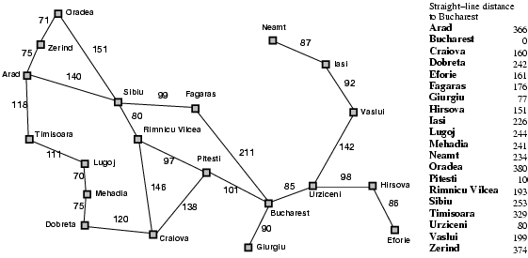
Romania with step costs in km

Slide 52
Greedy best-first search
Evaluation function f(n) = h(n) (heuristic)
h(n) = estimate of cost from n to goal
e.g., h_{SLD}(n) = straight-line distance from n to Bucharest.
h_{SLD}(arad)=?
Greedy best-first search expands the node that appears to be closest to goal

Slide 53

Greedy best-first search example
Notes:
‹#›

Slide 54
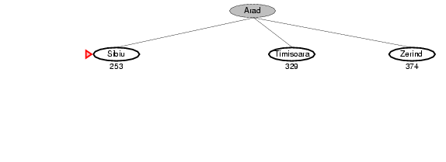
Greedy best-first search example
Notes:
‹#›

Slide 55
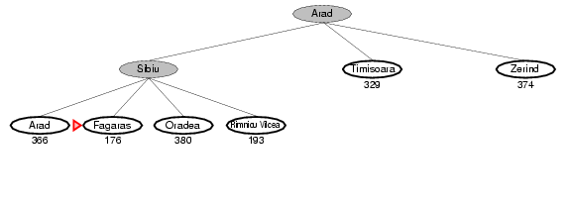
Greedy best-first search example
Notes:
‹#›

Slide 56
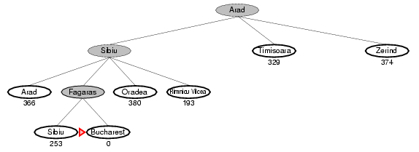
Greedy best-first search example
Notes:
‹#›

Slide 57
Greedy best-first search
It is not optimal.

Slide 58
A* search
Idea: avoid expanding paths that are already expensive
Evaluation function f(n) = g(n) + h(n)
g(n) = cost so far to reach n
h(n) = estimated cost from n to goal
f(n) = estimated total cost of path through n to goal

Slide 59

A* search example
Notes:
‹#›

Slide 60
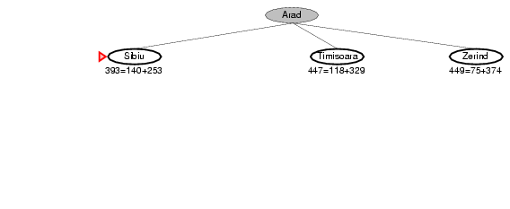
A* search example
Notes:
‹#›

Slide 61
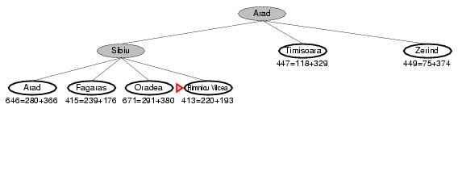
A* search example
Notes:
‹#›

Slide 62
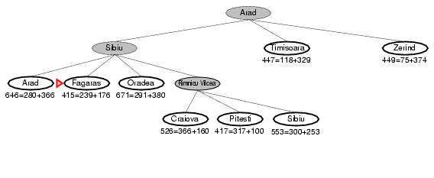
A* search example
Notes:
‹#›

Slide 63
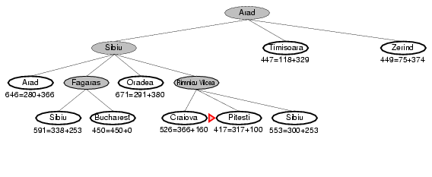
A* search example
Notes:
‹#›

Slide 64
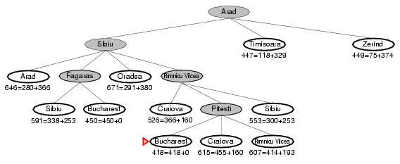
A* search example
Notes:
‹#›

Slide 65
8-Puzzle
f(N) = h(N) = number of misplaced tiles
3
3
4
5
3
4
2
4
2
1
3
3
0
4
5
4

Slide 66
8-Puzzle
f(N) = g(N) + h(N)
with h(N) = number of misplaced tiles
3+3
1+5
2+3
3+4
5+2
0+4
3+2
4+1
1+3
2+3
5+0
3+4
1+5
2+4

Slide 67
IDA* search
Idea: It is a kind of iterative deepening depth-first search that adopts the A* search algorithm’s technique
Evaluation function f(n) = g(n) + h(n)
g(n) = cost so far to reach n
h(n) = estimated cost from n to goal
f(n) = estimated total cost of path through n to goal

Slide 68
IDA* search
It avoids the time complexity of traditional DFS by increasing the search space gradually.
But as it uses the approach of IDDFS, the space complexity is relatively low than A* algorithm.
IDA* is an admissible heuristic and guaranteed to find the optimal solution if one exists

Slide 69
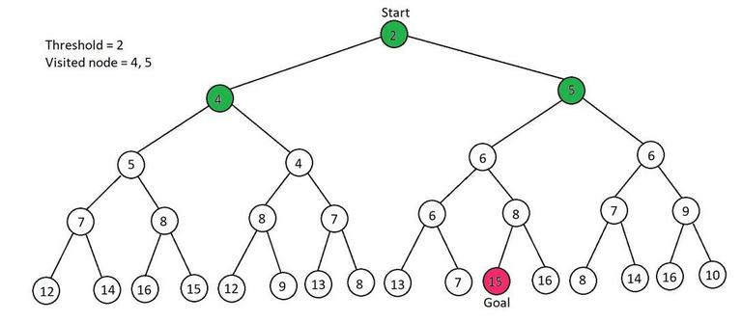
IDA* search

Slide 70
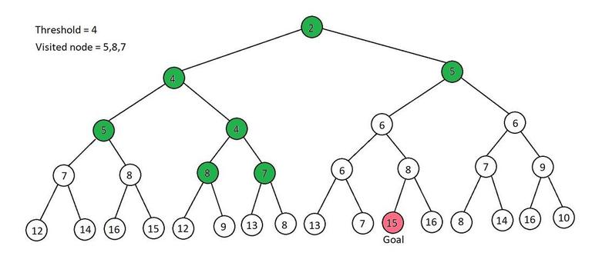
IDA* search

Slide 71
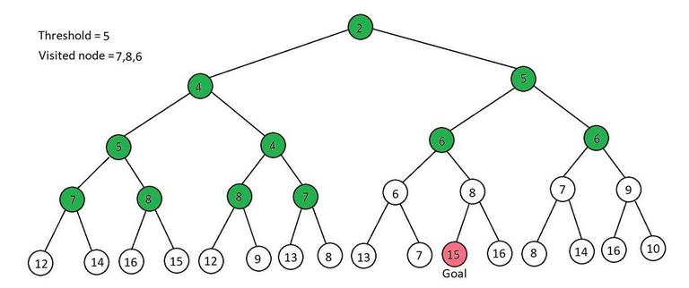
IDA* search

Slide 72
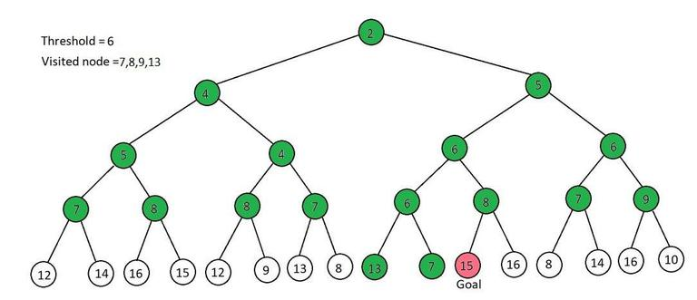
IDA* search

Slide 73
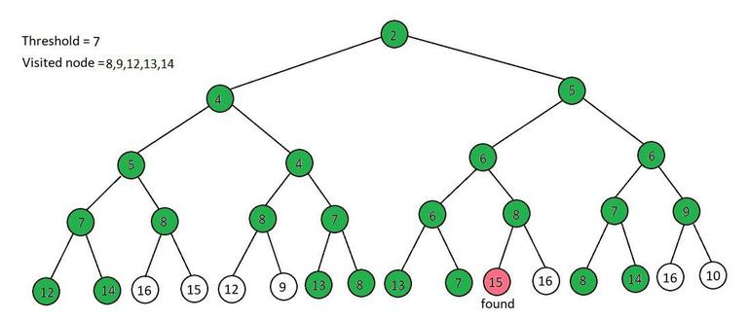
IDA* search

Slide 74
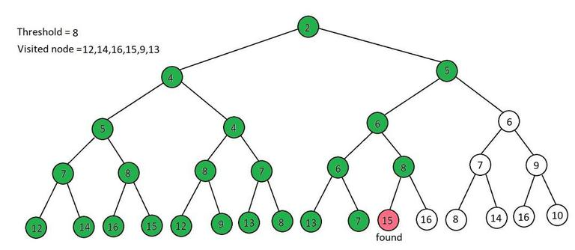
IDA* search

