Slide 1









Idea submission

Slide 2


Team details
Team Lead: Name: Tanvi Rao
Contact: 80730 14367
Email: tanvirao.is23@bmsce.ac.in
Team Member 2: Name: Arpita Patel
Contact: 6363515496
Email: arpitapatel.is23@bmsce.ac.in
Team Member 3: Name: Tanisha Shinthray
Contact: 9632601233
Email: tanishashinthray.ad23@bmsce.ac.in

Slide 3


Our solution
Problem: Time-consuming and inefficient initial medical triage, leading to delays in appropriate care.
Solution: AI-powered, voice-activated symptom analysis and specialist recommendation tool.
Unique Feature: Direct, natural language voice input for symptom description.
Technology: HTML/CSS frontend, Node.js backend, and ChatGPT API for symptom interpretation.
AI Integration: Uses ChatGPT's language understanding for more accurate and context-aware symptom analysis.
Productivity Boost: Streamlines patient routing, reducing administrative burden and improving speed of access to specialists.
User Accessibility: Voice interface enhances accessibility for diverse users.

Slide 4

TECHNICAL APPROACH
Frontend Development :Utilized HTML, CSS, and JavaScript for a responsive and user-friendly interface.
Implemented voice input functionality for direct symptom description.
Backend Development: Developed a Node.js backend to handle API requests and data processing.
Established communication between the frontend and ChatGPT API.
AI Integration: Leveraged the ChatGPT API for natural language understanding and symptom analysis.
Implemented logic to interpret user-provided symptoms and determine appropriate specialist referrals.
Deployment: Deployed the project using GitHub, ensuring version control and streamlined deployment.

Slide 5
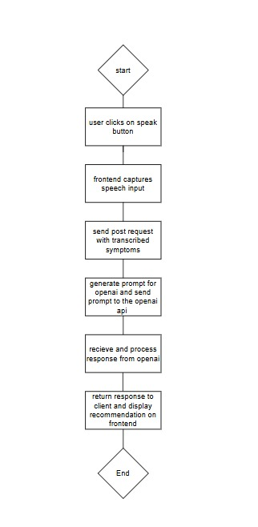
Workflow/pipeline

Slide 6
Feasibility & FUTURE SCOPE
Pros:
Improved Healthcare Accessibility
AI-Powered Decision Making
Easy Integration with Telemedicine
Cons:
AI is not 100% accurate
Lack of Personalized Recommendations
Future scope: AI Model Improvements for Higher Accuracy
Medical History-Based Recommendations

