Slide 1

Chemical Engineering Undergraduate Research Project
Aerosol Dynamics of COVID-19
Arpita Singh
2nd year undergraduate
Chemical Engineering Department
IIT Ropar
Research Lead
Dr. Asad H.Sahir

Slide 2
Outline
Introduction
Known Outbreaks suggesting aerosol transmission
Monteiro’s Model
- Assumptions, model and graphical result
Beggs et al. Model
- Assumptions, model and graphical result
Conclusion
Recommendations for future study

Slide 3

Introduction
SARS-CoV-2, the coronavirus which causes COVID-19, is transmitted via droplets, surface contamination and aerosols.
A contagious individual shed virus particles (virions), as a result of discrete events like coughing or sneezing, or through a continuous process like breathing and talking.
Modes of transmission

Slide 4
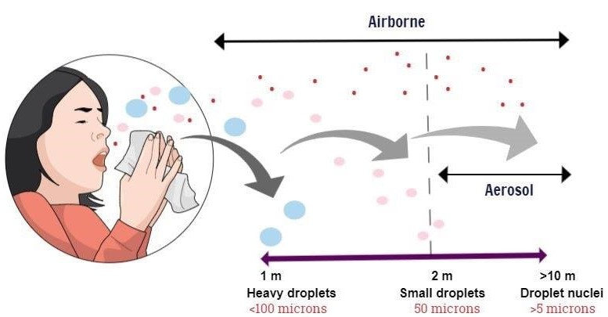
Respiratory droplets are enclosed within a turbulent gas cloud. The gravitational force acts on it and tends to settle it down.
Large droplets settle down while droplets having diameter less than 50 µm, quickly lose most of their water to evaporation, and form residual particulates known as "droplet nuclei" or "aerosols".
These aerosols remain suspended in air for long time duration and go airborne, thereby acting as a dominant source of respiratory transmission.
“Droplet transmission: particle size >5 μm in diameter
airborne transmission: particle size ≤5 μm in diameter.”
Reference: https://jamanetwork.com/journals/jama/fullarticle/2763852
Notes:
Respiratory transmission mechanism: The clinical characteristics of the COVID-19 disease stem from the competition between the invasive action of the virus and the immune reaction. The virus particles attack the protective mucus layer and tries to penetrate inside the cell. The most external S1 domain,
(Receptor Binding Domain) binds with an exopeptidase, ACE-2 (Angiotensin-Converting Enzyme 2). The sequence of amino acids(fusion peptides) then facilitate the fusion between the viral pericapsid and the membrane of the human cell. As a reult of the fusion, the RNA of the virus penetrates into the cell and undergoes translation into proteins, causing corona virus disease.

Slide 5
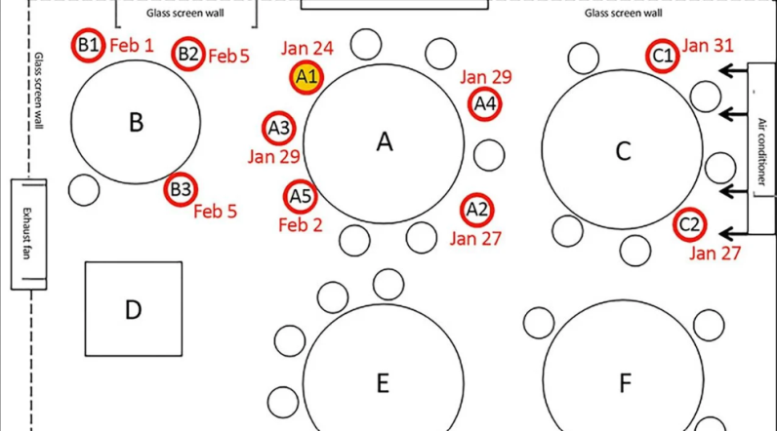
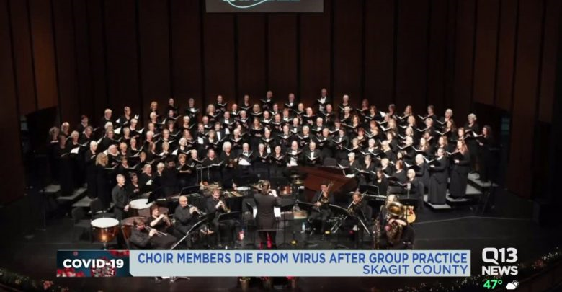
Some major outbreaks suggesting the possibility of aerosol transmission :
Guangzhou Restaurant, China:
In this outbreak, a contagious individual
infected 9 people, of which, 5 people were
seated in different tables, roughly 4.6 m
away from the contagious person. The
restaurant was poorly ventilated.
Seattle Choir : In a choir practice that
took place in Seattle, Washington, 45
out of 60 people present tested positive
for coronavirus. During the rehearsals,
no one showed any signs of being ill and
they even avoided physical contact.
Reference: https://www.researchgate.net/publication/341615088_Avoiding_COVID19_Aerosol_Guidelines

Slide 6
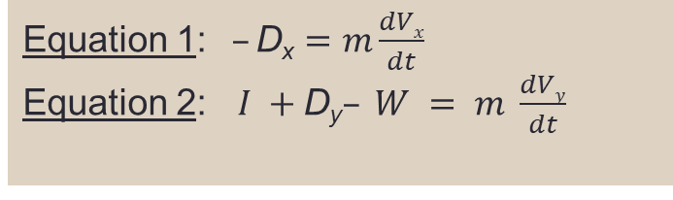
Mathematical Modeling of Dynamic Behavior of Droplets
Monteiro’s Model
Assumptions: Respiratory droplets are assumed to be spherical, with no rotation or deformation.
Model: The droplets of mass (m) are suspended in air, a viscous fluid. The forces acting on it are the drag force ( D_{x} ) in the horizontal direction and the weight(W), the buoyancy force (I) and the drag force ( D_{y} ), in the vertical direction. From the free body diagram,
D_{y} , I
D_{x}
W
Equation 1: $–\text{D}\text{x}=m\frac{dVx}{dt}$
Equation 2: $I +\text{D}\text{y}– W = m \frac{dVy}{dt}$
Free Body diagram of a droplet
Reference: https://www.asrjetsjournal.org/index.php/American_Scientific_Journal/article/view/5953

Slide 7

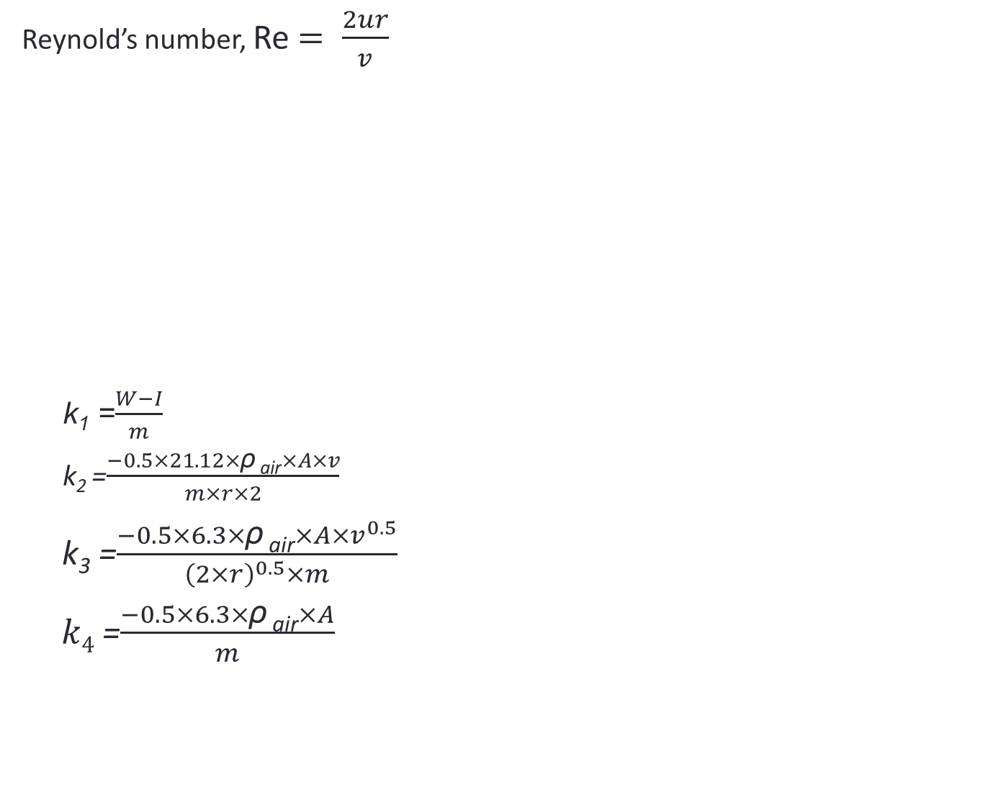

Reynold’s number, Re $= \frac{2ur}{v}$
k₁ =$\frac{W−I}{m}$
k₂ =$\frac{−0.5×21.12×\text{ρ} \text{air}×A×v}{m×r×2}$
k₃ =$\frac{−0.5×6.3×\text{ρ} \text{air}×A×v^{0.5}}{{\left(2×r\right)}^{0.5}×m}$
$k4$ =$\frac{−0.5×6.3×\text{ρ} \text{air}×A}{m}$
Re ≤ 1
Drag coefficient (C) = $\frac{24}{Re}$
Drag force (D)= 0.5 × $\text{ρ} \text{air}$×A× $u^{2}$×C
$\frac{dVx}{dt}=k×V_{x}$
$\frac{dVy}{dt}=k1+k×V_{y}$
0.2 ≤ Re≤ 2 × ${10}^{3}$
Drag coefficient (C) =$\frac{21.12}{Re}+ \frac{6.3}{{Re}^{0.5}}$ + 0.25
Drag force (D)= 0.5 × $\text{ρ} \text{air}$×A× $u^{2}$
× C
$\frac{dVx}{dt}=k_{2}×V_{x}+k_{3}×V_{x}^{1.5}+k_{4}×V_{x}^{2}$
$\frac{dVy}{dt}=k1+k2×V_{y}+k3 ×{V_{y}}^{1.5}+k4 ×{V_{y}}^{2}$

Slide 8
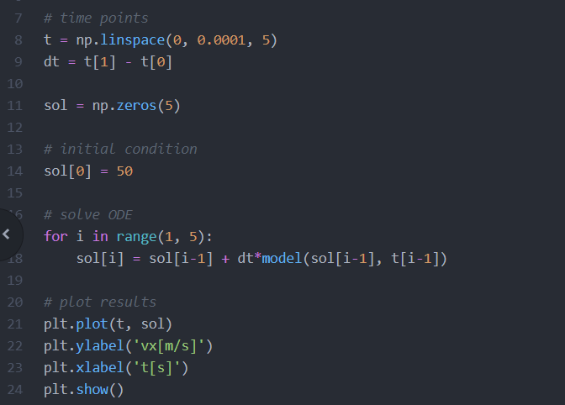

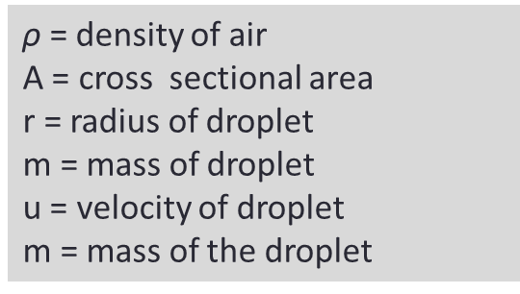
Dynamic air viscosity, µ = $\frac{145\text{×}{10}^{−8}\text{×}T^{1.5}}{T+110.4}$
Kinematic air viscosity, $v= \frac{\text{µ}}{\text{ρ}}$
Solving the differential equation in python and plotting the result :
$\text{ρ}$ = density of air
A = cross sectional area
r = radius of droplet
m = mass of droplet
u = velocity of droplet
m = mass of the droplet

Slide 9
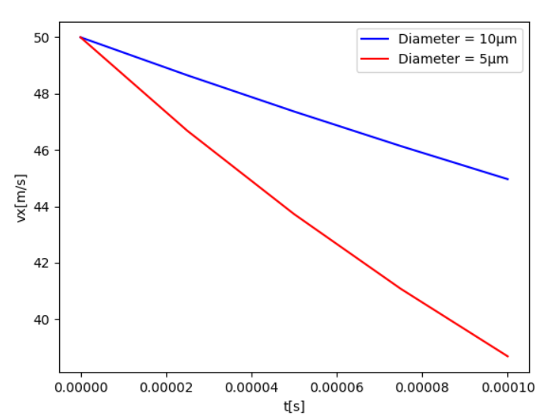
Result: The horizontal velocity of the droplets decreases with time, but the rate of this decay is higher for smaller droplets and decreases as the size of the droplets increase.
Figure 1 : Horizontal velocity of droplets of diameter 5 µm and
10 µm as a function of time

Slide 10
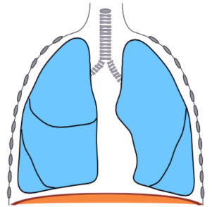
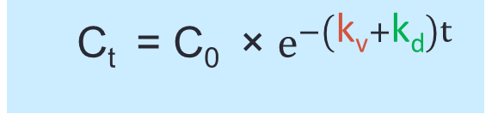
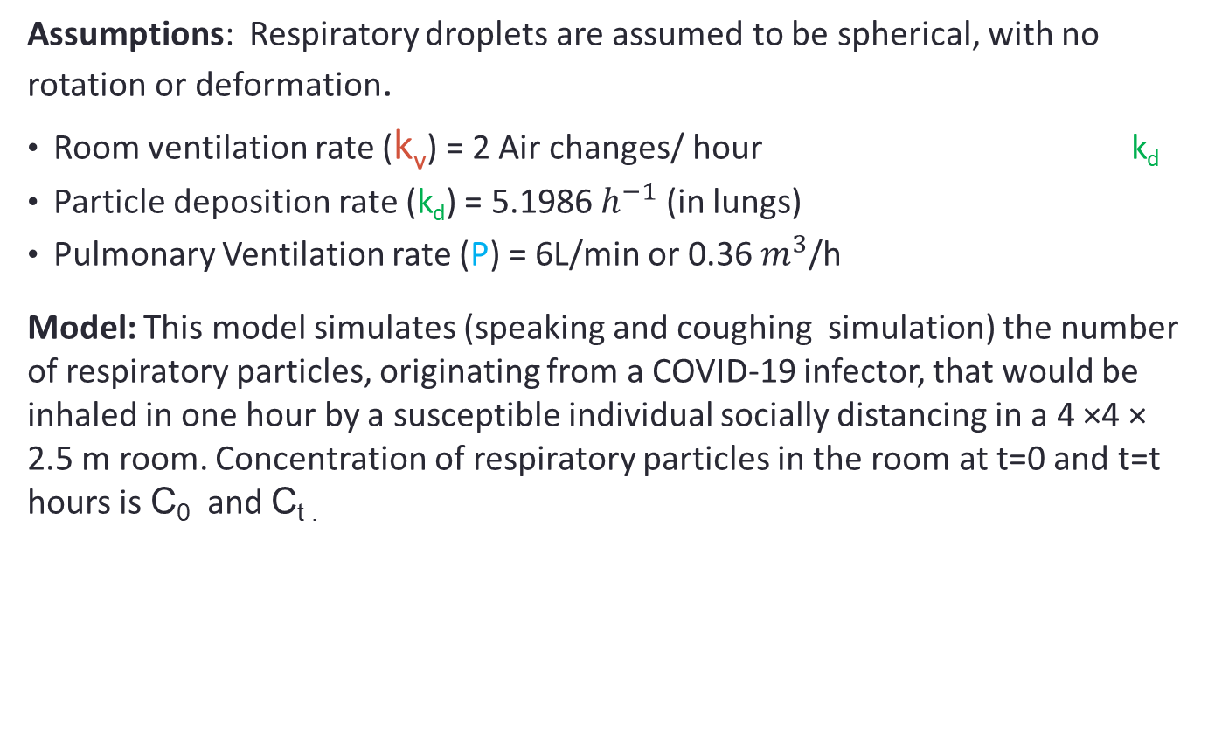
Beggs et al. Model
Assumptions: Respiratory droplets are assumed to be spherical, with no rotation or deformation.
Room ventilation rate (k_{v}) = 2 Air changes/ hour k_{d}
Particle deposition rate (k_{d}) = 5.1986 $h^{−1}$ (in lungs)
Pulmonary Ventilation rate (P) = 6L/min or 0.36 $m^{3}$/h
Model: This model simulates (speaking and coughing simulation) the number of respiratory particles, originating from a COVID-19 infector, that would be inhaled in one hour by a susceptible individual socially distancing in a 4 ×4 × 2.5 m room. Concentration of respiratory particles in the room at t=0 and t=t hours is C₀ and C_{t .}
C_{t} = C₀ × $e^{−\left(\text{k}\text{v}+\text{k}\text{d}\right)t}$

Slide 11
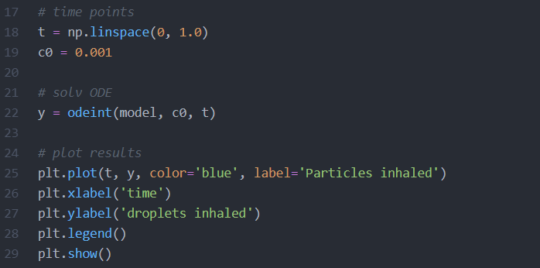

Total number of respiratory particles inhaled (I) by the susceptible individual :
$\frac{dI}{dt}=P ×C$
Where, P = Pulmonary Ventilation rate
C = Concentration of respiratory droplets
Solving the differential equation in python and plotting the results :

Slide 12
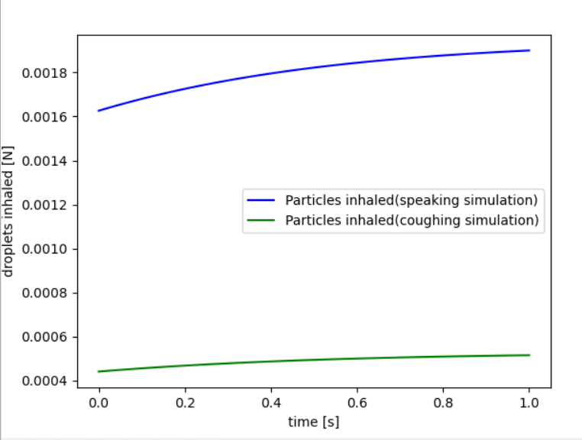
Result: The number of droplets inhaled by susceptible individual increases with time, even after strictly following social distancing.
Figure 2: Number of droplets inhaled Vs Time (speaking (C₀ = 0.001626) and coughing (C₀ = 0.000441) simulation)

Slide 13
Conclusions
From both the models :
Droplets travel large distances depending on their size as the rate of decay of horizontal velocity is inversely proportional to the size of the droplet. (Monteiro’s Model – Figure 1)
Whether the patient is symptomatic or asymptomatic, sharing enclosed space, for a longer time duration, results in higher risk of contracting COVID-19, despite social distancing. (Beggs et al. Model – Figure 2)
The authors of both the models also concluded the following results:
The range is almost insensitive with the increase of environmental air temperature.
The warmer the country is, the higher is the droplets drop time. This is because the air becomes more viscous and therefore more resistant to the movement of the droplets. Therefore, people living in warmer regions are subjected to higher risk of contracting the disease.

Slide 14
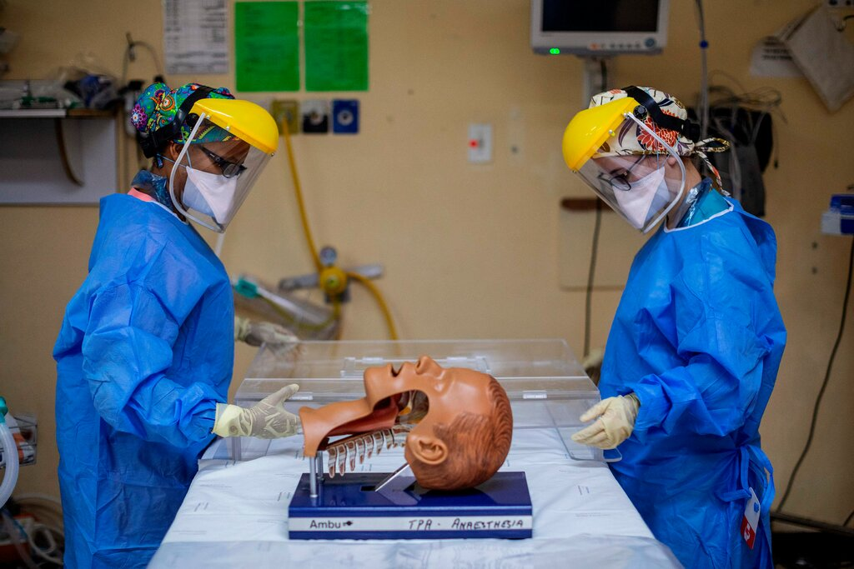
Recommendation for future study :
A team of virologists, and aerosol scientists have recently retrieved live coronavirus from hospital air. Further studies are needed to determine whether the amount of virus retrieved is enough for causing infection.
Doctors in Johannesburg demonstrated how to place a device called an intubox over a patient, to help curb the spread of viral droplets during intubation.

Slide 15
Thank
You

