Slide 1



Training Period-AEM
Jaypee University of Information Technology
Department of Computer Science and Engineering and Information Technology
Major Project - II (18B19CI891) | AY 2025-26
Mid-Term Evaluation | March 2026.
Group No.:
Team Member (s)
Arpita Rani(221030055)
Supervisor
Name: Mr. Gaurav Negi
Designation: Assistant Professor(Grade-1)
(CSE & IT)

Slide 2
Outline
Introduction
Objectives
Literature Review
Project Design
Tools, Technologies and Languages
Implementation
Experimental Results and Evaluation
Key Learnings
Work Contribution and Attendance
Supervisor Interactions
References

Slide 3
Introduction
During the internship, I worked on the following tasks: ● Developing custom AEM components using HTL ● Implementing Sling Models for backend logic ● Creating Path-based and Resource-based Servlets ● Managing JSON responses and API endpoints ● Configuring Dispatcher (Apache) for caching and URL rewriting ● Working with Author and Publish instances ● Debugging issues related to servlet mapping, script resolution, and content rendering ● Exploring Docker-based Dispatcher setup

Slide 4
Objectives
To develop practical understanding of Core Java and object-oriented programming (OOP) concepts used in enterprise applications.
To study the architecture and workflow of Adobe Experience Manager (AEM), including Author–Publish architecture and content replication.
To learn AEM development using technologies such as Sling, OSGi, JCR, HTL, and Sling Models for building and customizing components.
To implement backend functionality using Path-based and Resource-based Servlets and understand the structure of the CRX repository.
To explore Dispatcher (Apache) configuration for caching and URL rewriting, work with Maven-based project structures, and enhance debugging and deployment skills in a real-world development environment

Slide 5
Literature Review
S. No. | Author & Paper Title [Citation] | Journal/ Conference (Year) | Tools/ Techniques/ Dataset | Key Findings/ Results | Limitations/ Gaps Identified
1. | Dayasagar Vangala-Headless CMS with AEM: Building Omnichannel Digital Experiences | 2021 | AEM and GraphQL | Headless AEM uses Content Fragments and GraphQL APIs to deliver content across omnichannel touchpoints | High technical complexity for developers; marketing teams may struggle with the loss of "drag-and-drop" visual editing in purely headless models
2. | Bhanu Phanindra Babu Gogla- Optimizing Adobe Experience Manager Performance | 2024 | OSGi , Sling Framework | Edge Delivery Services (EDS) utilizes a performance-first architecture to achieve high Google Core Web Vitals scores. | Optimization requires strict adherence to lean HTML/CSS and rigorous performance profiling during load tests to simulate "real-world" content.
3. | Dayasagar Vangala- Secure AEM Integrations Using OAuth and Adobe I/O Runtime January 2020 | 2020 | HTL,AEM | Modern AEM uses OAuth 2.0 and JWT (JSON Web Tokens) via Adobe I/O Runtime to secure integrations. | Token theft and replay attacks remain a threat in distributed ecosystems, requiring adaptive access policies and continuous monitoring.

Slide 6
Literature Review (cont…)
S. No. | Author & Paper Title [Citation] | Journal/ Conference (Year) | Tools/ Techniques/ Dataset | Key Findings/ Results | Limitations/ Gaps Identified
4. | Agrawal, Y. – The Auth Shim: Lightweight Architectural Pattern for Enterprise SSO Integration | 2025 | Enterprise Identity Integration | Demonstrates secure authentication architecture for enterprise systems including platforms such as Adobe infrastructure. | Not specifically designed for AEM CMS platforms.
5.. | Adobe Inc. – Introduction to the AEM Architecture Stack | 2025 | Apache Sling, OSGi, JCR, Jackrabbit Oak | Describes the layered architecture of AEM including Sling framework, JCR repository, and OSGi modular services used for enterprise CMS development. | Mainly conceptual documentation; lacks experimental performance analysis
6. | Adobe – AEM Forms Architecture and Deployment Topologies | 2024 | REST APIs, Sling Framework, OSGi Container | AEM as a Cloud Service (AEMaaCS) uses a microservices-based, containerized infrastructure that auto-scales based on traffic | Legacy "on-premise" customizations, such as Classic UI and certain native OS-level binaries, are no longer supported.

Slide 7
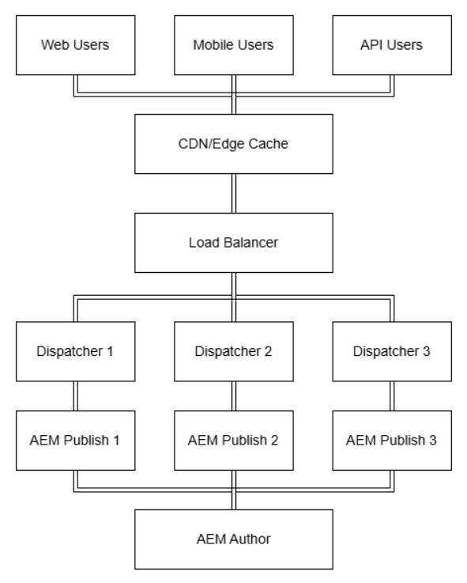
Project Design
Fig. 1: How internally system works

Slide 8
Project Design (cont…)
Adobe Experience Manager (AEM) is a content management system used to create, manage, and deliver digital content for websites and applications.
The AEM architecture mainly consists of Author Instance, Publish Instance, and Dispatcher.
The Author instance is used by developers and content authors to create and manage content, while the Publish instance delivers the content to end users.
Dispatcher acts as a caching and load balancing layer to improve performance and security.
AEM applications are developed using Components, Sling Models, Servlets, and OSGi Services, and projects are built using Apache Maven.
Sling Framework is used in AEM to map HTTP requests to resources and components.
CRX Repository stores all content, components, configurations, and digital assets in AEM.
HTL is used to create the frontend structure of AEM components.

Slide 9
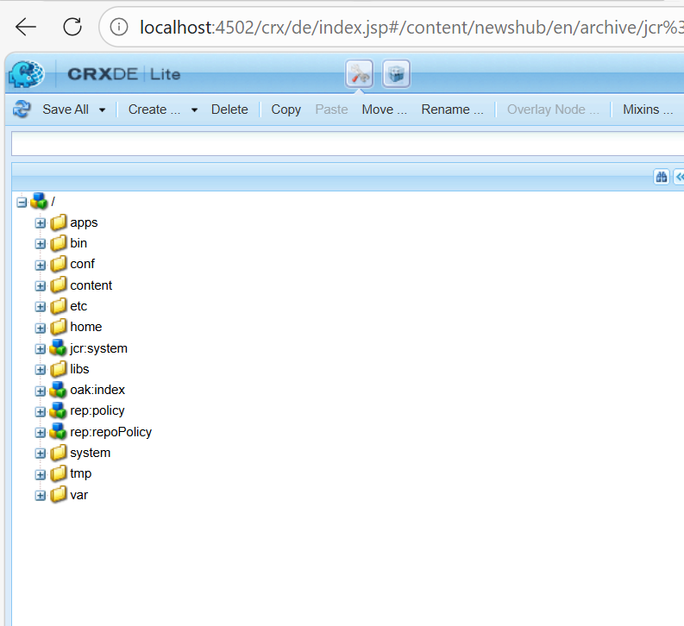
Project Design (cont…)
Fig. 2: CRXDE Lite

Slide 10
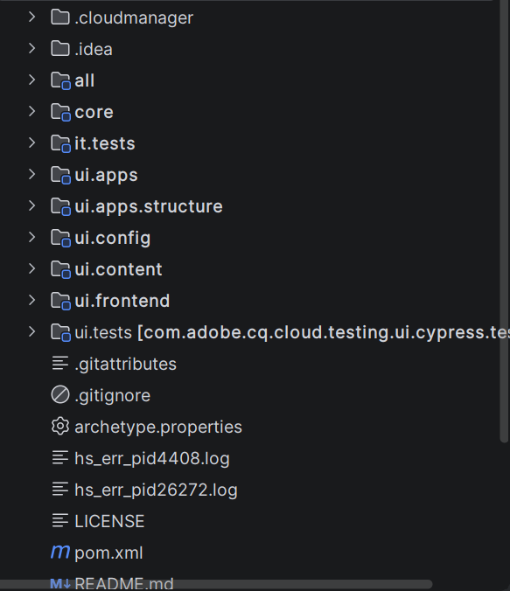
Project Design (cont…)
Fig. 3: IntelliJ Project Structure

Slide 11
Tools, Technologies and Languages
Tools Used:
IntelliJ IDEA – IDE for developing and managing AEM project code
CRXDE Lite – Repository browser for managing AEM content
Apache Maven – Build automation and dependency management tool
Git – Version control system for tracking code changes
Postman – Tool for testing APIs and servlets
Docker – Containerized setup for Dispatcher environment
Apache Web Server – Works with Dispatcher for caching and URL rewriting
Technologies Used:
Adobe Experience Manager (AEM) – Enterprise Content Management System
Apache Sling – Resource-based web framework used by AEM

Slide 12
Tools, Technologies and Languages (cont…)
OSGi (Apache Felix) – Framework for modular services and components
Apache Jackrabbit Oak (JCR) – Content repository used to store data in AEM
Dispatcher – Caching and load balancing tool for performance optimization
Programming Languages:
Java – Backend development (Servlets, Sling Models, Services)
HTL (HTML Template Language) – Used for rendering AEM components
HTML – Structure of web pages
CSS – Styling and layout design
JavaScript – Client-side functionality and interactivity
XML – Used for dialogs, configurations, and repository definitions

Slide 13
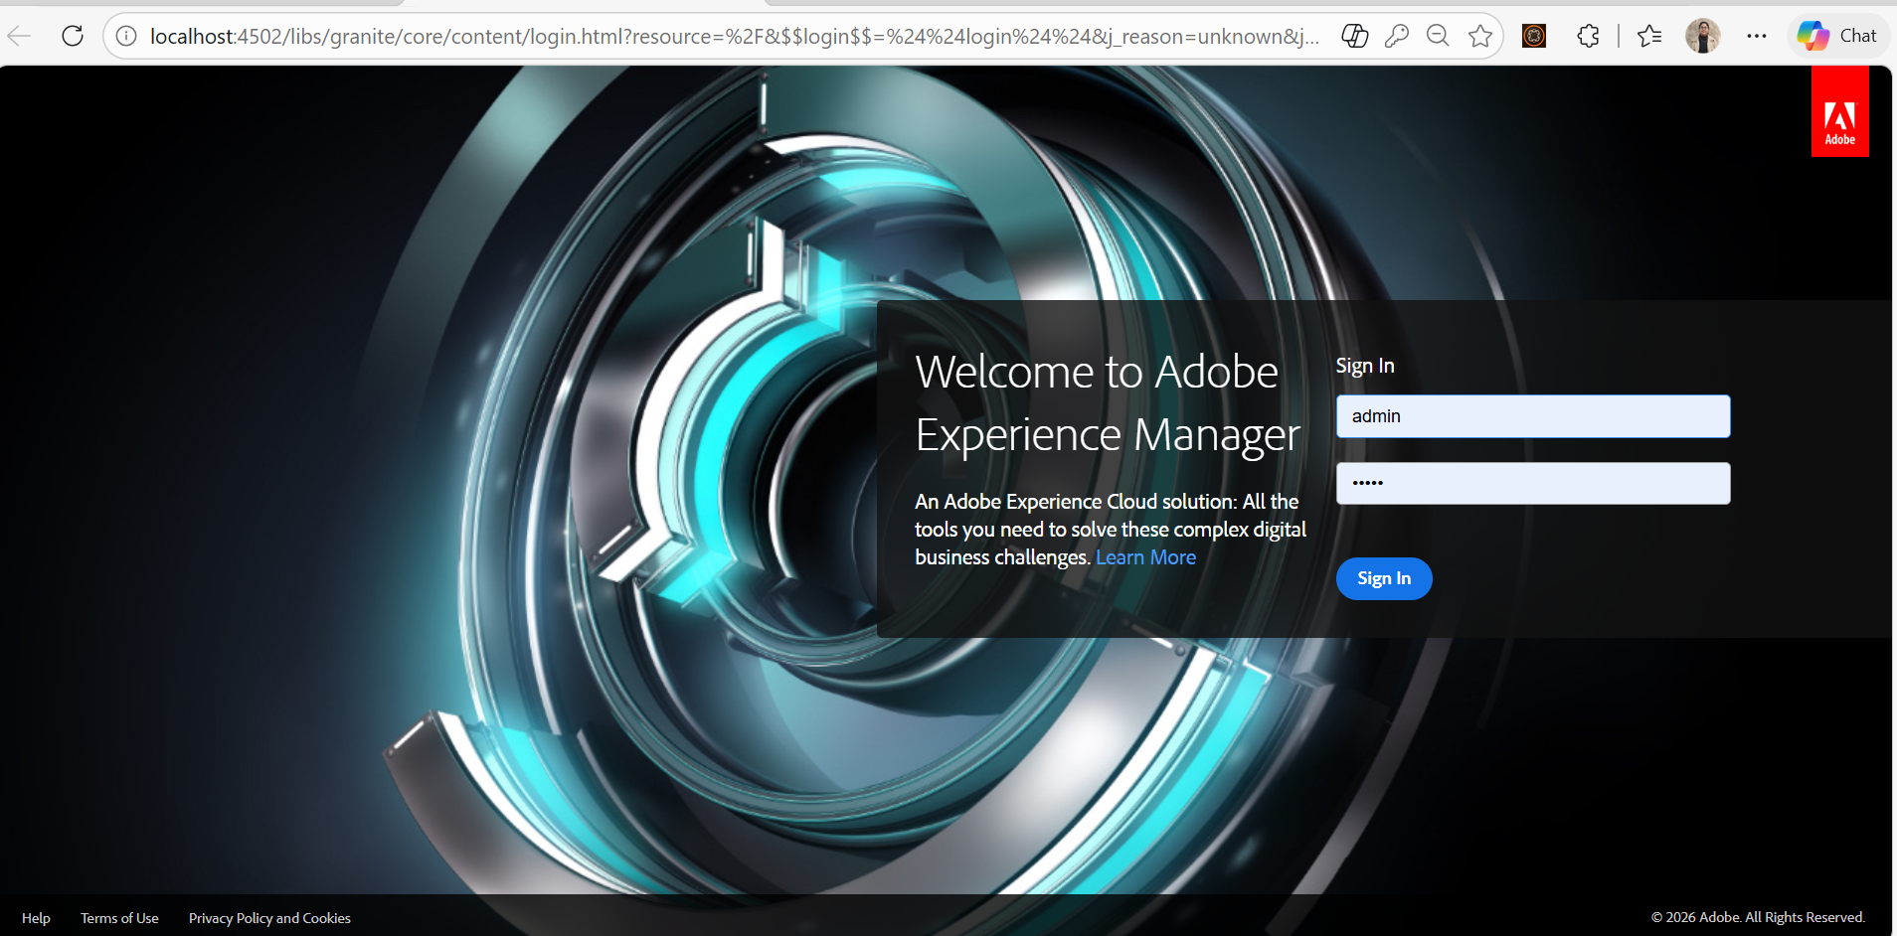
Implementation
Fig. 4: Login Page

Slide 14
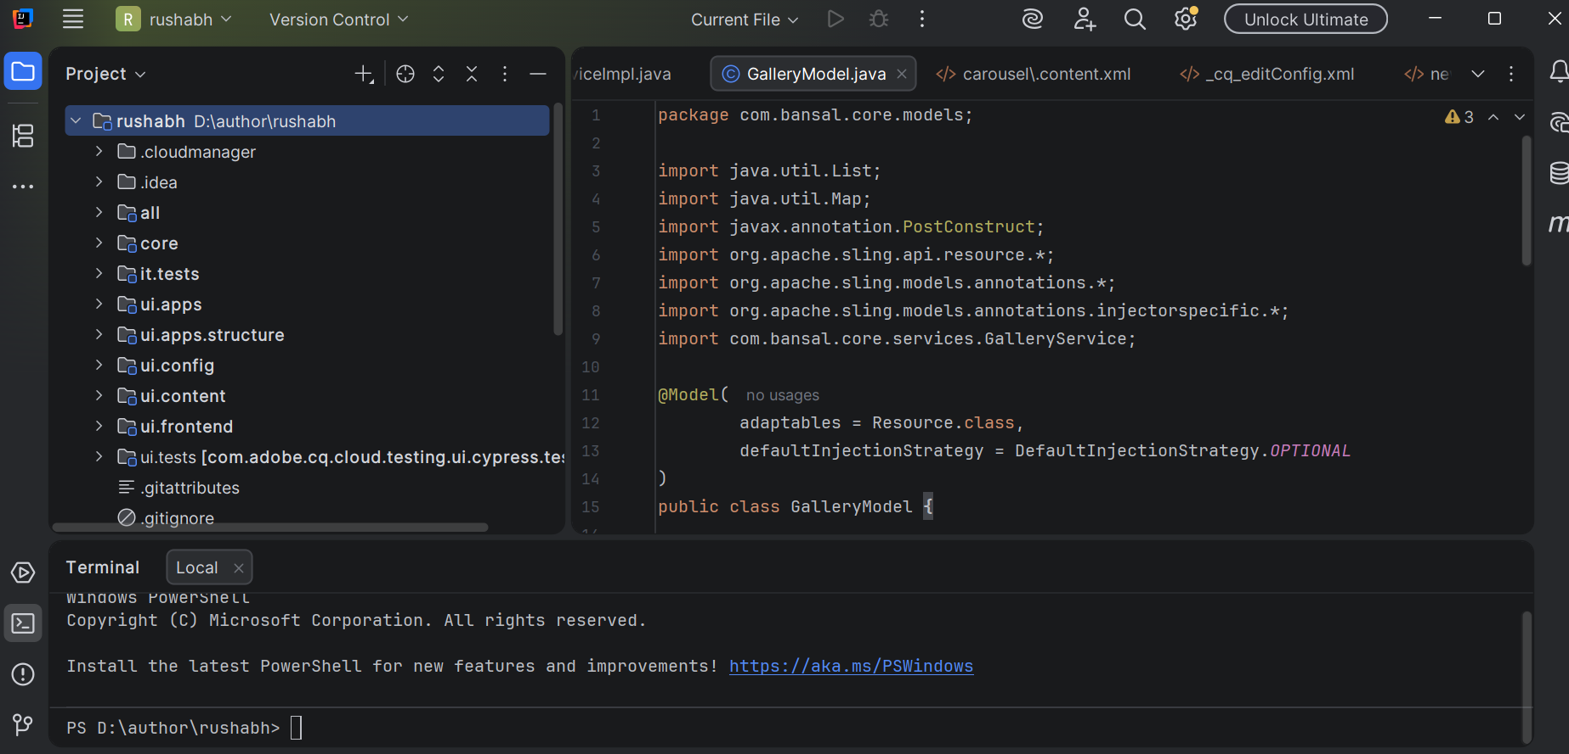
Implementation (cont…)
Fig. 5: Code Implementation

Slide 15
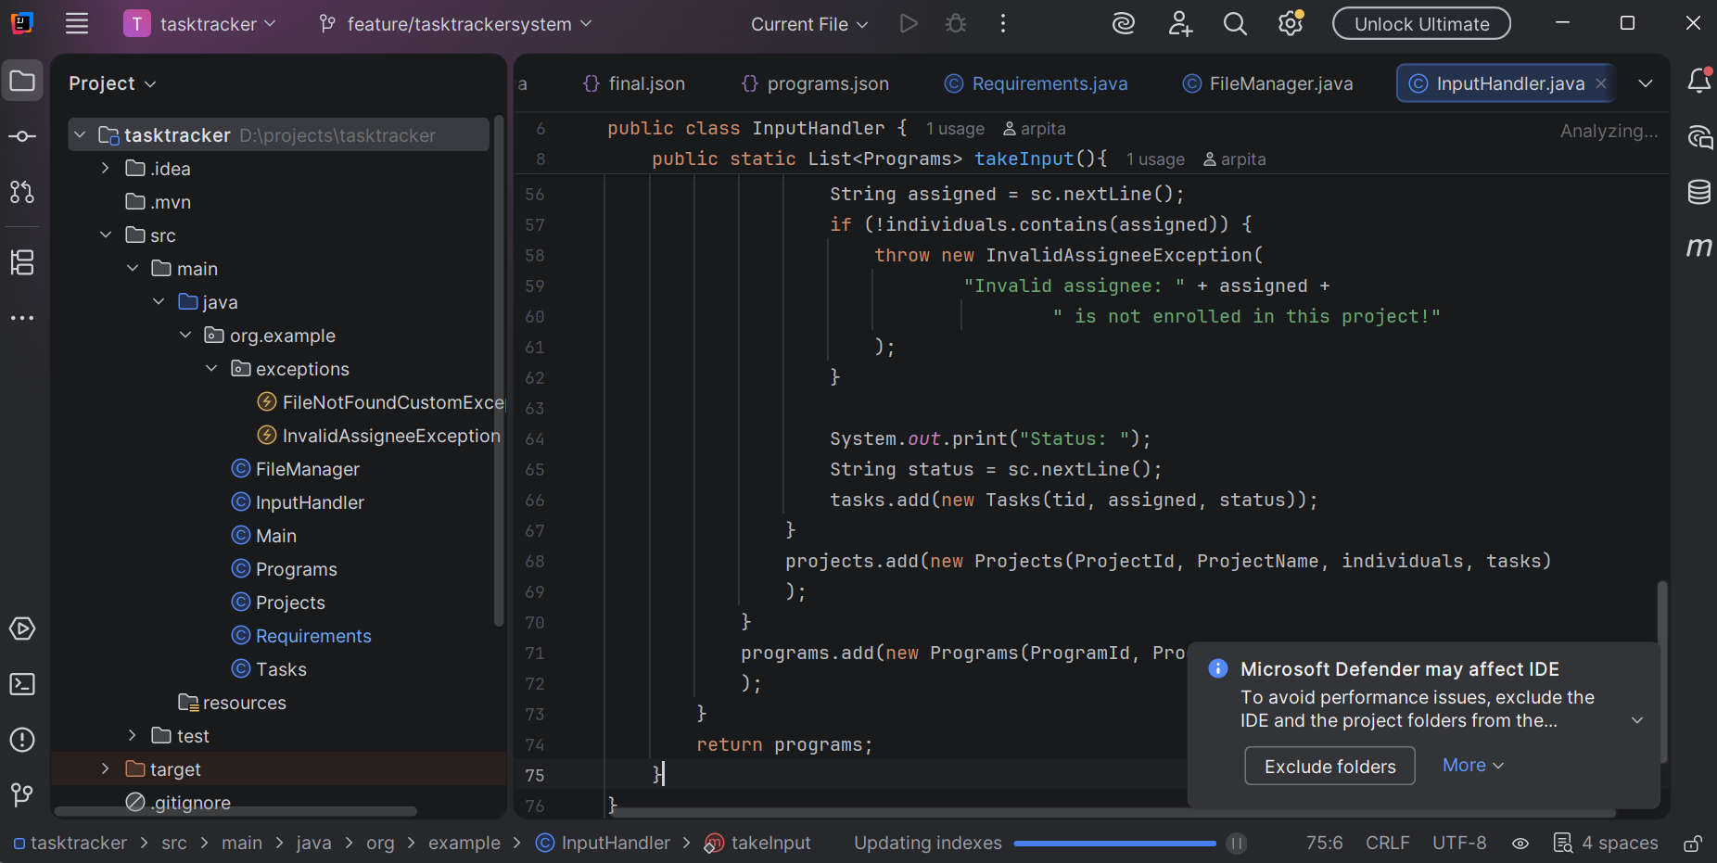
Implementation (cont…)
Fig. 6: Java Final Assignment

Slide 16
Implementation (cont…)
Set up the AEM development environment using IntelliJ IDEA, Apache Maven, and CRXDE Lite.
Created and configured AEM components and dialogs to manage and display content.
Implemented backend logic using Sling Models, Servlets, and OSGi services.
Used HTL (HTML Template Language) to render dynamic content in components.
Managed project build and deployment using Maven and maintained code using Git.
Tested functionalities and verified component behavior on the AEM Author instance.
Developed reusable AEM components following modular design practices.
Configured OSGi services and logging for backend functionality and debugging.
Performed testing and debugging to ensure proper rendering and functionality of components.

Slide 17
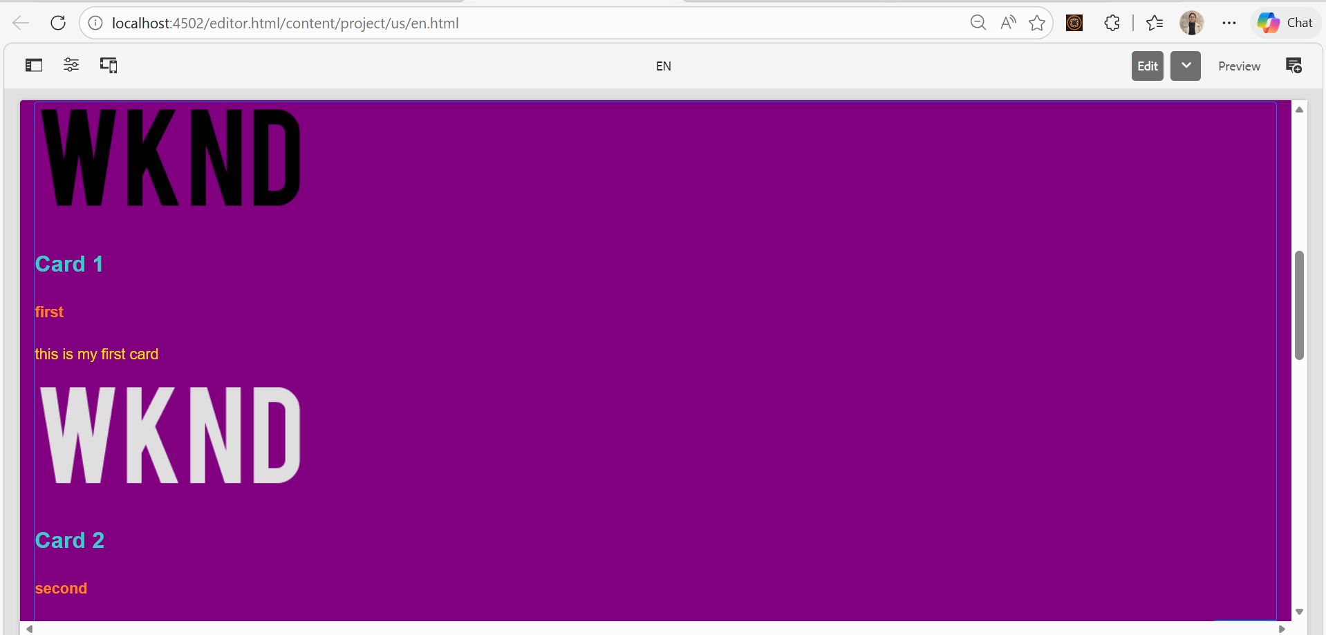
Experimental Results and Evaluation
Fig. 7: Card Listing Component

Slide 18
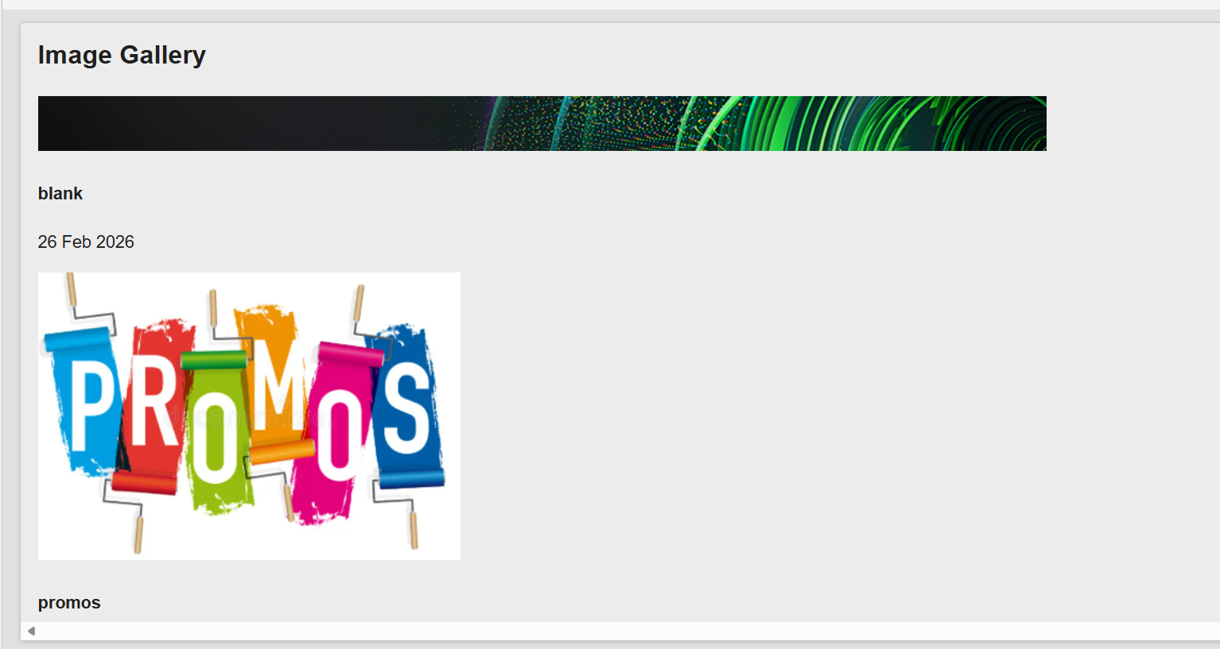
Experimental Results and Evaluation (cont…)
Fig. 8: DAM Asset

Slide 19
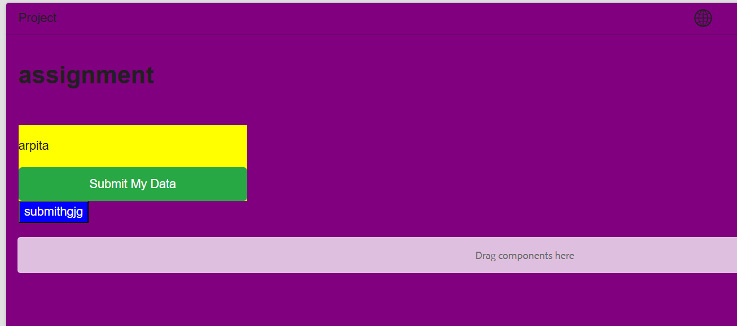
Experimental Results and Evaluation (cont…)
Fig. 9: ClientLibs(CSS and JS)

Slide 20
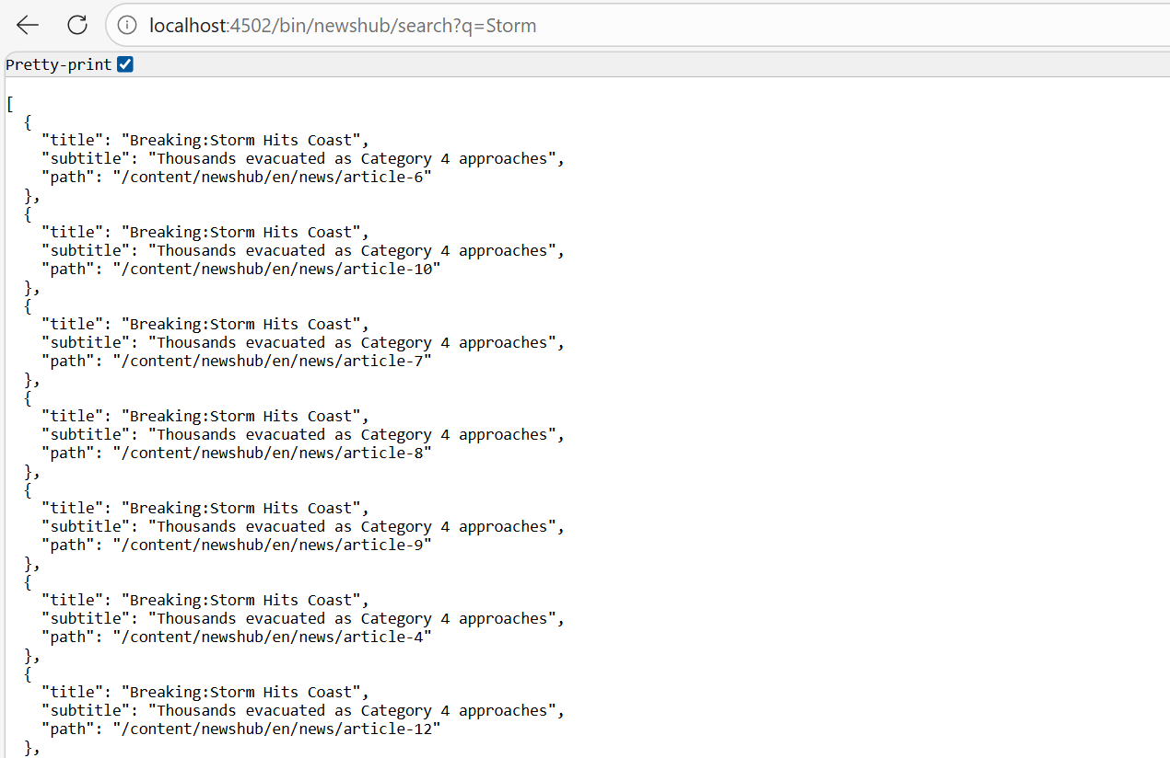
Experimental Results and Evaluation (cont…)
Fig. 9: Servlet Hit

Slide 21
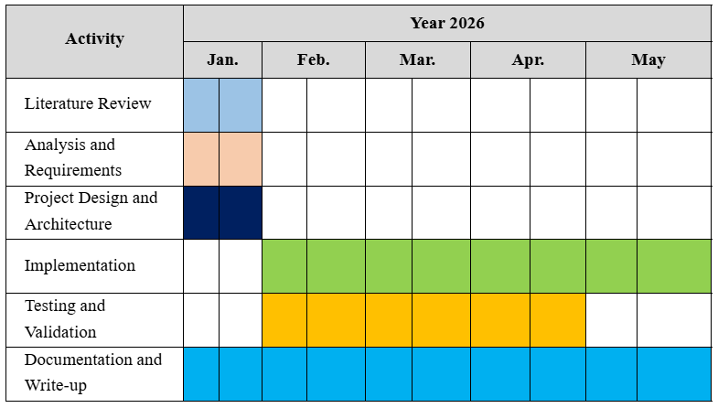
Project Plan
Here is the project plan:

Slide 22
Key Learnings
● Gained strong understanding of Core Java and Object-Oriented Programming (OOP)
● Learned how Apache Sling processes requests using resource-based architecture.
● Understood the working of OSGi (Apache Felix) and modular service development.
● Worked with JCR (CRX Repository) for content storage and management.
● Developed custom AEM components using HTL and Sling Models.
● Implemented Path-based and Resource-type Servlets for backend functionality.
● Learned how to generate and handle JSON responses in AEM.
● Understood Author–Publish architecture and content replication process
● Configured Dispatcher (Apache) for caching and URL rewriting.
● Improved debugging skills for servlet mapping and script resolution issues.
● Learned structured and modular coding practices
● Gained experience in working with real-time project architecture.
● Improved problem-solving and analytical skills.
● Understood best practices for scalable and maintainable web applications.
● Enhanced teamwork and professional communication skills.

Slide 23
Work Contribution and Attendance
GitHub Repository URL: arpita1501/university
Team Member | Roll No. | Work Done (provide complete details) | Work Contribution (%) | Lines of Code (if any) | Lab Attendance (%)
1. | 221030055 | Worked on developing components and services using Adobe Experience Manager (AEM). Implemented Sling Models, Servlets, and OSGi services to handle backend logic and dynamic content rendering. Gained hands-on experience with CRXDE Lite, Maven build processes, and component development. Also worked on configurations, logging, and integration of backend services within AEM architecture. | 100% |  | 100%

Slide 24
Supervisor Interactions (as mentioned in weekly log)
No. of Meetings with Supervisor:
Week No. | Duration | Remarks (as mentioned in the weekly log) | Incorporated (Yes/No)
1. | 05/01/2026 to 09/01/2026 | Learned basics of Core Java and AEM setup with good interest. | Yes
2. | 12/01/2026 to 16/01/2026 | Understood AEM project structure and CRXDE Lite usage. | Yes
3. | 19/01/2026 to 23/01/2026 | Worked on AEM component creation and dialog configuration. | Yes
4. | 26/01/2026 to 30/01/2026 | Implemented Sling Models and HTL for dynamic content. | Yes
5. | 02/02/2026 to 06/02/2026 | Developed and tested basic AEM Servlets. | Yes

Slide 25
Supervisor Interactions (cont…)
Week No. | Duration | Remarks (as mentioned in the weekly log) | Incorporated (Yes/No)
6. | 09/02/2026 to 13/02/2026 | Explored OSGi services and configurations. | Yes
7. | 16/02/2026 to 20/02/2026 | Demonstrated good debugging and logging practices. | Yes
8. | 23/02/2026 to 27/02/2026 | Successfully completed assigned tasks and showed good progress. | Yes

Slide 26
References
[1] Adobe Systems Incorporated, “Adobe Experience Manager Documentation,” Adobe Experience League, 2025.
[2] The Apache Software Foundation, “Apache Sling: A Web Framework for RESTful Applications,” Apache Software Foundation, 2025.
[3] The Apache Software Foundation, “Apache Jackrabbit Oak: A Scalable Hierarchical Content Repository,” Apache Software Foundation, 2025.
[4] The Apache Software Foundation, “Apache Felix: OSGi Framework and Runtime Service Platform,” Apache Software Foundation, 2025.
[5] Oracle Corporation, “Java Platform, Standard Edition Documentation,” Oracle, 2025.
[6] E. Gamma, R. Helm, R. Johnson, and J. Vlissides, Design Patterns: Elements of Reusable Object-Oriented Software. Boston, MA, USA: Addison-Wesley, 1994.
[7] J. Bloch, Effective Java, 3rd ed. Boston, MA, USA: Addison-Wesley, 2018.

Slide 27
References (cont…)
[7] J. Bloch, Effective Java, 3rd ed. Boston, MA, USA: Addison-Wesley, 2018.
[8] Adobe Systems Incorporated, “Adobe Experience Manager Dispatcher Documentation,” Adobe Experience League, 2025.
[9] The Apache Software Foundation, “Apache Maven Project Documentation,” Apache Software Foundation, 2025.
[10] R. Fielding, “Architectural Styles and the Design of Network-Based Software Architectures,” Doctoral dissertation, University of California, Irvine, 2000

Slide 28

Thanks.

