Slide 1
MID TERM PROJECT
Risk Assessment – Prudential life insurance
Team - 10
Created By-
Dhanush Kumar Shankar
Shardul Chavan
Arpita S Desai

Slide 2

PROBLEM STATEMENT
Developing models and choosing the most optimal one that accurately classifies risk using a more automated approach and greatly impacting public perception of the industry.
The results obtained would help Prudential better understand the predictive power of the data points, enabling us to significantly streamline the process.

Slide 3

APPROACH
DATA PREPROCESSING
Data Imputation
Feature Selection
Encoding data
MODELS BUILT
KNN
Random Forest
XGBoost Classifier
XGBoost Regressor
MODEL OPTIMIZATION
Grid Search

Slide 4
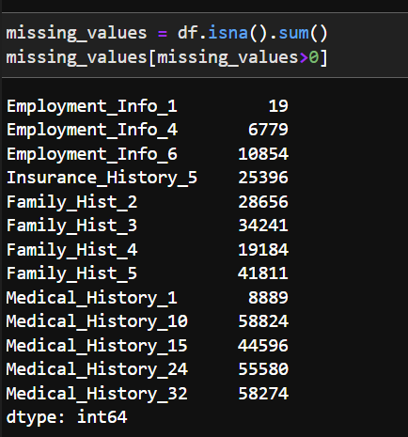
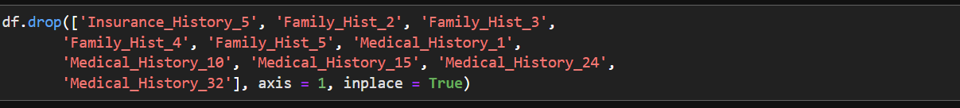
DATA IMPUTATION
Finding the missing values and dropping those columns which consists missing values greater than 25%

Slide 5
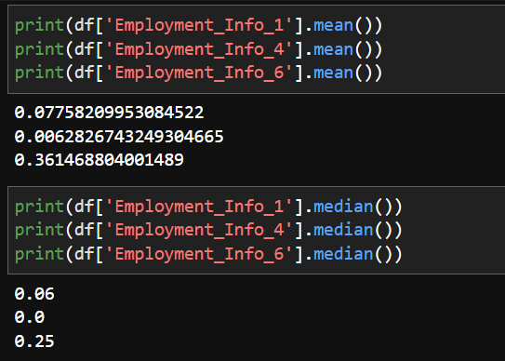
DATA IMPUTATION
Replacing the missing values with median

Slide 6
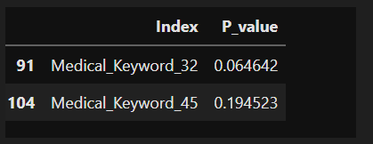
FEATURE SELECTION
Implementing Chi square method on categorical data and dropping the columns which have p-value greater than 0.05

Slide 7
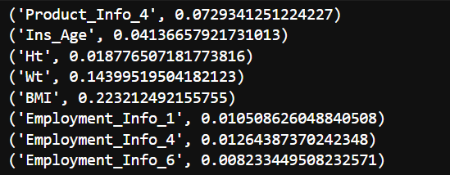
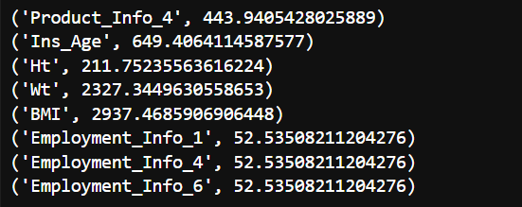
FEATURE SELECTION
Implementing Mutual Information and Anova method on numerical data

Slide 8


FEATURE SELECTION
After implementing Anova and Mutual Information we observe that these three columns have least feature importance and thus, we drop these columns

Slide 9
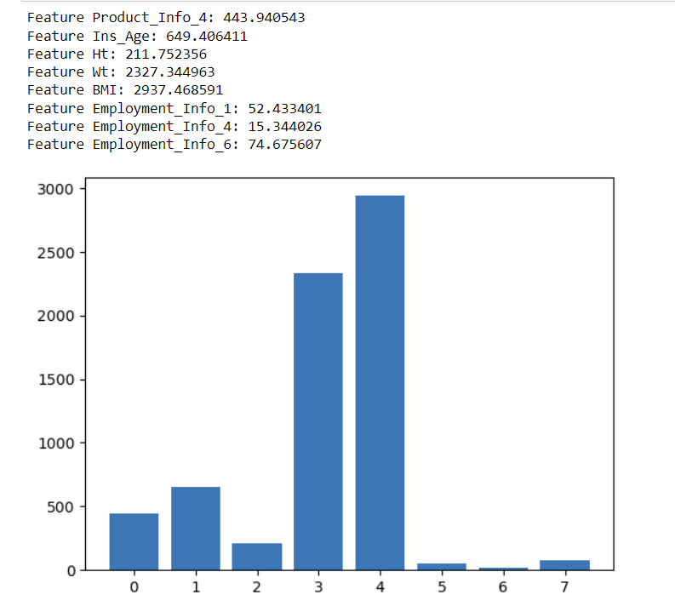
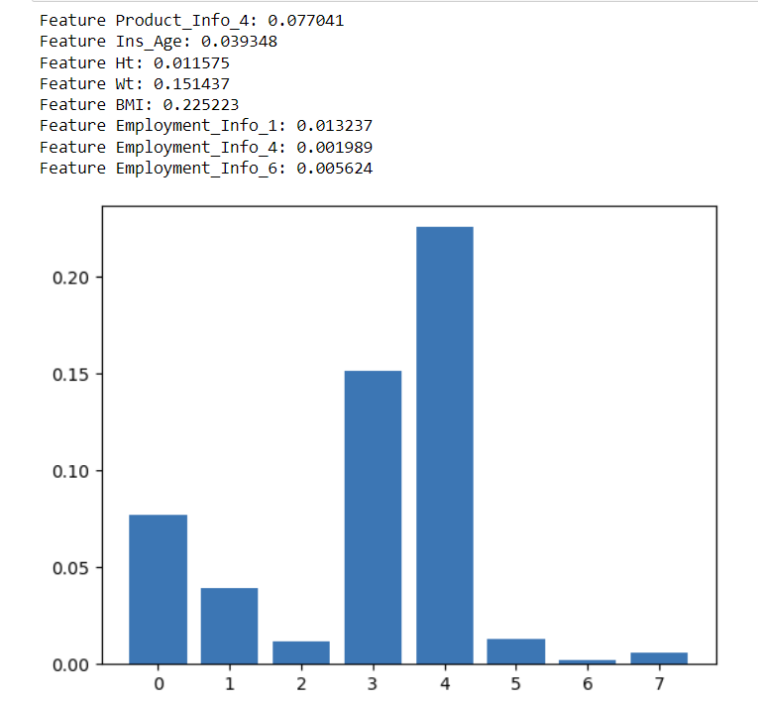
VISUALIZATION OF FEATURE SELECTION

Slide 10
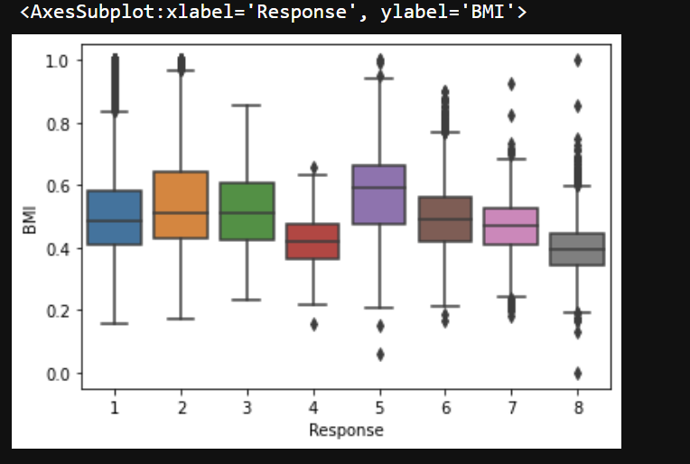
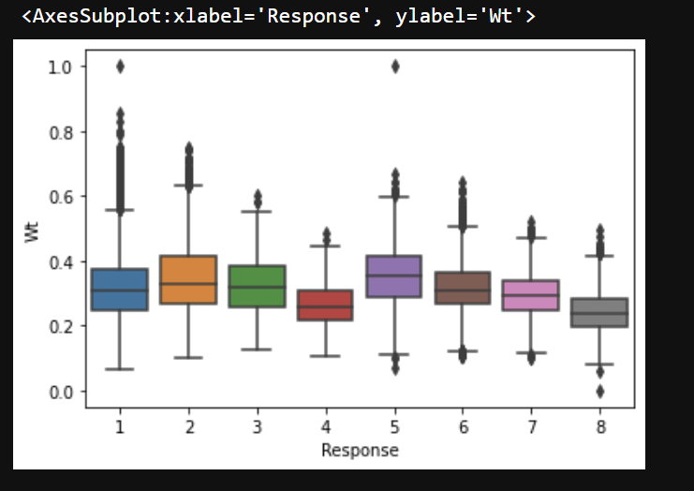
DATA VISUALIZATION

Slide 11


DIMENSIONALITY REDUCTION
After performing feature selection, we reduced the number of columns from 128 to 111

Slide 12
ENCODING
One – hot Encoding
Method 1:
Converting all the categorical data into numerical data
Method 2:
Converting only the alphanumeric data column to numeric data

Slide 13
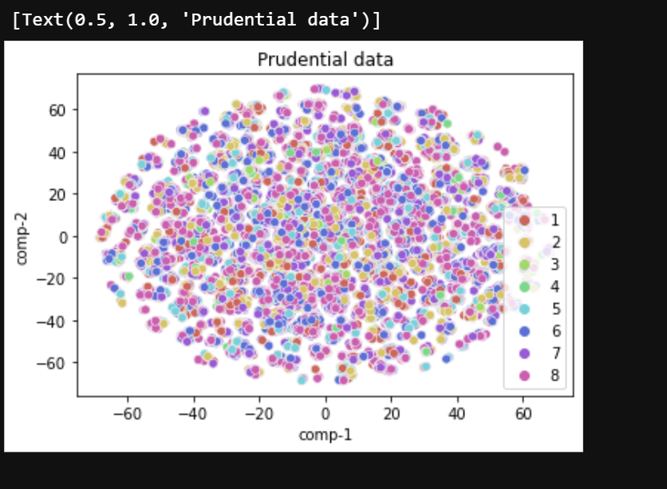
TSNE VISUALIZATION

Slide 14
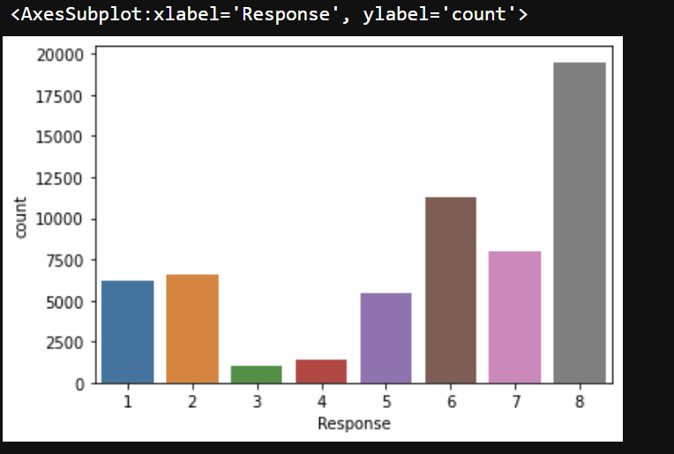
CLASS IMBALANCE

Slide 15
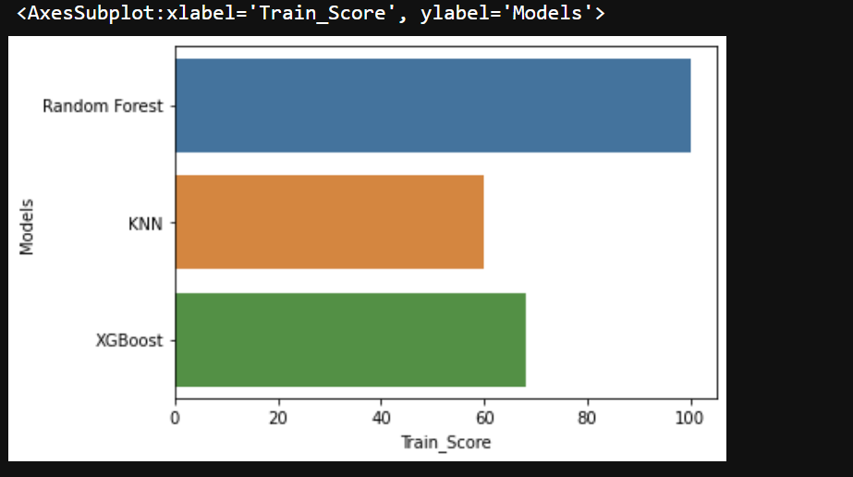
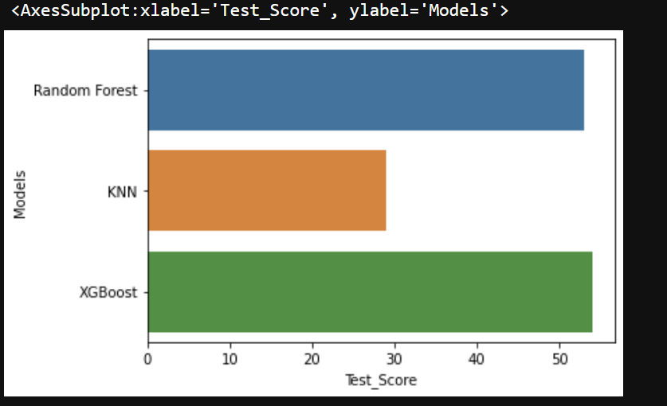
CLASSIFICATION RESULTS
METHOD 1: DATA WITHOUT ONE-HOT ENCODING

Slide 16
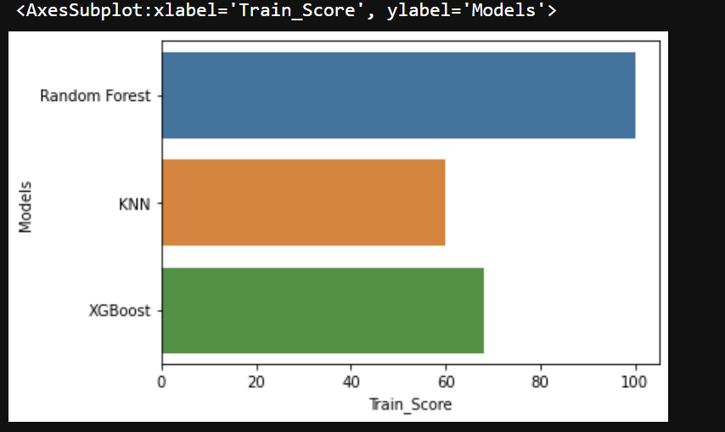
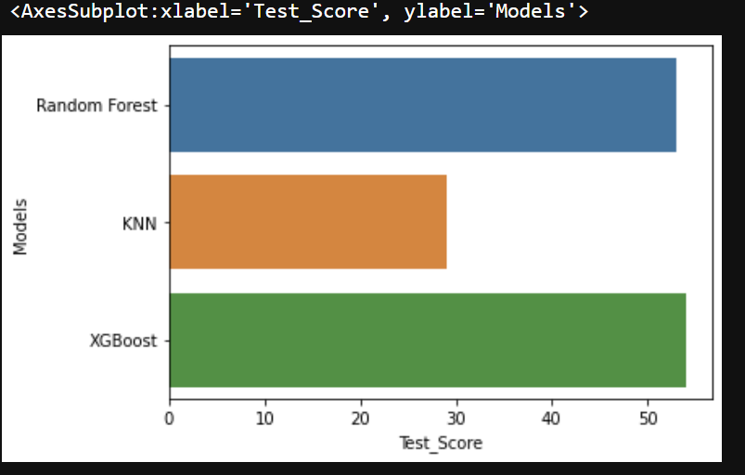
CLASSIFICATION RESULTS
METHOD 2: DATA WITH ONE-HOT ENCODING

Slide 17
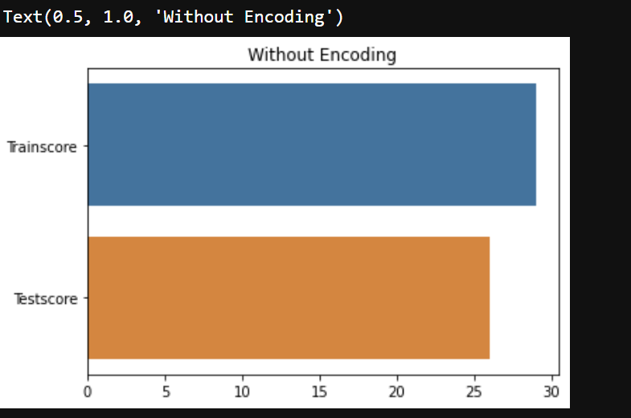
REGRESSION RESULTS
METHOD 1: DATA WITHOUT ONE-HOT ENCODING

Slide 18
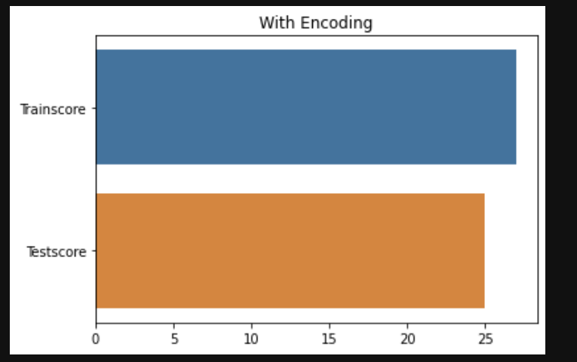
REGRESSION RESULTS
METHOD 2: DATA WITH ONE-HOT ENCODING

Slide 19
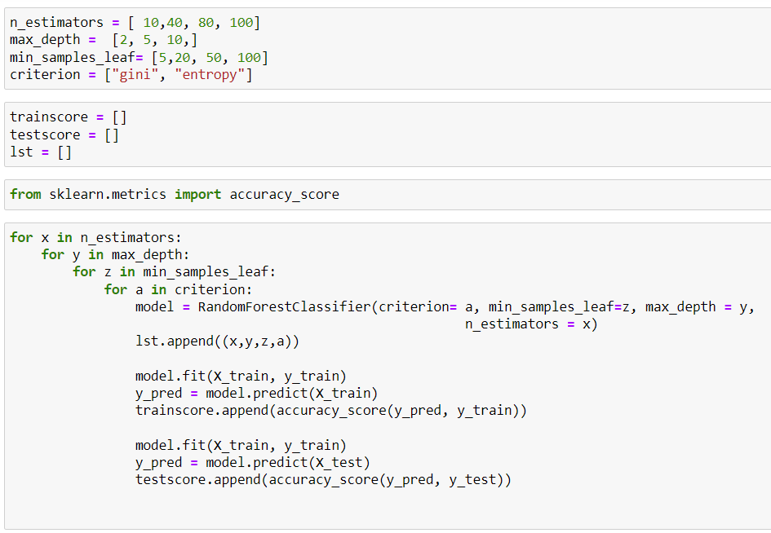
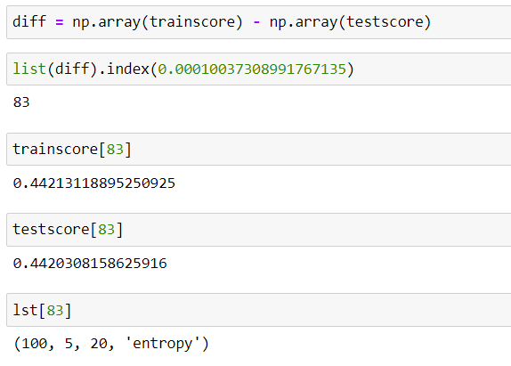
MODEL OPTIMIZATION

Slide 20
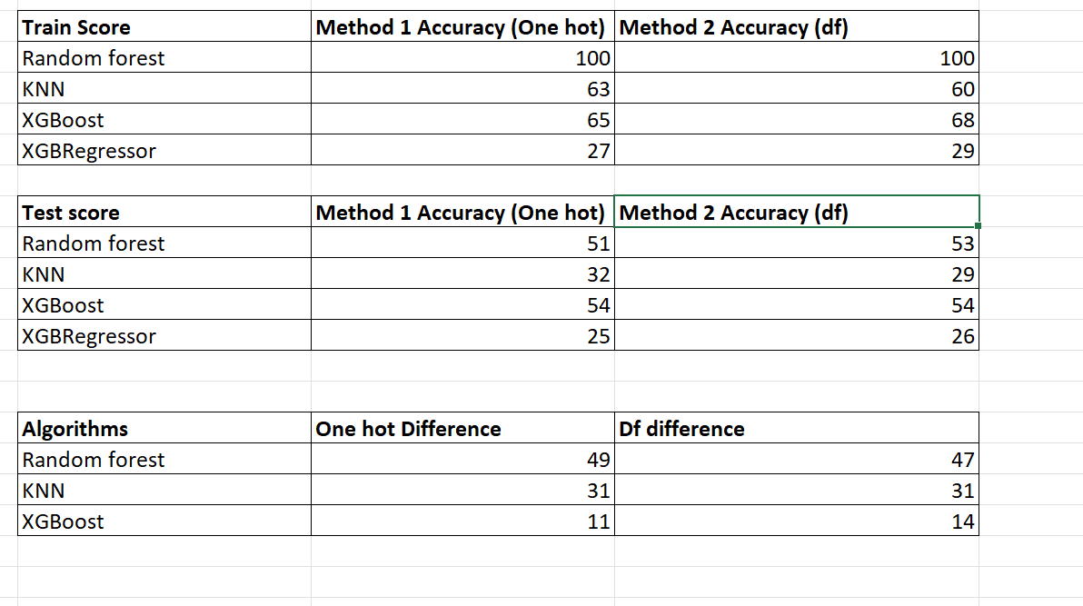
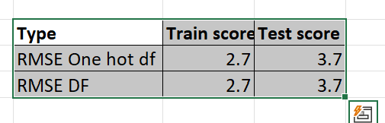
SUMMARY

Slide 21
CONCLUSION
Dropped features with more than 25% of missing values and imputed the missing data with the median value.
Overall, we were able to reduce the dimensions by from 128 to 117 attributes by using feature selection techniques like Chi-square, Mutual information and Anova.
XGBoost with one hot encoding was chosen as the optimal model as it had better accuracy as well as the difference between train and test score is comparatively smaller.
Model optimization can be performed on the model where there is a huge difference between the train and test score so that the model won't be overfit.
After applying the model optimization approach on the XGBoost data the accuracy dropped by 2% but the difference between the train and test score was smaller than before.

Slide 22
Thank You!!

