Slide 1
XGBoost
- Arpita Desai

Slide 2
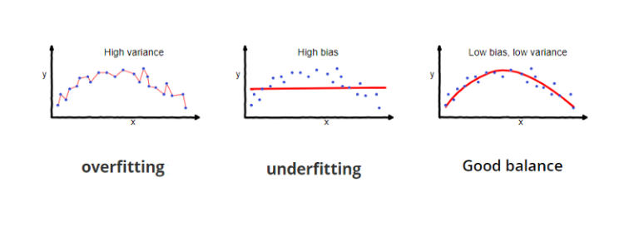
Model Fitting

Slide 3
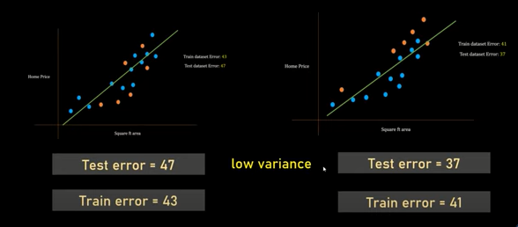
What is bias?
Bias is the difference between the average prediction of our model and the correct value which we are trying to predict. Model with high bias pays very little attention to the training data and oversimplifies the model. It always leads to high error on training and test data.

Slide 4
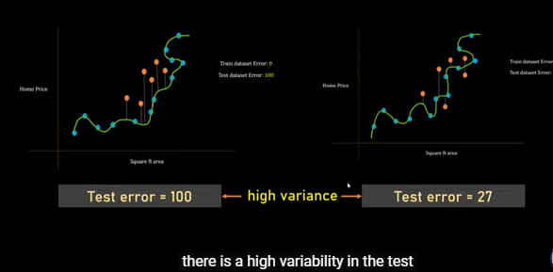
What is variance?
Variance is the variability of model prediction for a given data point or a value which tells us spread of our data. Model with high variance pays a lot of attention to training data and does not generalize on the data which it hasn’t seen before. As a result, such models perform very well on training data but has high error rates on test data.

Slide 5
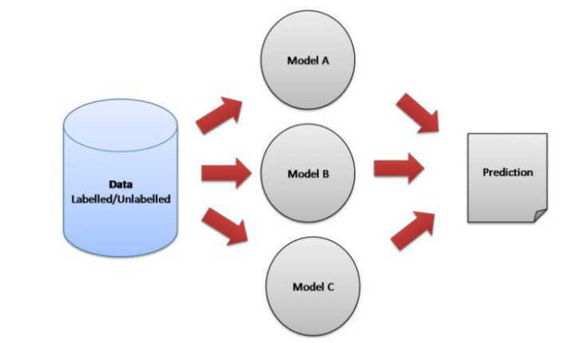
Ensemble methods is a machine learning technique that combines several base models in order to produce one optimal predictive model
Types of Ensemble Methods:
Bagging, or Bootstrap Aggregating.

Slide 6
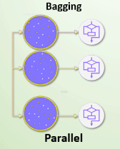
Bagging Steps:
Suppose there are N observations and M features in training data set. A sample from training data set is taken randomly with replacement.
A subset of M features are selected randomly and whichever feature gives the best split is used to split the node iteratively.
The tree is grown to the largest.
Above steps are repeated n times and prediction is given based on the aggregation of predictions from n number of trees.
Advantages:
Reduces over-fitting of the model.
Handles higher dimensionality data very well.
Maintains accuracy for missing data.
Disadvantages:
Since final prediction is based on the mean predictions from subset trees, it won’t give precise values for the classification and regression model.

Slide 7
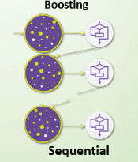
Boosting Steps:
Draw a random subset of training samples d1 without replacement from the training set D to train a weak learner C1
Draw second random training subset d2 without replacement from the training set and add 50 percent of the samples that were previously falsely classified/misclassified to train a weak learner C2
Find the training samples d3 in the training set D on which C1 and C2 disagree to train a third weak learner C3
Combine all the weak learners via majority voting.
Advantages:
Works well with interactions.
Disadvantages:
Prone to over-fitting.
Requires careful tuning of different hyper-parameters.

Slide 8
What is XGBoost?
XGBoost is a decision-tree-based ensemble Machine Learning algorithm that uses a gradient boosting framework. In prediction problems involving unstructured data (images, text, etc.) artificial neural networks tend to outperform all other algorithms or frameworks. However, when it comes to small-to-medium structured/tabular data, decision tree based algorithms are considered best-in-class right now.

Slide 9
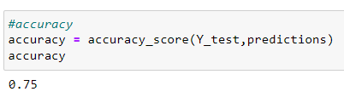
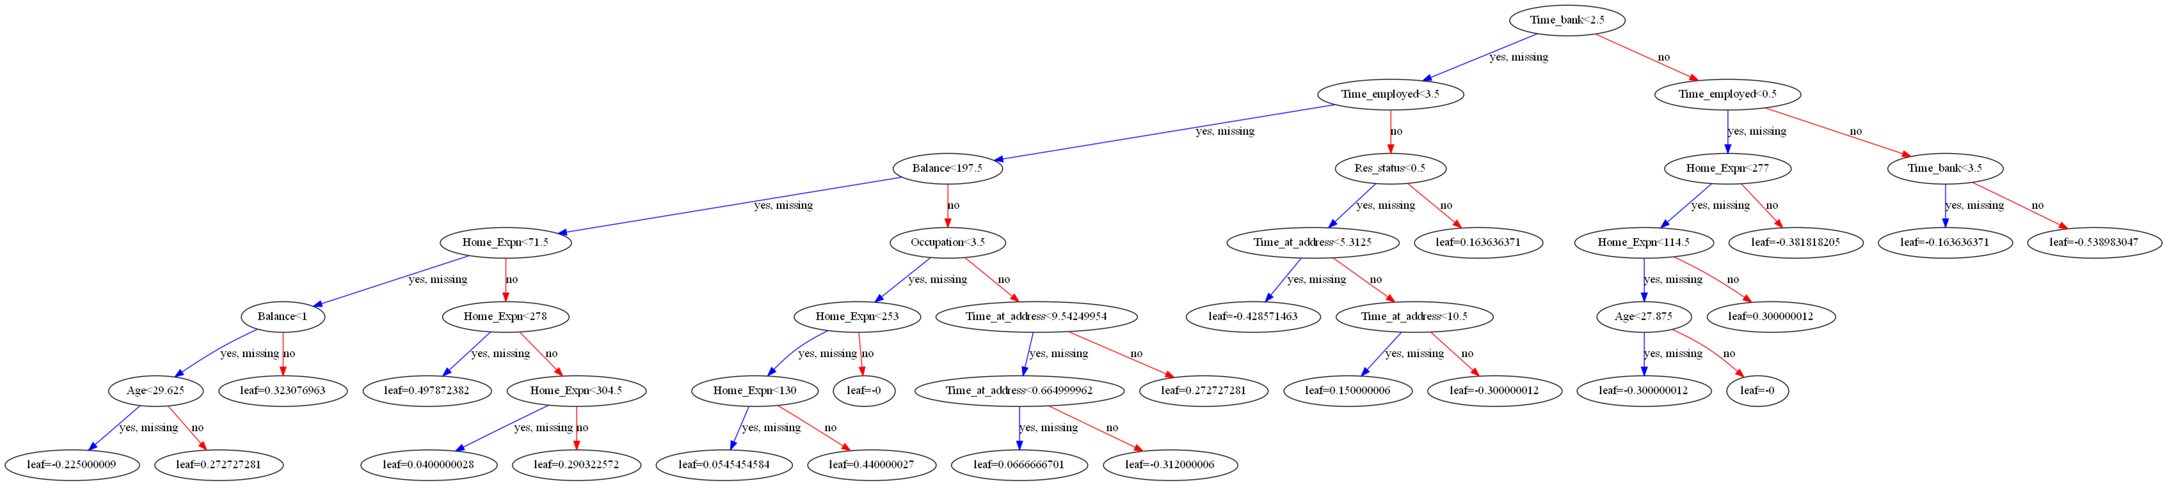
Results on Loan data
XGBoost

Slide 10
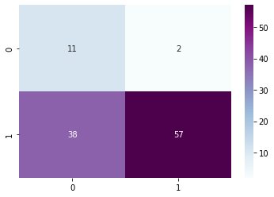
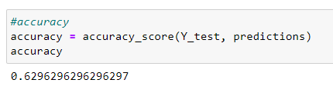
Results on Loan data
SVM

Slide 11
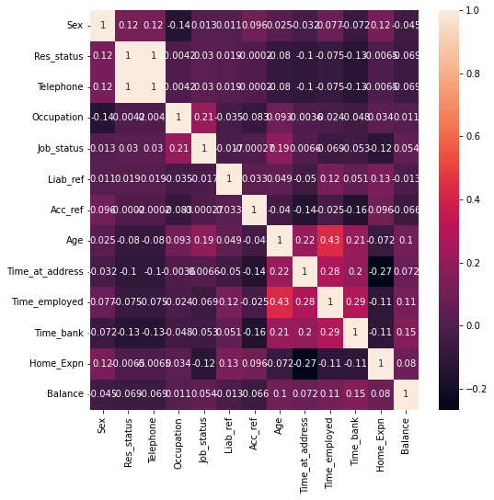
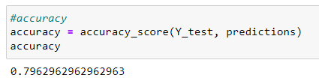
Results on Loan data
Logistic Regression

Slide 12
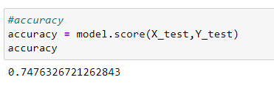
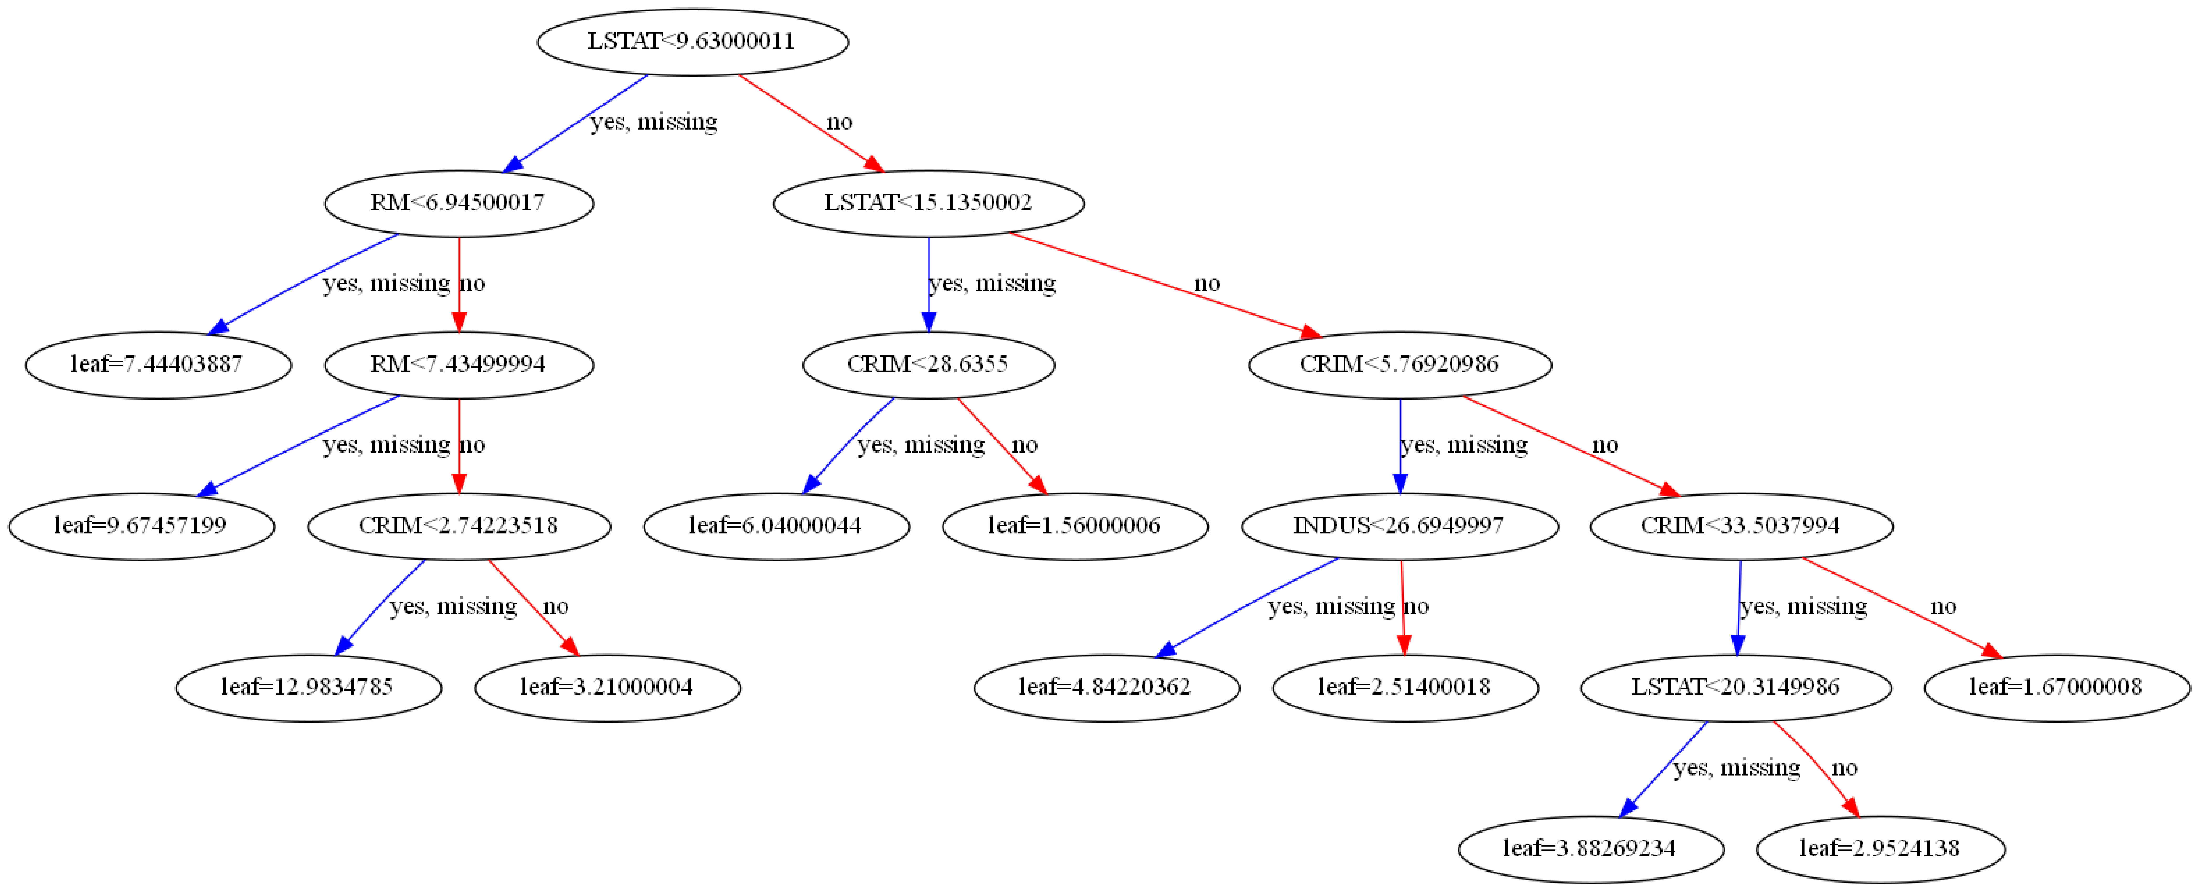
Results on Boston Housing data
XGBoost

Slide 13
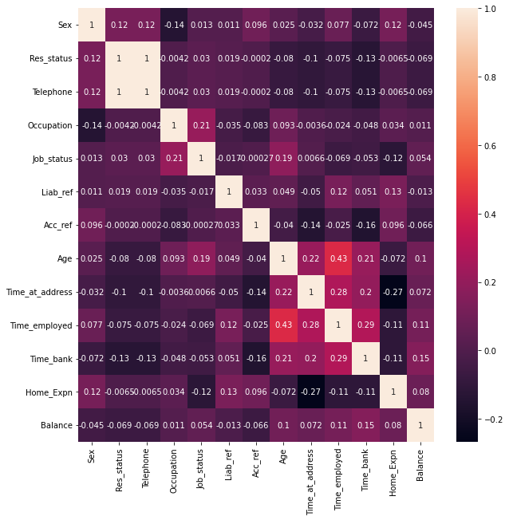
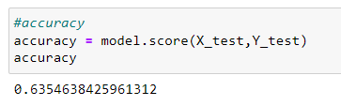
Results on Boston Housing data
Linear Regression

