Slide 1


EVENTRA
● LIVE IN PRODUCTION
The complete platform for professional event planners
From user research to a shipped, installable web app — Eventra runs weddings and events end to end: budgets, vendors, tasks, analytics, and a client-ready portfolio, all in one place.
Solo founder + PM
Research-driven
Shipped & live
PWA installable
Arpita Gupta Founder & Product Manager · MBA, Data Science & AI, IIT Mandi · Product Case Study 2026
Notes:
Eventra is a live, solo-built event-planning platform. This deck walks from problem and research through the shipped product, PM frameworks, and go-to-market.

Slide 2





01 — EXECUTIVE SUMMARY
Eventra at a glance
A working product — not a mockup. Eventra is an operating system for event professionals, validated with real planners and shipped to production.
9
Product modules
Dashboard → Showcase
What it is
A complete platform to manage events, budgets, vendors, tasks and a client-facing portfolio — in one place.
₹XX
Event managed live
Who it's for
Wedding, real budget
Professional planners — weddings first, plus corporate, academic and social event coordinators.
Status
3
Shipped differentiators
Live in production, PWA-installable, desktop-first. Multi-event, multi-user, real-time.
PDF · Receipts · Client link
My role
Solo — research, product strategy, UX, full-stack build, and go-to-market.
100%
Free to start
Freemium, zero friction
Eventra · Product Case Study
02

Slide 3





FOUNDER'S NOTE
I researched it. I designed it.
I built it. I shipped it.
Eventra began as a question, not a codebase: why do the people who run our most important events still work from spreadsheets, WhatsApp threads and paper receipts? I interviewed planners, mapped the workflow, prioritised ruthlessly, designed the experience, and built and deployed the product myself — then repositioned it from an academic tool into a platform for professional planners.
Discovery & research
Product & UX design
Full-stack build
Go-to-market
One person. Full product lifecycle.

Slide 4






02 — PROBLEM
Six-figure events, run on spreadsheets and hope
A single wedding spans multiple functions, dozens of vendors, and budgets from ₹10 lakh to ₹1 crore+ — coordinated across WhatsApp groups, shared Excel files and paper receipts. There is no single source of truth, and no client-facing polish.
No single source of truth
No real-time budget visibility
Spreadsheet fragility
5+ disconnected tools per event — nothing reconciles.
Overruns surface after the event, during manual reconciliation.
Version conflicts, broken formulas, zero audit trail.
Vendor payment chaos
Broken approval chains
No client-facing polish
Quotes, advances and balances tracked in someone's head.
Sign-offs happen over chat — nothing is structured or logged.
Planners have no simple, professional way to show their work.
VALIDATED PAIN
#1
Excel
Post-event
Budget tracking named the top pain, unanimously
The default financial tool for nearly every planner
When most overruns are discovered today
Eventra · Product Case Study
04

Slide 5



03 — DISCOVERY
Research before a single line of code
I started with the workflow, not the product. Structured conversations across the people who touch an event revealed where the money, time and trust leak out.
WHAT I HEARD
Budget control
Planners & coordinators
The #1 unmet need, named by every planner
The daily drivers — budgets, vendors, teams.
Real-time truth
"I only know the number after it's too late"
Finance & approvers
Own accountability and sign-off on spend.
Coordination
Tasks and vendors scattered across chats
Vendors & clients
Credibility
Where quality, payments and trust are judged.
No polished way to win the next client
Eventra · Product Case Study
05

Slide 6
04 — PERSONAS
Four stakeholders, four jobs to be done
PS
Priya — Wedding Planner
AM
Arjun & Meera — Clients
Primary user
The couple
Goal Run flawless events and win the next client.
Goal See progress and spend without chasing the planner.
Pain Everything lives in her head and ten chat threads.
Pain Anxious, in the dark, asking for updates constantly.
JTBD Manage every event, budget and vendor from one screen.
JTBD Get a clean, shareable view of their event's status.
RP
Raj — Vendor
RS
Rashi — Coordinator
Service partner
Team member
Goal Get booked, deliver, and get paid on time.
Goal Know exactly what to do, when, and where.
Pain Quotes and balances tracked informally, disputes arise.
Pain Task hand-offs get lost; ownership is unclear.
JTBD Clear scope, tracked payments, on-time settlement.
JTBD See assigned tasks, deadlines, and mark them done.
Eventra · Product Case Study
06

Slide 7




05 — JOBS TO BE DONE
The jobs Eventra is hired to do
Framing needs as jobs — not features — kept the build anchored to outcomes planners actually care about.
When I'm mid-event, I want to see exactly where the budget stands — so I can stop overruns before they happen.
When work is spread across my team, I want to assign and track every task in one place — so nothing slips through the cracks.
When vendors send quotes and bills, I want quotes, advances and balances tracked automatically — so I always know who's owed what.
When I meet a new client, I want to share a polished portfolio of past work — so I can win the booking on the spot.
Eventra · Product Case Study
07

Slide 8
06 — VALUE PROPOSITION
Matching real pains to product value
THE PLANNER
EVENTRA DELIVERS
Jobs
Products
Deliver flawless multi-function events
Real-time budget & analytics engine
Keep spend inside budget
Unified tasks, calendar & vendors
Win and retain clients
Client showcase + shareable link
Pains
→
Pain relievers
Budget blind spots
Live spend vs budget, always current
Scattered tasks & vendors
One workspace, full audit trail
No professional showcase
One link replaces a pitch deck
Gains
Gain creators
Confidence & control
PDF reports in one click
Time back
Receipts + structured approvals
A credible brand
PWA — installable, always on hand
Eventra · Product Case Study
08

Slide 9




07 — POSITIONING
For professional event planners who run high-value, multi-function events, Eventra is the platform that unifies budgets, vendors, tasks and a client-ready portfolio — unlike spreadsheets and generic project tools, because it is purpose-built for how events actually run.
PRODUCT PRINCIPLES
Budget is the spine
Real-time or nothing
Respect the client
Ship the 90%
Every screen ties back to money in vs money out.
A number you can't trust live is worse than no number.
The planner's reputation is a first-class feature.
A great web app beats a delayed native one.

Slide 10
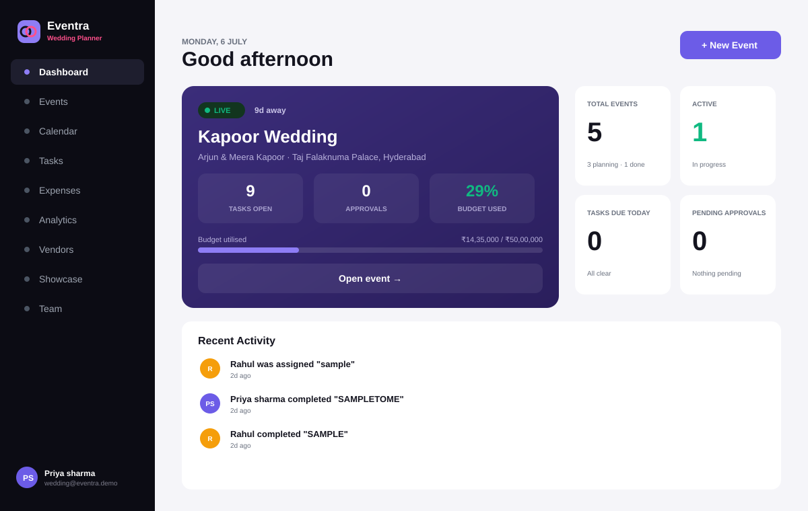
08 — HOW IT WORKS
One workflow, end to end
1
Onboard by role
Pick your event type — the workspace tailors itself.
2
Create the event
Client, dates, venue, functions, and budget by category.
3
Build the team
Invite members; role-based access to the right events.
4
Run operations
Tasks, calendar, vendors, expenses & receipts — live.
5
Track & approve
Real-time analytics; structured expense approvals.
6
Report & share
The live dashboard — one event's money, tasks and status at a glance.
One-click PDF and a shareable client showcase link.
Eventra · Product Case Study
10

Slide 11





09 — FEATURE DEEP-DIVE
Multi-function events, budgeted to the rupee
Real weddings aren't one event — they're five. Eventra models each function with its own budget, then rolls everything into a single financial picture.
Kapoor Wedding
29% used
₹14,35,000 spent of ₹50,00,000
Functions as first-class objects
Mehendi, Haldi, Sangeet, Baraat, Reception — each with its own budget and timeline.
Mehendi
₹8,00,000
Budget by category
Haldi
₹3,00,000
Allocate across venue, catering, decor, photography and more — 10 categories.
Sangeet
₹12,00,000
Live utilisation
A running % of budget used, updated the moment an expense is logged.
Baraat & Wedding
₹18,00,000
Board-ready overview
Reception
₹9,00,000
Export the full event summary as a client- or finance-ready PDF.
Eventra · Product Case Study
11

Slide 12
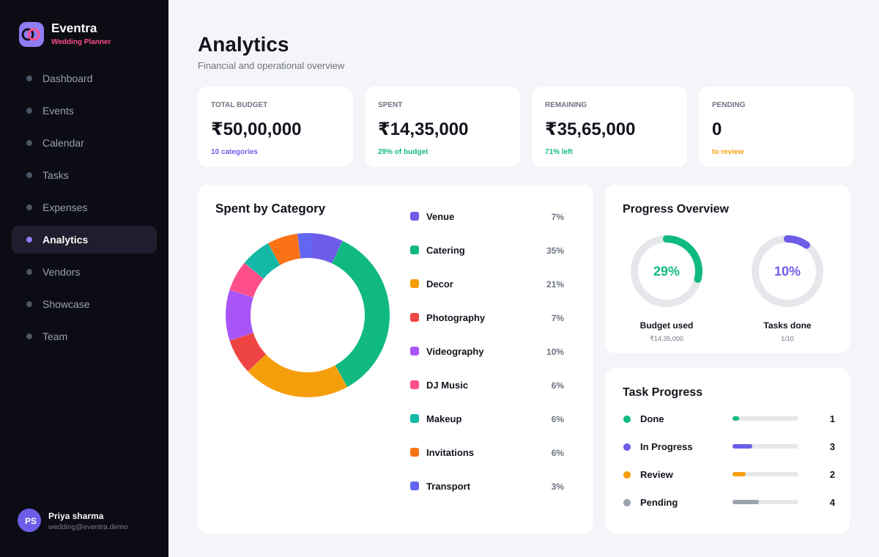




09 — FEATURE DEEP-DIVE
Financial intelligence, not just tracking
Spend by category
See exactly where money goes — catering, decor, venue — as a live breakdown.
Budget burn over time
Expected vs actual spend across the event timeline, so drift is visible early.
Vendor payments
Quoted vs paid vs balance — ₹28.5L quoted, ₹9.8L paid, ₹18.7L outstanding.
Operational health
Task progress and approval status alongside the financials.
Eventra · Product Case Study
12

Slide 13

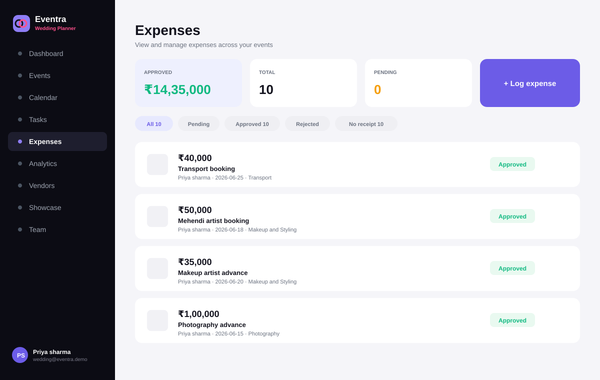



09 — FEATURE DEEP-DIVE
Every rupee logged, approved and traceable
Receipts on every expense
Attach a receipt to any expense; filter instantly for anything missing one.
Structured approvals
Pending → Approved → Rejected — a real workflow, not a chat message.
Vendor directory
Every vendor, service, contact and payment status in one place.
Quote-to-settlement
Track quoted, paid and outstanding balances per vendor automatically.
Eventra · Product Case Study
13

Slide 14




09 — FEATURE DEEP-DIVE
Coordination that replaces the group chat
Task management
Unified calendar
Assign, prioritise and track — 13 tasks, 7 active, delays surfaced automatically.
Events, functions, payments and tasks — colour-coded on one timeline.
Team & roles
Live activity feed
Invite members by email; role-based access to only their events.
Every assignment and completion logged for full accountability.
ONE CALENDAR, EVERY MOVING PART
Events
Functions
Payments
Tasks
July 2026 — from vendor payment reminders to the Baraat, every date planners actually track lives on a single view.
Eventra · Product Case Study
14

Slide 15
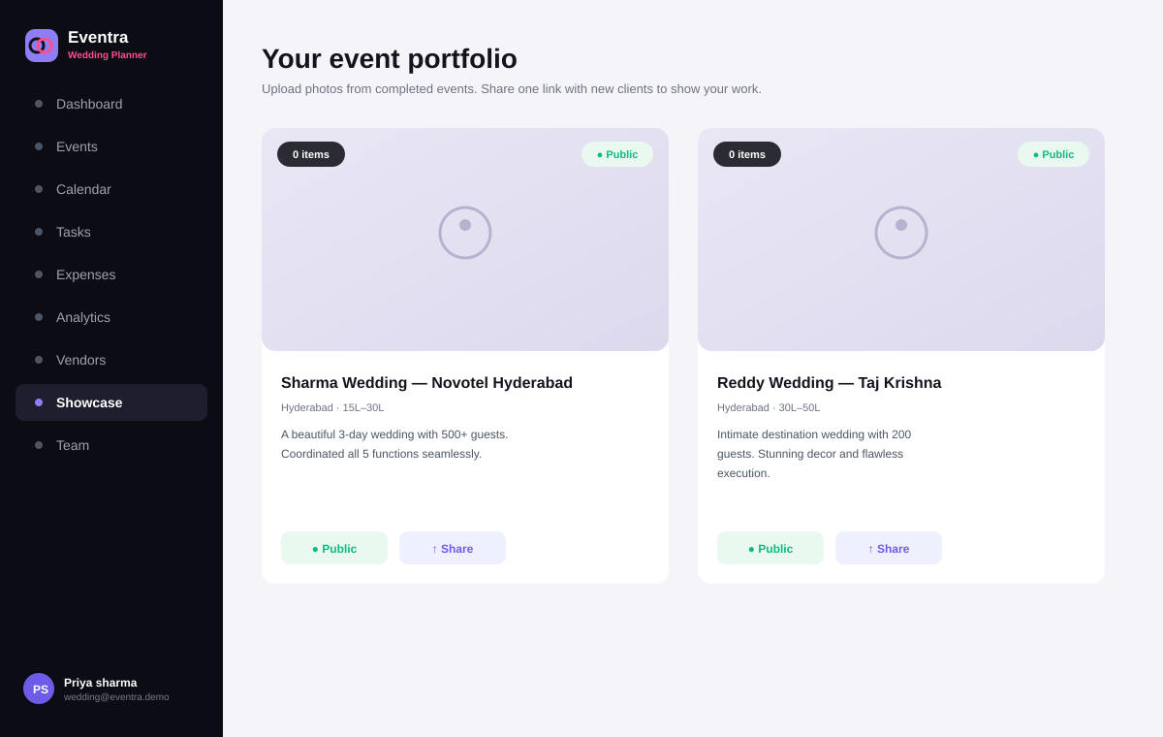



10 — WHAT SETS IT APART
The client experience — Eventra's edge
Three shipped features that generic tools simply don't have — and that turn a planner's back-office into a client-winning asset.
Showcase portfolio
Turn completed events into a beautiful, public portfolio of your work.
One shareable link
Send prospective clients a single link — no deck, no PDF attachment.
One-click PDF export
Generate a polished event or financial report instantly, ready to send.
The Showcase — a public, shareable portfolio that sells the next booking.
Eventra · Product Case Study
15

Slide 16




11 — COMPETITIVE ANALYSIS
Why existing tools fall short
Multi-function
budgeting
Real-time
analytics
Vendor
payments
Receipts +
approvals
Client showcase
& share
Purpose-built
for events
Spreadsheets (Excel)
Generic PM (Trello/Asana)
Wedding checklist apps
Eventra
Only Eventra combines event-native budgeting, real-time analytics, vendor payments, structured approvals and a client-facing showcase in one platform.
Eventra · Product Case Study
16

Slide 17


12 — MOAT
What compounds over time
Event-native data model
Data flywheel
Functions, budgets, vendors and approvals modelled the way events truly work — hard for horizontal tools to retrofit.
Every event adds financial and operational data that powers benchmarks and future AI prediction.
Client-side distribution
Workflow lock-in
Shared showcase links put Eventra in front of the planner's next clients — built-in, organic reach.
Once budgets, vendors and history live here, Eventra becomes the system of record.
Eventra · Product Case Study
17

Slide 18
13 — PRIORITISATION
Ruthless scope control: MoSCoW + RICE
MUST
SHOULD
COULD
WON'T (yet)
Real-time budget tracker
Analytics dashboard
Client showcase + share
Native iOS/Android
Multi-function events
Vendor payments
Push notifications
AI budget prediction
Expenses + receipts
Calendar & tasks
Activity feed
Vendor marketplace
Role-based access
PDF export
PWA install
Multi-tenant SaaS
RICE — how the top bets ranked
Feature | Reach | Impact | Confidence | Effort | Score
Real-time budget tracker | High | Massive | High | Med | ★★★★★
Client showcase + share | Med | High | High | Low | ★★★★☆
Vendor payment tracking | High | High | Med | Med | ★★★★☆
AI budget prediction | Med | High | Low | High | ★★☆☆☆
Eventra · Product Case Study
18

Slide 19

14 — SUCCESS METRICS
North Star, funnel and KPIs
Acquisition
Sign-ups via showcase links & referrals
AARRR — the growth funnel
NORTH STAR METRIC
Activation
First event created + budget set
% of events completed within ±5% of planned budget
Retention
Planner returns for their next event
Referral
Shares a showcase / invites team
Real financial discipline — not just visibility. It proves the product changed the outcome.
Revenue
Upgrades to a paid tier
KPIs BY PRODUCT AREA
Financial
Engagement
Operational
Growth
Budget accuracy · overrun rate · time-to-report
Active events · tasks done · WAU/MAU
Approval turnaround · receipt capture
Showcase CTR · referral · paid conversion
Eventra · Product Case Study
19

Slide 20




15 — AI STRATEGY
Intelligence that compounds with every event
Eventra collects the exact data that makes AI valuable: real budgets, real vendors, real outcomes. AI ships only once there's enough history to make it trustworthy.
Budget prediction
Anomaly detection
AI report summaries
Data-driven baselines from past events
Flag duplicate or inflated expense claims
Auto-generate post-event write-ups
Impact: 20–30% fewer overruns on the first pass
Impact: Near-zero duplicate submissions
Impact: Hours of reporting cut to minutes
Smart task priority
Risk scoring
Vendor recommendations
Surface what needs attention now
Predict budget & timeline risk early
Suggest vendors from institutional history
Impact: Fewer day-of operational surprises
Impact: Proactive intervention, not post-mortems
Impact: Lower cost, faster procurement
Eventra · Product Case Study
20

Slide 21
16 — ROADMAP
From shipped MVP to intelligent platform
PHASE 1
PHASE 2
PHASE 3
PHASE 4
Shipped
Next
Intelligence
Scale
Live now
0–6 months
6–12 months
9–24 months
Multi-function events
Push notifications
AI budget prediction
Multi-org SaaS
Real-time budget tracker
Native iOS / Android
Anomaly detection
Integrations / API
Expenses + receipts
AI report summaries
Risk scoring
Vendor marketplace
Vendors & payments
Deeper client portal
Smart vendor recs
Cross-event benchmarks
Analytics dashboard
Payment reminders
Tasks, calendar & team
Showcase + share link
PDF export · PWA install
The hardest 90% — the working product — already exists. What's left is intelligence and scale.
Eventra · Product Case Study
21

Slide 22
17 — MARKET OPPORTUNITY
A large, underserved, high-value market
TAM
₹1,200 Cr
WHY NOW
India's wedding & events industry — one of the world's largest, and famously spend-heavy.
Weddings are back — bigger
Post-pandemic spend per event is rising, not falling.
₹300 Cr
Planners are professionalising
SAM
More agencies, more staff, more need for real tooling.
Planners & agencies who would pay for software to run events end to end.
Tools haven't caught up
The market still runs on Excel and WhatsApp.
SOM
₹15 Cr
Mobile-first, cloud-native
Professional planners reachable via showcase-link virality and referral in 3–5 years.
A PWA reaches every planner with zero install friction.
Figures are indicative market context, not audited estimates.
Eventra · Product Case Study
22

Slide 23
18 — GO-TO-MARKET
Land, expand, monetise
01
LAND
02
EXPAND
03
MONETISE
Free tier for individual planners
Agencies & multi-planner teams
Paid tiers + AI upsell
Ship free, frictionless sign-up
Team invites drive seat expansion
Institutional / agency subscription
Win a beachhead of active planners
Referral + campus/agency ambassadors
AI features as premium upsell
Tight feedback loop, weekly iteration
Templates for common event types
Vendor & payment partnerships
Every showcase link is a growth ad
Case studies from real weddings
Community-led PM positioning
🎯 First 100 active planners
🎯 Multi-seat agency accounts
🎯 Recurring subscription revenue
Eventra · Product Case Study
23

Slide 24
19 — BUSINESS MODEL
Freemium to paid, AI as the upsell
Starter
MOST POPULAR
Professional
Enterprise
Free
₹4,999
Custom
Individual planners
per month · most popular
Agencies & institutions
1 active event
Unlimited events
Everything in Professional
Core budget & tasks
Full analytics & PDF export
AI prediction & insights
Receipts & expenses
Vendor payment tracking
Priority support & SLAs
Showcase + share link
Team seats & roles
API & integrations
UNIT ECONOMICS LOGIC
Low CAC — Showcase links & referrals drive organic sign-ups
Sticky retention — Budgets & history make Eventra the system of record
Expansion revenue — Seats + AI upsell grow account value over time
Eventra · Product Case Study
24

Slide 25
20 — TRADEOFFS
What I chose not to build — and why
Scope
Prioritisation
PWA before native app
No AI at launch
A responsive PWA delivers ~90% of native value with none of the 3–4 month delay. Native comes once web workflows are validated.
Budget prediction needs history to be trustworthy. Shipping AI without data creates false confidence — worse than none.
Strategy
Focus
Single-org before SaaS
No vendor marketplace at MVP
Multi-tenancy is heavy infrastructure. One deep, real deployment yields better product insight than spreading thin.
Valuable but not mission-critical. Adding it early would fragment focus before the core workflow was solved.
UX
Simplicity
Approvals as workflow, not automation
Online-first, no offline sync
Kept humans in the loop on money. Structured sign-off beats brittle auto-approval that erodes trust.
Offline introduces heavy conflict complexity for marginal gain. Simpler architecture means faster iteration.
Eventra · Product Case Study
25

Slide 26



21 — REFLECTION
Not a college project — a shipped product strategy.
Real problem
Smart solution
PM depth
Market path
Grounded in research with real planners — budget control was the unanimous #1 pain.
Budgets, vendors, tasks and client showcase unified where generic tools fail.
JTBD, MoSCoW + RICE, KPIs, North Star, honest tradeoffs — end to end.
Large underserved market with a clear GTM, pricing and AI expansion path.
What building Eventra taught me:
ship the 90%, let real data earn the AI, and treat scope you cut as a decision — not a limitation.
Arpita Gupta · Founder & Product Manager · arpitagupta8806@gmail.com
LIVE · eventra-app-pied.vercel.app

