Slide 1
Experiential Learning
Project Assessment-III
on
“Tower of Hanoi Visual Simulator”
under the course
Python Programming Lab (N-PCCCD304P)
Under the Guidance of
Ms. Ashwini Yerlekar
Presented By:
Arpita Ikhankar – CD26D004
Session: 2026-27 (ODD)

Slide 2
1. Problem Statement
The Tower of Hanoi puzzle has three rods and n disks of different sizes.
All disks start on the Source rod, largest at the bottom.
Goal: move the whole stack to the Destination rod using the Auxiliary rod.
Rules: move one disk at a time, only the top disk, never a larger disk on a smaller one.
Understanding the steps by reading rules is difficult, so a visual tool helps.
The project shows every move of the solution visually, step by step, using Python.

Slide 3
2. Objective
Solve the Tower of Hanoi puzzle using recursion.
Take the number of disks (1 to 8) from the user with input validation.
Display three rods and coloured disks of different sizes using Tkinter.
Animate each disk movement one by one with a small delay.
Calculate the minimum moves using the formula 2^n - 1 and show the move counter.
Provide Start, Pause/Resume, Reset buttons and a speed slider.
Manage the project using Git and GitHub.

Slide 4
3. Flowchart
START
Recursive idea
1. Move n-1 disks: Source to Auxiliary
2. Move the largest disk: Source to Destination
3. Move n-1 disks: Auxiliary to Destination
Base case: n = 0, stop.
Moves: 3 disks = 7, 4 disks = 15.
Enter number of disks (n)
Check: 1 <= n <= 8 ?
Generate moves using recursion
Show total moves = 2^n - 1
Animate each move, update counter
Display "Puzzle Solved!"
STOP

Slide 5
4. Understanding of Python Logic
1. hanoi_logic.py
2. main.py (HanoiApp class)
minimum_moves(n) returns 2**n - 1.
solve_hanoi() is the recursive function.
Base case n == 0 stops the recursion.
get_all_moves(n) returns the list of (from, to) moves.
Rods stored as list of lists [[], [], []].
draw() redraws rods and disks on Canvas.
next_move() uses pop() and append().
root.after() adds delay so window never freezes.
Core Logic
Number of disks → Recursion → List of moves → Animate on Canvas

Slide 6
5. Graphical Representation and Working
Example: 3 disks (7 moves)
Start
After 7 moves
Source
Auxiliary
Destination
Source
Auxiliary
Destination
Moves: 1) D1 S→D 2) D2 S→A 3) D1 D→A 4) D3 S→D 5) D1 A→S 6) D2 A→D 7) D1 S→D (D = disk, S = Source, A = Auxiliary, D at end = Destination)

Slide 7
6. Utility Implementation & Features
Number of disks (1 to 8) taken from user with try-except validation.
Recursive function solve_hanoi() generates all moves.
Three rods and coloured disks drawn on a Tkinter Canvas.
Each move animated step by step using root.after() delay.
Move counter shows "Move i / total" with total = 2^n - 1.
Start, Pause/Resume and Reset buttons, plus a speed slider.
Completion message "Puzzle Solved!" when all moves are done.

Slide 8
7. Testing
No. | Input (disks) | Expected Result | Status
1 | 1 | 1 move | Pass
2 | 3 | 7 moves | Pass
3 | 4 | 15 moves | Pass
4 | 8 | 255 moves | Pass
5 | 0 or 9 | Error: enter 1 to 8 | Pass
6 | abc (text) | Error message | Pass
Pause/Resume, Reset and the speed slider were also tested during animation.

Slide 9
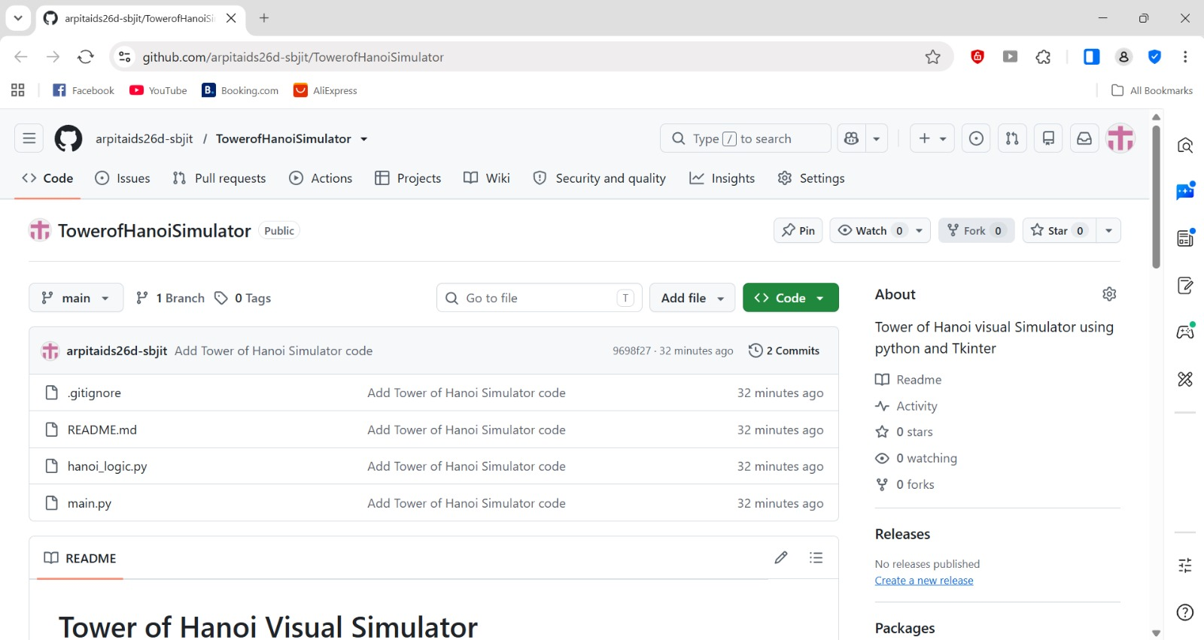
8. GitHub Repository Quality & Maintenance
Created public repository: TowerofHanoiSimulator.
Uploaded main.py, hanoi_logic.py, README.md and .gitignore.
Clear README.md (overview, features, requirements, how to run) and .gitignore.
Repository Link: github.com/arpitaids26d-sbjit/TowerofHanoiSimulator

Slide 10
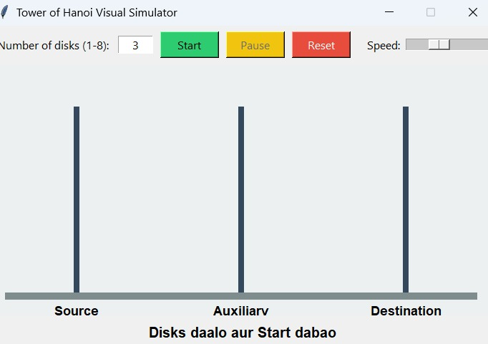
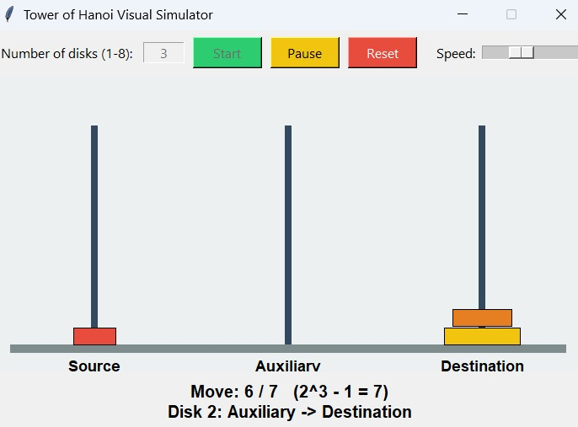
9. Final Output: Start and Animation
Initial screen (3 disks)
Animation in progress (move 6 of 7)

Slide 11
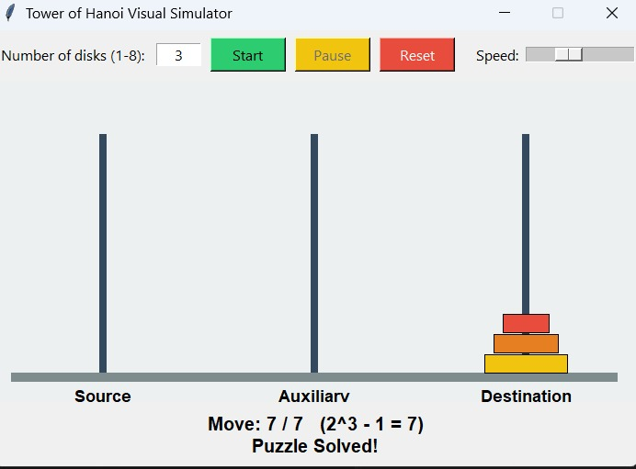
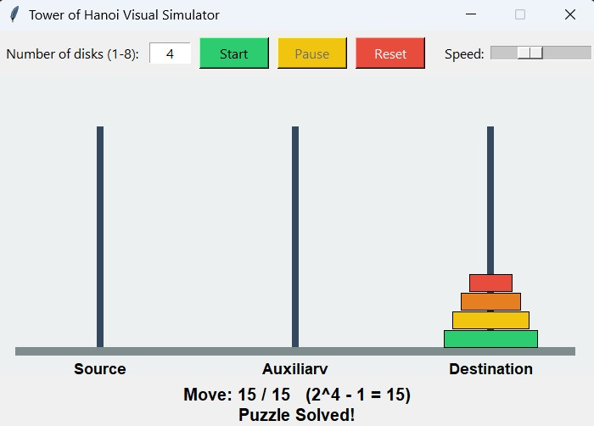
10. Final Output: Puzzle Solved
Solved: 3 disks, 7 moves
Solved: 4 disks, 15 moves

Slide 12
11. Conclusion & Future Scope
The simulator solves Tower of Hanoi using recursion and shows each step visually.
It covers functions, recursion, lists, OOP, exception handling and Tkinter GUI.
The project is maintained on GitHub with README and meaningful commits.
Future scope: move disks with the mouse, sound effects, smooth sliding animation, Step button.

Slide 13
Thank You
Tower of Hanoi Visual Simulator
Experiential Learning – Project Assessment-III

