Slide 1


Slide 2
Expectations
Great View
Best Holiday
Mesmerising Experience
PROBLEM

Slide 3
PROBLEM
Expectations ≠ Reality

Slide 4

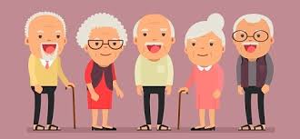
Total Population
Disabled
Elderly
Hodophobia
Time Issues
Money Issues
PROBLEM
WHO WANT TO TRAVEL BUT CANNOT
ELDERLY PEOPLE UNABLE TO TRAVEL

Slide 5
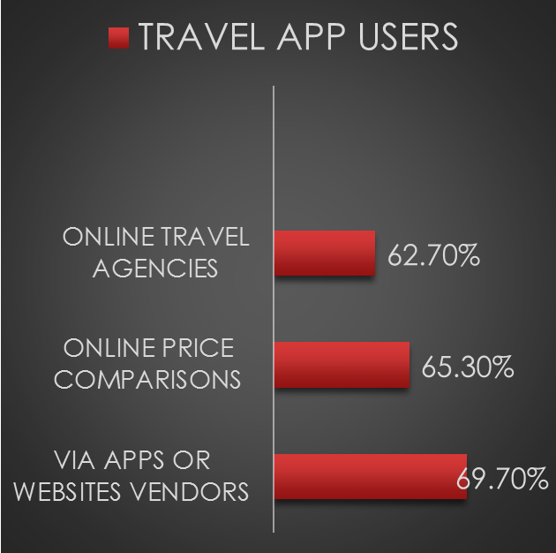
Why Now?
TOURISM IN INDIA
APPLICATION USERS

Slide 6
WHAT’S DIFFERENT
USE OF 360
VR HEADSETS ENABLED
WHY
CULTURE AND TRADITIONS
TOURISM
FUTURE ASPECTS
AUDIO GUIDES
PLAN A TRIP
WIKI-SEARCH
TRAVEL PURPOSE
OVERVIEW

