Slide 1
ENTERPRISE HR PORTAL
Development of a Full-Stack Geofenced HR System
Presenter: Software Engineering Intern Project Domain: HR Management & Automated Geofencing

Slide 2
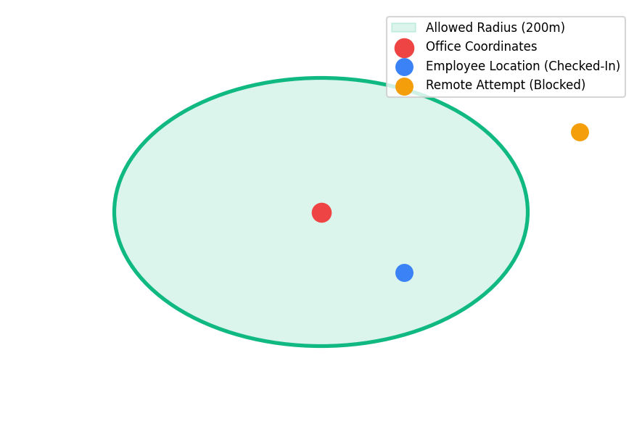
Problem Statement & Project Overview
• Manual spread-sheeting is slow, prone to parsing errors, and hard to audit.
• Traditional check-ins allow geolocation spoofing or remote clock-in fraud.
• Lack of granular access control exposes personal details and employee salaries.
• Goal: Build a unified hub with automated geofencing, leave tracking, and secure document vaults.

Slide 3
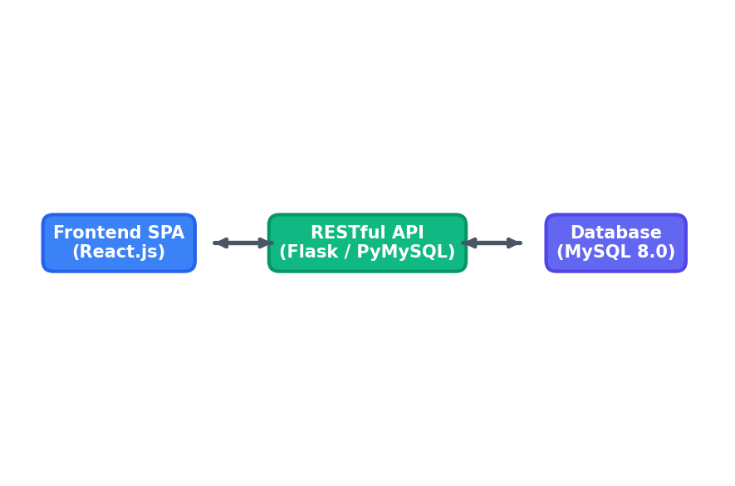
System Architecture Details
• Decoupled React.js 18 frontend communicating with backend REST endpoints.
• Flask API logic layer with custom python decorator-based access checks.
• SQLAlchemy ORM provides secure MySQL interface and parameterized statements.
• Python multi-threaded client delegates SMTP mail dispatch to background threads.

Slide 4
Secure Authentication Flow
• Employee passwords hashed with dynamic salt rounds using bcrypt.
• Stateless sessions established via signed JWT tokens (HS256 encryption).
• Axios response interceptor handles automatic redirection to /login on 401s.
• Sequential onboarding generates HR-00x IDs and triggers automated emails.

Slide 5
Geofence Verification & Maps
• Interactive OpenStreetMap overlays allowed boundaries using Leaflet.
• Frontend retrieves active browser geolocation coordinates (HTML5 API).
• Haversine formula validates distance in meters both on client and backend API.
• Admins dynamically re-center geofencing parameters from the Settings page.

Slide 6
Leaves, Tasks & Meetings
• Dynamic leave module with calculation engine supporting negative balances.
• Real-time task tracking boards (Pending ➔ In Progress ➔ Completed).
• Meeting scheduler with department-based mail notifications and meeting links.
• Strict file path checks limit resume download actions to the owner or admins.

Slide 7
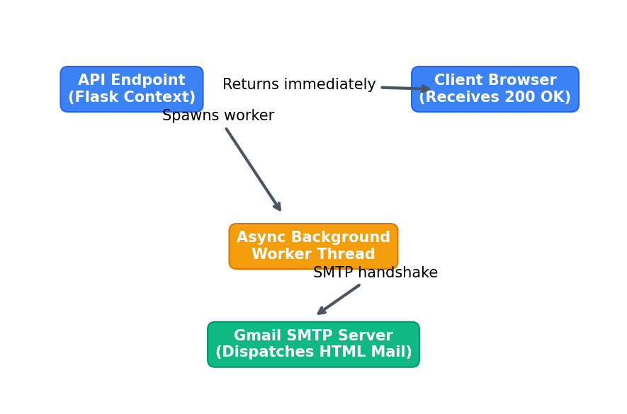
Async Email Notification System
• SMTP mail connections run inside decoupled Python background threads.
• Prevents UI freeze and reduces endpoint API response times below 100ms.
• Sends responsive corporate HTML template emails (welcome logs, approvals, updates).
• Graceful fallback: SMTP connection errors logged without failing request cycles.

Slide 8
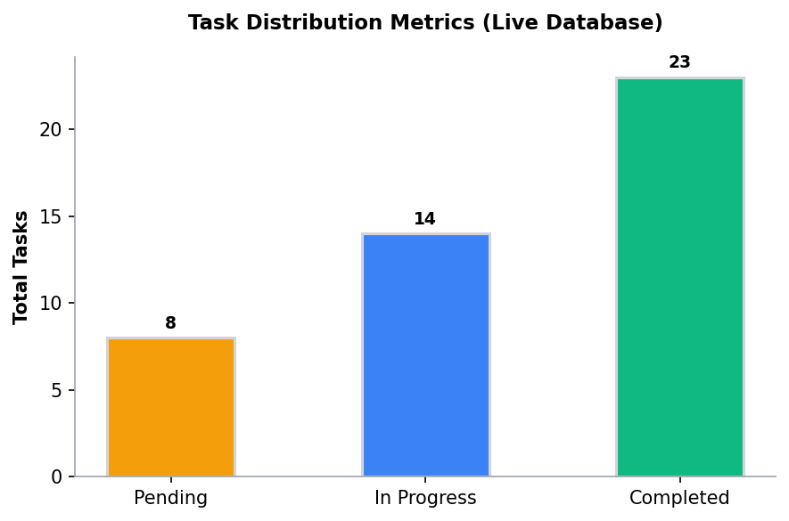
Live Analytics & Dashboard Metrics
• Direct Recharts integration binds graphs to live database metrics.
• Visualizes daily attendance status, task rates, and meeting schedules.
• RBAC decorators (@admin_required, @self_or_admin) wrap backend endpoints.
• Prevents data leak of sensitive PII columns (aadhar, salary) across API logs.

Slide 9
Technical Challenges & Resolutions
• Timezone Dates Bug: Client parsed naive UTC datetimes as local; resolved by appending 'Z' suffix.
• Thread App Context Leak: Initializing Flask context inside threads leaked DB connections; resolved by decoupling contexts.
• Resume Reference Bug: File uploaded to uploads folder but reference never committed; resolved by explicit DB session commit.
• SMTP Handshake Lag: Decoupled SMTP email validation using thread pool executors.

Slide 10
Project Outcomes & Future Scope
• Successfully developed and secured a highly responsive, unified HR dashboard.
• Reduced administrative time spent tracking leaves and attendance telemetry.
• Future SSID/WiFi Checks: Supplying IP address constraints to supplement geofences.
• Future Accrual Services: Automatic leave additions on the first of every month.

