Slide 1
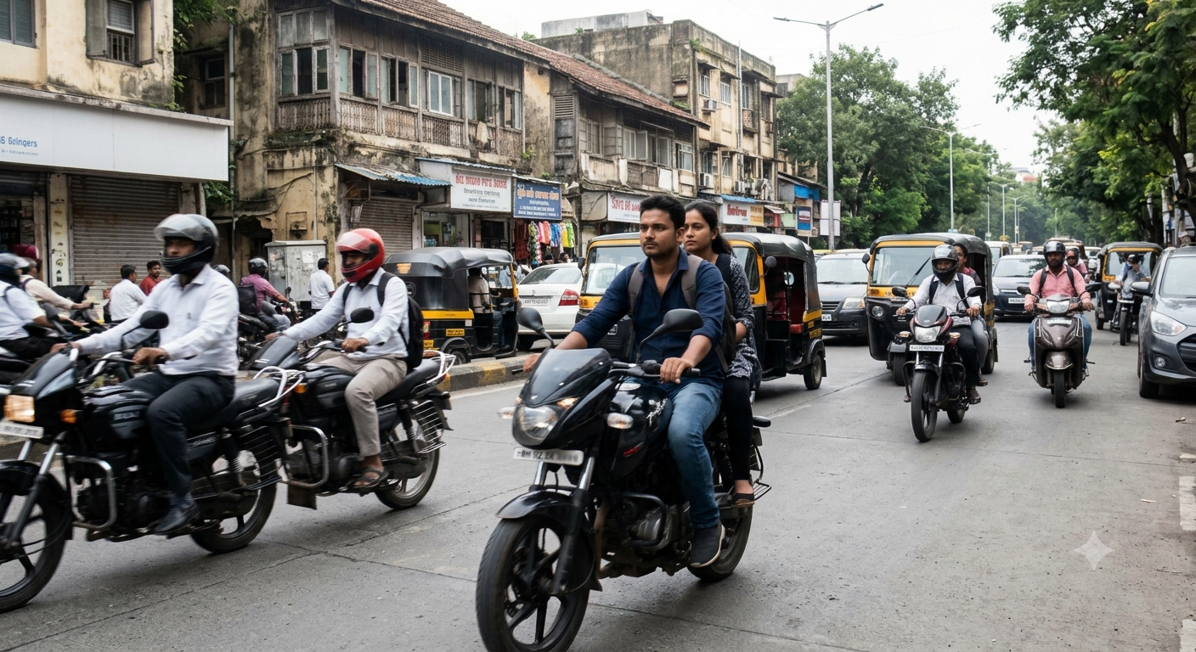
COMPUTER VISION / ROAD SAFETY
Traffic Violation
Detection
An image based prototype for motorcycle safety review
HELMET STATUS · RIDER COUNT · PLATE OCR
PROJECT OVERVIEW
Notes:
Project overview based on the repository README and implemented frontend/backend. The repository contains an image analysis prototype; it does not currently analyze live video or speed.

Slide 2
THE PROBLEM
A focused review workflow for motorcycle safety
Roadside images contain several linked questions.
Who is on each motorcycle? Is a rider visibly without a helmet? Can a plate be read well enough to help identify the vehicle?
01
Helmet use
Find possible no helmet cases
02
Rider count
Flag possible triple riding
03
Vehicle context
Read a plate when association is clear
Still image input · human review remains part of the process
TRAFFIC VIOLATION DETECTION
02
Notes:
The project aims to help review motorcycle imagery for helmet use, rider count, and plate text. This framing describes the implemented prototype, not a claim about measured road safety impact.

Slide 3
ANALYSIS WORKFLOW
One uploaded image, several linked checks
The pipeline connects detections to the motorcycle they belong to.
01
02
03
04
05
Upload
Detect
Associate
Read / flag
Review
→
→
→
→
JPG or PNG
from the dashboard
People, bikes
and helmet status
Match riders and
plates to a bike
OCR clear plates;
flag possible cases
Inspect annotation
and saved record
Association is the guardrail
Unmatched detections stay review alerts; OCR is skipped for plates that do not clearly overlap a detected motorcycle.
TRAFFIC VIOLATION DETECTION
03
Notes:
The Flask API accepts JPG and PNG still images. Detection association uses spatial overlap rules. Plate OCR is skipped if the plate cannot be clearly associated with a motorcycle. Results include an annotated image and record data.

Slide 4
WHAT THE SYSTEM CHECKS
Detection logic combines model output with spatial matching
Three signals feed the case decision.
OBJECTS
HELMET MODEL
PLATE MODEL + OCR
People + motorcycles
Helmet status
Plate text
YOLO detects the vehicle and nearby people. Person boxes are associated to each motorcycle.
A trained helmet model classifies visible head regions. Unclear cases remain unknown.
A plate detector finds candidate plates; EasyOCR estimates text from clearly matched crops.
Decision rule
No helmet → confirmed only when linked to a motorcycle · 3+ riders → possible case for human review
TRAFFIC VIOLATION DETECTION
04
Notes:
The repository uses the Ultralytics YOLO family for motorcycle/person and helmet/plate detection, plus EasyOCR for plate text. The Flask service associates boxes spatially; a clear motorcycle match is required to count a no helmet violation. Triple riding is stored as a review item. The exact thresholds and model performance are not asserted here.

Slide 5
OPERATOR EXPERIENCE
Results are visible, traceable, and reviewable
The frontend returns an annotated image with counts, confidence, plate status, and saved case details.
01
Detection result
Motorcycle count · violation count · model confidence
02
Plate result
Estimated text, OCR confidence, or unreadable status
03
Saved record
SQLite record with timestamp, image path, and plate when available
04
Review action
BIKE + RIDERS
Confirm or dismiss a possible triple riding alert
Schematic overlay for illustration
TRAFFIC VIOLATION DETECTION
05
Notes:
The traffic photo is illustrative and the colored bounding boxes on this slide are schematic, not model output. The application renders actual annotations after analysis. Violation records are stored in SQLite. Triple riding alerts can be confirmed or dismissed in the violation list. OCR text is explicitly an estimate and should be reviewed.

Slide 6
IMPLEMENTATION
A compact local web application architecture
The prototype runs as a browser interface and a local Python API.
FRONTEND
API + INFERENCE
LOCAL STORAGE
React + Vite
↔
Flask + YOLO + OCR
↔
SQLite + image files
Upload · results · history
violations · analytics views
Association rules
annotated image response
Saved violation records
uploads · annotated outputs
Run mode
Local development: Vite frontend → Flask API at 127.0.0.1:5000
GPU can accelerate EasyOCR when available; CPU fallback is supported.
TRAFFIC VIOLATION DETECTION
06
Notes:
The README documents a local development setup with Vite and Flask. The Flask API loads YOLO models and calls the plate OCR service. SQLite stores violation records, while uploaded and annotated images are saved under the ai directory.

Slide 7
LIMITATIONS
Prototype scope and next steps
Current scope
Not implemented
Still JPG / PNG images
Helmet and rider count checks
Plate text estimate when image quality allows
Video or live camera analysis
Overspeed detection
Automatic enforcement decisions
Practical next steps
01
Measure accuracy on representative, labeled images
02
Test across camera angles, lighting, and plate sizes
03
Keep operator review before acting on OCR or uncertain detections
Detection quality varies with resolution, angle, lighting, and training data.
TRAFFIC VIOLATION DETECTION
07
Notes:
Scope and limitations are drawn from the repository README. The listed next steps are recommendations, not work already completed. The repository does not publish a quantified accuracy evaluation, so no accuracy figures are shown.

