Slide 1
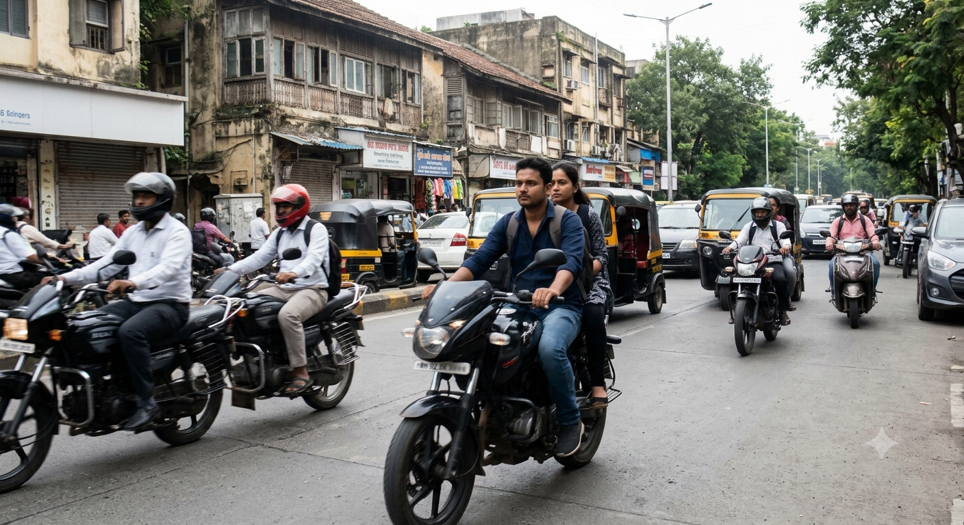
COMPUTER VISION / ROAD SAFETY
Traffic Violation
Detection
An image based prototype for motorcycle safety review
HELMET STATUS · RIDER COUNT · PLATE OCR
PROJECT OVERVIEW / 15 SLIDES
Notes:
Project overview based on the repository README and implemented frontend and backend. This is an image analysis prototype, not a live camera system.

Slide 2
EXECUTIVE SUMMARY
A local image review tool for motorcycle safety
The prototype turns a traffic image into a structured case for review.
INPUT
ANALYSIS
OUTPUT
JPG or PNG image
Detection + association
Annotated result + record
Uploaded through the React interface
YOLO models, spatial matching, and plate OCR
Counts, plate estimate, review alert, SQLite record
WHAT IT DOES TODAY
Screens for no helmet and possible triple riding; reads plates when the image and vehicle match are clear.
TRAFFIC VIOLATION DETECTION
02
Notes:
The repository README identifies a React dashboard and Flask service for image based motorcycle, helmet, and number plate analysis. It accepts still images only and reports overspeed as N/A.

Slide 3
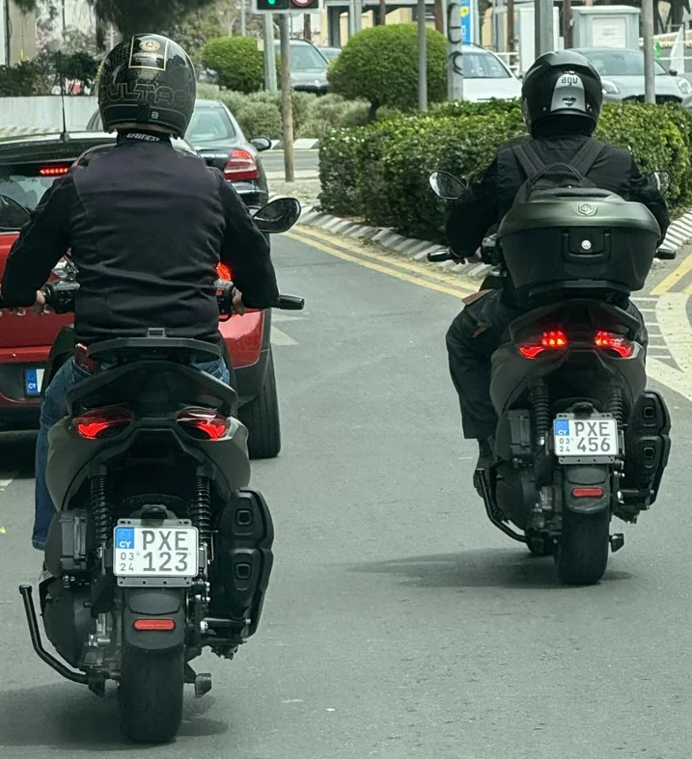
PROBLEM CONTEXT
A single image can require several linked judgments
Reviewers need more than an object label.
They need to connect riders to a specific motorcycle, assess visible helmet status, and decide whether a plate is readable enough to support follow up.
01
Which people belong to this motorcycle?
02
Does a visible rider appear without a helmet?
03
Can the detected plate be read with confidence?
Illustrative project image · not a model result
TRAFFIC VIOLATION DETECTION
03
Notes:
The image is used as an illustrative traffic context image. No claim is made that it was analyzed by the models. The system is designed to connect person, motorcycle, helmet, and plate evidence.

Slide 4
PROJECT GOALS
The prototype focuses on three review tasks
HELMET USE
Identify visible helmet and no helmet detections
Count only no helmet detections associated with a motorcycle
RIDER COUNT
Estimate people associated with each motorcycle
Flag counts of three or more as possible triple riding
VEHICLE CONTEXT
Locate plate candidates and associate them with a motorcycle
Run OCR only when the association is clear
Scope is still images only. Video, live camera analysis, and speed detection are not implemented.
TRAFFIC VIOLATION DETECTION
04
Notes:
These goals are drawn from implemented behavior described by the README and Flask API. The scope note is a current prototype limitation, not a future-state assumption.

Slide 5
END-TO-END WORKFLOW
From image upload to reviewable case
The processing flow preserves vehicle context as detections move through the system.
01
02
03
04
05
Upload
Detect
Associate
Read / flag
Review
→
→
→
→
JPG or PNG
from dashboard
People, bikes,
helmet status
Link riders and
plates to a bike
OCR clear plates;
flag possible cases
Inspect annotation
and saved record
Association is a quality gate
Unmatched plates skip OCR; unmatched no helmet detections remain review alerts.
TRAFFIC VIOLATION DETECTION
05
Notes:
The API accepts JPG and PNG still images. Motorcycle association gates downstream plate OCR and violation confirmation. The UI displays the annotated result and review state.

Slide 6
DETECTION COMPONENTS
Three model outputs support the case
01 · OBJECT DETECTION
02 · HELMET CLASSIFIER
03 · PLATE DETECTOR
People + motorcycles
Helmet status
Number plate
YOLO identifies person and motorcycle boxes to establish the scene and vehicle candidates.
The trained helmet model classifies visible head regions; uncertain cases can remain unknown.
A separate detector locates plate regions for later association and text recognition.
Model detections are evidence candidates. The application applies spatial rules before turning them into cases.
TRAFFIC VIOLATION DETECTION
06
Notes:
The Flask API loads a YOLOv8n model for people and motorcycles and a trained helmet model. Plate detection is implemented in a separate OCR service. This slide does not make accuracy claims.

Slide 7
ASSOCIATION LOGIC
Spatial matching ties detections to a motorcycle
The system asks whether boxes overlap in a plausible way before linking evidence.
PERSON → BIKE
Person center and lower edge are checked against a rider zone around each motorcycle.
HEAD → BIKE
A head region is matched to the person assigned to a motorcycle.
PLATE → BIKE
Plate overlap is compared across motorcycles; ambiguous near ties stay unassigned.
Guardrail: ambiguous associations are left for human review.
TRAFFIC VIOLATION DETECTION
07
Notes:
The backend uses bounding-box spatial rules and avoids assigning a plate when top matches are too close. Person-to-motorcycle and head-to-person associations also use geometry.

Slide 8
DECISION POLICY
Case status depends on the evidence link
SIGNAL
ASSOCIATION
SYSTEM ACTION
No helmet
Linked to motorcycle
Confirmed no helmet record
No helmet
No clear motorcycle match
Unmatched alert for review
Three or more riders
Possible motorcycle association
Possible triple riding review item
Speed
Not measured
N/A
Possible triple riding is stored for operator confirmation; it is not an automatic enforcement decision.
TRAFFIC VIOLATION DETECTION
08
Notes:
The README states no helmet violations are counted only when associated with a motorcycle, while unmatched cases appear as alerts. Possible triple riding cases are stored as review items. Overspeed is not implemented.

Slide 9
PLATE OCR
Plate text is an estimate, not an identity guarantee
01
02
03
04
05
Detect
→
Associate
→
Crop + read
→
Normalize
→
Review
Find a plate region
Require a clear motorcycle match
Enlarge crop and run EasyOCR
Clean text and compare expected pattern
Show text, confidence, or unreadable status
Why OCR can fail
•
Small or blurred plates
Review plate text before using it to identify a vehicle.
•
Angle, glare, or low light
•
Text may not meet the expected pattern
TRAFFIC VIOLATION DETECTION
09
Notes:
The plate OCR service detects, crops, enlarges, normalizes, and reads plate images. It has a minimum confidence threshold and pattern checks. The README warns that small or unclear plates can be incorrect or unreadable and says to review results.

Slide 10

OPERATOR EXPERIENCE
The interface returns evidence with its status
A reviewer can see what was detected and how the system classified the result.
ANALYSIS RESULT
Example result fields
Motorcycles
Count
Confirmed violations
Count
Helmet confidence
Average
Plate results
Text / status
Illustrative photo; not a captured application result.
Unclear text remains marked for review.
TRAFFIC VIOLATION DETECTION
10
Notes:
The UI displays motorcycle counts, confirmed violations, confidence, plate statuses, annotated image, and review markers. The photograph is from the repository and is illustrative; it is not a result screenshot or model prediction.

Slide 11
DATA HANDLING
Analysis history and violation records have different roles
The browser keeps a working history; the local database holds saved cases.
BROWSER
LOCAL SERVICE
Analysis summaries
SQLite violations
→
Stored in local browser state for recent results, history, and dashboard views.
Timestamp · image path · bike id · violation type · plate when available
Reviewer controls
Possible triple riding can be confirmed or dismissed in the violations view.
TRAFFIC VIOLATION DETECTION
11
Notes:
The README says image-analysis summaries are kept in browser storage and confirmed or reviewable violation records are stored in SQLite. The violation UI supports confirm and dismiss actions for possible triple riding.

Slide 12
TECHNICAL ARCHITECTURE
A local frontend, API, inference service, and database
FRONTEND
API + INFERENCE
LOCAL STORAGE
React + Vite
↔
Flask · YOLO · EasyOCR
↔
SQLite + image files
Upload · results · history
violations · analytics
Association rules
annotated response
Violation records
uploads · annotated outputs
Local development
Vite frontend → Flask API at 127.0.0.1:5000
EasyOCR can use CUDA when available and falls back to CPU if GPU initialization fails.
TRAFFIC VIOLATION DETECTION
12
Notes:
Architecture is based on README setup and current source code. The React app uses Vite; Flask serves analysis and records; Ultralytics and EasyOCR run locally; SQLite stores cases.

Slide 13
OPERATIONAL CONSTRAINTS
Image quality and association drive practical reliability
Resolution
Camera angle
Small plates and distant riders lose detail.
Oblique views change box geometry and text shape.
Lighting
Association
Glare, shadows, and night scenes reduce visibility.
Overlapping motorcycles can make matches ambiguous.
Operational posture
Treat low confidence and unmatched detections as prompts for review, not facts.
TRAFFIC VIOLATION DETECTION
13
Notes:
The README notes that detection quality depends on image resolution, camera angle, lighting, and model training. The matching guardrails and review status inform the recommended operator posture.

Slide 14
VALIDATION ROADMAP
Evaluate performance before any wider deployment
The repository does not publish a quantified accuracy evaluation.
01
Build a labeled sample
Include clear, blurred, night, angled, crowded, and partially occluded cases.
02
Measure each stage
Track object recall, helmet precision/recall, association accuracy, and plate exact match.
03
Inspect error groups
Separate false alarms, missed violations, unreadable plates, and wrong associations.
04
Set review thresholds
Agree acceptable error rates and when the system should abstain.
All measures here are proposed evaluation criteria; results have not been supplied.
TRAFFIC VIOLATION DETECTION
14
Notes:
The source materials contain no evaluated accuracy figures. This slide proposes evaluation work and metrics; it does not present completed results.

Slide 15
SUMMARY & NEXT STEPS
A review assistant today; evidence led growth next
The current prototype
Before expanding scope
Image based motorcycle review for helmet status, rider count, and readable plate text.
01
Measure performance on labeled images
02
Test difficult lighting, angles, and crowded scenes
03
Keep human review for uncertain outputs
Current boundary
Still images only · no live video · no speed measurement · no automatic enforcement
Next decision: validate the image pipeline on representative, labeled data.
TRAFFIC VIOLATION DETECTION
15
Notes:
The project is currently an image based prototype. Suggested next steps are evaluation and operational review; this summary does not imply a production deployment.

