Slide 1
.
WELCOME

Slide 2

Presentation on an Indian startup company :

Slide 3
Table of Contents :-
PhonePe - Introduction
PhonePe - Startup Story | PhonePe - Competitors
PhonePe - Founders & Team | PhonePe - Awards & Achievements
PhonePe - Mission & Vision | About PhonePe ADs
PhonePe - Business Model | PhonePe - Future Plans
PhonePe - Revenue Model | PhonePe - Company Highlights
PhonePe - Growth | Conclusion
Incidents to Remembered
Market Share of UPI Apps by Transaction Value
PhonePe - Partnership

Slide 4




Team Name : THE HUBBLES
01
Arpita Sarkar(2112200001098)
02
Shubham kr.Dubey(2111200001510)
03
Subhadeep Chatterjee(2111200001512)
04
Moumita Mandal(2112200001109)

Slide 5
Introduction

Slide 6

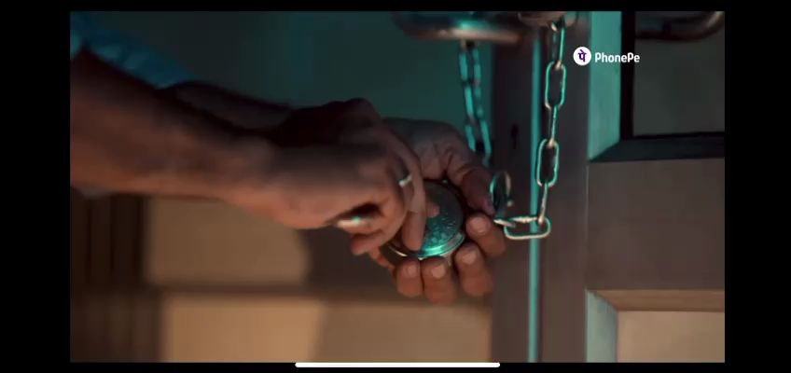

PhonePe Success Story - How It Became India’s Leading Payments App?

Slide 7
PhonePe - Startup Story
PhonePe was founded in 2015 by Sameer Nigam, Rahul Chari, and Burzin Engineer, who were ex-Flipkart employees. With a vision of simplifying transactions and making financial services accessible to all, they founded PhonePe.
In 2016, PhonePe took a significant leap forward when it caught the attention of Flipkart, one of India's leading eCommerce giants. Recognizing its immense potential, Flipkart swiftly acquired PhonePe, forging a strategic partnership that would shape the future of digital payments.
With the backing of Flipkart, PhonePe began its journey toward revolutionizing the digital transaction landscape. The founders had a groundbreaking idea to leverage the Unified Payments Interface (UPI), a newly launched infrastructure by the National Payments Corporation of India (NPCI). This decision would prove to be a turning point in PhonePe's story.
By integrating with UPI, PhonePe offered users a seamless and secure way to make transactions directly from their bank accounts. The app gained popularity for its user-friendly interface, fast processing times, and convenient features. It quickly became a trusted name in the digital payment space.
As PhonePe continued to innovate and expand its offerings, it solidified its position as a leader in the fintech industry. The platform's commitment to user empowerment, data privacy, and convenience resonated with millions of users across India.
In December 2022, Flipkart and PhonePe announced their complete ownership separation. This move granted PhonePe the independence to chart its own growth trajectory, marking a pivotal moment in its journey. Additionally, PhonePe shifted its domicile from Singapore to India in October 2022.
Today, PhonePe continues to redefine the way Indians transact digitally. With its secure and innovative solutions, PhonePe empowers users to effortlessly manage their finances, access a wide range of financial services, and experience the convenience of digital payment .

Slide 8
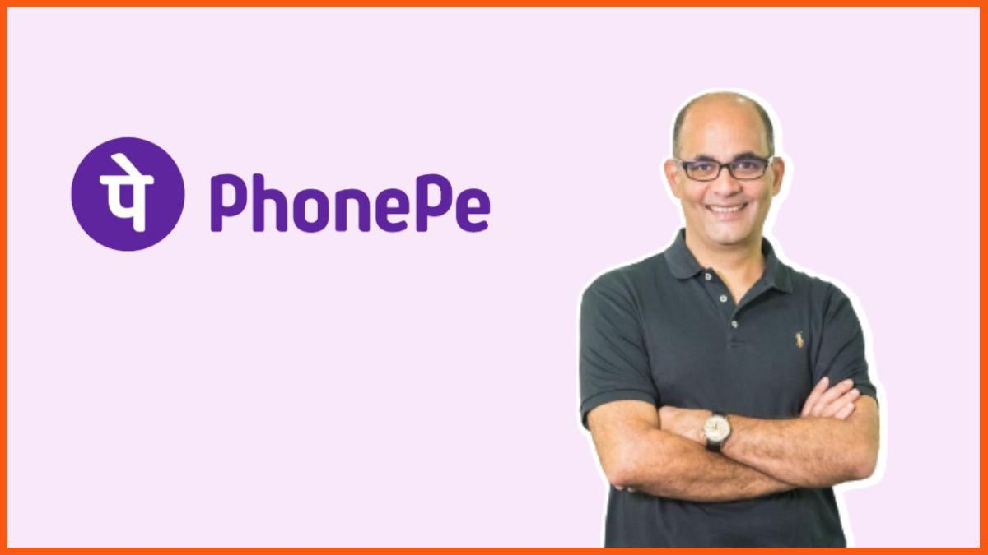
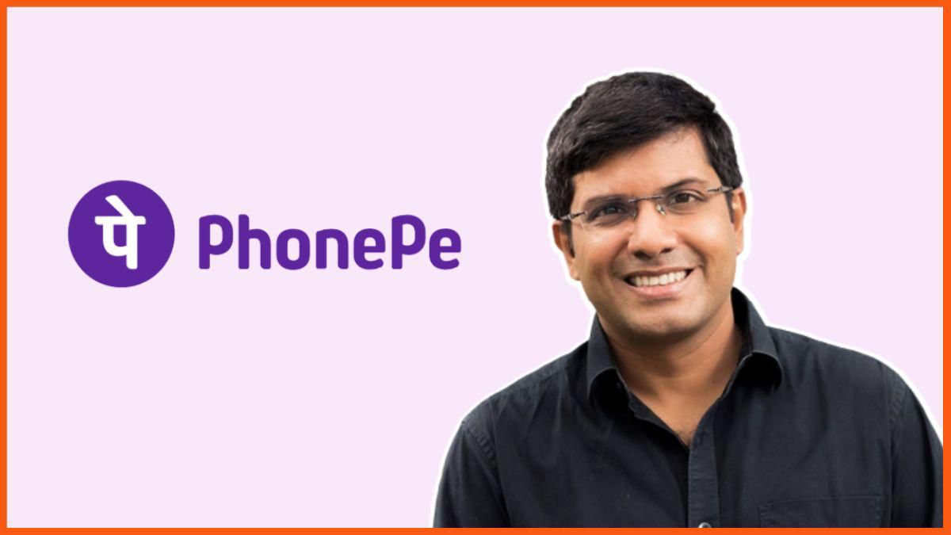
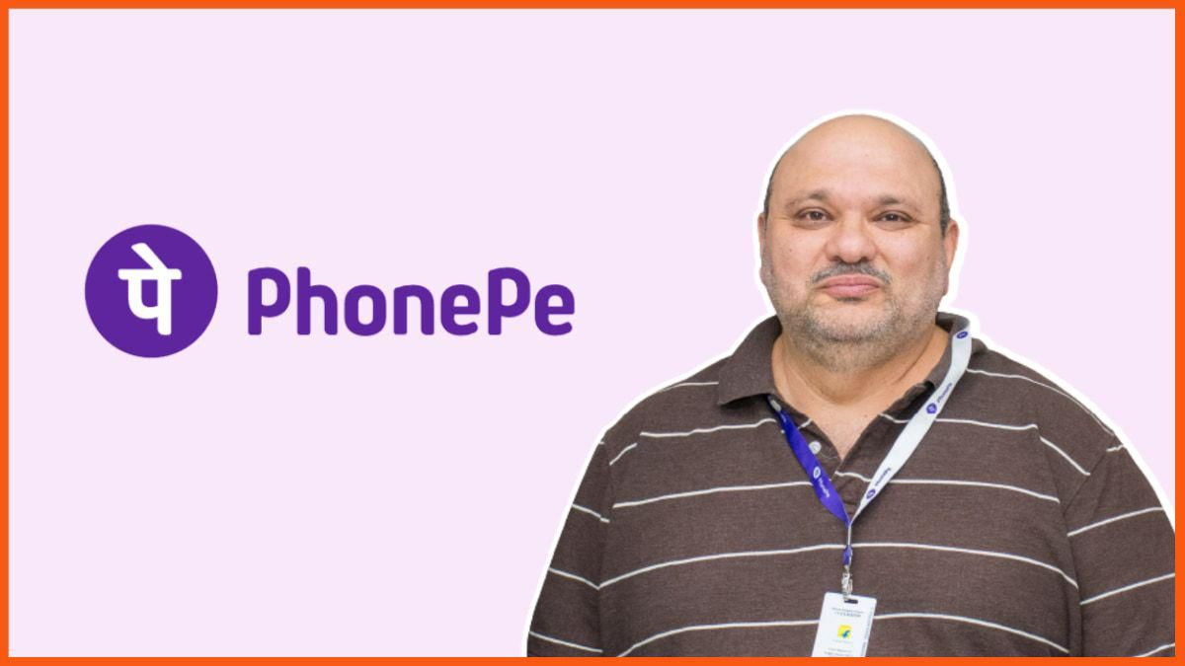
PhonePe - Founders and Team
Sameer Nigam - Founder &CEO
Rahul Chari - Founder & CTO
Burzin Engineer - Founder & CRO

Slide 9
PhonePe - Mission and Vision
PhonePe's mission is to offer every Indian an equal opportunity to accelerate their progress by unlocking the flow of money and access to services.
The vision statement of PhonePe is, "Our Vision is to build India’s largest transaction platform anchored on payments. A scalable ecosystem that creates maximum positive impact for all stakeholders".

Slide 10
PhonePe - Business Model
PhonePe operates on a combined B2B and B2C business model in the digital payments and financial services sectors.
Consumer Side: On the consumer side, PhonePe offers a digital payment platform that allows users to make seamless transactions using their smartphones. Users can link their bank accounts, debit cards, and credit cards to the PhonePe app, enabling them to make payments, transfer money, recharge mobile phones, pay bills, and more. PhonePe provides a user-friendly interface and a secure platform for convenient and efficient financial transactions.
Merchant Side: PhonePe also caters to merchants by providing them with payment solutions and tools to accept digital payments. Merchants can use the PhonePe app or integrate PhonePe's payment gateway into their own applications or websites. This enables them to accept payments from customers using various payment methods, including UPI, cards, and wallets. PhonePe offers features such as payment notifications, transaction history, and easy reconciliation to enhance the merchant's payment experience.
PhonePe has also obtained a license from the RBI (Reserve Bank of India) to provide services related to money transactions and payment systems in India. The company strives to expand its user base, generate profits, and offer additional services beyond traditional banking transactions.

Slide 11
PhonePe - Revenue Model
PhonePe operates on a revenue model that encompasses various streams of income.
Transaction Fees: PhonePe generates revenue by charging transaction fees or commissions on each transaction made through its platform. This includes fees on UPI payments, bill payments, recharges, and other financial transactions processed through the app.
Merchant Services: PhonePe offers merchant services, enabling businesses to accept payments through its POS machines. PhonePe earns revenue by charging merchants a fee for using its POS machines and accepting payments from customers.
Insurance Brokerage: With its insurance brokerage license obtained from the IRDAI (Insurance Regulatory and Development Authority of India), PhonePe offers insurance products to its user base. The company earns revenue through commissions on insurance policy sales.
Affiliate Commissions: PhonePe partners with various brands and vendors to promote their products and services to its users. It earns affiliate commissions when users make purchases or engage with partner offerings through the PhonePe platform.

Slide 12
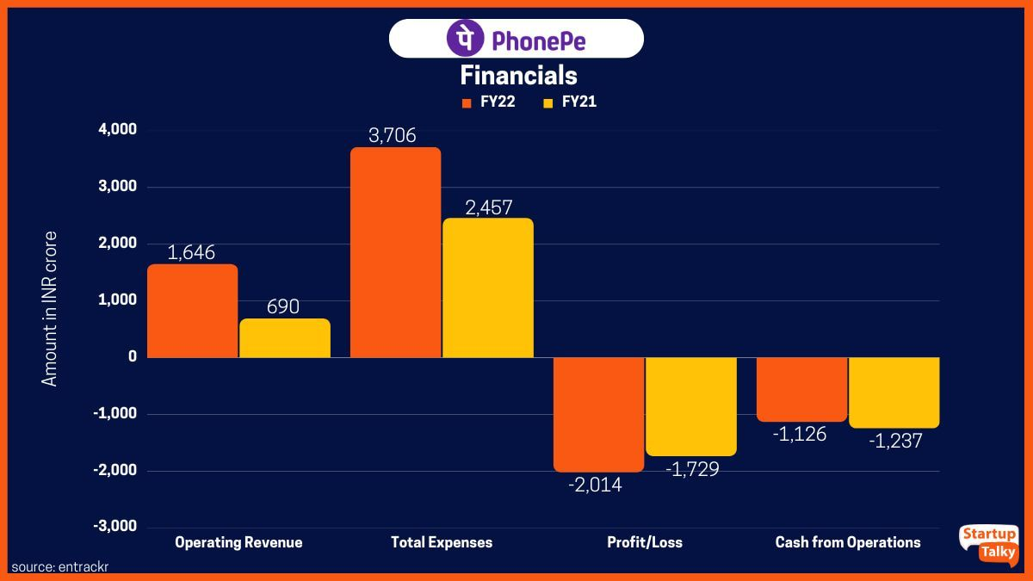
PHONEPE - GROWTH
PhonePe witnessed robust revenue growth, surging 77% growth to Rs 2,914 crore in FY23 from Rs 1,646 crore in FY22.
The company claims that in FY23, as opposed to FY22, its EBITDA for the payment segment stood at negative Rs 1,755 crore where in FY22 it was negative Rs 1,622 crore.
2X

Slide 13
Incidents to remember
Blockage by ICICI Bank and Airtel
PhonePe was blocked on January 14, 2017, by ICICI Bank because the PhonePe transactions did not meet the NPCI guidelines. Though the NPCI initially instructed ICICI to allow UPI transactions via PhonePe on January 19, 2017, the regulatory body confirmed a day later that the digital payments service provider had indeed violated the UPI norms. Airtel was another company that blocked PhonePe transactions on its platforms during the same period.
This led PhonePe to close its operations on Flipkart's website, which helped the startup align itself with the terms stated in the updated verdict from the NPCI. The digital payments app resolved all of these issues with ICICI and Airtel by February 2017.
QR Code Burning Incident
PhonePe faced a notable incident where its QR codes were allegedly burned by employees of Paytm. PhonePe promptly filed a police complaint at Surajpur Lakhnawali police station in Greater Noida. Upon identification of the individuals involved, including a Paytm Area Sales Manager (ASM) and a former PhonePe employee, Paytm took immediate action and suspended them. Paytm emphasized its commitment to upholding high standards of work ethics and stated that it does not tolerate any form of misconduct.
Domicile Shift and Investor Contribution
Another challenge PhonePe encountered was the process of shifting its domicile from Singapore to India. PhonePe's investors contributed approximately Rs 8,000 crore in taxes to facilitate this domicile shift. This significant financial contribution from investors played a vital role in aligning PhonePe's operations with the regulatory framework in India.
PhonePe - Challenges Faced
Starting up was indeed a big challenge for PhonePe because the industry was quite new and rather unexplored. However, the PhonePe acquisition by Flipkart settled things.

Slide 14
Market Share of UPI Apps by Transaction Value ( March 2023)
In the vibrant and rapidly evolving Digital Payments market of India, the total transaction value is anticipated to reach $180.40 billion in 2023, with a projected annual growth rate of 15.56% (CAGR 2023–2027), culminating in a projected total of $321.70 billion by 2027.PhonePe, along with Google Pay and Paytm, emerged as the dominant players, collectively accounting for nearly 96% of all UPI transactions by value in March. PhonePecontinued to lead the market in terms of both value and volume for UPI transactions, solidifying its standing in the market.
Phonepe
49.4%
Google Pay 33.8%
Paytm
10.8%
Others
6%

Slide 15
PhonePe - Partnerships
PhonePe has seen many partnerships over the years that it has been operating. Here's a dive into some of the most important ones:
PhonePe partnered with Axis Bank in July 2021 on the UPI multi-bank model. It has already collaborated with Yes Bank.
Ola collaborated with PhonePe in July 2020 to allow Ola payments through the PhonePe app and wallet.
PhonePe has partnered with Flipkart to digitize cash-on-delivery payments in July 2021.
PhonePe became the official payments partner for KBFC in September 2021.
Edelweiss General Insurance tied up with PhonePe in December 2021 with the aim of offering digital motor insurance products.
In April 2022, PhonePe and Extreme IX entered into a strategic partnership with the objective of minimizing latency in the PhonePe app during transactions.
dd Your Title
This Presentation template for the rice husk designer pencil demo works, focusing
This Presentation template for the rice husk designer pencil demo works, focusing
This Presentation template for the rice husk designer pencil demo works, focusing

Slide 16
PhonePe - Competitors
The top competitors of PhonePe include Google Pay, Amazon Pay, Whatsapp Pay, Juspay, Paytm, MobiKwik, BharatPe, and more.
GPay is a Google-developed digital wallet platform and online payment service. Released in 2011, GooglePay initially offers contactless payment options.
Amazon Pay was founded in 2007 and serves as an online payment processing service owned by Amazon, headquartered in Seattle.
Whatsapp Pay is a payments service provider powered by the social media giant Facebook, which owns Whatsapp, to help users send and receive money while chatting.
Juspay is an online platform used for mobile-based payments. Juspay was founded in 2012.
Paytm is a pioneer of the Indian eCommerce payment system. It is a financial technology company. Paytm was founded in 2010.
MobiKwik is an Indian company. It has a mobile phone-based payment system. MobiKwik was founded in 2009.
BharatPe is a platform, particularly for retailers and businesses. It is a QR-based payment app. The company was founded in 2018.
dd Your Title

Slide 17
PhonePe - Awards and Achievements
Some of the prominent awards and achievements received by PhonePe include:
Recognition by the National Payments Corporation of India (NPCI) for driving the largest number of merchant transactions on the UPI network in 2018.
Best Mobile Payment Product or Service Category at the IAMAI India Digital Awards 2019.
Excellence in the Insurtech category at Assocham's Fintech and Digital Payments Awards 2021.
Winner at the Third ET BFSI Innovation Tribe Virtual Summit & Awards (APAC edition).
Winner at the 8th Annual India Retail and e-Retail Awards 2019.
Winner at the IAMAI 9th India Digital Awards 2019.
Best BFSI Brand 2023 at The Economic Times Best BFSI Brands Conclave.
Best Payment Solutions and Best Insurtech of the Year at the BW Festival of Fintech 2023.
dd Your Title

Slide 18



PhonePe - Future Plans
PhonePe has ambitious plans for the future, including aiming for an IPO in 2024–2025. The company seeks to leverage its strong user base, innovative technologies, and strategic partnerships to drive growth and expand its market presence. With a focus on seamless payments and financial inclusion, PhonePe aims to enhance its product offerings, expand its merchant network, and provide a comprehensive ecosystem of services. Going public will provide additional opportunities for investment and propel the company's expansion plans in the competitive digital payments landscape.

Slide 19
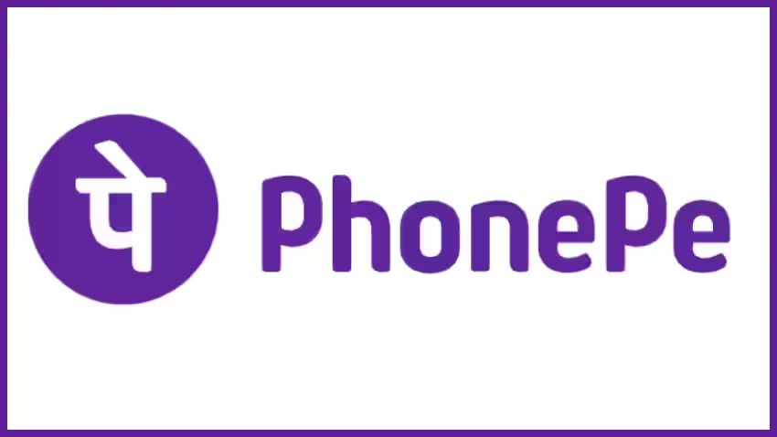
- Company Highlights
Customer support center
call no.
Mail ID
080-68727374/ 022-68727374
grievances@phonepe.com
Headquarters
website
Bengaluru,Karnatak,India
phonepe.com

Slide 20
PhonePe is investing in AI and ML to personalize user experiences and
enhance predictive analytics for credit risk and fraud prevention.We assign a
risk score to every transaction on the app. Transactions with high
risk scores are automatically blocked, keeping your payment safe.
PhonePe is a digital payment and wallet-based app
that operates within the Unified Payments Interface (UPI) ecosystem.
To use PhonePe, users need to download the app, link
their phone numbers, and verify their bank accounts.
Once set up, users can make transactions directly through the app.
PhonePe acts as a mediator between users and their bank accounts, enabling
seamless fund transfers, bill payments, and online shopping.
The app provides a secure and convenient platform for users to
manage their digital payments, ensuring a smooth and hassle-free experience.
Conclusion

Slide 21
Acknowledgement
Thank you sir for giving us this oppertunity.

Slide 22
Thank You

