Slide 1
Internship Report
Internal Audit
Virtual Internship
Goldman Sachs Job Simulation via Forage | September 2026
Name: Arpita Srivastava
Roll Number: 2410030177
Batch: 2024-2028
B.Tech (Computer Science and Engineering)
School of Computer Science and Engineering, IILM University, Greater Noida, U.P.

Slide 2
Introduction & Organization Profile
Introduction
Organization Profile
Virtual job simulation completed on the Forage platform with Goldman Sachs
Domain: internal audit and risk assessment
Applied to a global banking and markets business context
Completed as part of the B.Tech (CSE) curriculum at IILM University
Forage: global virtual work-experience platform offering free, self-paced job simulations with leading companies
Goldman Sachs: leading global investment banking, securities and investment management firm, founded in 1869
Certificate of Completion issued by Forage on September 20, 2026
Arpita Srivastava | 2410030177 | IILM University

Slide 3
Problem Statement & Objectives
Problem Statement
Project Objectives
Large financial institutions operate in complex, regulated environments where weak controls can cause financial loss and reputational damage. Internal audit independently checks that risks are managed well. Students rarely get hands-on exposure to this, so the internship aimed to learn and apply audit foundations and risk assessment in a global banking setting.
Understand the role and purpose of internal audit
Learn the stages of an audit engagement
Understand the risk-based approach to audit
Identify and assess key risks in global banking and markets
Communicate findings clearly and professionally
Arpita Srivastava | 2410030177 | IILM University

Slide 4
Scope of the Project & Tools Used
Scope
Concepts & Tools
Foundations of internal audit
Risk assessment in global banking and markets
Virtual, simulation-based learning environment
No live audit engagement or access to confidential data
Risk-based audit approach and audit lifecycle
Risk rating by likelihood and impact
Internal controls and roles in risk management
Word processing and spreadsheet tools for documentation
Platform: Forage Virtual Work Experience
Arpita Srivastava | 2410030177 | IILM University

Slide 5
System Architecture: Audit Workflow
Understand
Identify
Assess
Controls
Report
Follow-up
Business and its objectives
Risks that threaten objectives
Rate likelihood and impact
Evaluate control effectiveness
Communicate observations
Track agreed actions
Each stage feeds the next, moving from understanding the business to tracking improvements.
Arpita Srivastava | 2410030177 | IILM University

Slide 6
Methodology: Task-wise Approach
Task | Module | Description
1 | Foundations of Internal Audit | Learned the purpose of internal audit, its role in governance, risk management and control, and the stages of an audit engagement
2 | Risk Assessment in Global Banking & Markets | Applied risk-based thinking to identify key risks, assess likelihood and impact, and prioritise areas for audit attention
The foundations learned in Task 1 provided the framework used to carry out the risk assessment in Task 2.
Arpita Srivastava | 2410030177 | IILM University

Slide 7
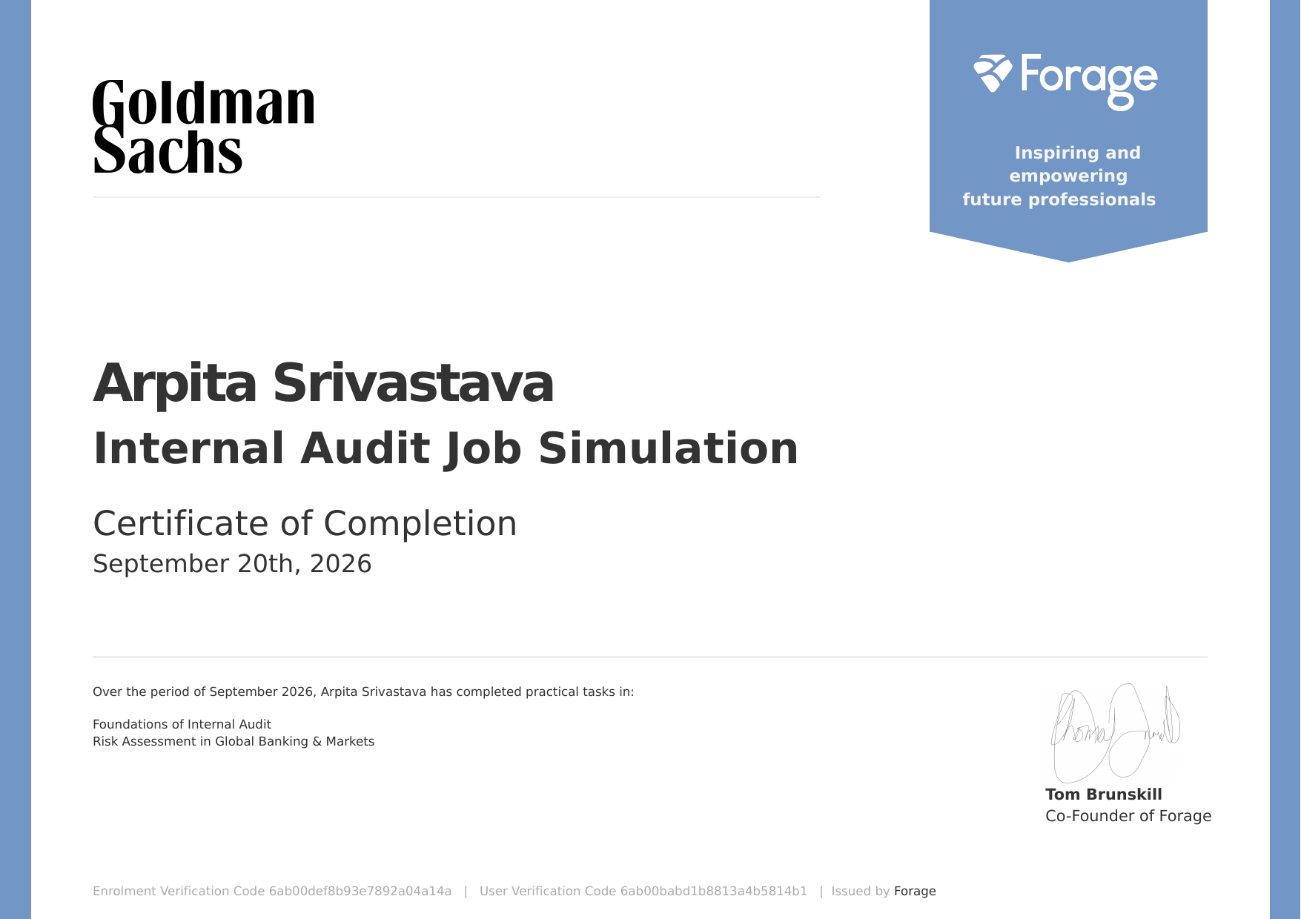
Outcomes & Certificate of Completion
Understand the role of internal audit in a financial institution
Know the audit stages and the risk-based approach
Identify and assess risks in banking and markets
Understand how internal controls reduce risk
Communicate findings clearly
Certificate of Completion issued via Forage
Arpita Srivastava | 2410030177 | IILM University

