Slide 1


Hyperparameter Tuning: Grid Search vs. Random Search
"Finding the Best Hyperparameters Efficiently!"
Arpita Thokal
Student ID : 24005907

Slide 2

Agenda
Introduction to Hyperparameter Tuning
Understanding Grid Search
Understanding Random Search
Implementing Hyperparameter Tuning ⚙️
Performance Comparison 📊
Key Takeaways🎯

Slide 3

What is Hyperparameter Tuning?
What are Hyperparameters?
Why do they matter?
How do we tune them?

Slide 4

For example, in a Random Forest model, hyperparameters include:"
Random Forest is an ensemble ML algorithm that uses many decision trees to make better, more accurate predictions.
✔️ Number of trees (n_estimators) – More trees can improve accuracy but slow training.
✔️ Maximum depth of a tree (max_depth) – Controls how complex each decision tree can be.
✔️ Minimum samples split (min_samples_split) – Prevents overfitting by requiring a minimum number of samples to split a node.

Slide 5

Think of hyperparameters like cooking recipes—if you add too much salt or spice, the dish won’t taste right!

Slide 6



What is Grid Search?
🧮 Grid Search tests every possible combination
of these values
🥇 Picks the model with the best validation performance
Trying Every
Dish on a Menu! ->
Takes lot of time

Slide 7
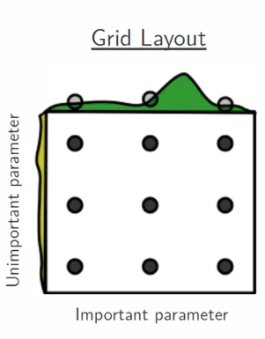
How does it work?
🌲 n_estimators: Total number of trees
🌳 max_depth: Maximum depth of trees
✔️ n_estimators =[50, 100, 150](horizontal axis – important parameter) ✔️ max_depth = [10, 20, None](vertical axis – unimportant parameter)
3 × 3 = 9 model

Slide 8

Understanding Random Search
What is Random Search??
🔄 Randomly selects combinations of hyperparameters
🎯 Tests only a subset instead of all combinations
⏱️ Saves time and resources, especially for large models
✅ Often finds good solutions with fewer trials

Slide 9

Real-World Analogy: Playing the Lottery!
Random Search in Machine Learning
Randomly picks combinations of hyperparameters
Saves time by avoiding exhaustive search
Often finds good enough results, faster

Slide 10
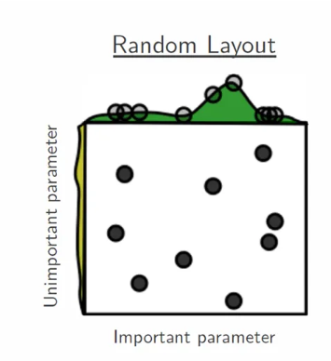
How does it work?
✔️ n_estimators = np.arange(50, 200, 50) ✔️ max_depth = [None, 10, 20]
= 5 models
🔁 Each selected combination trains a model
→ best one is kept

Slide 11

Grid Search vs. Random Search
Grid Search
Random Search
🔹 Pros
✅ Finds the best result (within search space)
✅ Exhaustive and systematic
✅ Simple to understand and implement
🔸 Cons
❌ Very slow for large datasets
❌ Tests many unnecessary combinations
❌ Computationally expensive
🔹 Pros
✅ Much faster and scalable
✅ Efficient for high-dimensional spaces
✅ Often finds good results quickly
🔸 Cons
❌ Doesn’t guarantee the best result
❌ Performance varies with randomness
❌ May miss optimal combinations

Slide 12
"Implementing Hyperparameter Tuning in Python"
“
”

Slide 13

✅ Hyperparameter tuning boosts model performance
✅ Grid Search is exhaustive but time-consuming
✅ Random Search is faster and often just as effective
✅ Choose the method based on your dataset & resources

Slide 14

“A well-tuned model is a powerful model.”
https://github.com/arpitathokal/Hyperparameter_Tunning_ML
References:
https://www.analyticsvidhya.com/blog/2021/06/tune-hyperparameters-with-gridsearchcv/
https://www.analyticsvidhya.com/blog/2015/06/tuning-random-forest-model/

