Slide 1

MSC IN ARTIFICIAL INTELLIGENCE · NATIONAL COLLEGE OF IRELAND
Trustworthy Deep Learning for
Pharmaceutical Tablet Quality Prediction
End-to-end multi-task modelling with dual uncertainty quantification on industrial compression trajectories
Arpit Joshua Elias · Student ID 24257567
Supervisor: Arundev Vamadevan · School of Computing
Notes:
Introduce yourself and the project in one breath, then move on.

Slide 2
INTRODUCTION
Why this problem is worth solving
The domain
Tablet manufacturing is among the most tightly regulated production processes there is. Every batch is laboratory tested before it can be released.
The gap
Presses record ten sensors continuously, but that stream is used to confirm the machine is running, not to anticipate whether the product will pass.
The motivation
A failed batch means regulatory reporting, delay and rework. Knowing earlier, with a trustworthy statement of confidence, is worth a great deal.
MT-TrajNet · Arpit Joshua Elias · 24257567
Notes:
Thirty seconds. Set the scene, do not detail.

Slide 3
BACKGROUND
What the existing work does not do
Compared on method and capability, since the studies use different datasets and error values would mislead.
Study
Input
Targets
Uncertainty
OOD test
Significance
Susto & McLoone (2015)
Engineered features
1
No
No
Monte Carlo CV
Žagar & Mihelič (2022)
Engineered features
Several
No
No
Benchmark only
Wang et al. (2025)
Features + graph
Several
No
No
Not corrected
This work
Raw 10-channel trajectory
4, jointly
Yes
Yes
Nadeau–Bengio
Signal thrown away first
Attributes modelled alone
No trustworthy confidence
Runs lasting hours are reduced to a handful of summary statistics before modelling starts.
Four physically linked quality attributes are treated as separate regression problems.
A number arrives with no dependable statement of how far it can be believed.
MT-TrajNet · Arpit Joshua Elias · 24257567
1
Notes:
Point at the last row of the table, then name the three gaps below. Do not read either.

Slide 4
RESEARCH QUESTIONS
One question, four parts
Can an end-to-end multi-task model reading raw compression trajectories match engineered-feature baselines, exploit the correlations between quality attributes, and supply calibrated uncertainty that stays informative on unseen product conditions?
RQ1
Trajectory representation
RQ2
Multi-task structure
Does reading the raw signal beat engineered features?
Is one shared model better than four separate ones?
RQ3a
Calibrated uncertainty
RQ3b
Confidence-aware explanation
Can the reported confidence be trusted?
Does the model explain itself differently when unsure?
MT-TrajNet · Arpit Joshua Elias · 24257567
2
Notes:
Read the four plainly. They map onto the results slides that follow.

Slide 5
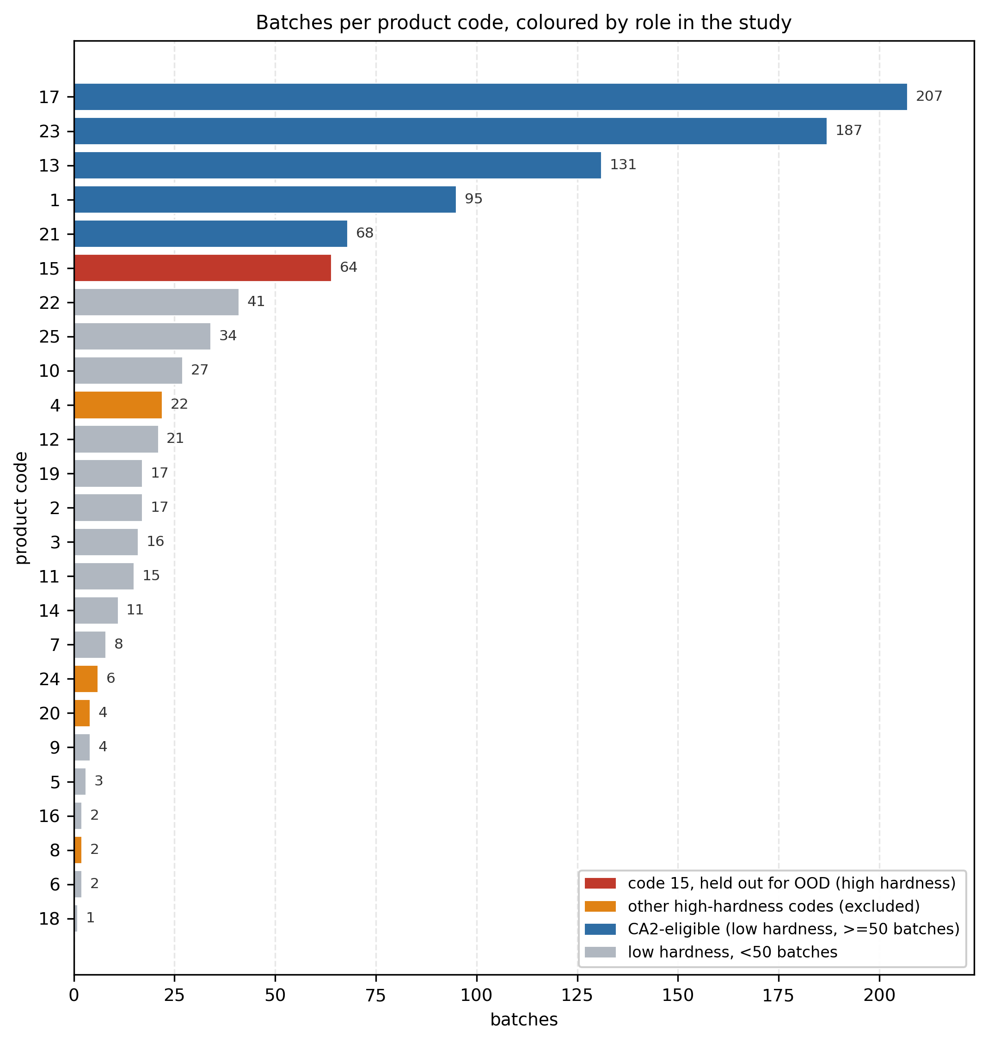
DATA
The dataset, and one property that shaped the whole study
Žagar and Mihelič (2022), CC BY 4.0. Chosen because it publishes the raw trajectories, not just engineered features.
1,005
25
10
4.72M
THE DISCOVERY
batches
product codes
channels
readings
Hardness is bimodal
98
batches sit above 70 N
5
product codes hold all of them
64
of those 98 are a single code
34
remain for training after holdout
Because evaluation groups whole product codes to stop leakage, this concentration decides how the folds can be built at all.
Preprocessing: stride-2 downsampling, padded to 6,000 steps, standardised on training folds only.
MT-TrajNet · Arpit Joshua Elias · 24257567
3
Notes:
This is the slide showing you understood the data before modelling it.

Slide 6
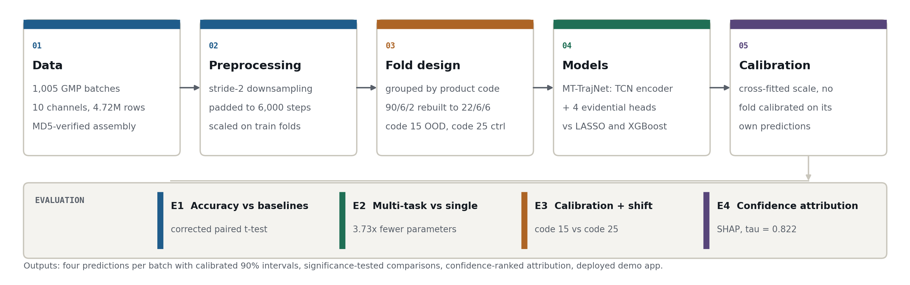
METHODOLOGY
The full research pipeline
From the raw sensor files through to the four evaluation experiments.
Every stage is fixed and reproducible: one fingerprinted data file, seed 42, deterministic cuDNN, and calibration cross-fitted so no batch is ever calibrated on its own prediction.
MT-TrajNet · Arpit Joshua Elias · 24257567
4
Notes:
The central visual. Walk left to right, one sentence per stage. Take your time here.

Slide 7
MODEL AND SETUP
MT-TrajNet, and how it is evaluated
FOUR EVIDENTIAL HEADS
SHARED TCN ENCODER
Dissolution
γ ν α β
Trajectory
blk 1
blk 2
blk 3
blk 4
Pooling
Hardness
γ ν α β
10 × 6,000
d=1
d=2
d=4
d=8
128-dim
Weight RSD
γ ν α β
Tensile
γ ν α β
384,400 parameters
941 batches, 3 folds
3.73× smaller than four separate models
grouped by product code to stop leakage
Code 15 held out
Nadeau–Bengio test
OOD probe, with code 25 as matched control
corrected for overlapping training folds
A plain grouped split put 90 of the 98 high-hardness batches into one test fold. It was rebuilt to 22 / 6 / 6 before any modelling. Seed 42, PyTorch, single Tesla T4.
MT-TrajNet · Arpit Joshua Elias · 24257567
5
Notes:
Architecture in one breath, then the setup. Mention that you found the fold failure yourself.

Slide 8
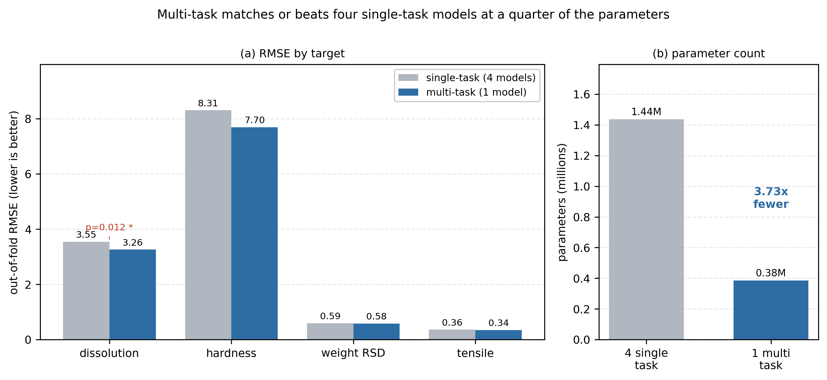
RESULTS · RQ1 AND RQ2
Accuracy against baselines, and the value of sharing
RQ1 · AGAINST ENGINEERED-FEATURE BASELINES
RQ2 · ONE SHARED MODEL AGAINST FOUR SEPARATE ONES
Dissolution
+2.8%
level with the best baseline
Weight RSD
+5.0%
level with the best baseline
Tensile
+28%
behind, not significant
Hardness
+63%
behind, and significant (p = 0.015)
384,400
1,435,408
shared model parameters
four separate networks, 3.73× larger
Not a uniformly more accurate model. The one comparison reaching significance is the one where my model loses. With three folds the others are inconclusive, not equal.
Better on all four targets, significantly on dissolution (p = 0.012). Sharing costs nothing and saves a great deal.
MT-TrajNet · Arpit Joshua Elias · 24257567
6
Notes:
Left side first, and say the honest part out loud. Then the right side, which is the clean win.

Slide 9
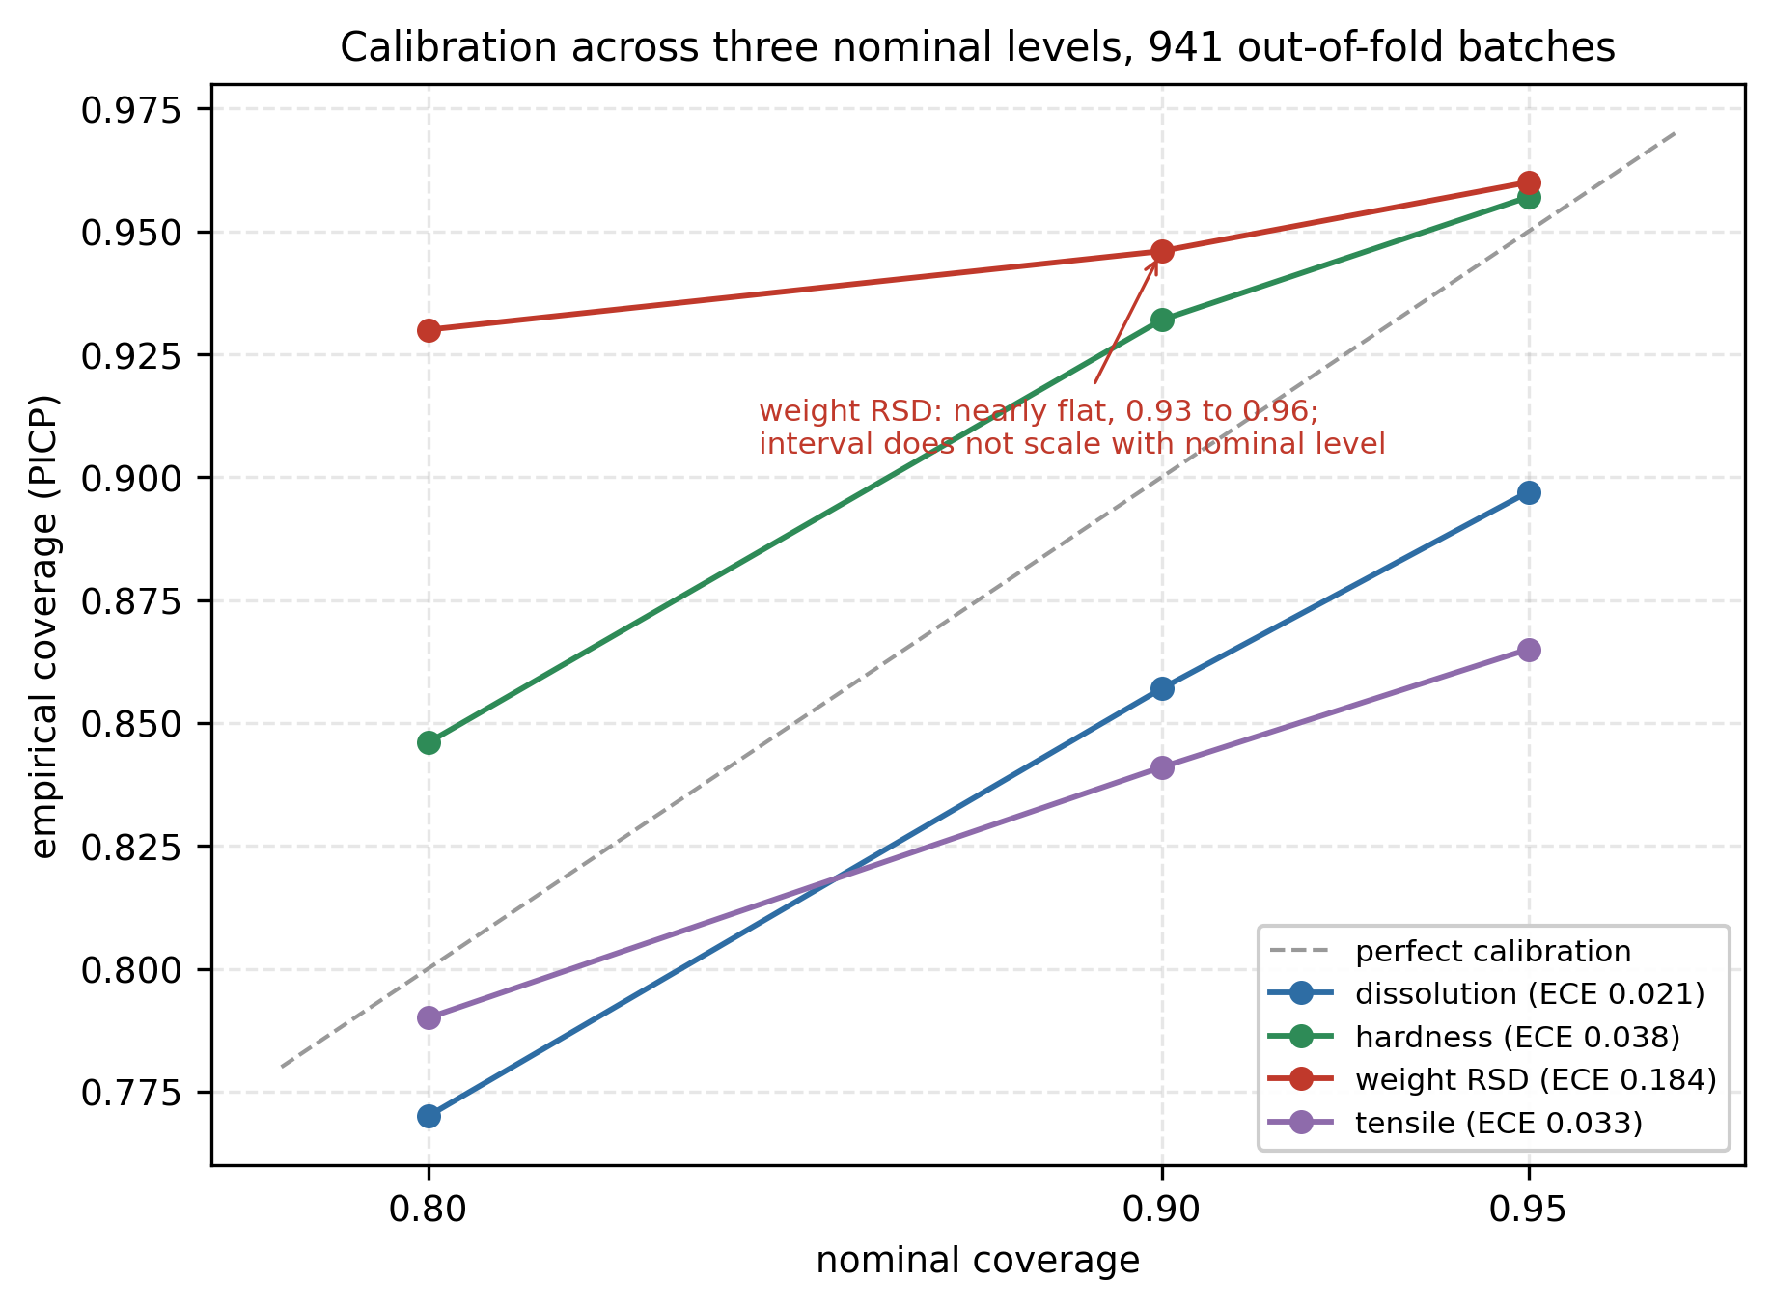
RESULTS · RQ3a
Calibrated, and it notices when the product changes
Two product codes were withheld from training. Only one of them costs anything.
Seen products
1.00×
cross-validation reference
Code 25 — unseen, same regime
0.64×
unfamiliar product, no penalty
Code 15 — unseen, shifted regime
2.43×
unfamiliar regime, large penalty
An unfamiliar product is fine. An unfamiliar operating regime is not. Nothing tells the model which code is unseen, it separates them itself. Coverage is near nominal on three of four attributes; weight uniformity is poorly calibrated and reported as a limitation.
MT-TrajNet · Arpit Joshua Elias · 24257567
7
Notes:
The strongest finding for a practitioner. Slow down on the two ratios.

Slide 10
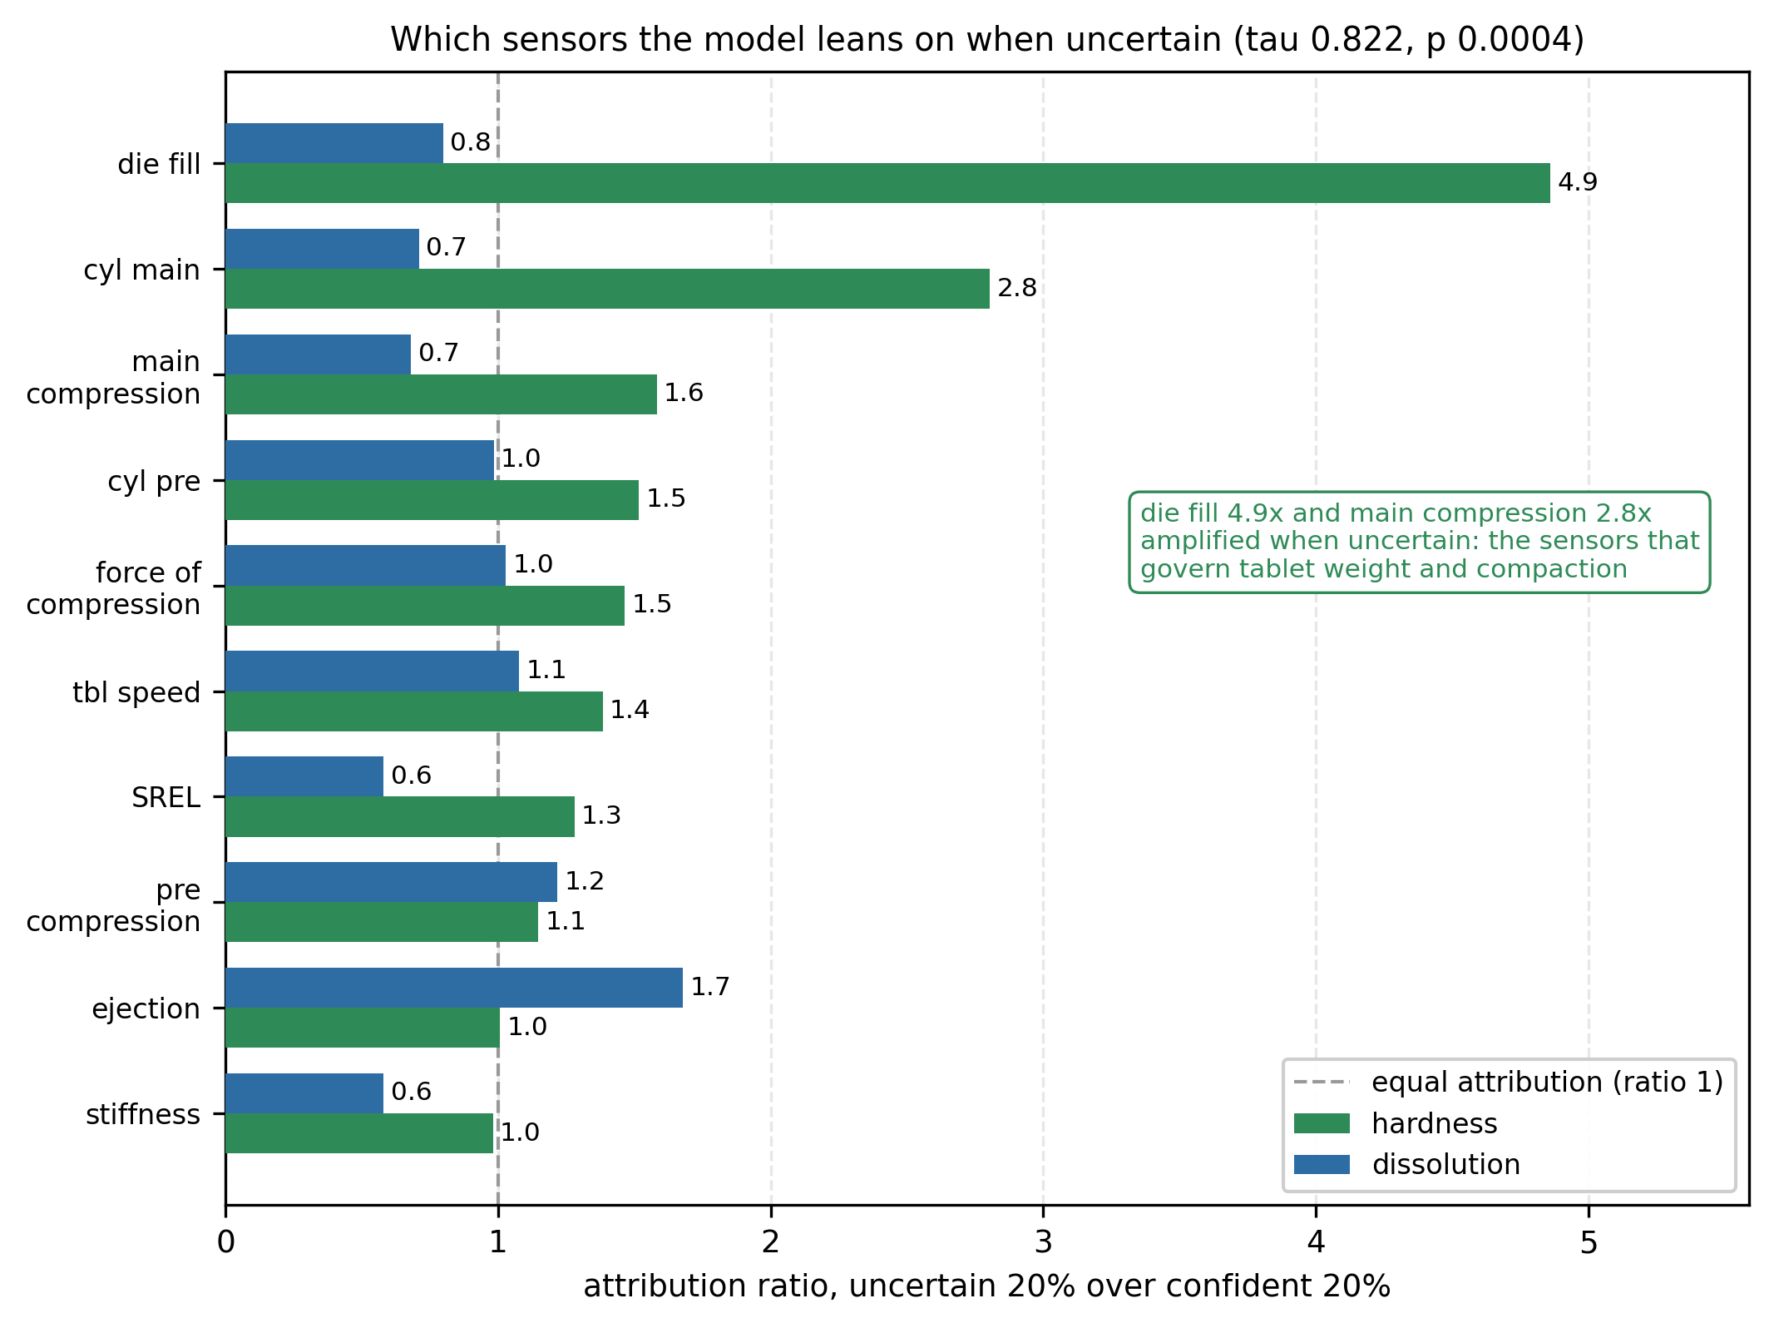
RESULTS · RQ3b
The model changes what it looks at when it is unsure
The strongest statistical result in the study.
τ = 0.822
rank agreement, confident against uncertain
p = 0.0004
the shift is real, not noise
4.86×
die fill, amplified when uncertain
2.81×
main compression, amplified when uncertain
Die fill and main compression are the two signals that physically determine tablet hardness. The model was given ten raw channels and four laboratory numbers, and was never told which mattered.
MT-TrajNet · Arpit Joshua Elias · 24257567
8
Notes:
Land this one. It is the most novel result in the project.

Slide 11
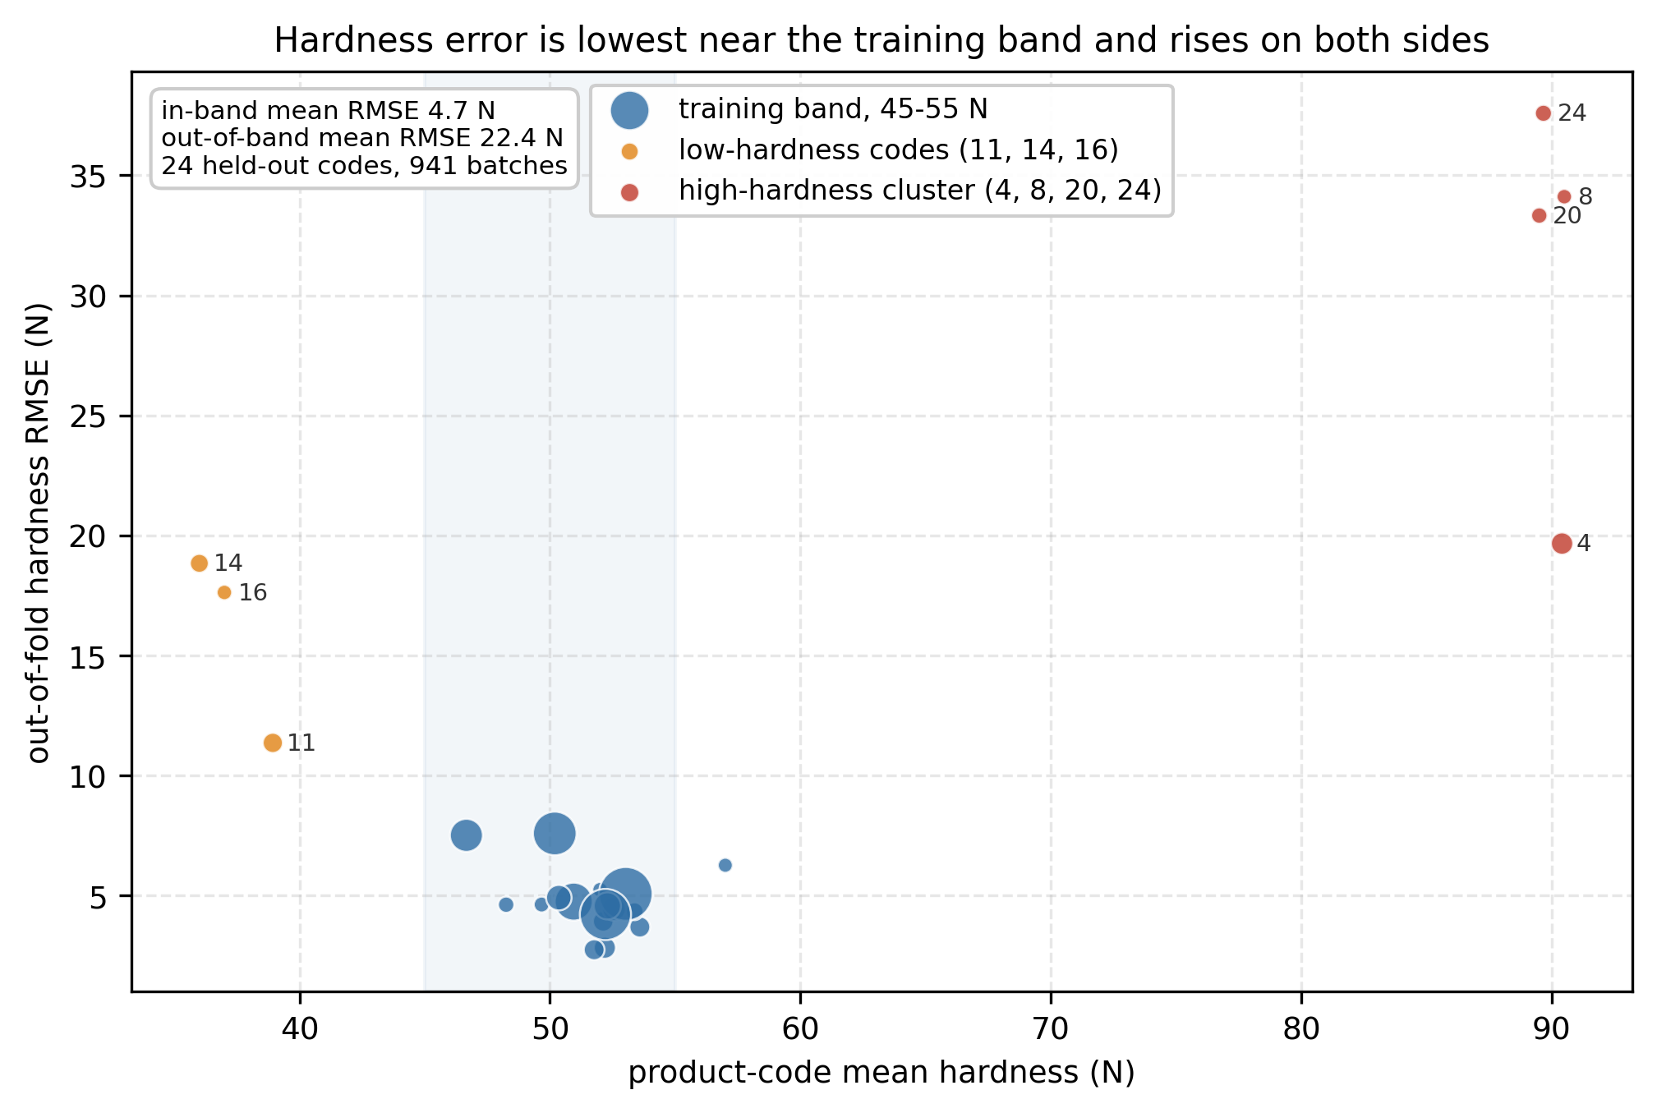
DISCUSSION
Why hardness is hard, and what this work does not show
LIMITATIONS
One production line
Transfer to other equipment is untested.
Low statistical power
Three folds detect only large effects.
Weight uniformity poorly calibrated
Its intervals should not be trusted per batch.
Ensembles more robust under shift
Beat the single-pass model, at five times the cost.
A result that did not replicate
An early phase-level effect vanished once folds were fixed.
r = 0.941
Hardness error scales with distance from the centre of the training distribution, across 24 held-out codes. A property of the dataset, not the architecture.
Not a release decision
Predicts values; does not pass or fail batches.
Reporting these is deliberate. A study showing only what worked is not much use to anyone assessing it.
MT-TrajNet · Arpit Joshua Elias · 24257567
9
Notes:
Explain the hardness result first, then run the limitations quickly. Confidence matters here.

Slide 12
CONCLUSION
What this work contributes, and what comes next
Trajectory-native multi-task modelling
1
Four correlated attributes from one shared encoder reading the raw signal, at 3.73× fewer parameters.
Uncertainty that responds to real regime shift
2
Flat on an unseen product inside the trained range, sharply higher outside it.
Explanations conditioned on confidence
3
The model reorders which sensors it relies on as confidence falls, onto the mechanically relevant ones.
FUTURE WORK
· Nested cross-validation with a search
gives the tests usable power
· Targeted collection at the extremes
the most valuable batches, not just more
· Hybrid uncertainty estimation
ensemble robustness at single-pass cost
· Cross-site validation on a second press
before any claim of generality
Not a uniformly more accurate predictor. A model whose confidence and explanations can be trusted, evaluated honestly.
MT-TrajNet · Arpit Joshua Elias · 24257567
10
Notes:
Close here. The remaining two slides are references and thanks.

Slide 13
REFERENCES
Harvard referencing
Amini, A., Schwarting, W., Soleimany, A. and Rus, D. (2020) 'Deep evidential regression', in Advances in Neural Information Processing Systems, 33, pp. 14927–14937.
Nadeau, C. and Bengio, Y. (2003) 'Inference for the generalization error', Machine Learning, 52(3), pp. 239–281.
Bai, S., Kolter, J. Z. and Koltun, V. (2018) 'An empirical evaluation of generic convolutional and recurrent networks for sequence modeling', arXiv preprint arXiv:1803.01271.
Ovadia, Y., Fertig, E., Ren, J., Nado, Z., Sculley, D., Nowozin, S., Dillon, J. V., Lakshminarayanan, B. and Snoek, J. (2019) 'Can you trust your model's uncertainty? Evaluating predictive uncertainty under dataset shift', in Advances in Neural Information Processing Systems, 32, pp. 13991–14002.
Caruana, R. (1997) 'Multitask learning', Machine Learning, 28(1), pp. 41–75.
Rudin, C., Chen, C., Chen, Z., Huang, H., Semenova, L. and Zhong, C. (2022) 'Interpretable machine learning: fundamental principles and 10 grand challenges', Statistics Surveys, 16, pp. 1–85.
Guo, C., Pleiss, G., Sun, Y. and Weinberger, K. Q. (2017) 'On calibration of modern neural networks', in Proceedings of the 34th International Conference on Machine Learning, 70, pp. 1321–1330.
Susto, G. A. and McLoone, S. (2015) 'Slow release drug dissolution profile prediction in pharmaceutical manufacturing: a multivariate and machine learning approach', Computers in Biology and Medicine, 63, pp. 300–308.
Lakshminarayanan, B., Pritzel, A. and Blundell, C. (2017) 'Simple and scalable predictive uncertainty estimation using deep ensembles', in Advances in Neural Information Processing Systems, 30, pp. 6402–6413.
Wang, K., Chen, X., Li, N., Feng, H., Liu, X., Wang, Y. et al. (2025) 'AI-integrated IQPD framework of quality prediction and diagnostics in small-sample multi-unit pharmaceutical manufacturing', Acta Pharmaceutica Sinica B, 15(8), pp. 4193–4209.
Lundberg, S. M. and Lee, S.-I. (2017) 'A unified approach to interpreting model predictions', in Advances in Neural Information Processing Systems, 30, pp. 4765–4774.
Žagar, J. and Mihelič, J. (2022) 'Big data collection in pharmaceutical manufacturing and its use for product quality predictions', Scientific Data, 9(1), 99.
MT-TrajNet · Arpit Joshua Elias · 24257567
Notes:
Do not read these. Leave the slide up briefly and move on.

Slide 14
Thank you
Arpit Joshua Elias · Student ID 24257567
Supervisor: Arundev Vamadevan · MSc in Artificial Intelligence, National College of Ireland
Live application: mt-trajnet-thesis-4kznhd8sjhv28lcfds4e2k.streamlit.app
Repository: github.com/arpitelias/mt-trajnet-thesis
Notes:
Closing slide. Stop here.

