Slide 1
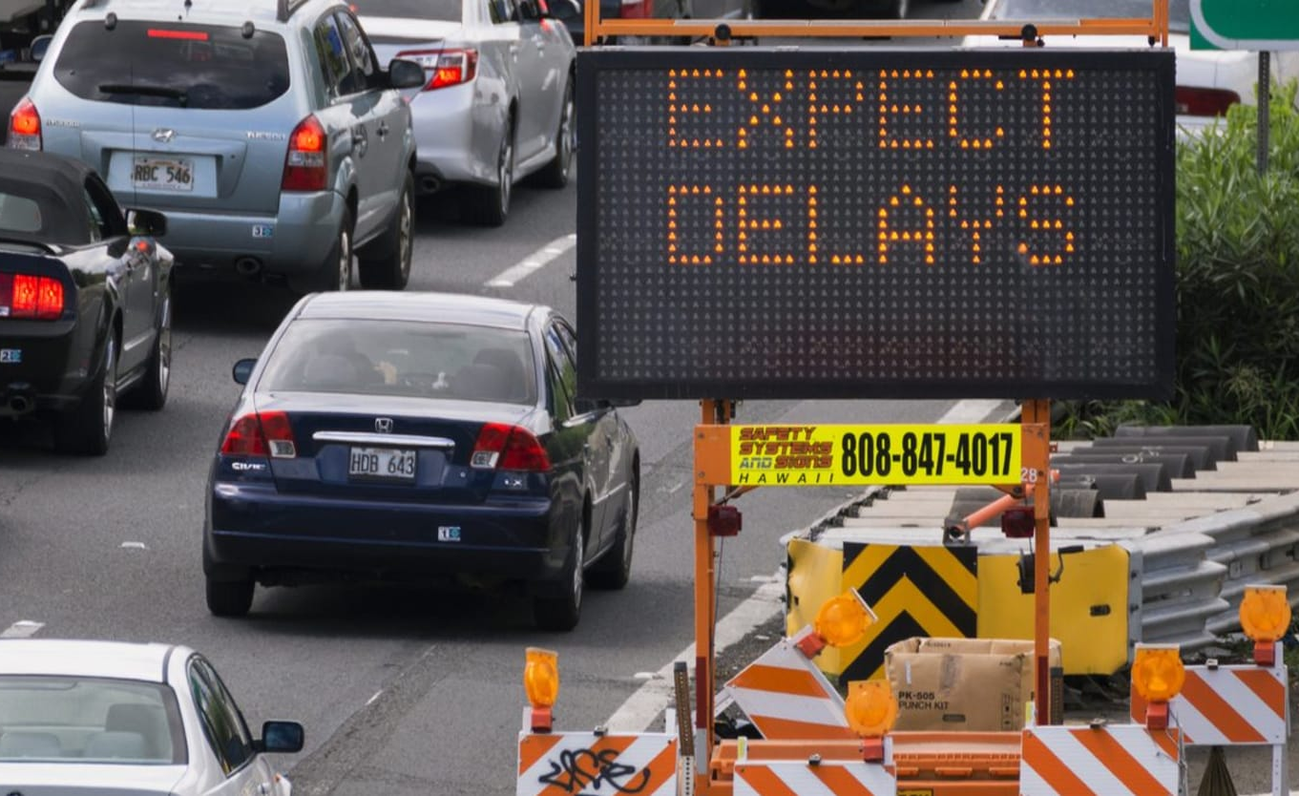

Machine Learning for Traffic Prediction
Exploring the relationship between weather conditions and traffic volume.
Using the Metro Interstate Traffic Volume dataset.
Employing machine learning models to improve predictions.

Slide 2

Introduction
Traffic congestion impacts urban mobility, economy, and environment.
Weather conditions such as rain, snow, and temperature affect traffic behavior.
Objective: Develop machine learning models leveraging weather data.

Slide 3
Machine Learning Models
Traditional statistical models (e.g., ARIMA) are less effective for dynamic traffic patterns.
Machine learning models like Random Forest and Gradient Boosting improve accuracy.
Weather conditions significantly influence traffic volume.

Slide 4
Dataset Overview
Source: Metro Interstate Traffic Volume dataset from Kaggle.
Features: Traffic volume, weather conditions, and temporal variables.
Size: 48,000 rows covering multiple years of data.

Slide 5

Feature Engineering
Creating temporal features like hour, day, and season.
Combining weather variables for richer insights (e.g., precipitation indicators).
Scaling and encoding data for compatibility with machine learning models.

Slide 6

Model Building
Models used: Linear Regression, Random Forest, XGBoost, LSTM.
Steps: Feature selection, train-test split, hyperparameter tuning.
Metrics: MAE, RMSE, R².

Slide 7

Results and Evaluation
Best model: LSTM (R² = 0.93, MAE = 70.10, RMSE = 88.12).
Feature importance: Weather and temporal variables heavily influence predictions.
Visualization: Actual vs Predicted Traffic Volume.

Slide 8
Conclusion
Weather significantly affects traffic patterns on Interstate-94.
Advanced ML models outperform traditional methods.
Accurate predictions enable smarter urban planning.

Slide 9

Future Work
Incorporate real-time traffic and geospatial data.
Explore hybrid models and advanced deep learning techniques.
Develop real-time systems for dynamic traffic management.

