Slide 1

Disaster Management Using Crowdsourcing
Team Members: Arpith -1PE10CS018
Kumar Vishal -1PE10CS047
Vinutha M V -1PE10CS115
Manigandan C -1PE11CS408
Guide : Mrs. Bidisha Goswami
Batch No: 16

Slide 2

What is Crowdsourcing?

Slide 3
Crowdsourcing
Crowdsourcing is the practice of obtaining needed services, ideas, or content by soliciting contributions from a large group of people, and especially from an online community, rather than from traditional employees or suppliers.
Each contributor by their own initiative, adds a small portion of data for the greater result.

Slide 4
Disaster Management using Crowdsourcing
In this project, we plan to use crowdsourcing for the production of volunteer-produced information before, during and after a disaster takes place.
During a disaster, information is at a premium.

Slide 5
Disaster Management
There is an urgent need to know which
Areas that are affected
How they are affected
What are the priority of those incidents (in that area)

Slide 6
Disaster Management
Existing surveillance sensors used by a disaster warning and response system cannot provide adequate data for situation assessment purposes
Crowdsourcing is an effective solution
People armed with wireless devices and social network services can be used as mobile human sensors.
Eye-witness reports from them can complement data from in-situ physical sensors and provide the system with more extensive and detailed sensor coverage.

Slide 7

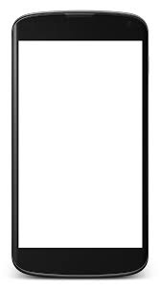
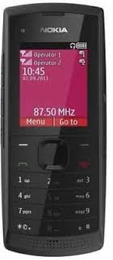
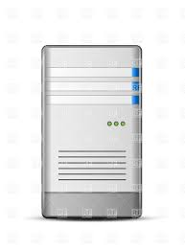

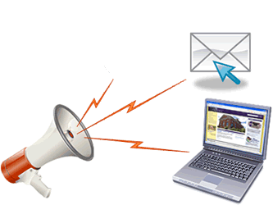
Data SMS
Incident report
Server
Alert command staff
Areas that are affected
How they are affected
Priority

Slide 8
Use case Diagram
User
Report Incident
Server
Consolidate
Command Staff
Information

Slide 9
:User
:System
:Server
:Command
Start
Give report Form
Fill report and submit
Send data to server
Consolidate
Alert User
Alert Command Staff
Command Staff responds to alerts

Slide 10
Architecture Diagram
System (Client Side)
User
Interface
Data
Collection
SMS
Server
Classifier
(Consolidator)
Database
Servlet
System (Command Staff)
User
Interface
Alert

Slide 11
Modules
Client Side
User
Report Incident
Data
SMS
Get Alerts pertaining to an incident
Command Staff
Alert
Display Reports
Server Side
Database
Classification/Consolidation

Slide 12
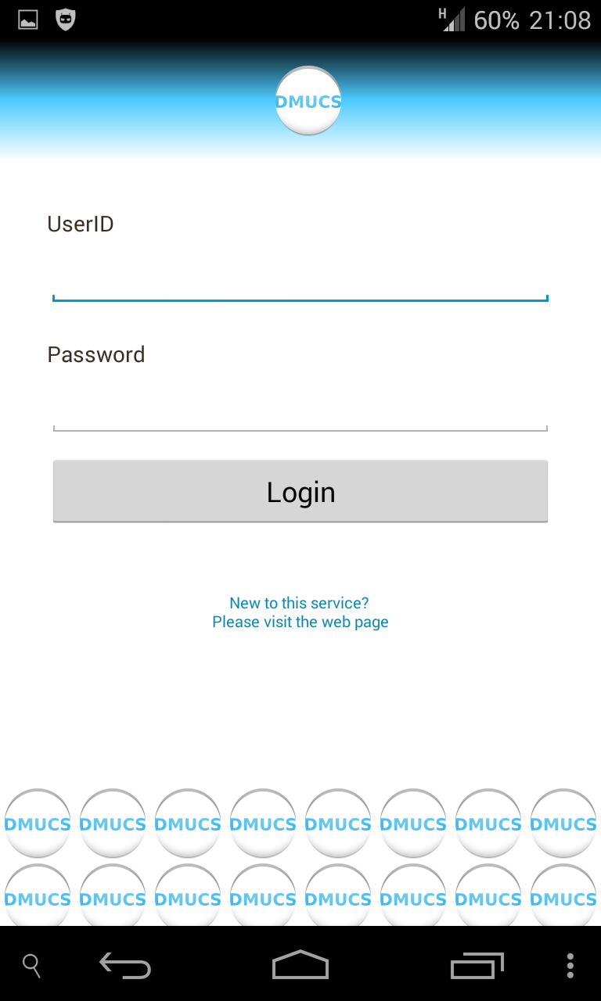
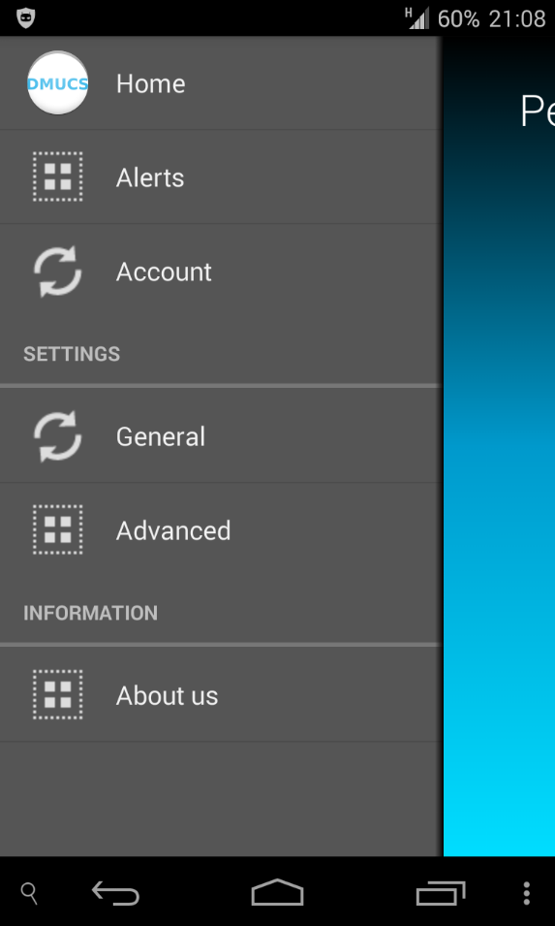
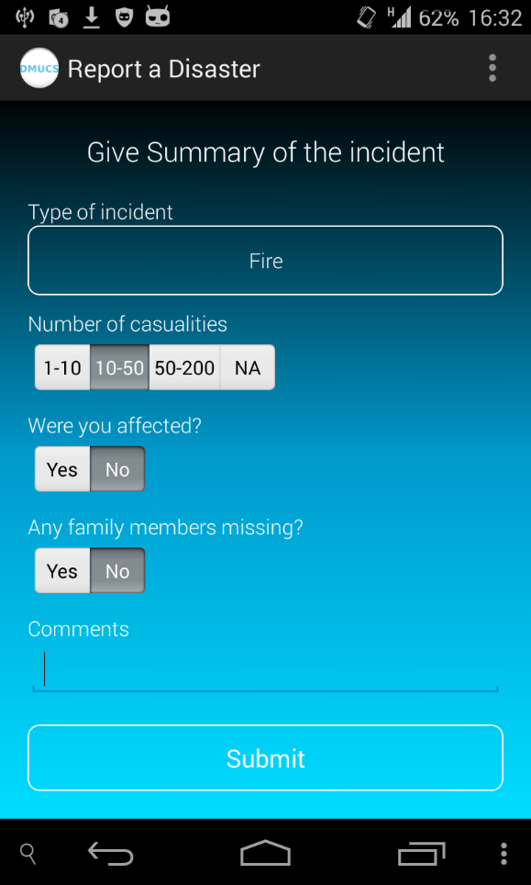
Notes:
How much completed
Work to be carried out in next month
How does this affect the society
by knowing who are affected and how they are affected helps manage disaster

Slide 13
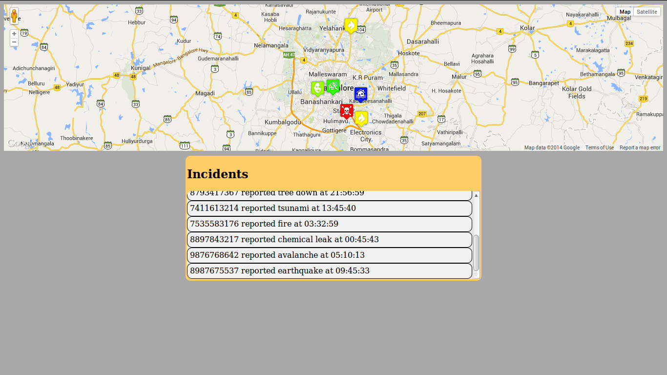

Slide 14
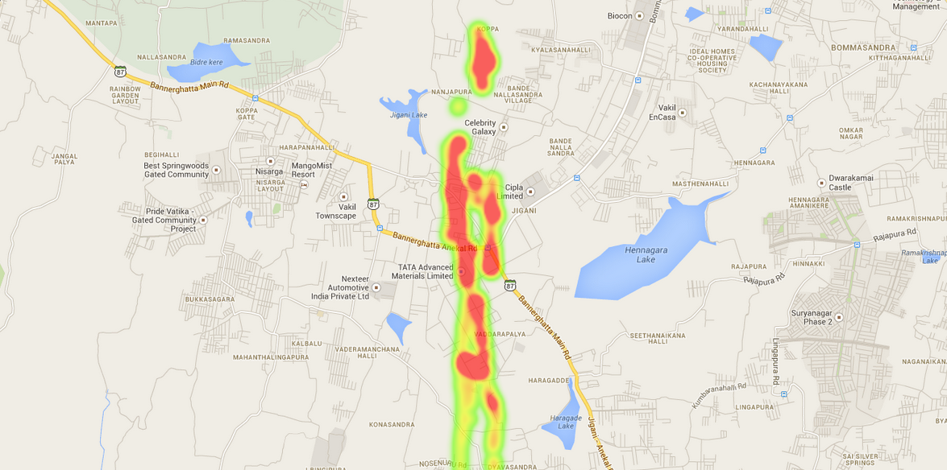

Slide 15
Work to be carried out in next month

Slide 16
How does this effect the society?
Makes use of time and other resources more sensibly.
Has far reaching impacts to resilience of vulnerable groups.
Catalyst and reinforcement for current and future projects.
Environmental awareness.
Brings together a wide range of stakeholders.

Slide 17
Thank You

