Slide 1

Disaster Management Using Crowdsourcing
Team Members: Arpith -1PE10CS018
Kumar Vishal -1PE10CS047
Vinutha M V -1PE10CS115
Manigandan C -1PE11CS408
Guide : Mrs. Bidisha Goswami
Batch No: 16

Slide 2

Crowdsourcing
Crowdsourcing is the practice of obtaining needed services, ideas, or content by soliciting contributions from a large group of people, and especially from an online community, rather than from traditional employees or suppliers.
Each contributor by their own initiative, adds a small portion of data for the greater result.

Slide 3
The effectiveness of emergency response largely depends on having a precise, up-to-date situational picture.
In this project, we use crowdsourcing for the production of volunteer-produced information before, during and after a disaster takes place to obtain this information.

Slide 4
Features
Quick and easy reporting (of an incident)
Android wear support
CrowdFunding
API Support
Gamification
Heatmaps
MySQL Cluster
Missing Person Reports

Slide 5

Android Wear is a version of Google's Android operating system for wearable devices
announced on 18 March 2014 (only developer preview)

Slide 6
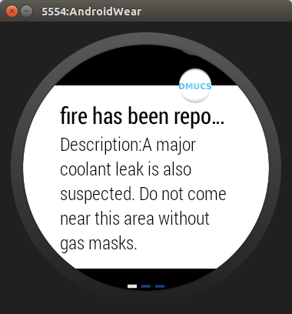
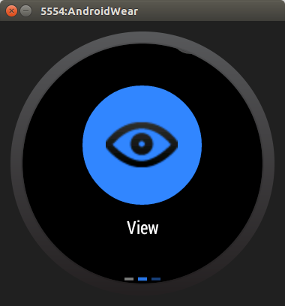

Slide 7
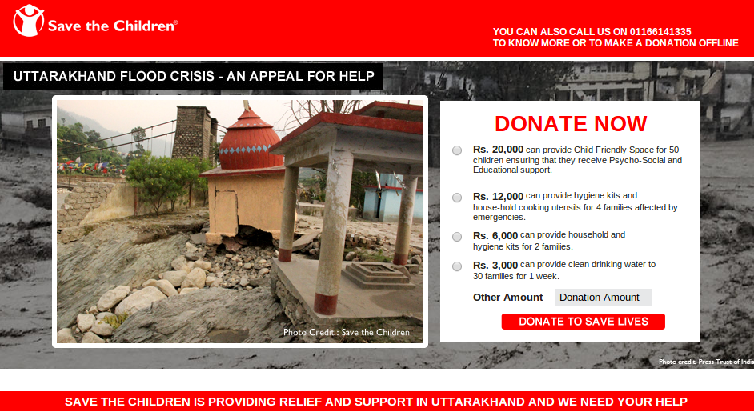

CroudFunding
Save the Children is providing relief and support to the survivors of the massive destruction in Uttarakhand caused by flash floods and landslides. We know from experience that, after a disaster like this, children are always among the most vulnerable as the adults around them struggle to come to terms with the loss of homes, possessions and livelihoods.
We urgently need your support to reach out and help thousands of children and families to make it through this crisis.
Please donate today and help save the lives of many children in Uttarakhand devastated by the floods.
Thank you for your generous support.

Slide 8
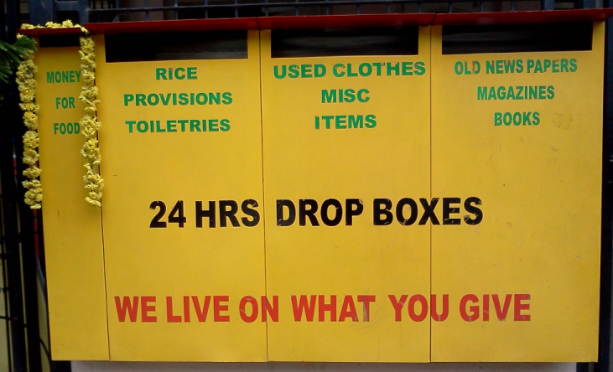
Drop Boxes

Slide 9
API Support
Support 3rd party developers
Data in database is encoded using
JSON notation

Slide 10


Gamification
Gamification is the use of game thinking and game mechanics in non-game contexts .
Improves user engagement

Slide 11
MySQL Cluster
Auto-sharding for Write-scalability
MySQL Cluster automatically shards (partitions) tables across nodes, enabling databases to scale horizontally on low cost
Shared Nothing Architecture
Real-time Performance

Slide 12
Server Side Demo

Slide 13
Missing Person Module

Slide 14
Thank You

