Slide 1


Everything you need to know about AutoML!
CMPE 297 – Special Topics
Arpitha Gurumurthy
014642290
Research Paper reference:
AutoML: A Survey of the State-of-the-Art
https://arxiv.org/pdf/1908.00709.pdf

Slide 2

Problem Statement
Tired of figuring out which model to use for your use case?
Tired of feature selection and hyperparameter tuning?
Well then, welcome to the world of AutoML!

Slide 3
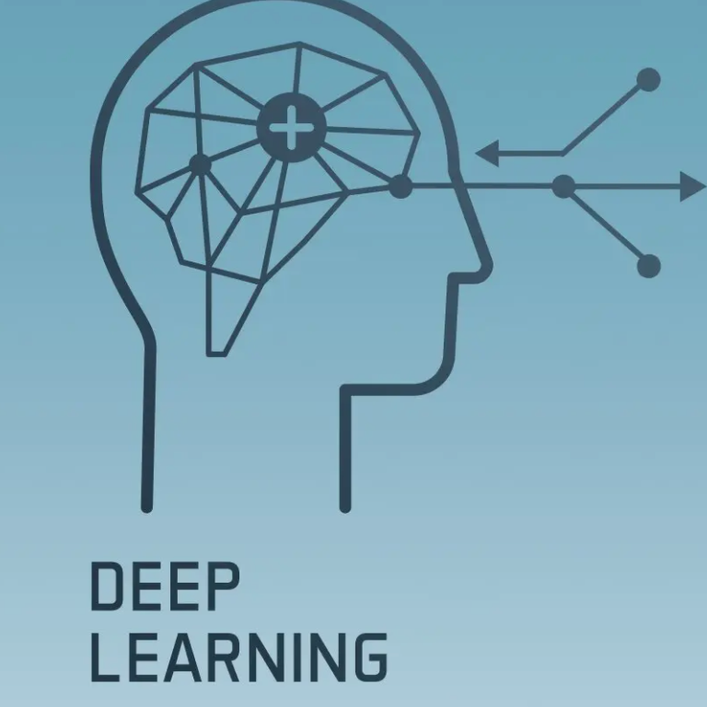
What’s stopping DL techniques from being widely employed?
DL methods have proven to perform remarkably well on image classification, object detection, and language modeling tasks.
But the development relies heavily relies on human expertise.
AutoML helps in removing the need for humans in the loop by automating the entire ML pipeline.

Slide 4

What is AutoML?
AutoML is the process of automating the construction of an ML pipeline on a limited budget by enabling even infants in the field to build ML applications.
A complete AutoML system is beginner-friendly and helps us build an end-to-end ML pipeline.

Slide 5
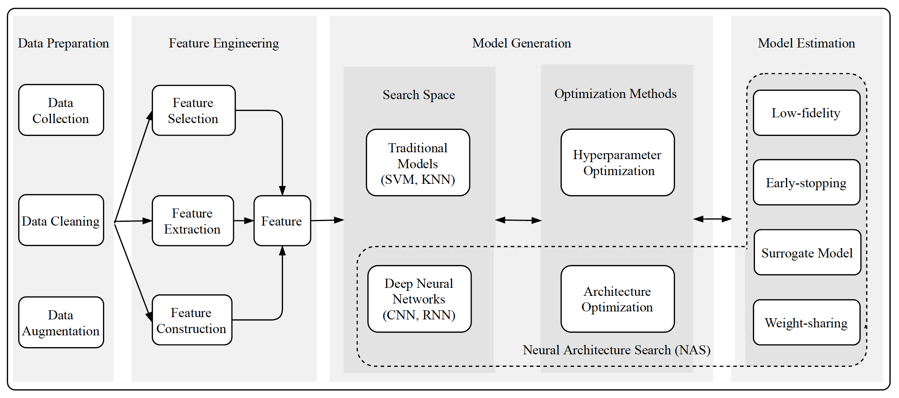
What are the main stages in AutoML?

Slide 6

Stage 1: Data Preparation

Slide 7
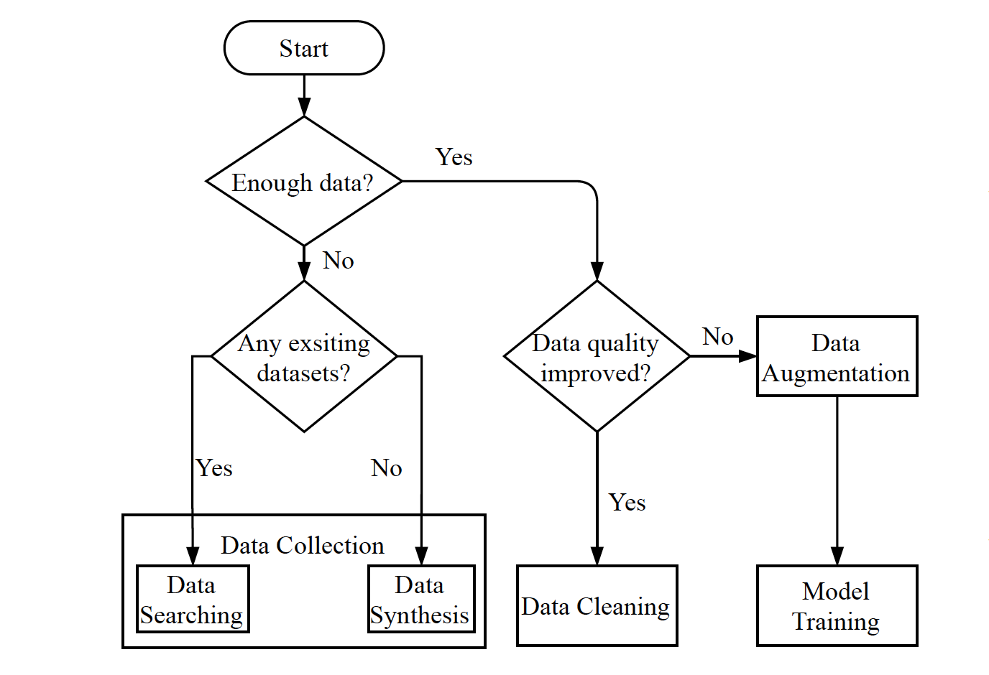
Data Preparation is a building block of an ML pipeline.
The three main aspects are
1. Data Collection
2. Data Cleaning
3. Data Augmentation

Slide 8
1. Data Collection
This step involves building or enhancing an existing dataset.
The most important part of building an ML system is having the right dataset.
This is a very challenging task as it would require several resources.
To solve this problem, data searching, and data synthesis were introduced.

Slide 9
1. Data Collection - Continued
Data Searching:
The most common source of data is web data and searching the web data is tough given that it is inexhaustible.
Web data may be unlabeled or incorrectly labeled. To solve for incorrect labels, active and semi-supervised learning methods can be employed.
Dataset imbalance is another problem when it comes to web data. Symmetric Minority Oversampling Technique (SMOTE) can help alleviate the imbalance by creating new minority samples.

Slide 10
1. Data Collection - Continued
Data Synthesis:
Acquiring data or synthesize it is a very expensive affair.
Data simulators can be used to mimic real-world data during the research phase.
OpenAI gym is a tool that provides a variety of simulated environments. For example, they are beneficial for Autonomous driving given the safety hazards.
With the help of this toolkit, developers can focus their energy on writing the algorithm instead of worrying about generating data.
Another very useful technique for generating an image, tabular, and text data is Generative Adversarial Networks (GANs).

Slide 11
2. Data Cleaning
Data that is collected from the web or any other source is bound to have noise, and noise can negatively affect what the model learns.
Traditionally this process was carried out through crowdsourcing and required expert knowledge. This was very expensive.
Many methods like BoostClean and AlphaClean were introduced to automate data cleaning on static data.
As for dynamic data, meta-learning techniques were applied.

Slide 12
3. Data Augmentation
This process can be considered as an extension to data collection as it involves generating new samples based on existing data.
Data Augmentation (DA) also helps in generalizing the model by avoiding overfitting since it essentially focuses on generating more data for model training.
This enhances the model robustness and in turn the performance.

Slide 13
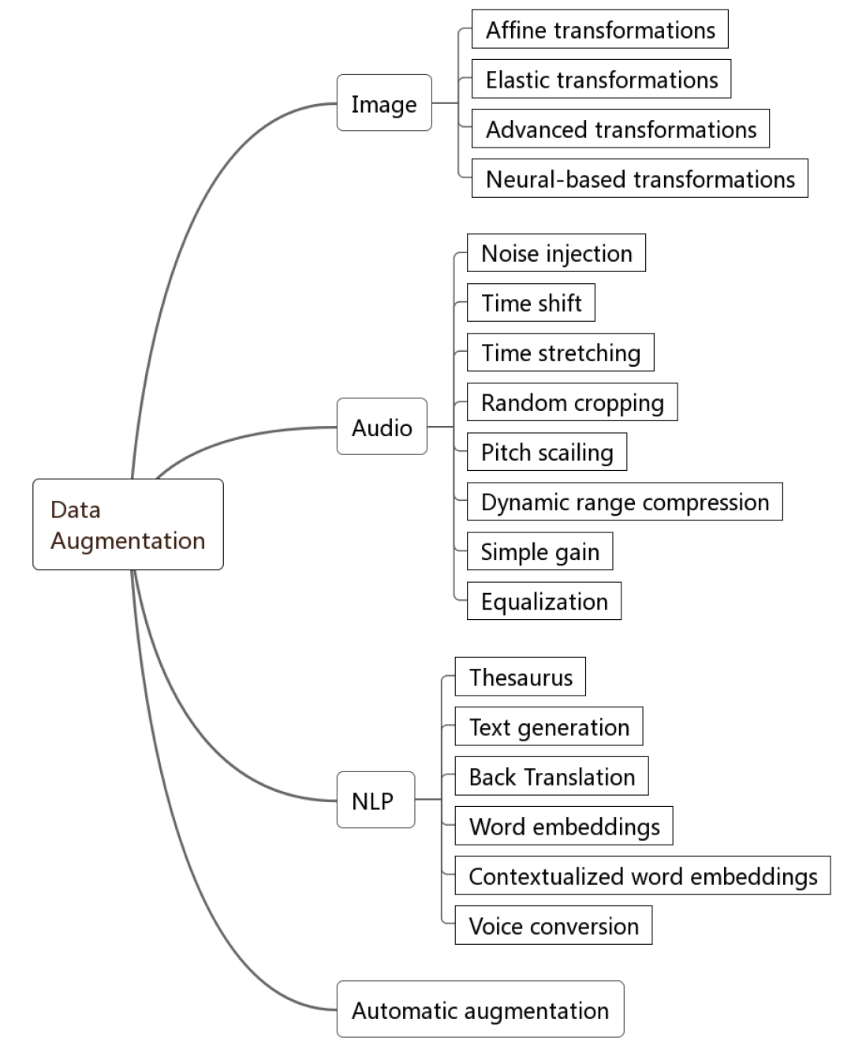
Data Augmentation techniques

Slide 14
Stage 2: Feature Engineering

Slide 15
What is Feature Engineering?
Feature Engineering is the process of extracting features from raw data that the models can understand.
The three main aspects of feature engineering include feature selection, feature extraction, and feature construction.
Feature extraction and selection involve reducing the dimensionality/number of features, while feature construction deals with increasing this dimensionality.
Automatic feature engineering involves the combination of these three processes.

Slide 16
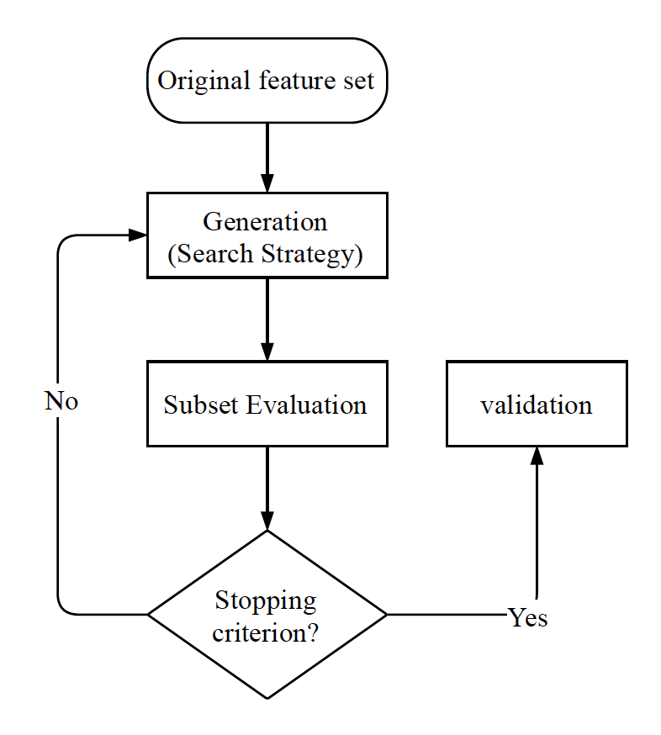
1. Feature Selection
The main purpose of feature selection is to eliminate redundant and irrelevant features.
This helps in simplifying the model complexity while also increasing its robustness and performance.

Slide 17
Feature Selection: Generation (Search Strategy)
The three types of algorithms used in search strategy are complete search, heuristic search, and random search.
The heuristic search involves Sequential Forward Selection (SFS), Sequential Backward Selection (SBS), and Bidirectional search (BS).
As the name suggests, SFS and SBS follow a sequential order for adding and removing features. BS performs both SFS and SBS until they result in the same subset.
As for random search methods, the most used are Simulated Annealing (SA) and Genetic Algorithms (GAs).

Slide 18
2. Feature Construction
This process involves creating new features from raw data thereby increasing the number of samples.
This in turn helps in increasing the model generalizability and performance.
Preprocessing transformation is one of the most used methods for feature construction. This includes standardization, normalization, and feature discretization.
Decision tree-based methods, genetic algorithms, annotation-based approaches are some automated methods for feature construction.

Slide 19
3. Feature Extraction
The essence of feature extraction is dimensionality reduction. Unlike feature selection, original features are allowed to be altered during this process.
Most popular approaches include to automate this process are Principal Component Analysis (PCA), Independent Component Analysis, isomap, non-linear dimensionality reduction, Linear Discriminant Analysis (LDA), and feed-forward neural network-based approaches.

Slide 20
Stage 3: Model Generation

Slide 21
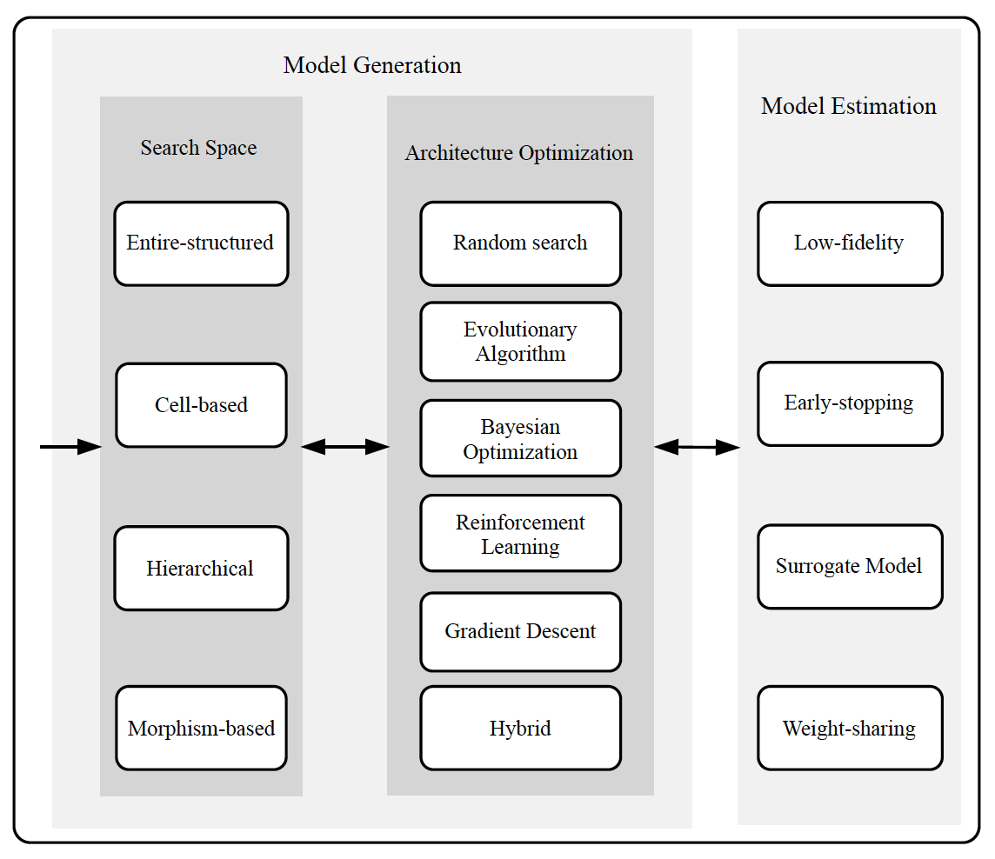
Model Generation
The 2 broad categories of models are traditional ML models and Deep Neural Networks (DNN).
Search space defines the structure of the model that can be designed
Optimization methods involve optimizing hyperparameters for training and model design.

Slide 22
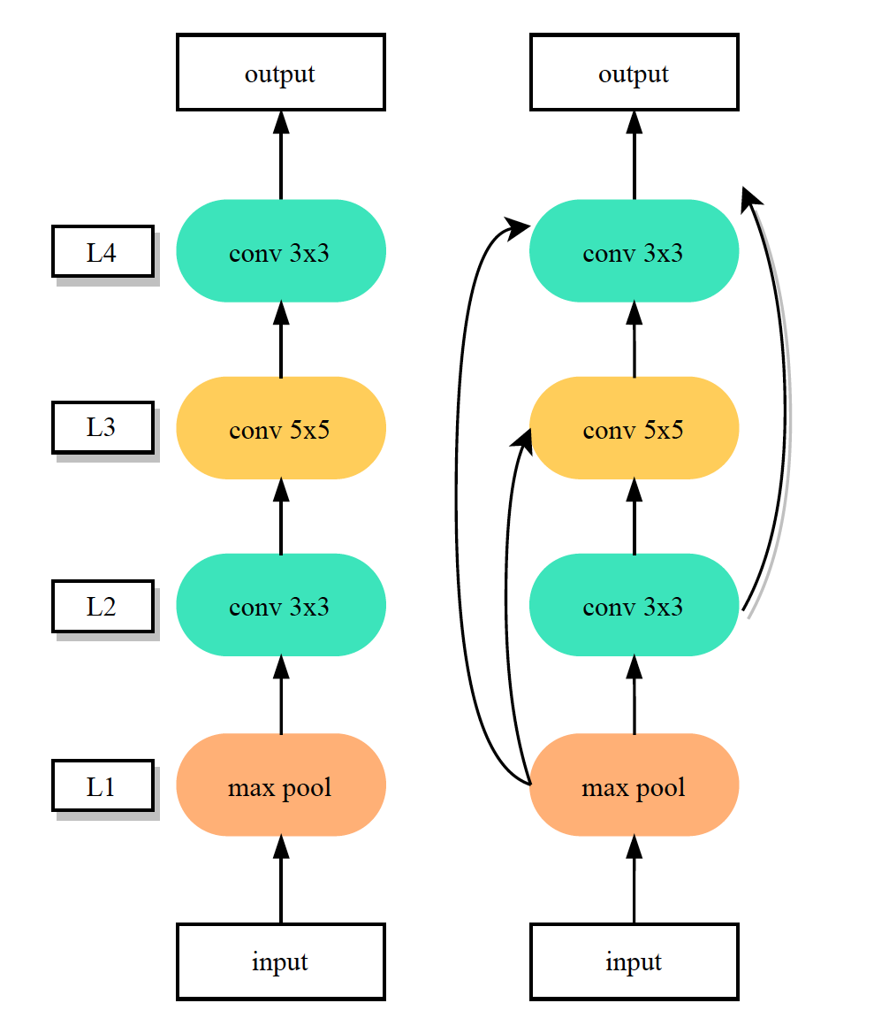
Search Space: Entire-structured Search Space

Slide 23
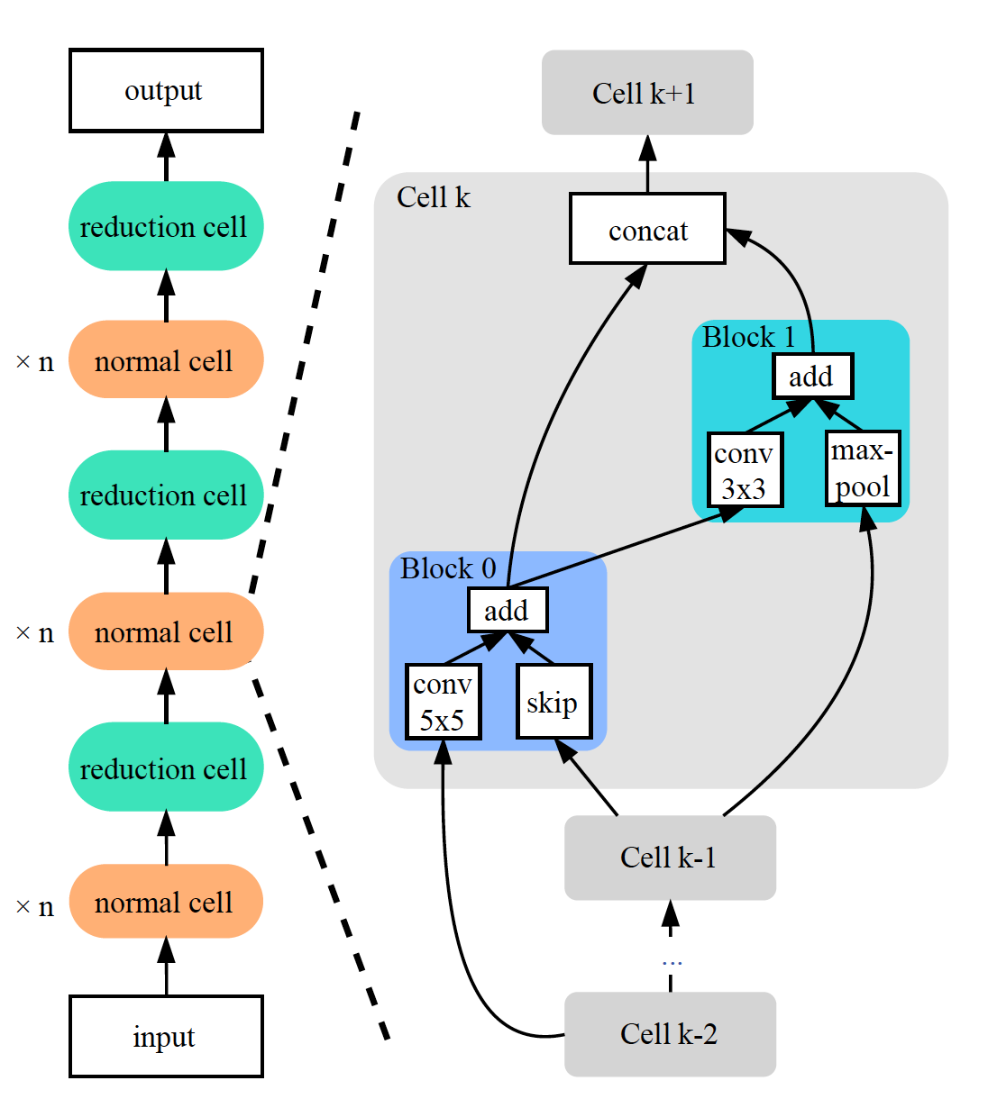
Search Space: Cell-based Search Space

Slide 24
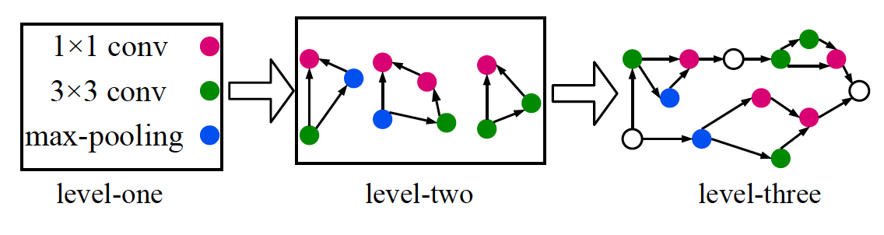
Search Space: Hierarchical Search Space

Slide 25
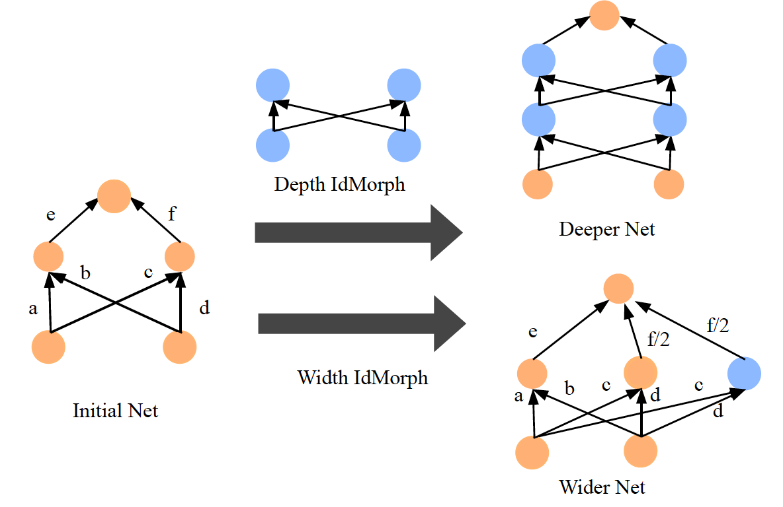
Search Space: Morphism-based Search Space

Slide 26
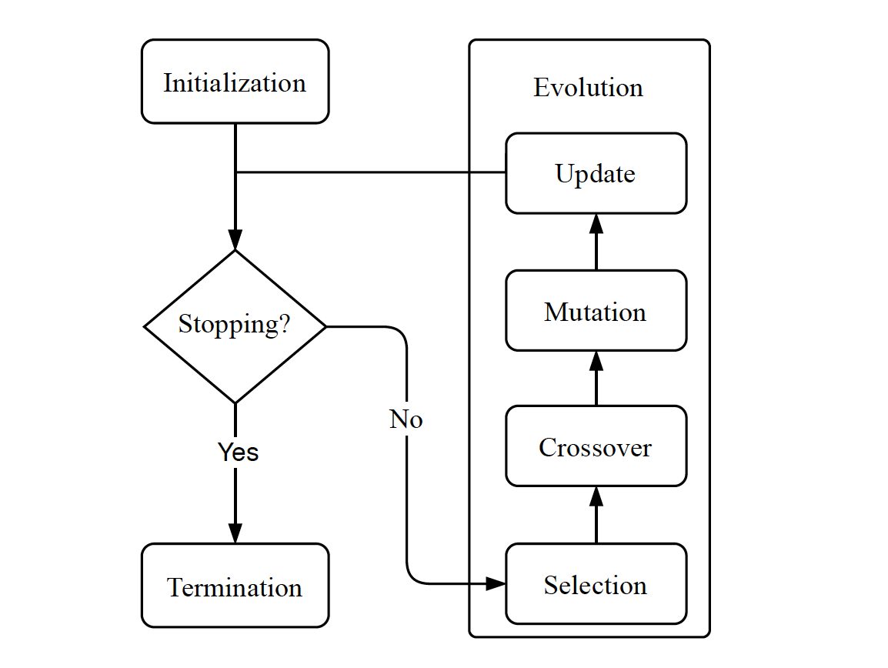
Architecture Optimization: Evolutionary Algorithm (EA)
Selection: selects a subset of the generated architectures.
Crossover: every 2 networks are combined to form an offspring network.
Mutation: Mutation refers to altering the learning rate and removing skip connections.
Update: the low-performing networks are removed periodically leaving behind only robust architectures

Slide 27
Other Architecture Optimization techniques:
Reinforcement Learning (RL)
Gradient Descent (GD)
Surrogate Model-based Optimization (SMBO)
Hybrid Optimization Method

Slide 28
Hyperparameter Optimization
Once we have the most optimal architecture after the AO stage, it becomes essential to finetune this network with different values of hyperparameters and find the most suitable values.
1. Grid and Random Search (GS and RS)
2. Bayesian Optimization (BO)
3. Gradient-based Optimization (GO)

Slide 29
Stage 4: Model Evaluation

Slide 30
Model Evaluation
Approaches that can accelerate the process of model evaluation:
Low fidelity: Model training time is directly proportional to the size of its dataset. We can also reduce the model size and compare its performance.
Weight Sharing: The core idea is to reuse the knowledge gained by the previous tasks to ramp up the training time of the current model design.
Early stopping: It is very beneficial to accelerate the model evaluation time by terminating the evaluations when the model starts to perform poorly on the evaluation data.
After the new model has been selected, we need to evaluate its performance

Slide 31

NAS Performance Comparison
The early research on EA- and RL-based NAS methods focused more on high performance rather than on resource consumption.
The later research on NAS attempted to improve search efficiency by not compromising on model performance.
EENA utilized the mutation and crossover operations of EA which reused the learned information in the evolution process.
ENAS was the first RL-based NAS approach that adopted a parameter-sharing strategy, thereby reducing the number of GPUs.

Slide 32
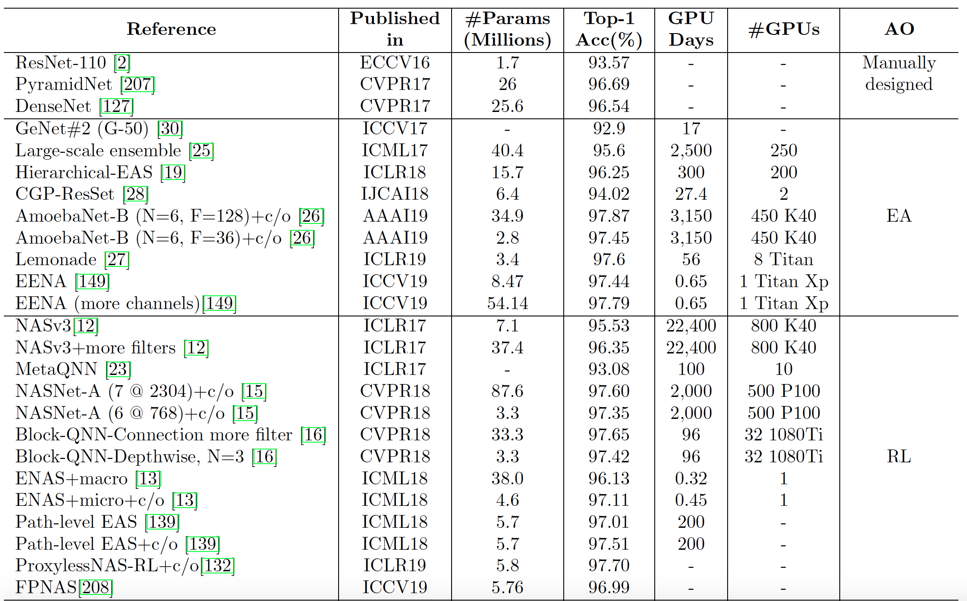
Performance of different NAS algorithms on CIFAR-10 – Part 1

Slide 33
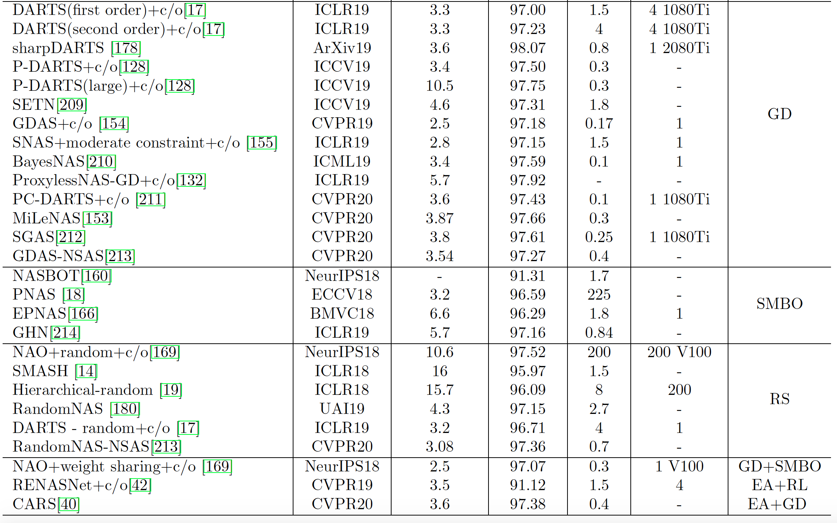
Performance of different NAS algorithms on CIFAR-10 – Part 2

Slide 34
Open Problems and Future Directions
The existing search spaces have proven to be efficient but require some degree of human interference. This introduces bias.
When it comes to NLP tasks, the NAS community is yet to produce models that can match up to human-designed ones. This is surely an area for improvement and requires more research.
Another important direction for further research is to learn how to interpret the results of AutoML mathematically.
Reproducibility is an ever-challenging problem in ML which is also carried over to AutoML.
The datasets used in AutoML research (CIFAR-10 and ImageNet) are mostly labeled and well-structured. However, data in the real world is almost chaotic.

Slide 35
Conclusion
We’ve seen various AutoML applications in this article, from data preparation to model evaluation.
We’ve also shed some light on the less explored areas which might need some attention.
With, it is worthy to note that AutoML is a powerful invention that allows even beginners in the field of ML to build and deploy AI applications.
AutoML marks a huge milestone in taking the world towards self-improving AI.

Slide 36

THANK YOU!
I would like to thank my Professor Vijay Eranti for inspiring me to research on AutoML and understand its benefits.

Slide 37

References
https://arxiv.org/pdf/1908.00709.pdf
https://careers.edicomgroup.com/what-is-deep-learning-case-study-in-edicom-part-i/
https://searchsoftwarequality.techtarget.com/feature/Analysts-mixed-on-future-growth-of-MLOps-AutoML-tools
https://www.freepik.com/free-vector/cute-monkey-confused-cartoon-vector-icon-illustration-animal-nature-icon-concept-isolated-premium-vector-flat-cartoon-style_16305659.html
https://arxiv.org/pdf/1904.11827.pdf
https://arxiv.org/pdf/1711.01299.pdf

