Slide 1

WELCOME

Slide 2
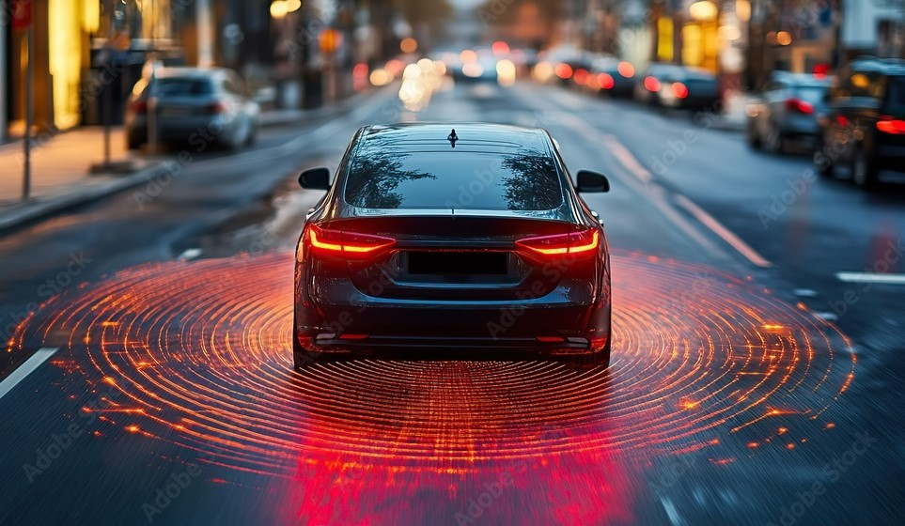
CAR BLACK BOX PROJECT

Slide 3

Under the guidance OF
SABARI SIR
POOVARASAN SIR
PRESENTED BY
ARPITHA J

Slide 4

CONTENTS:
      INTRODUCTION
      METHODOLOGY
      HARDWARE, SOFTWARE REQUIREMENTS
      WORKING
      IMPLEMENTATION
      APPLICATION
      ADVANTAGES
      RESULTS
      CONCLUSION

Slide 5

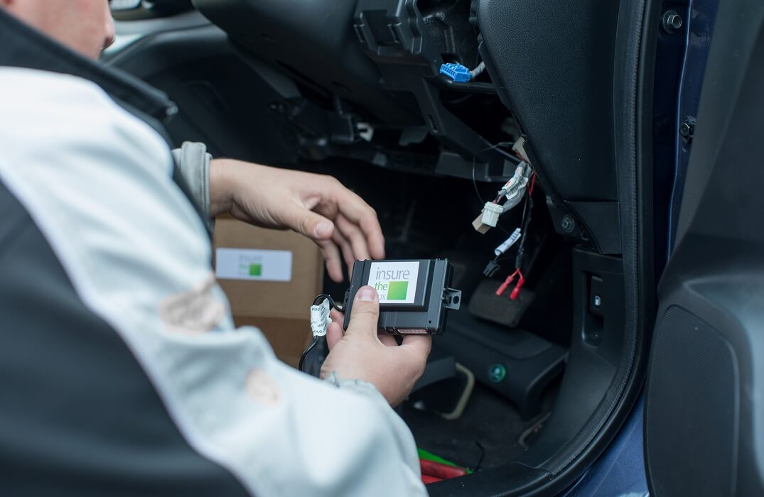
INTRODUCTION
A Car Black Box project is a system designed to record and store critical data about a vehicle's operation, similar to the black boxes used in aircraft.

Slide 6
The purpose of a car black box is to enhance safety, improve vehicle performance, and assist in accident investigation
It doesn’t only store event data in the light of a fatality or an accident but also provides with live statistics of the car details through an application interface on a mobile phone.
A traditional black box system requires a box with all the sensors physically connected to car.

Slide 7

METHODOLOGY
PIC18F4580
MICRO
CONTROLLER
PIC18F4580
MICRO
CONTROLLER
CLCD
POWER SUPPLY
CLCD
UART
I2C
RTC/EEPROM
UART
I2C
RTC/EEPROM
MATRIX KEYPAD
MATRIX KEYPAD
ADC
ADC
POTENTIOMETER
POTENTIOMETER

Slide 8
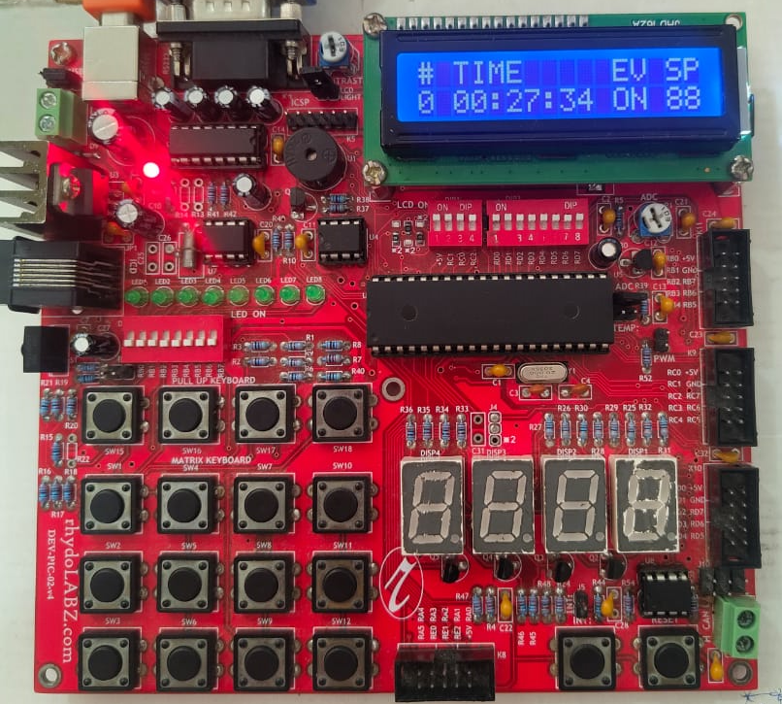
HARDWARE COMPONENTS
POWER
SUPPLY
CLCD
PHOTENTIO
METER
RTC
EEPROM
ADC
MATRIX
KEYPAD

Slide 9
SOFTWARE REQUIREMENTS
C programming
Teraterm 5 application
MPLAB X IDE v5.35
Tinybldwin
CH3x_installation

Slide 10
      WORKING
PIC18F4580 Microcontroller:
  This is the central processing unit of the system. It controls and processes data from connected peripherals and executes programmed instructions.
CLCD :
  A Character Liquid Crystal Display (CLCD) is a display module commonly used to show alphanumeric characters.
RTC (Real-Time Clock):
  Provides accurate time and date to the system. The microcontroller uses this information for time-stamping events or operations.
Matrix Keypad:
  Used for user input. When a button is pressed, the keypad sends a signal to the microcontroller, which interprets the input.

Slide 11
5. Potentiometer:
  Acts as an analog input to the microcontroller, typically used to adjust parameters like voltage or resistance.
6. Power Supply:
  Provides the necessary electrical power for all components in the system.
7. EEPROM (Electrically Erasable Programmable Read-Only Memory):
  Used for storing data that must be retained even after power is turned off, such as configuration settings.
8. ADC (Analog-to-Digital Converter):
  Converts analog signals (like those from the potentiometer) into digital data that the microcontroller can process.

Slide 12
    IMPLEMENTATION
DASHBOARD
We display the Time, Gear, Speed
EVENT STORE
To store the data in external EEPROM
MAIN MENU
In main menu 4 menus
  View log
  Clear log
  Set time
  Download log

Slide 13
      APPLICATION
Accident Analysis
Insurance Claims
Fleet Management
Driver Safety and Training
Law Enforcement
Research and Development
Emergency Response

Slide 14
      ADVANTAGES
Provides accurate data to determine the cause of accidents, which can be crucial for investigations and insurance claims.
Can help resolve disputes quickly, potentially leading to lower premiums for safe drivers.
Logs technical data, allowing early detection of mechanical issues and timely maintenance.
Encourages responsible driving, as drivers are aware their actions are being recorded.

Slide 15
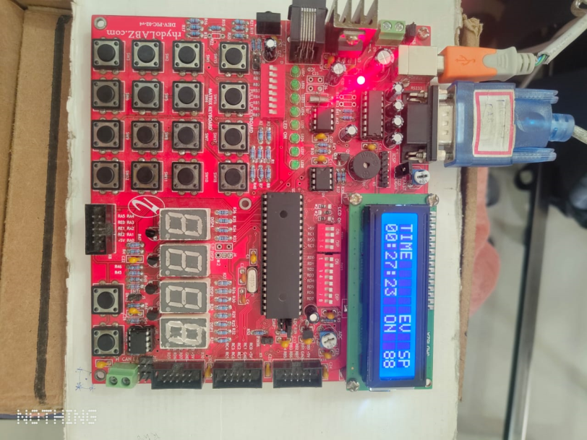
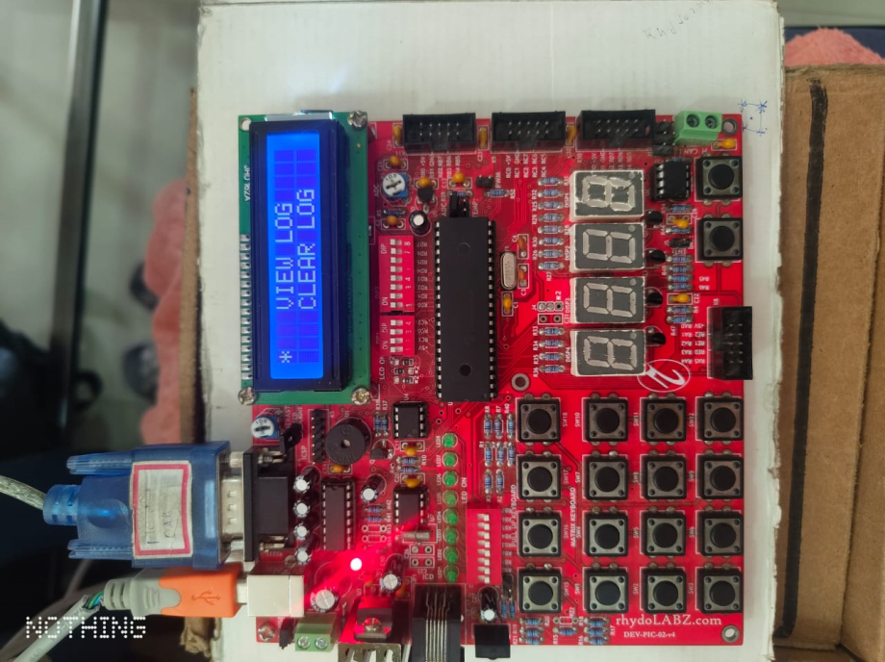
      RESULTS
When power ON or RESET to display the RTC time, event and speed.
If Switch 1 pressed gear will be increase the GN to GR and store the event.
If Switch 2 pressed gear will be decrease the GR to GN and store the event.
If Switch 3 pressed Collision happens at the time SW1 is GN to GR and SW2 is GR to GN and store the event.
If Switch 11 pressed enter the main menu and again SW11 enter all logs. If SW1 or SW2 inc and dec scroll down * will be changed as scroll up.
If Switch 12 pressed exit

Slide 16

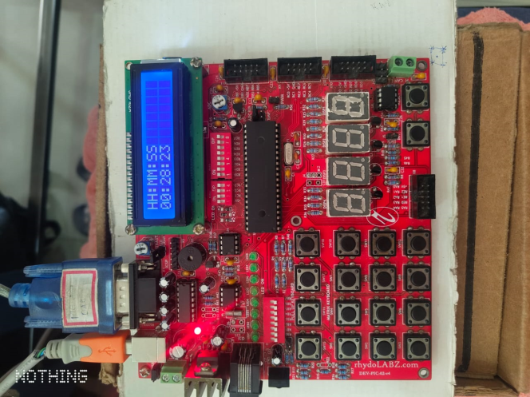
In view log SW1 is pressed decrement the stored events and SW2 is increment the stored events.
Only stored 10 data or events
If SW12 pressed exit.
In Set time If SW1 pressed increment the value in what field select that only
If SW2 pressed change fields hour or minute or seconds.
If SW11 save and exit and again SW11 what time set that will be print.

Slide 17
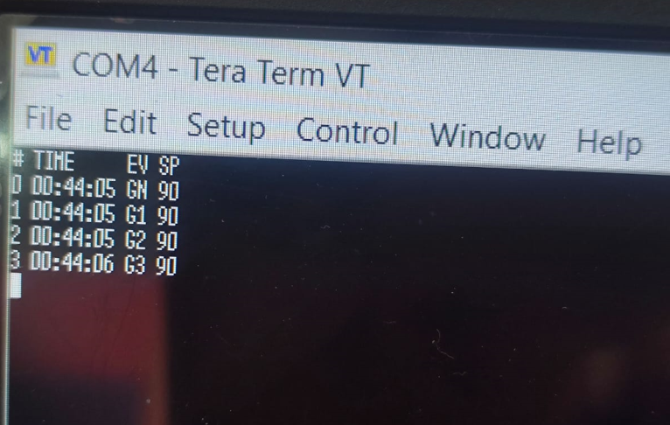
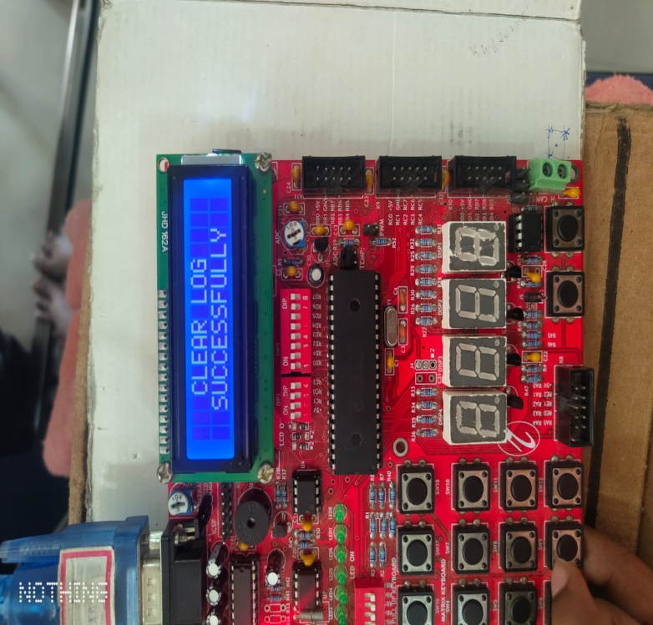
In Download log SW11 pressed what ever data present that will shows in teraterm application automatically displayed message in CLCD is Download log successfully and exit
If Clear log pressed CLCD print Clear data successfully and exit but in view log and download log pressed its shows No data found.

Slide 18
      CONCLUSION
The Black Box system built can be implemented in any vehicle. As soon as the driver runs the motor, this system will begin saving the events of the corresponding vehicle. The data saved can be retrieved only after the accident for privacy purposes.

Slide 19


