Slide 1
Takeaways from ArchConf 2015
Srini Karlekar, Scott Nestor

Slide 2
What is ArchConf?
ArchConf is an educational event for software architects, technical leaders, and senior developers.
The ArchConf 2015 event included full-day workshops on
Cloud-Native App Architecture
Modularity, Microservices and Modern Architectural Paradigms
Agile Design
Featured expert speakers included Martin Fowler, Rebecca Parsons, Neal Ford, Mark Richards, Matt Stine & Venkat Subramaniam.
Sponsored by Pivotal, Thoughtworks and Gradle.

Slide 3
Topics at ArchConf 2015
Agile Design · Scalable Systems · Microservices · Evolutionary Architecture · Distributed Systems · Continuous Delivery · Service-Based Architecture · Design Principles · Soft Skills · Web Application Security · Enterprise Messaging · Data Architecture · Architecture Patterns · Cloud Architectures · Measuring and Profiling · Modular Java

Slide 4
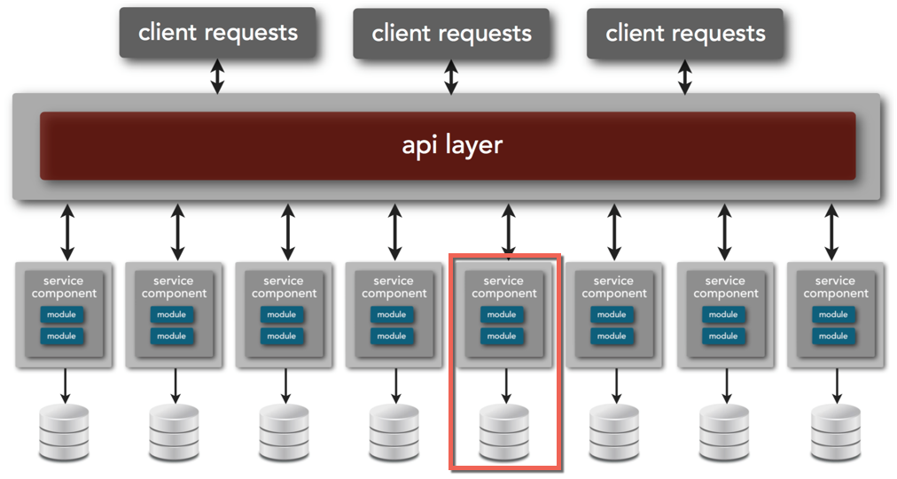
Microservices Overview

Slide 5
Microservices Concepts
Small, autonomous service that can be deployed independently.
Has a single business responsibility.
Small such that it favors rewrite over maintenance.
Self-contained and interacts through Web-based API.

Slide 6
Microservices Benefits
Resilience – Bulkheads built into the system prevent systemic failures.
Scaling – Lends to scaling on demand.
Speed of Deployment – Changes can be made to single service and deployed independently.
Reusability – Allows for functionality to be consumed in different ways for different purposes.
Multiple versions – Allows multiple versions to co-exist due to self-contained nature.
Notes:
Anti-pattern:
public class Employee {
public Money calculatePay() ...
public String reportHours() ...
public void save() ...
}
Microservice Pattern:
Employee Service:
public class Employee {
public Money calculatePay() ...
}
EmployeeReporter Service:
public class EmployeeReporter {
public String reportHours(Employee e) ...
}
EmployeeData Service:
public class EmployeeRepository {
public void save(Employee e) ...
}

Slide 7
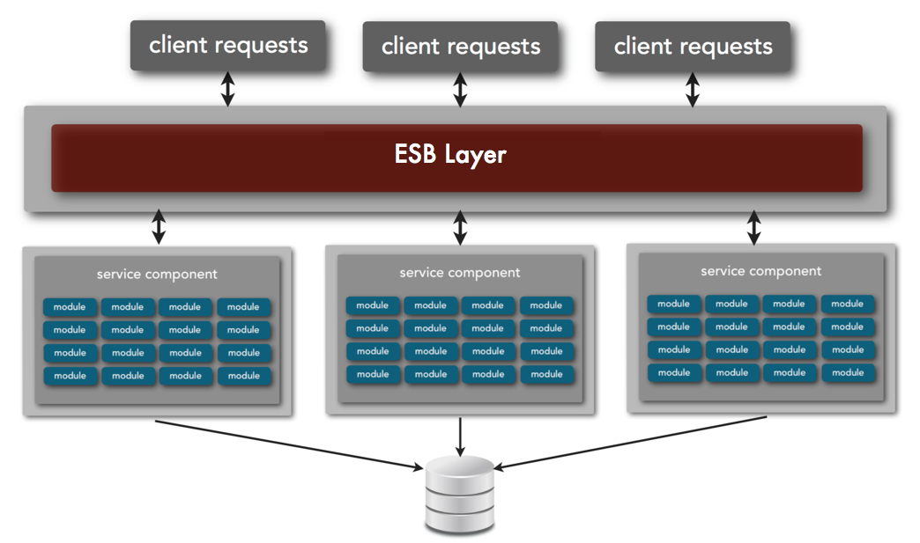
Service-oriented Architecture
Notes:
In SOA, the services are large with multiple modules sharing a database. Most of the time, a change to the service requires redeployment of the whole application.

Slide 8
Cloud-native Applications
Cloud-native Applications are applications composed of micro-services that can deployed in private or public cloud, are infrastructure-agnostic and elastic in nature.
Cloud-native Applications provide high-visibility into the state of the applications (logs, real-time metrics etc), fault isolated, fault tolerant and are able to recover automatically.
Built based on a collection of patterns called Twelve-factor app.

Slide 9
Twelve-factor App
Twelve-factor App refers to a single deployable unit that focuses on speed, safety and scale by emphasizing declarative configuration, stateless/shared-nothing processes that horizontally scale, and an overall loose coupling to the deployment environment.
Cloud application platforms like Cloud Foundry, Heroku, and Amazon Elastic Beanstalk are optimized for deploying twelve-factor apps.

Slide 10
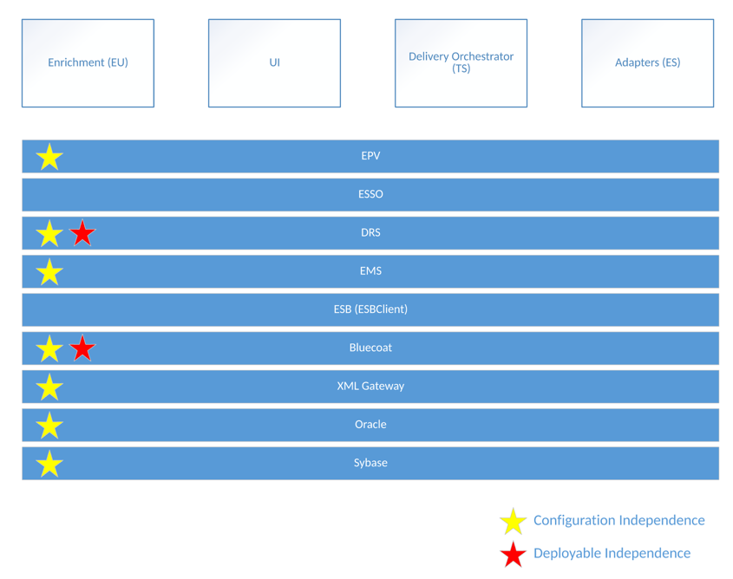
Current LDNG Architecture

Slide 11
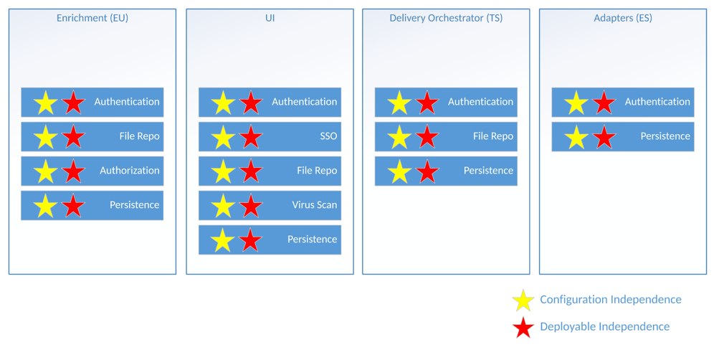
LDNG as Microservices

Slide 12
Takeaways
LDNG has already contains some foundational aspects of microservice and cloud native architectures.
Microservices Learning
Does not infer/imply functional/domain sizing (forget “micro”)
Applications and cloud providers should adhere to the 12 factor methodology
Not a “silver bullet” … complexity trade-offs
Cloud provider sophistication is evolving rapidly and is mature enough to facilitate “new adopters” more easily
Spring Boot is a mature framework to facilitate the creation of applications and/or services that incorporates industry leading components, libraries, and databases
Notes:
Microservice 12 factor principals already acheived – version control, dependency isolation, externalized config (partial), coordinated stateless processes, concurrency (partial), logs
Cloud Native – separately deployable (and releasable) components
Complexity Trade-offs – 1) Stateless coordination between services relies primarily on REST integration only and may require logical/app transactional management, 2) “Carry On” cloud deployment strategy introduces infrastructure redundancy and may require an “eventually consistent” approach to data persistence.

