Slide 1
Takeaways from ArchConf 2015
Srini Karlekar, Scott Nestor

Slide 2
What is ArchConf?
ArchConf is an educational event for software architects, technical leaders, and senior developers.
The ArchConf 2015 event included full-day workshops and seminars on topics including, Cloud-Native Application Architecture, Microservices, Web Application Security, Continuous Delivery & Spring Boot.
Featured expert speakers included Martin Fowler, Rebecca Parsons, Neal Ford, Mark Richards, Matt Stine & Venkat Subramaniam.
Sponsored by Pivotal, Thoughtworks and Gradle and organized by No Fluff Just Stuff.
The conference was attended by over 200 attendees spanning a variety of industries such as banking, finance, telecom, aerospace, travel & publishing.

Slide 3
Key Takeaways
Cloud Native Application architecture enables building always available, web-scale applications rapidly.
Microservices are the components of a well-designed Native Cloud Applications.
The Twelve-Factor App pattern & methodology defines the characteristics of a cloud native application architecture.
Spring Boot is a framework that facilitates building of Cloud Native Applications based on the twelve factors pattern. It can be used for building micro-services and twelve-factor applications.

Slide 4
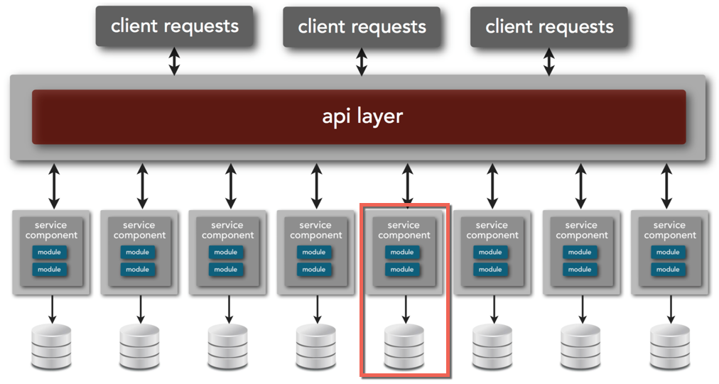
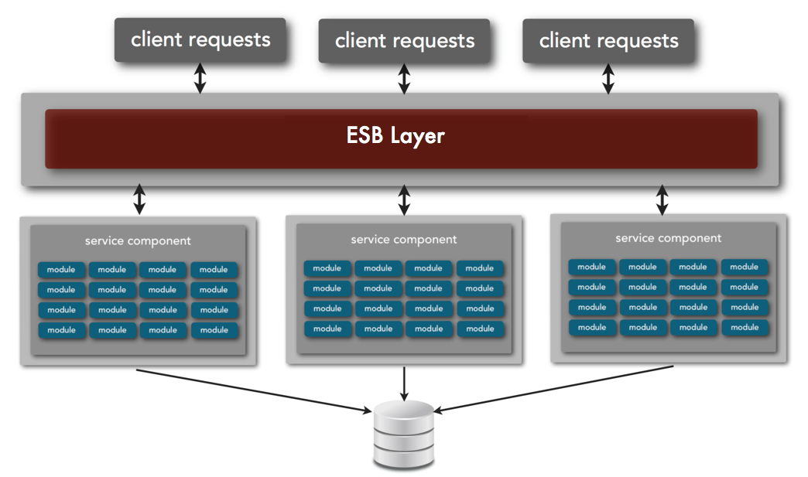
Microservices vs Service-oriented Architecture
Microservices Architecture
Service-oriented Architecture
Small, autonomous services that can be deployed independently through automated delivery.
Has a single business responsibility.
Small such that it favors rewrite over maintenance.
Self-contained and interacts through Web-based API.
Centrally orchestrated.
Larger services and heavier footprint.
Services usually share databases.
Services are often implemented in deployment monoliths.
Adding new services require laying new routing paths.

Slide 5
Microservices Benefits
Resilient – Fail-safes built into the system prevent systemic failures.
Scaling – Lends to scaling on demand.
Speed of Deployment – Changes can be made to single service and deployed independently.
Reusability – Allows for functionality to be consumed in different ways for different purposes.
Multiple versions – Allows multiple versions to co-exist due to self-contained nature.
Notes:
Anti-pattern:
public class Employee {
public Money calculatePay() ...
public String reportHours() ...
public void save() ...
}
Microservice Pattern:
Employee Service:
public class Employee {
public Money calculatePay() ...
}
EmployeeReporter Service:
public class EmployeeReporter {
public String reportHours(Employee e) ...
}
EmployeeData Service:
public class EmployeeRepository {
public void save(Employee e) ...
}

Slide 6
Cloud-native Applications & Twelve-factor Apps
Cloud-native Applications are applications composed of micro-services that can deployed in private or public cloud, are infrastructure-agnostic and elastic in nature.
Cloud-native Applications provide high-visibility into the state of the applications (logs, real-time metrics etc), fault isolated, fault tolerant and are able to recover automatically.
Built based on a collection of patterns called Twelve-factor app.
Twelve-factor App refers to a single deployable unit that focuses on speed, safety and scale by emphasizing declarative configuration, stateless/shared-nothing processes that horizontally scale, and an overall loose coupling to the deployment environment.
Cloud application platforms like Cloud Foundry, Heroku, and Amazon Elastic Beanstalk are optimized for deploying twelve-factor apps.

Slide 7
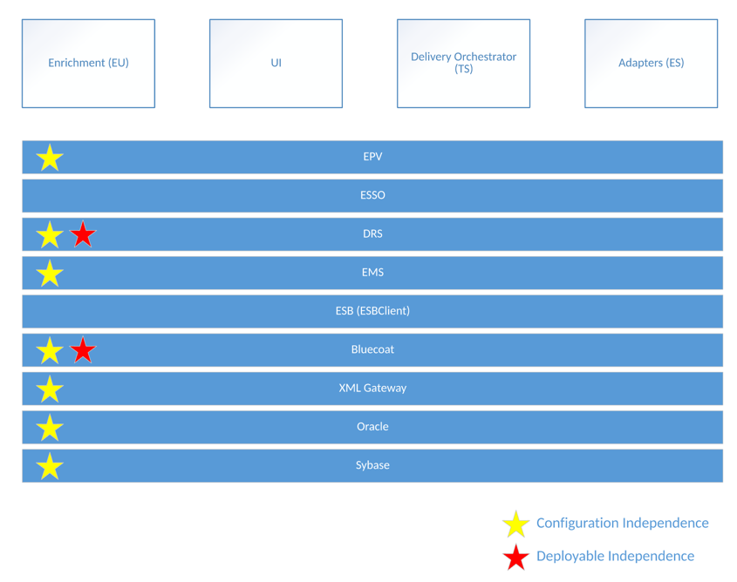
Current LDNG Architecture
LDNG already contains some foundational aspects of microservices and cloud native architectures.

Slide 8
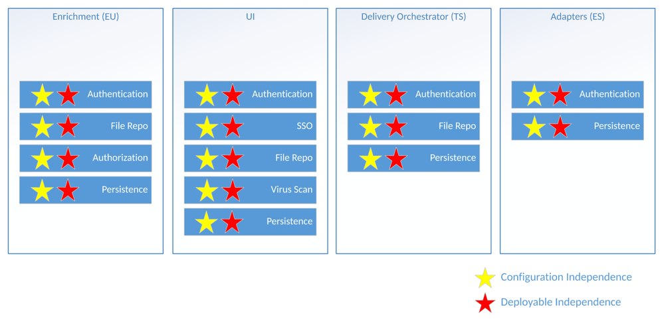
LDNG as Microservices
Refactoring LDNG as Microservices would require splitting the database across the various services and removing the ESB layer.

Slide 9
Appendix: Twelve Factors
One codebase tracked in revision control, many deploys.
Explicitly declare and isolate dependencies.
Store config in a configuration server.
Treat backing services as attached resources.
Strictly separate build and run stages.
Execute the app as one or more stateless processes.
Export services via port binding.
Scale out via the process model.
Maximize robustness with fast startup and graceful shutdown.
Keep development, staging, and production as similar as possible.
Treat logs as event streams.
Run admin/management tasks as one-off processes.

