Slide 1
Takeaways from ArchConf 2015
Srini Karlekar, Scott Nestor

Slide 2
What is ArchConf?
ArchConf is an educational event for software architects, technical leaders, and senior developers.
The ArchConf 2015 event included full-day workshops on
Cloud-Native App Architecture
Modularity, Microservices and Modern Architectural Paradigms
Agile Design
Featured expert speakers included Martin Fowler, Rebecca Parsons, Neal Ford, Mark Richards, Matt Stine & Venkat Subramaniam.
Sponsored by Pivotal, Thoughtworks and Gradle.

Slide 3
Topics at ArchConf 2015
Agile Design · Scalable Systems · Microservices · Evolutionary Architecture · Distributed Systems · Continuous Delivery · Service-Based Architecture · Design Principles · Soft Skills · Web Application Security · Enterprise Messaging · Data Architecture · Architecture Patterns · Cloud Architectures · Measuring and Profiling · Modular Java

Slide 4
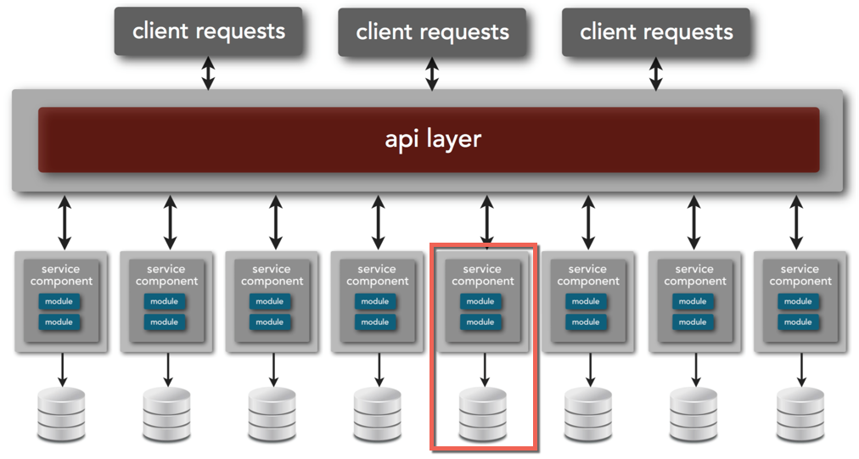
Microservices Overview

Slide 5
Microservices Concepts
Small, autonomous service that can be deployed independently.
Has a single business responsibility.
Small such that it favors rewrite over maintenance.
Self-contained and interacts through Web-based API.

Slide 6
Microservices Benefits
Resilience – Bulkheads built into the system prevent systemic failures.
Scaling – Lends to scaling on demand.
Speed of Deployment – Changes can be made to single service and deployed independently.
Reusability – Allows for functionality to be consumed in different ways for different purposes.
Multiple versions – Allows multiple versions to co-exist due to self-contained nature.
Notes:
Anti-pattern:
public class Employee {
public Money calculatePay() ...
public String reportHours() ...
public void save() ...
}
Microservice Pattern:
Employee Service:
public class Employee {
public Money calculatePay() ...
}
EmployeeReporter Service:
public class EmployeeReporter {
public String reportHours(Employee e) ...
}
EmployeeData Service:
public class EmployeeRepository {
public void save(Employee e) ...
}

Slide 7
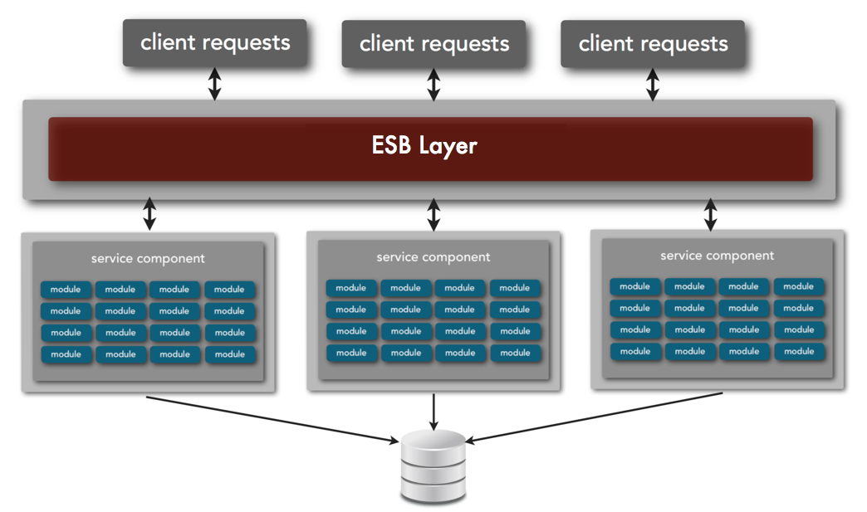
Service-oriented Architecture
Notes:
In SOA, the services are large with multiple modules sharing a database. Most of the time, a change to the service requires redeployment of the whole application.

Slide 8
Cloud-native Applications
Cloud-native Applications are applications composed of micro-services that can deployed in private or public cloud, are infrastructure-agnostic and elastic in nature.
Cloud-native Applications provide high-visibility into the state of the applications (logs, real-time metrics etc), fault isolated, fault tolerant and are able to recover automatically.
Built based on a collection of patterns called Twelve-factor app.

Slide 9
Twelve-factor App
Twelve-factor App refers to a single deployable unit that focuses on speed, safety and scale by emphasizing declarative configuration, stateless/shared-nothing processes that horizontally scale, and an overall loose coupling to the deployment environment.
Cloud application platforms like Cloud Foundry, Heroku, and Amazon Elastic Beanstalk are optimized for deploying twelve-factor apps.

Slide 10
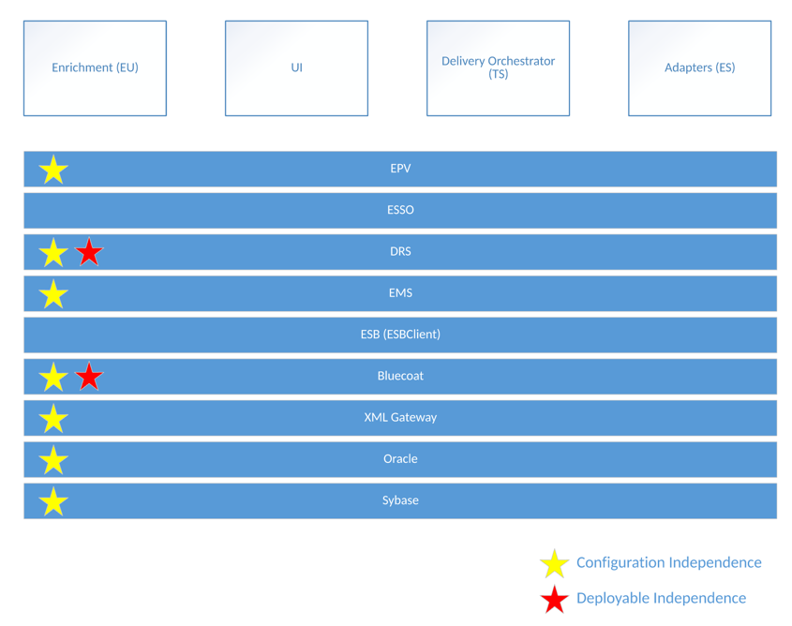
Current LDNG Architecture

Slide 11
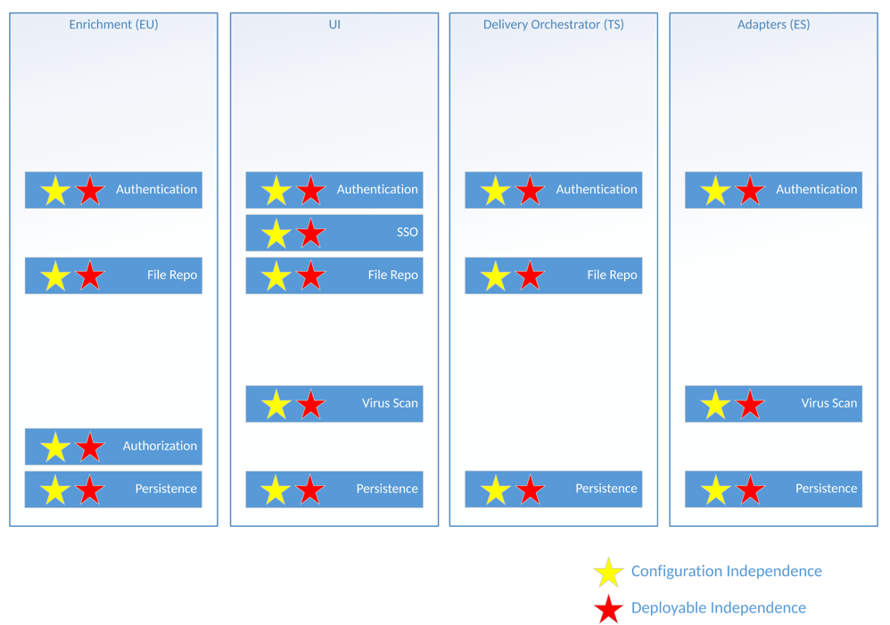
LDNG as Microservices

