Slide 1
Takeaways from ArchConf 2015
Srini Karlekar and Scott Nestor

Slide 2
What is ArchConf?
ArchConf is sponsored by Pivotal, Thoughtworks and Gradle and organized by No Fluff Just Stuff (NJFS)
The target audience are primarily software architects, designers and senior developers.
Key seminar topics included: Cloud-Native Application Architecture, Microservices, Web Application Security, Continuous Delivery & Spring Boot.
Featured expert speakers included: Martin Fowler, Rebecca Parsons, Neal Ford, Mark Richards, Matt Stine & Venkata Subramanian.
The conference was attended by over 200 attendees spanning a variety of industries such as banking, finance, telecom, aerospace, travel & publishing.
Notes:
Feedback
Why you went – 1) Industry leaders currently contributing to methodologies and frameworks that expand those we’re using, 2) Additional learning about CI/CD, Microservices, and cloud applications to evaluate areas for improvement
Areas of promise and where you want to go – lends to independent functional build out (e.g., import, eligibility), design secure and scalable apps, faster infrastructure configuration/setup, graceful failure management.

Slide 3
Key Takeaways
Significant energy and engagement around:
Cloud Native Apps (CNAs)
Cloud Native Application architecture enables building always available, web-scale applications rapidly
The Twelve-Factor App pattern & methodology defines the characteristics of a cloud native application architecture
Microservices
Microservices are the components of a well-designed Native Cloud Applications.
Spring Boot
Spring Boot is a framework that facilitates building of Cloud Native Applications based on the twelve factors pattern. It can be used for building micro-services and twelve-factor applications.
All these capabilities hold promise for Fannie Mae to adopt
Notes:
Feedback
Who cares about this – Architects, developers, business
How will this help – Faster development/start-up, Externalized dependency management (app dependencies),
De-centralizing reduces risk
Scaling becomes easier (dynamic)

Slide 4
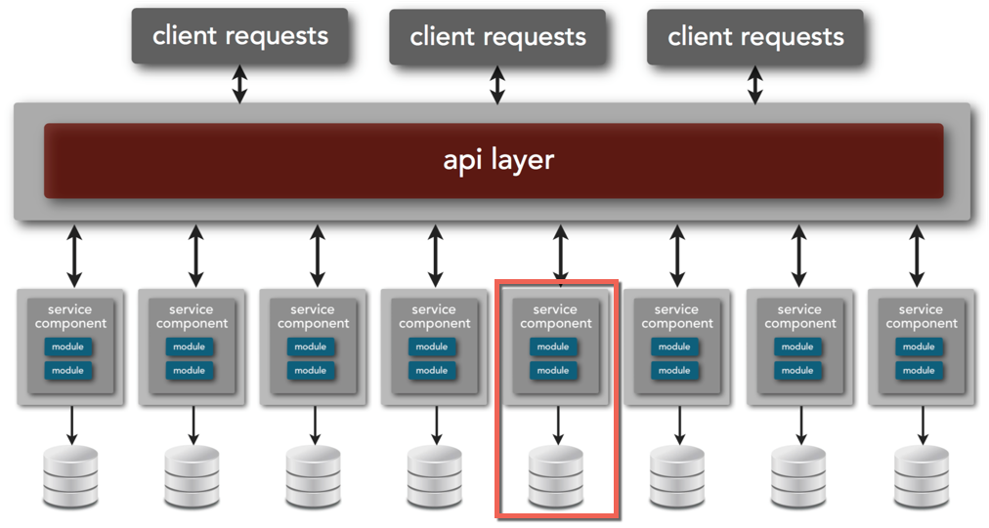
Microservices - Concepts
Small, autonomous services that can be deployed independently through automated delivery.
Has a single business responsibility.
Small such that it favors rewrite over maintenance.
Self-contained and interacts through Web-based API.
A loosely coupled, service oriented architecture with bounded contexts.
Notes:
Resilient – Fail-safes built into the system prevent systemic failures.
Scaling – Lends to scaling on demand.
Speed of Deployment – Changes can be made to single service and deployed independently.
Reusability – Allows for functionality to be consumed in different ways for different purposes.
Multiple versions – Allows multiple versions to co-exist due to self-contained nature.
Not heavy weight (no SOA soap), no common database (each svc has a table, view or cache), bounded context – domain driven design (Eric Evans)
Don’t have to know the whole system … just have a good svc API
Point to point instead of ESB (no longer trying to standardize common messages)
Multiple versions running concurrently (port binding)
No central orchestration
Feedback
Tie it back to project. Ease of retirement, talk about ES

Slide 5
Cloud-native Applications & Twelve-factor Apps
Cloud-native Applications:
Composed of micro-services that can deployed in private or public cloud, are infrastructure-agnostic and elastic in nature.
Provide high-visibility into the state of the applications (logs, real-time metrics etc), fault isolated, fault tolerant and are able to recover automatically.
Built based on a collection of patterns called Twelve-factor app.
Twelve-factor App:
Single deployable unit that focuses on speed, safety and scale by emphasizing declarative configuration, stateless/shared-nothing processes that horizontally scale, and an overall loose coupling to the deployment environment.
Cloud application platforms including Cloud Foundry, Heroku, and Amazon Elastic Beanstalk are optimized for deploying twelve-factor apps.
Notes:
Feedback
How does this align with current cloud strategy
How will it help with phase 2 and beyond

Slide 6
Appendix

Slide 7
Twelve Factors
Codebase - One codebase tracked in revision control, many deploys
Dependencies - Explicitly declare and isolate dependencies (“carry-ons”)
Config - Store config in the environment
Backing Services - Treat backing services as attached resources
Build, release, run - Strictly separate build and run stages
Processes - Execute the app as one or more stateless processes
Port binding - Export services via port binding
Concurrency - Scale out via the process model
Disposability - Maximize robustness with fast startup and graceful shutdown
Dev/prod parity - Keep development, staging, and production as similar as possible
Logs - Treat logs as event streams
Admin processes - Run admin/management tasks as one-off processes
Notes:
Most FNM apps already doing the first two (hopefully) … e.g., CVS, CC, or SVN (repos) and Maven Note: Should move to git and Spring Boot
Config in the env doesn’t mean property files or DB. Need env variables, or config server (versioned, and language agnostic)
Backing services – swappable, no distinction between local and 3rd party
Build, release, run – partially there with Maven, but env dependency assumptions still there Note: Need to move to Docker (or Chef)
Processes – State adds complexity (scaling, consistency) Note: Use Spring for session management
Port Binding – Bring your own container (TC, Jetty, etc.)
Concurrency – More processes, less multiplexing
Disposibility – “Crash Well”
Logs – ELK (logstash) ... Yeah!

Slide 8
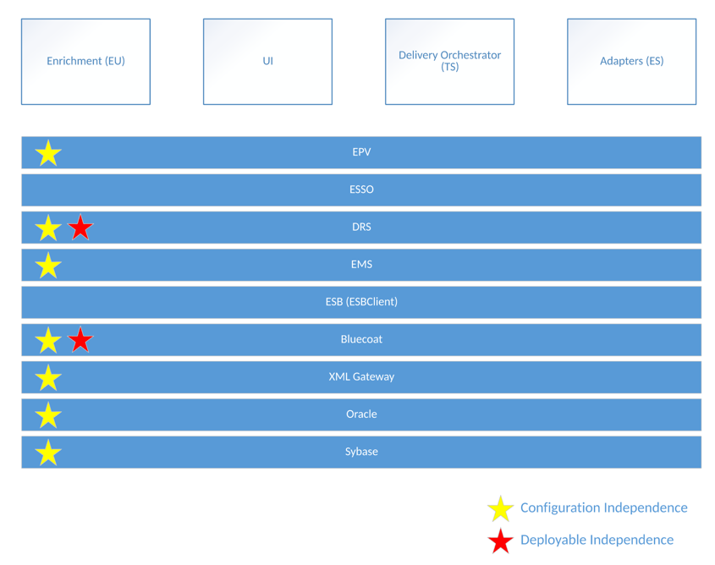
Example: Current LDNG Architecture
LDNG already contains some foundational aspects of microservices and cloud native architectures.

Slide 9
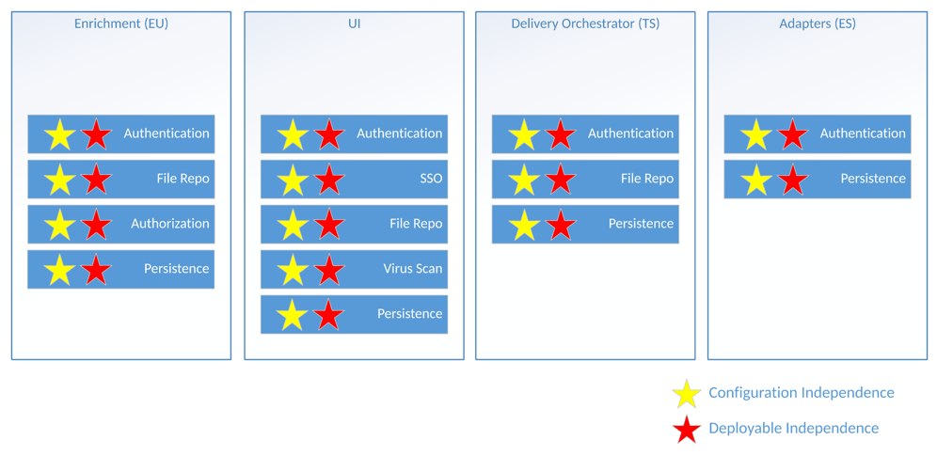
Example: LDNG as Microservices
Refactoring LDNG as Microservices would require splitting the database across the various services and removing the ESB layer.

