Slide 1
Building Event-Driven Microservices with the Serverless Framework
Srini Karlekar – Director, Software Engineering, Capital One.
Twitter: @skarlekar

Slide 2
The momentum behind serverless
The introduction of function PaaS (fPaaS¹) by AWS Lambda in re:Invent, Nov 2014 (and out of beta in late 2015) created a momentum for "serverless" platform architecture. AWS Lambda was soon followed by most major cloud platform vendors, including IBM, Microsoft, Google and, more recently, Oracle. Serverless is a cloud-native platform model.
Per Gartner, by 2022 most cloud architectures will evolve to a fundamentally serverless model rendering the cloud platform architectures dominating in 2017 as legacy architectures².
Serverless is a cloud-native platform model and reflects the core-promise of cloud-computing by offering agility and capability on demand at a value price.
Amazon started the trend with Lamda

Slide 3
Serverless Architecture vs. serverless Framework
Serverless computing model is an emerging trend and quite often misunderstood because of the hype and build-up surrounding the topic.
The term Serverless refers to building applications without having to configure or maintain infrastructure required for running your applications.
In reality, servers are still involved, though they are owned and controlled by the platform providers.
On the other hand there are frameworks used for exploiting the serverless architecture uninspiringly named Serverless Framework increasing the confusion.
No need to configure or maintain infrastructure

Slide 4

Serverless Architecture

Slide 5
What is Serverless
Serverless Architectures are those models where the applications logic provided by the Developer is run on stateless, compute containers that are provisioned and managed by a provider.
Typically these compute instances are ephemeral (short-lived for the duration of the request-response cycle), typically runs a function and triggered through an event.
Due to the on-demand provisioning nature of this architecture, the systems built using Serverless technologies are inherently scaleable and highly responsive under load.
Functions are ephemeral and triggered via an event

Slide 6
Function as a Service (Faas)
The technique of building applications using Serverless architecture is known as FaaS (Function as a Service).
The reason becomes clear when you contrast FaaS applications with the traditionally built applications or PaaS (Platform as a Service) where there is a perpetual process running on a server waiting for HTTP requests or API calls.
In FaaS there is no perpetual process (for the most part) but an event mechanism that triggers the execution of a piece of code, usually just a function. You still need a perpetual gateway that will field your API calls to start the events to cascade.
The other key operational difference between FaaS and PaaS is scaling. With most PaaS solutions you still need to worry about scale. With FaaS the compute resources are provisioned at a request level. You cannot get the same level of granularity with PaaS applications even if you set it to auto-scale.
As a result of this, FaaS applications are extremely efficient when it comes to managing cost.
FaaS – Applications Built with Serverless Architecture

Slide 7
Limitations of Faas – State & Duration
State - Due to the ephemeral nature of the FaaS architecture, the state of your application should be managed externally from the FaaS infrastructure or off-loaded to a cache or data-base. This could be very limiting for certain type of applications running on thin clients or untrusted devices where the application orchestration has to extend through multiple request-response cycles.
Duration - Because of the on-demand provisioning and low-cost nature of the FaaS solution there is a restriction on how long your functions are allowed to run. To keep the price low - as you are billed by minutes of usage, some providers such as Amazon AWS and Microsoft Azure restrict the duration of time a function is allowed to process a request.
State between Requests must be maintained outside of FaaS

Slide 8
Limitations of Faas - Resource limits
Deployment & Resource Limits - Some providers such as AWS have deployment limits on the size of the deployment package, code and libraries that can be deployed in the package.
This could be severely limiting for some applications such as image processing functions that depend on large libraries that have to be packaged along with the code.
Additionally, there are limits on the number of concurrent function executions, ephemeral disk capacity (temp space) etc.
While some of these limits are soft limits and can be reconfigured per function by working with the providers, others are hard limits and will force you to reevaluate the choice of your design.
Resources are limited – Use Wisely

Slide 9
Limitations of Faas - Latency
Latency - Due to the on-demand provisioning nature of the FaaS infrastructure, applications that uses languages such as Java/Scala that require a long start time to spin up JVMs may encounter longer runtime.
Having said that, providers optimize the infrastructure spin-ups based on the usage patterns of the functions.
On the other hand, due to the interpreted nature of Python and Javascript, functions written in these languages may not see a significant difference in latency between a PaaS and FaaS offering.
Test the performance of your applications thoroughly

Slide 10
The players
While there are new providers entering the market to exploit the Serverless wave, the following rule the roost:
Amazon with its AWS Lambda,
Microsoft with its Azure Functions,
Google with its Google Functions and
IBM with its Openwhisk.
Amazon’s AWS Lambda is the dominant player

Slide 11
Serverless framework

Slide 12
Drivers for a Framework
Organizations want to diversify risk and hence do not want to be bound to a single provider.
While not having to manage infrastructure by using serverless functions is nice, having to deal with hundreds of functions in a project between multiple providers, managing buckets, messaging and permissions becomes an issue in itself.
While many providers are entering into the Serverless field to make developing cloud-native applications easy, you are still bound to idiosyncrasies of the provider when it comes to their FaaS offering.
Not only do you have to learn the different terminologies used by the various providers, you will have to learn how to use their offerings on their respective consoles or CLI (Command Line Interface).
Too many cooks spoil the broth

Slide 13
Serverless Framework to the rescue
The Serverless Framework is an MIT open-source project, actively maintained by a vibrant and engaged community of developers and provides robust plugins for various FaaS providers and allows to extend it when needed.
The Serverless Framework allows you to provision and deploy REST APIs, backend services, data pipe-lines, and other uses cases by providing a framework and CLI to build serverless services across many providers by abstracting away provider-level complexity.
The Serverless Framework is different than other application frameworks because:
It manages your code as well as your infrastructure
It supports multiple languages (Node.js, Python, Java, and more)
Serverless framework allows choice of FaaS providers across a single project

Slide 14
Core Concepts of Serverless FrameWORK
Serverless Framework consists of the following core concepts:
Service
Function
Events
Resources
Plugins

Slide 15
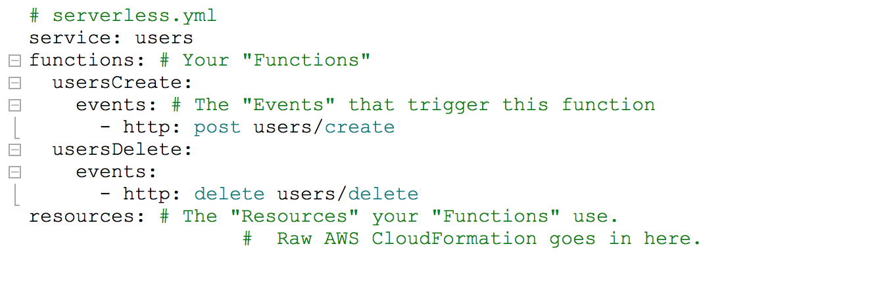
Services
Service - The unit of organization. It's where you define your Functions, the Events that trigger them, and the Resources your Functions use, all in one file titled serverless.yml.
An application can have multiple services and hence multiple serverless.yml files.

Slide 16
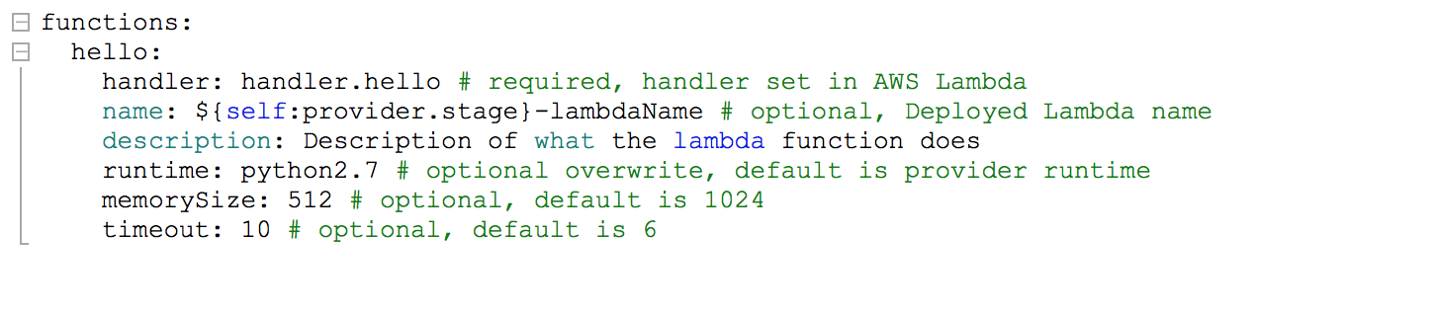
Functions
Functions - A Function is an independent unit of deployment or microservice. It manifests itself as a Lambda or Azure Function depending upon the provider. It's merely code, deployed in the cloud, that is most often written to perform a single job such as:
Saving a user to the database
Processing a file in a database
Performing a scheduled task

Slide 17
Events
Anything that triggers an Function to execute is regarded by the Framework as an Event.
Events are infrastructure events on AWS such as:
An AWS API Gateway HTTP endpoint request (e.g., for a REST API)
An AWS S3 bucket upload (e.g., for an image)
A CloudWatch timer (e.g., run every 5 minutes)
An AWS SNS topic (e.g., a message)
A CloudWatch Alert (e.g., something happened)
When you define an event for your functions in the Serverless Framework, the Framework will automatically create any infrastructure necessary for that event (e.g., an API Gateway endpoint) and configure your Functions to listen to it.

Slide 18
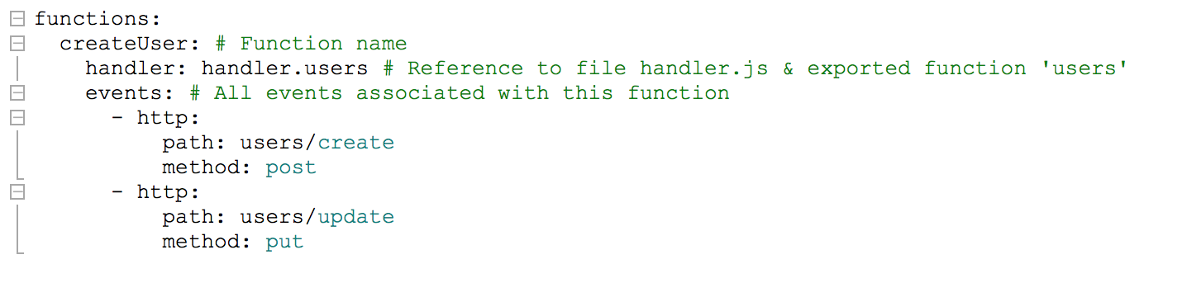
Events
Simply put, events are the things that trigger your functions to run. If you are using AWS as your provider, all events in the service are anything in AWS that can trigger an AWS Lambda function, like an S3 bucket upload, an SNS topic, and HTTP endpoints created via API Gateway.
Upon deployment, the framework will deploy any infrastructure required for an event (e.g., an API Gateway endpoint) and configure your function to listen to it.

Slide 19
Resources
Resources are infrastructure components which your Functions uses.
If you use AWS as you provider, then resources are:
An AWS DynamoDB Table (e.g., for saving Users/Posts/Comments data)
An AWS S3 Bucket (e.g., for saving images or files)
An AWS SNS Topic (e.g., for sending messages asynchronously)
Anything that can be defined in CloudFormation is supported by the Serverless Framework
The Serverless Framework not only deploys your Functions and the Events that trigger them, but it also deploys the infrastructure components your Functions depend upon.

Slide 20
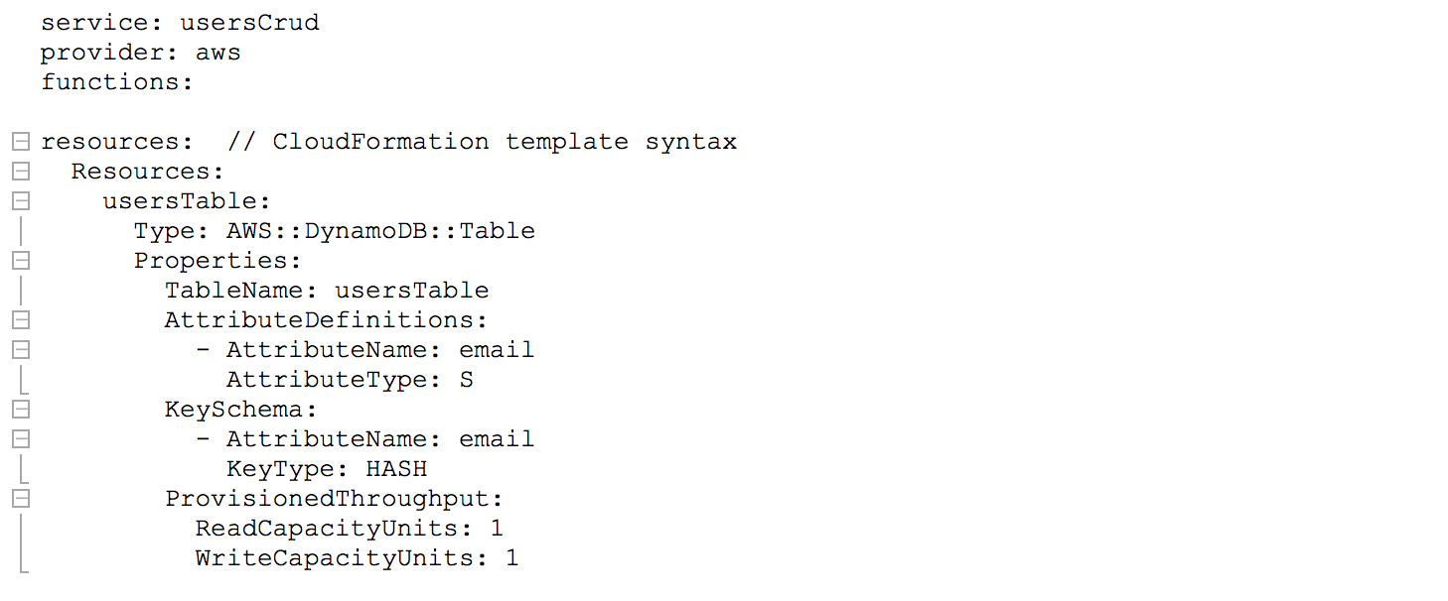
Resources
An example of resources in Serverless Framework using AWS as provider:

