Slide 1
Movie Recommender System
CS771, Group 1
Akshay Kumar
Arpit Jain
Dhananjay Sharma

Slide 2
Approaches Followed
Naive Approach : Train it on any classifier
Content Based Filtering : Based on genre (feature vector) of movie
Low Rank Matrix Factorization : Extension of previous idea

Slide 3
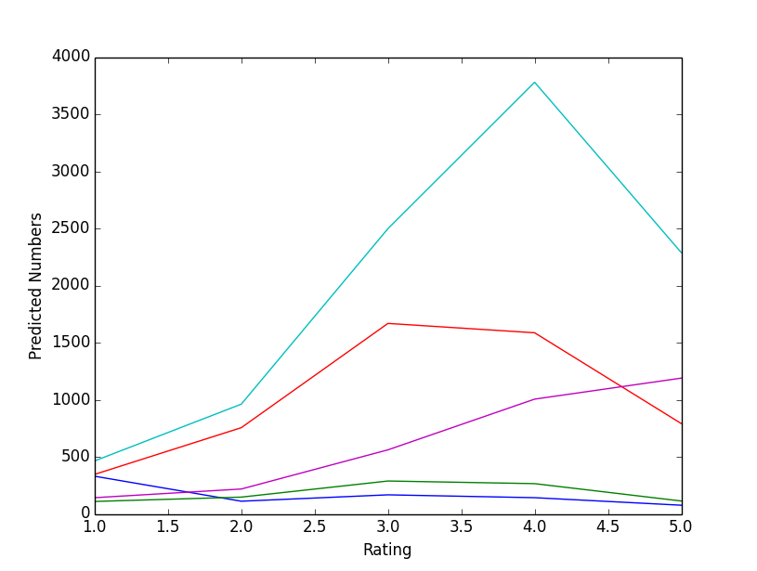
Naive Approach
.arff file containing movies and users attributes
Train it via some classifier
Validate it : 35 % accuracy

Slide 4
Content Based Filtering
Have the feature vector for movies (genres)
Pose it as a minimization problem
Apply Linear Regression to get weight vector for each of the user
Error rate of nearly 18 %

Slide 5
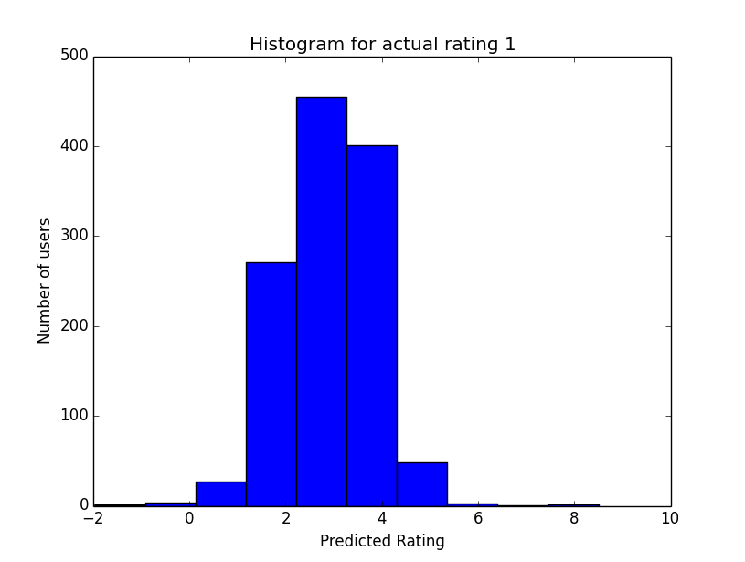
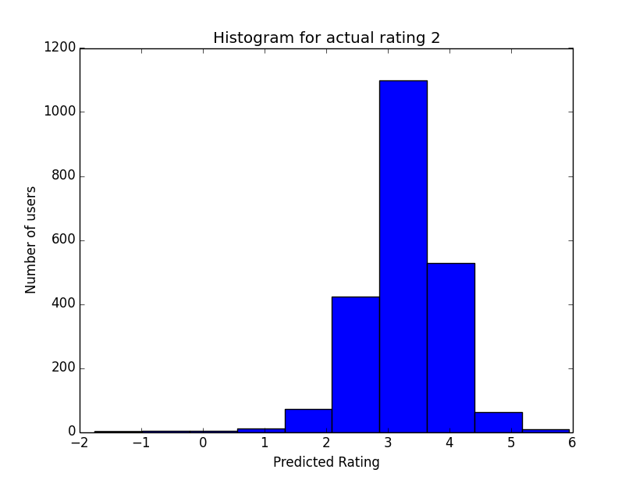
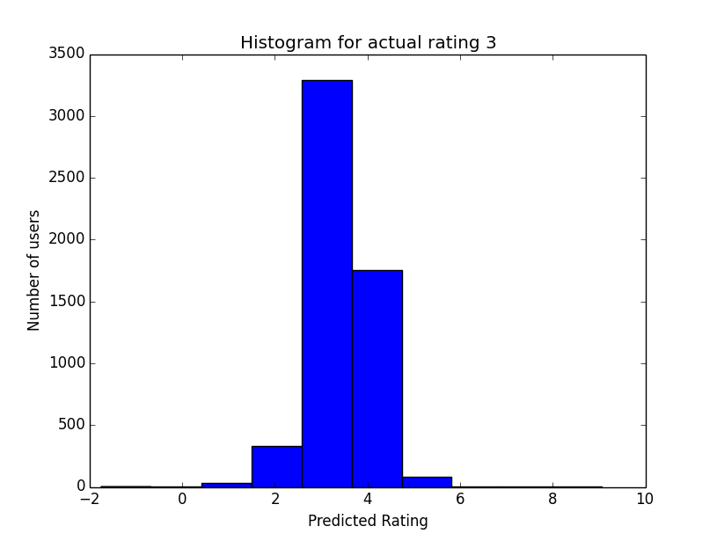
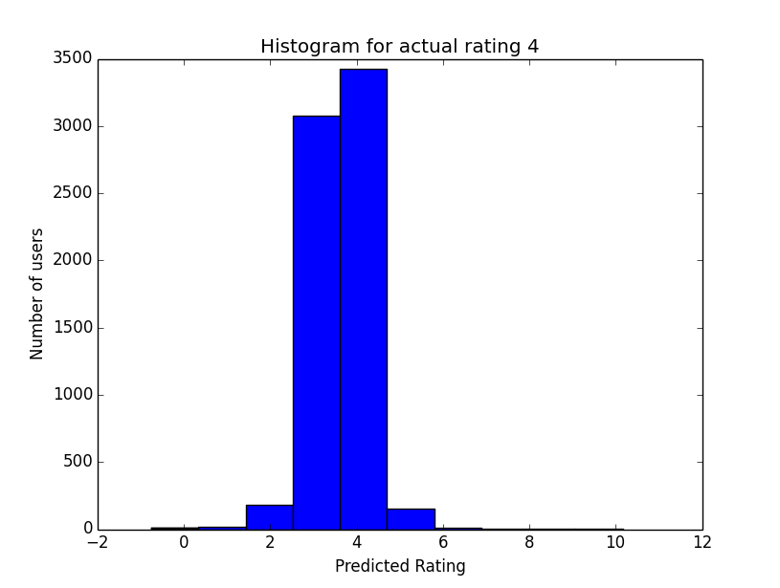
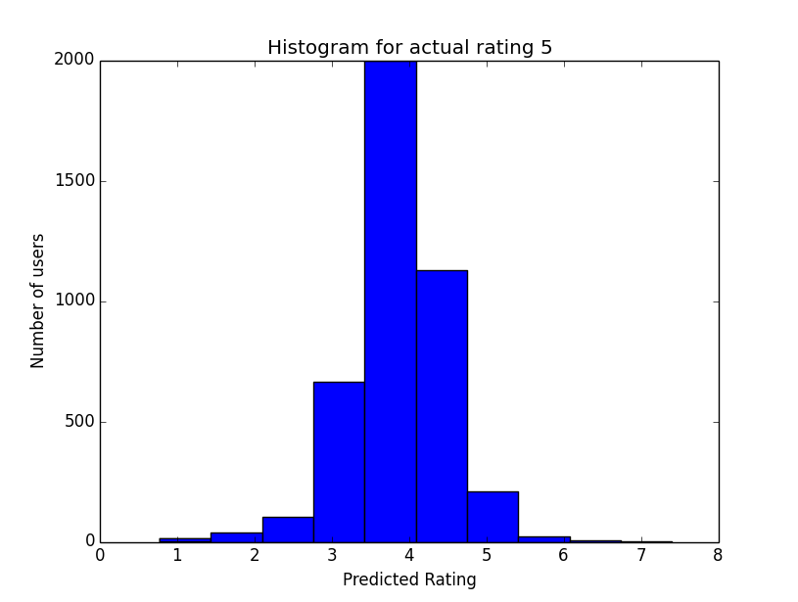
Content Based Filtering : Results

Slide 6
Low Rank Matrix Vectorization
Extended Content Based Filtering to perturb both movie feature vector and user feature vector
Useful when a new user rates a movie
Error rate approximately the same as the previous one

Slide 7
THANK YOU

