Slide 1
Detection of Suspicious Objects using Deep Learning Architecture
Arpit Jain

Slide 2
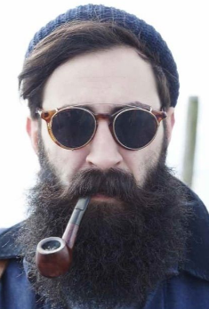
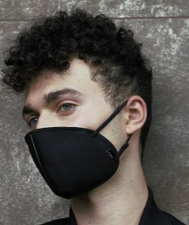
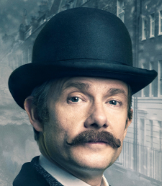
Suspicious Objects
Suspicious Objects that I have trained my model on are:
Hat
Mask
Sunglass
Notes:
The aim is to add functionality to surveillance camera to detect burglars and thieves who are assumed to have an attire as shown.

Slide 3
Data Set
Prepared Own Data Set (Google Images). No Standard Data Set was used.
Hat ~ 2000 images
Mask ~ 2000 images
Sunglass ~ 2000 images
Other ~ 10,000 images

Slide 4
Training Set
Hat ~ 1000 images
Mask ~ 1000 images
Sunglass ~ 1000 images
Other ~ 9000 images
TOTAL ~ 12k images

Slide 5
Test Set
Hat ~ 1000 images
Mask ~ 1000 images
Sunglass ~ 1000 images
Other ~ 1100 images
TOTAL ~ 4.1k images

Slide 6
Training the Model
Software Used: Caffe
Caffe is a deep learning, open source framework primarily developed by the Berkeley Vision and Learning Center (BVLC) and by community contributors.
Caffe is written in C++. It can be used on LINUX and MAC OS.
Its functionality can be extended in Languages such as Python, MATLAB and the command line of Ubuntu.

Slide 7
Model Used
Modified the architecture presented a paper in 2012 titled as:
“ImageNet Classification with Deep Convolutional Neural Networks”
Alex Krizhevsky, Ilya Sutskever, Geoffrey E. Hinton
It is popularly known as AlexNet.

Slide 8
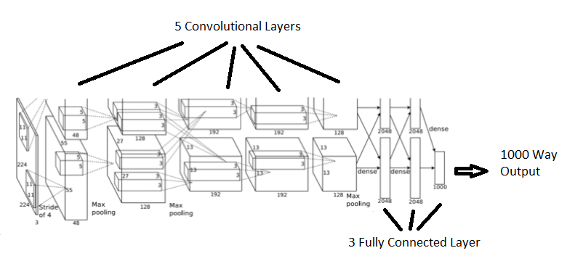
Architecture
Notes:
The net contains eight layers with weights;
The ﬁrst ﬁve are convolutional and the remaining three are fully connected.
The output of the last fully-connected layer is fed to a 1000-way softmax which produces a distribution over the 1000 class labels.
One GPU runs the layer-parts at the top of the ﬁgure while the other runs the layer-parts at the bottom. The GPUs communicate only at certain layers.

Slide 9
Technique Used
Fine Tuning
Fine Tuning takes an already learned model, adapts the architecture, and resumes the training from the already learned model weights.
Its a great way of saving time and energy as the model weights are stored in a file and the training can be resumed once it is done on standard dataset.
Fine Tune Mode used : bvlc_alexnet.caffemodel (weights after 360,000 iterations for 1000 classes)

Slide 10
Modification
AlexNet architecture is designed to output for 1000 classes.
Our Need: 4 Classes
Hat
Mask
Sunglass
Others (i.e. which don’t belong to either of these categories)

Slide 11
Modification
Two ways of Modifying the Architecture:
Modifying the Last Fully Connected layer of the existing AlexNet architecture to change the 1000 Way Output to 4 Way Output.
Adding an extra Fully Connected Layer towards the end of the Model with 4 way output.

Slide 12
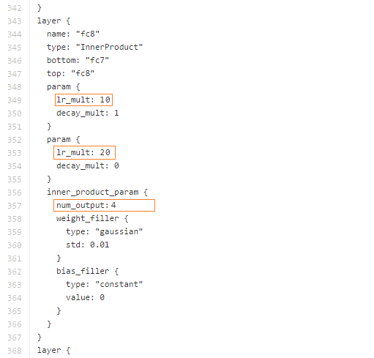
Modification: updating the last layer
Last Inner Product Layer was modified.
1000 way output was modified to 4 way output
Learning Rate was increased to 10 from 1 & 20 from 2.
This is done as since previous layers have already learned the weights and are pre-trained. We want the weights of previous layers to change very less as compared to the new layers.
Name of the last layer was modified.

Slide 13
Modification: adding a 4 way layer
An Inner Product Layer was added.
No. of output (1000) from previous layer were mapped to 4 way output for 4 classes.
Learning Rate of the last layer was increased to 10 from 1 & 20 from 2.
This is done as since previous layers have already learned the weights and are pre-trained. We want the weights of previous layers to change very less as compared to the new layers.
Name of the layer was modified.

Slide 14
Accuracy
TRAINING PHASE (Training Dataset)
Average Accuracy obtained over 10,000 iteration : 95.78%
Model is trained on 100 batches and accuracy calculated after every 25 iterations (each batch containing 50 images)
Solved using Stochastic Gradient Descent Method. Initial Learning Rate : 0.0001 (Changed by a factor of 0.1 after every 1500 iterations)
TEST PHASE (Validation Dataset)
Average Accuracy over 100 batches : 95.02%
Each batch containing 50 images.

Slide 15
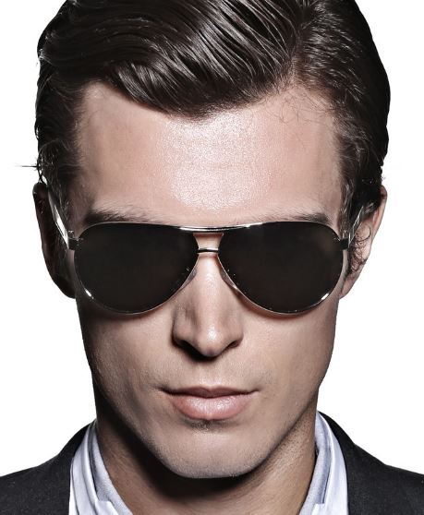
Test Results
Sunglass : 0.9978 Hat : 0.0021 Mask : 0.0001 Other : 0.0000

Slide 16
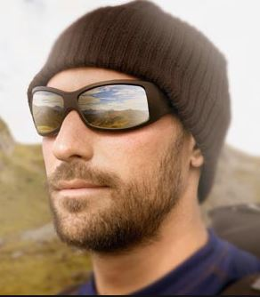
Test Results
Hat : 0.5800 Sunglass : 0.3894 Other : 0.0200 Mask : 0.0107

Slide 17

Test Results
Mask : 0.9193 Hat : 0.0798 Sunglass : 0.0003 Other : 0.0001

Slide 18
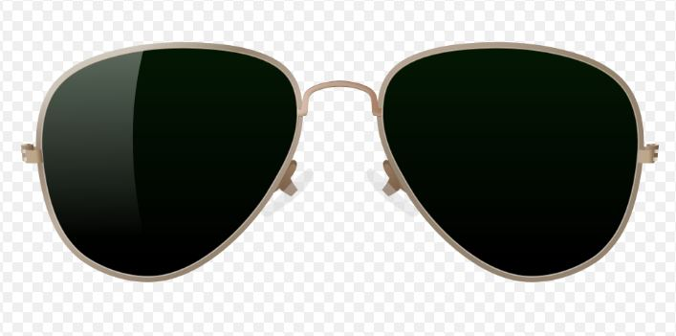
Test Results
Sunglass : 0.9563 Mask : 0.0265 Hat : 0.0169 Other : 0.0003

Slide 19
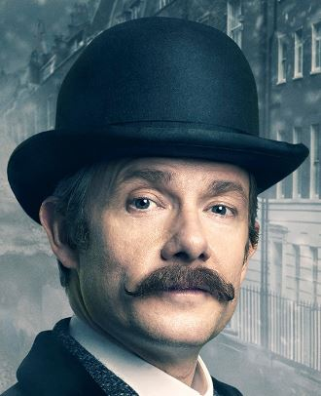
Test Results
Hat : 0.9925 Sunglass : 0.0026 Other : 0.0042 Mask : 0.0006

Slide 20
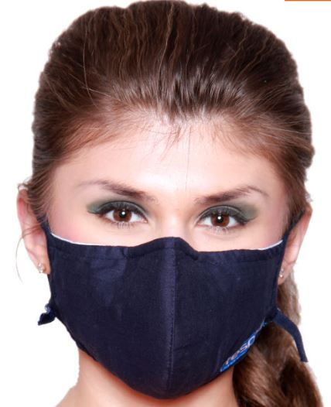
Test Results
Mask : 0.9970 Hat : 0.0021 Sunglass : 0.0006 Other : 0.0005

Slide 21
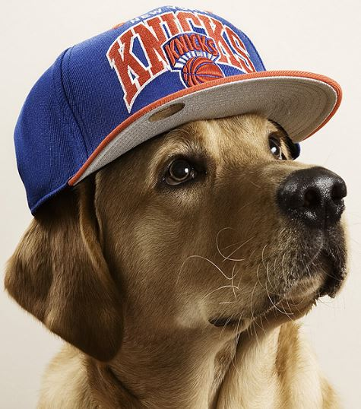
Test Results
Other : 0.9833 Hat : 0.0165 Mask : 0.0001 Sunglass : 0.0001

Slide 22
Thank You!

