Slide 1
Deep learning using Caffe
Practical guide

Slide 2
Open source deep learning packages
Caffe
C++/CUDA based.
MATLAB/python interface.
Theano-based
Compiled on the spot.
Python interface.
Torch
Lua interface
MatConvNet
User friendly, matlab interface
TensorFlow
New and promising?

Slide 3
Use Caffe at Wisdom
Connect to mcluster01
ssh mcluster01
Start a session on one of the GPU nodes
qsh -q gpu.q
Set environment variables
setenv LD_LIBRARY_PATH /usr/local/cuda/lib64:/usr/local/lib
Caffe location
/usr/wisdom/caffe-cpu
For Python interface, set environment variables
setenv PATH /usr/wisdom/python/bin:$PATH
setenv PYTHONPATH /usr/wisdom/python

Slide 4
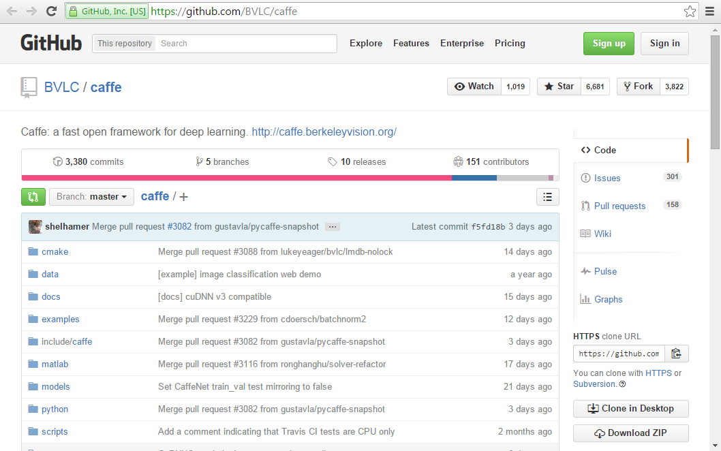
Download Caffe
+ copy Makefile.config
+ make all
+ make matcaffe
+ make pycaffe

Slide 5
Caffe - Storing Data In Memory
Width
C x
H x
W
Height
Channel

Slide 6
Caffe - Storing Data In Memory
Blob size:
N x
C x
H x
W
Caffe stores and communicates data using blobs.
Blobs provide a unified memory interface holding data
e.g., batches of images, model parameters, and derivatives for optimization.

Slide 7
Layer
top blob
ip
The layer is the fundamental unit of computation.
A layer takes input through bottom connections and makes output through top connections
Each layer type defines three computations: setup, forward, and backward.
ip (InnerProduct)
bias
weights
data
bottom blob

Slide 8

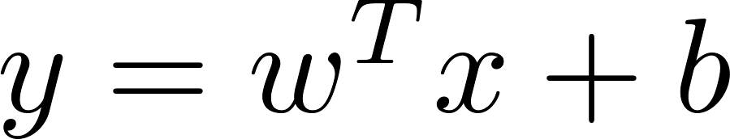

Layer Forward
top blob
ip
The forward pass goes from bottom to top
During forward pass Caffe composes the computation of each layer to compute the “function” represented by the model.
ip (InnerProduct)
bias
weights
data
bottom blob

Slide 9
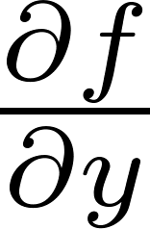
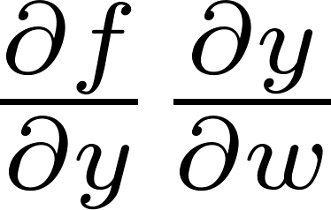
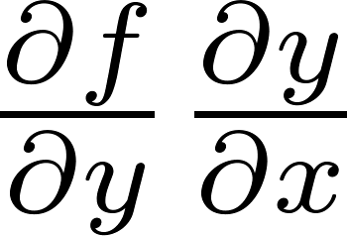
Layer Backward
top blob
ip
The backward pass performs back-propagation
Given the gradient w.r.t. the top output Caffe computes the gradient w.r.t. to the input and sends to the bottom.
A layer with parameters computes the gradient w.r.t. to its parameters and stores it internally.
ip (InnerProduct)
bias
weights
data
bottom blob

Slide 10
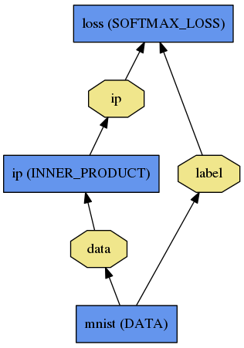
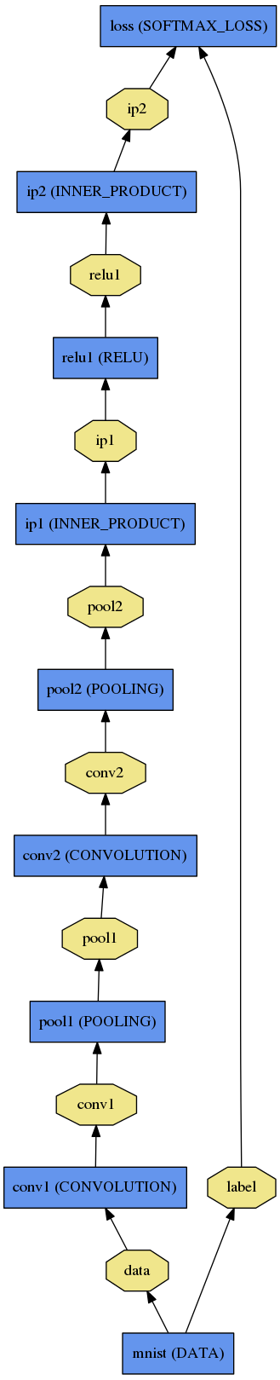
Net
A network is a set of layers and their connections
Most of the time linear graph
Could be any directed acyclic graph (DAG).
end-to-end machine learning: needs to start from data and end in loss.
LogReg ↑
LeNet →
Krizhevsky 2012 →
ImageNet

Slide 11
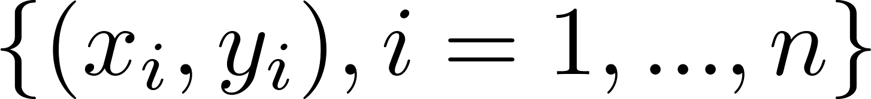
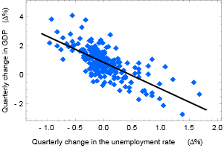
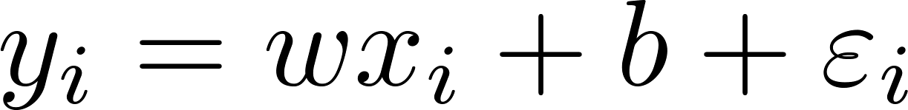
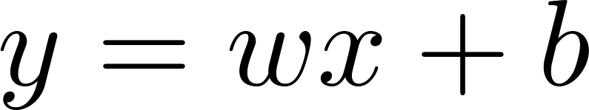
Simple Example – Linear regression
Suppose there are n data points:
The function that describes x and y is :
The goal is to find the equation of the straight line
which would provide a "best" fit for the data points.
Here the "best" will be understood as in the least-squares approach: a line that minimizes the sum of squared residuals of the linear regression model.
In other words, w and b that solve the following minimization problem:

Slide 12
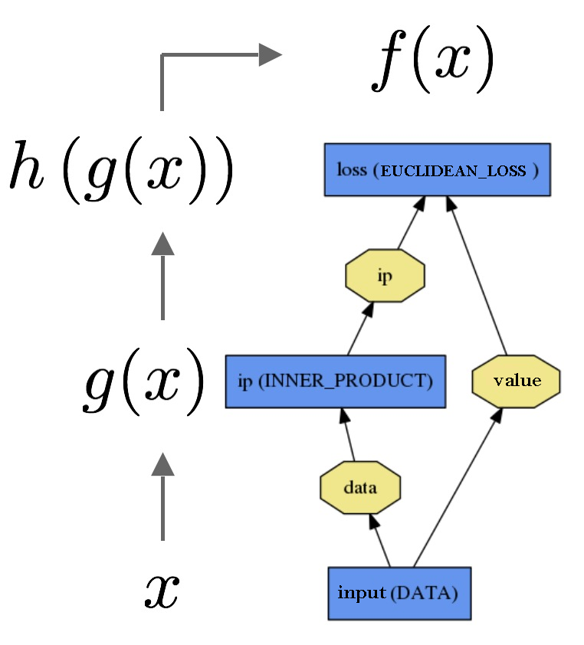
Simple Example – Linear regression
name: "LinearReg"
layer {
name: “input"
type: "Data"
top: "data"
top: “value"
data_param {
source: "input_leveldb"
batch_size: 64
}
}
layer {
name: "ip"
type: "InnerProduct"
bottom: "data"
top: "ip"
inner_product_param { num_output: 1 }
}
layer {
name: "loss"
type: "EuclideanLoss"
bottom: "ip"
bottom: “value"
top: "loss"
}

Slide 13
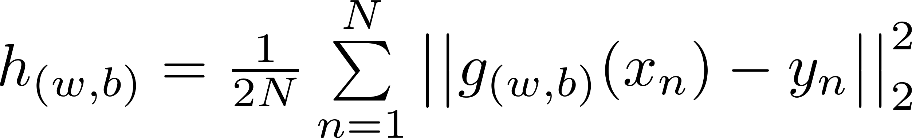
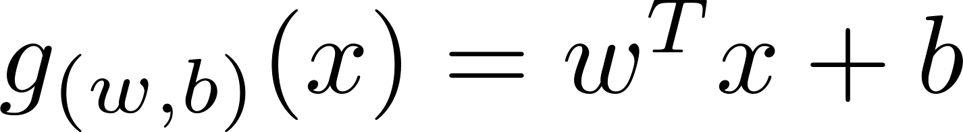
Simple Example – Linear regression

Slide 14
Gradient descent
Gradient descent is a first-order optimization algorithm.
To find a local minimum of a function using gradient descent, one takes steps proportional to the negative of the gradient (or of the approximate gradient) of the function at the current point.
One starts with a guess w0 for a local minimum of F, and considers the sequence w0, w1, w2,… such that
If function F is defined and differentiable in a neighborhood of a point wt,
then for small enough step size eta we get that:
so hopefully the sequence wt converges to the desired local minimum.
Note that the value of the step size eta is allowed to change at every iteration.

Slide 15
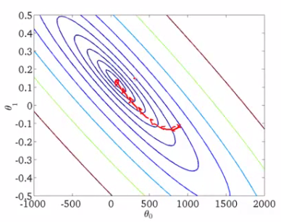
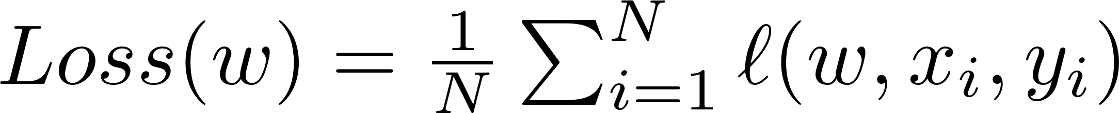
Learning using gradient descent
Loss function we are minimizing
Gradient descent
Problem – for large N, a single step is very expensive.

Slide 16
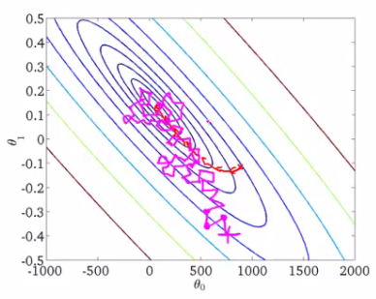
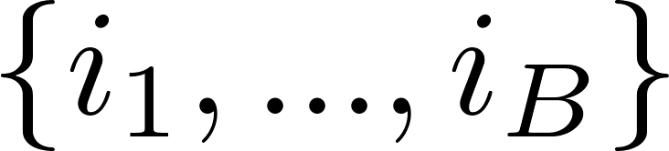
Stochastic gradient descent
Loss function we are minimizing
Gradient descent
Problem – for large N, a single step is very expensive.
Solution – Stochastic gradient descent. At each iteration select random data points with batch size B, then
As B grows, we get a better approximation of the real gradient but at a higher computational cost.

Slide 17
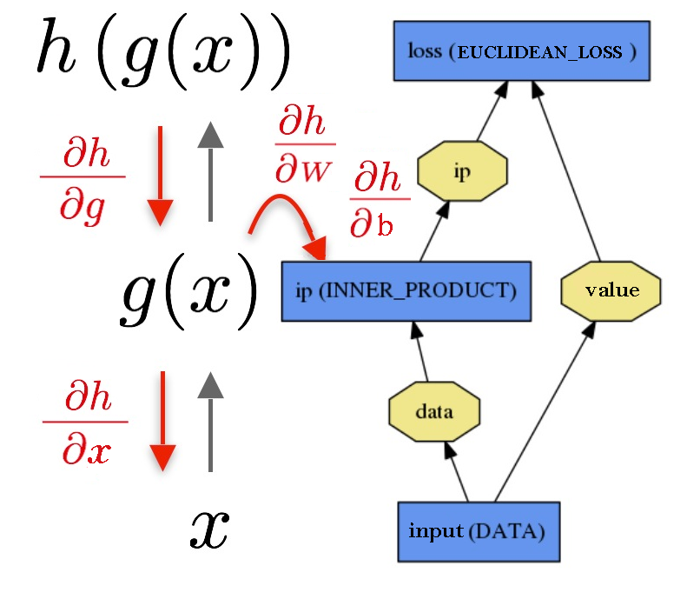
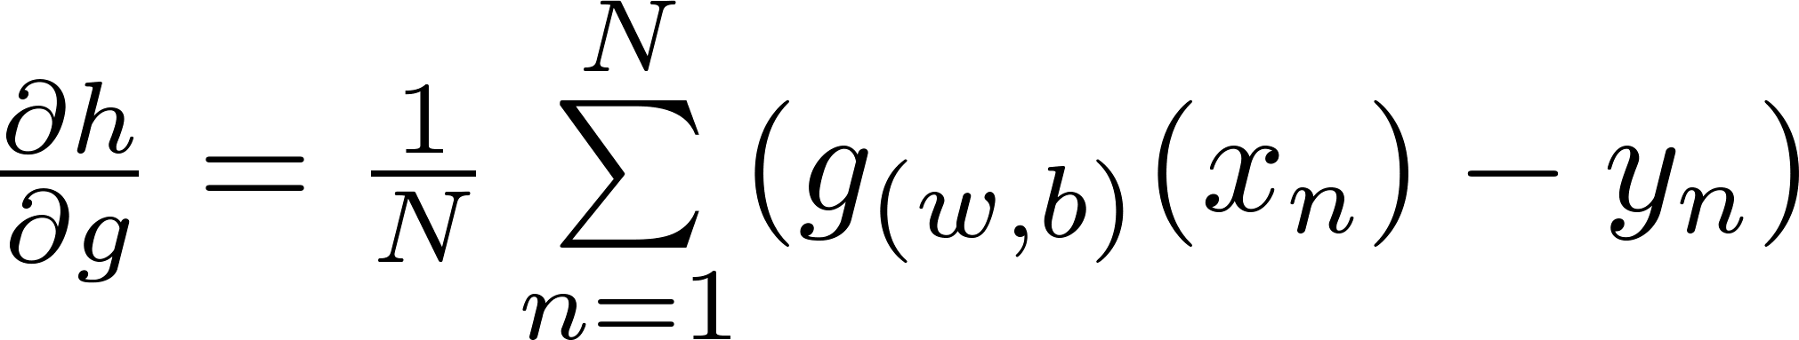
Simple Example – Linear regression
Use gradient descent

Slide 18
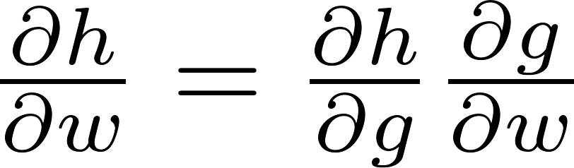
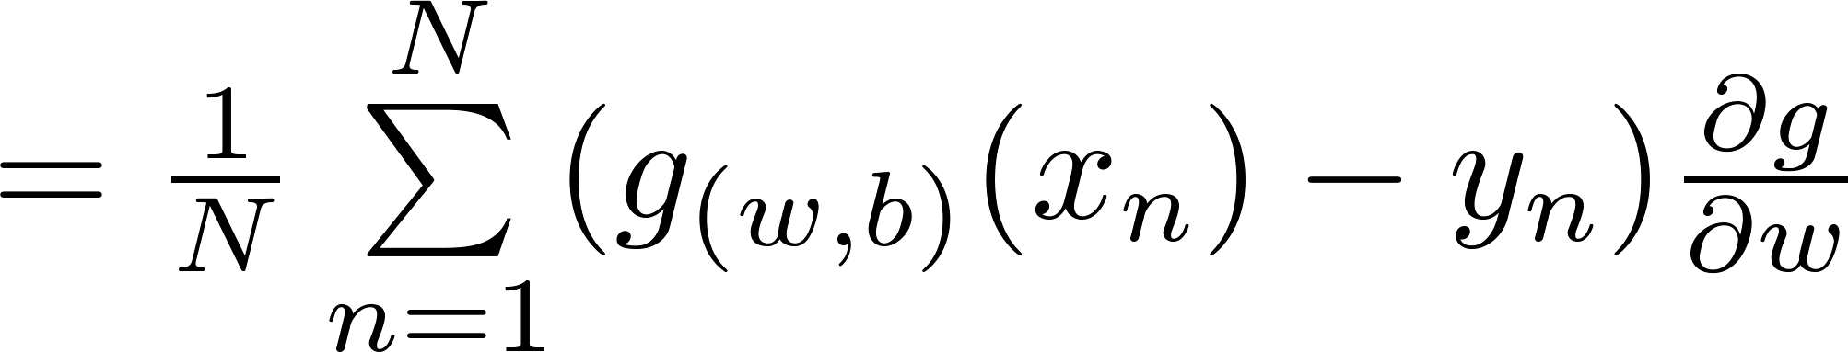
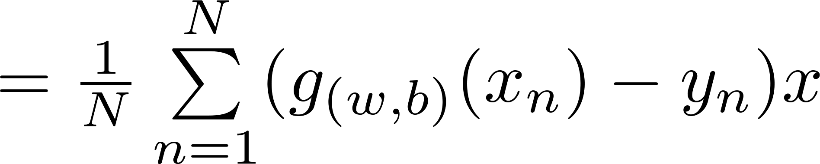
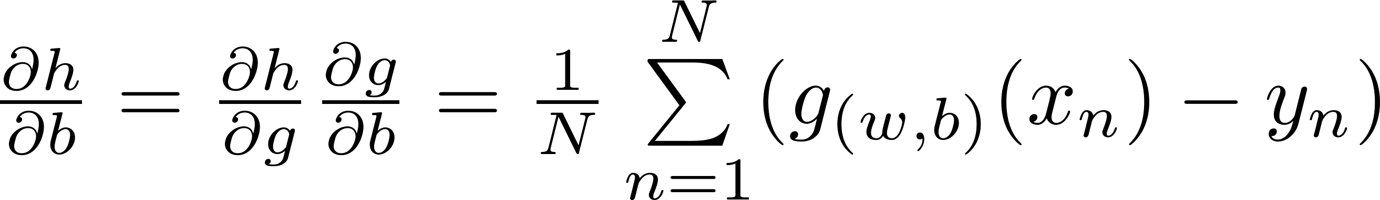
Simple Example – Linear regression

Slide 19
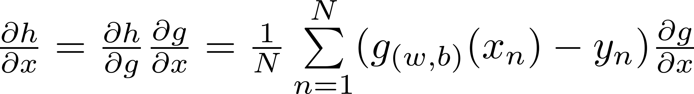
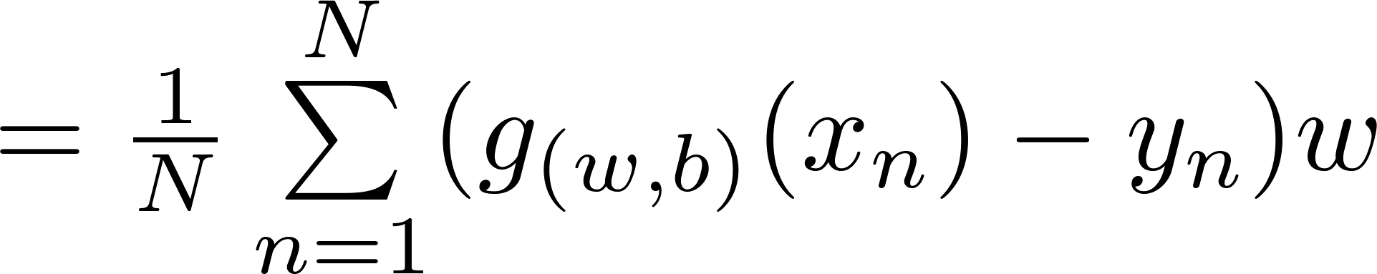
Simple Example – Linear regression

Slide 20
Simple Example – Linear regression
Caffe knows that data layers do not require back propagation and will not compute the derivatives

Slide 21
Layers Overview
Data Layers
Data can come from efficient databases (LevelDB or LMDB), directly from memory, or, when efficiency is not critical, from files on disk in HDF5 or common image formats.
Has common input preprocessing (mean subtraction, scaling, random cropping, and mirroring)
Common Layers
Various commonly used layers, such as: Inner Product, Reshape, Concatenation, Softmax, …
Vision Layers
Vision layers usually take images as input and produce other images as output. Most of the vision layers work by applying a particular operation to some region of the input to produce a corresponding region of the output. In contrast, other layers (with few exceptions) ignore the spatial structure of the input, effectively treating it as “one big vector” with dimension CxHxW.
Neuron Layers
Neuron layers are element-wise operators, taking one bottom blob and producing one top blob of the same size.
Loss Layers
Loss drives learning by comparing an output to a target and assigning cost to minimize. The loss is computed by the forward pass.

Slide 22
Data layers:
Caffe supports leveldb, lmdb, HDF5 and images inputs.
HDF5
very flexible and easy to use.
Problem – loads all the data into memory at once (problematic on large datasets).
Leveldb & LMDB
works sequentially.
Less flexible (Caffe-wise).
Much faster.
Images
takes a text file with image paths and labels (imagenet).

Slide 23
Data Layer – leveldb&LMDB
layer {
name: "mnist"
type: "Data"
top: "data"
top: "label"
include {
phase: TRAIN
}
transform_param {
scale: 0.00390625
}
data_param {
source: "examples/mnist/mnist_train_lmdb"
batch_size: 64
backend: LMDB
}
}
Name – for reusing net params (finetunning)
Bottom – on every layer except data
Top – for leveldb&LMBD always 2 top, data blob and label blob. Label is integer and of size Nx1x1x1.
Phases – select when to use layer, default == both.
For TEST phase define another layer with the same name
Transform_param – do simple preprocessing.
Data_param – tell caffe where (and what type) the data is.
Batch_size – how many examples per batch. Small batch_size is faster, but more oscillatory.
Backend – leveldb / LMDB

Slide 24
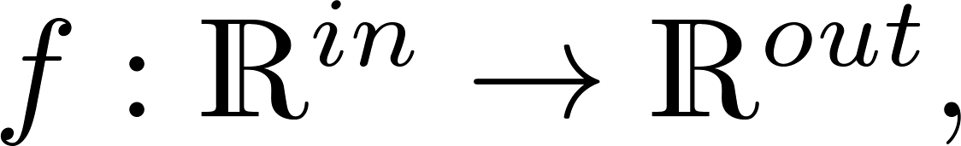
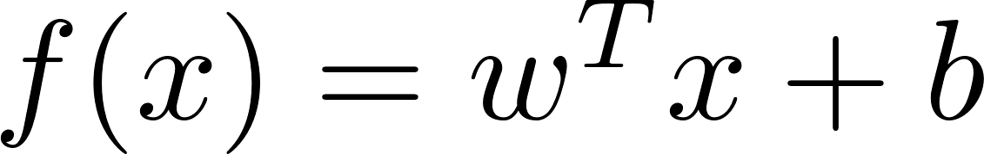


Common Layer - Inner product layer
layer {
name: "fc8"
type: "InnerProduct"
# learning rate and decay multipliers for the weights
param { lr_mult: 1 decay_mult: 1 }
# learning rate and decay multipliers for the biases
param { lr_mult: 2 decay_mult: 0 }
inner_product_param {
num_output: 1000
weight_filler {
type: "gaussian"
std: 0.01
}
bias_filler {
type: "constant"
value: 0
}
}
bottom: "fc7"
top: "fc8"
}
Linear function
In = , Bottom blob is of size (N,C,H,W)
Out is a layer parameter (num_output). Top blob is (N,out,1,1).
Number of parameters:
Param allows you to change specific layer learning rate, and separates weights and biases.
During Net Finetunning: fixed layer – lr_mult: 0
Can run on a single axis, see documentation.

Slide 25
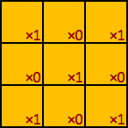
Vision Layer - Convolutional Layer
The Convolution layer convolves the input image with a set of learnable filters, each producing one feature map in the output.
Input size (H,W)
Kernel size (K,K)
Output size (H-K+1,W-K+1)

Slide 26
Vision Layer - Convolutional Layer
Convolution with zero-padding of P pixels
Convolution with zero-padding of P pixels and S pixels stride
0 | 0 | 0 | 0 | 0 | 0 | 0
0 | 0 | 0 | 1 | 1 | 1 | 0
0 | 0 | 1 | 1 | 1 | 0 | 0
0 | 1 | 1 | 1 | 0 | 0 | 0
0 | 0 | 1 | 1 | 1 | 0 | 0
0 | 0 | 0 | 1 | 1 | 0 | 0
0 | 0 | 0 | 0 | 0 | 0 | 0
1 | 1 | 3 | 2 | 2
1 | 4 | 3 | 4 | 1
3 | 3 | 4 | 2 | 2
1 | 4 | 3 | 2 | 1
1 | 1 | 3 | 2 | 1

Slide 27
Vision Layer - Convolutional Layer
Input size (C,H,W)
Kernel size (C,K,K)
Output size (H-K+1,W-K+1)

Slide 28
Vision Layer - Convolutional Layer
Input size (C,H,W)
D Kernels of size (C,K,K)
Output size (D,H-K+1,W-K+1)

Slide 29
Vision Layer - Convolutional Layer
Input size (C,H,W)
D Kernels of size (C,K,K)
Output size (D,H-K+1,W-K+1)
D

Slide 30

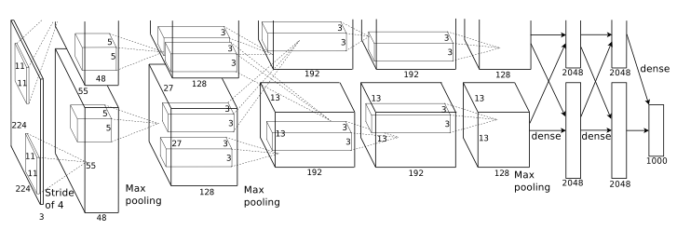
Vision Layer - Convolutional Layer
Given bottom of size (N,C,H,W)
Convolves each (C,H,W) image
Using D kernels of size (C,K,K)
Returns top of size
Assuming P pixels padding and stride of S pixels
Number of parameters =

Slide 31
Vision Layer - Convolutional layer
layer {
name: "conv1"
type: "Convolution"
bottom: "data"
top: "conv1"
param { lr_mult: 1 }
param { lr_mult: 2 }
convolution_param {
num_output: 20
kernel_size: 5
pad: 2
stride: 1
weight_filler { type: "xavier“ }
bias_filler { type: "constant“ }
}
}
Kernel_size – doesn’t have to be symmetric.
pad – specifies the number of pixels to (implicitly) add to each side of the input
stride – step size in pixels between each filter application, reduce output size by a factor.
weight_filler – random weight initialization. Break symmetry. “Xavier” picks std according to blob size. See “Understanding the difficulty of training deep feedforward neural networks” Glorot and Bengio 2010.
Performing a convolution with kernel size (C,H,W) is equivalent to performing inner product.

Slide 32
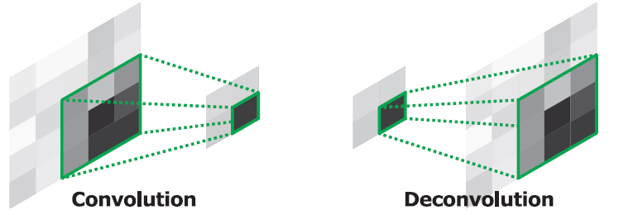
Vision Layer – Deconvolution (Convolution Transpose)
layer {
name: "upscore2“
type: "Deconvolution“
bottom: "score59“
top: "upscore2“
param {
lr_mult: 1
decay_mult: 1
}
convolution_param {
num_output: 60
bias_term: false
kernel_size: 4
stride: 2
}
}
Multiplies each input value by a filter elementwise, and sums over the resulting output windows. Resulting in convolution-like operations with multiple learned filters
Reuses ConvolutionParameter for its parameters, but in the opposite sense as in ConvolutionLayer (so padding is removed from the output rather than added to the input, and stride results in upsampling rather than downsampling).

Slide 33
Vision Layer - Pooling layer
Like convolution, just uses a fixed function MAX/AVE
Use stride to reduce dimensionality.
Allows for small translation invariance (MAX).
layer {
name: "pool1"
type: "Pooling"
bottom: "conv1"
top: "pool1"
pooling_param {
pool: MAX
kernel_size: 2
stride: 2
}
}

Slide 34
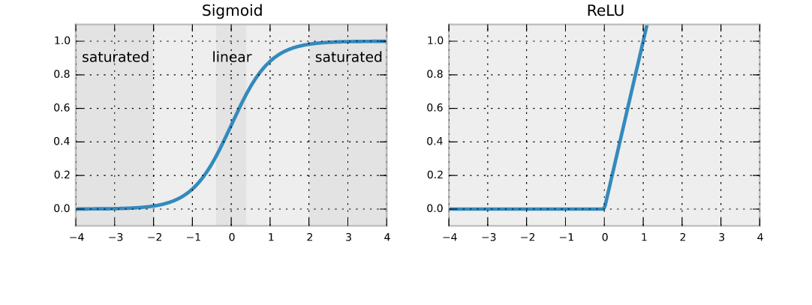
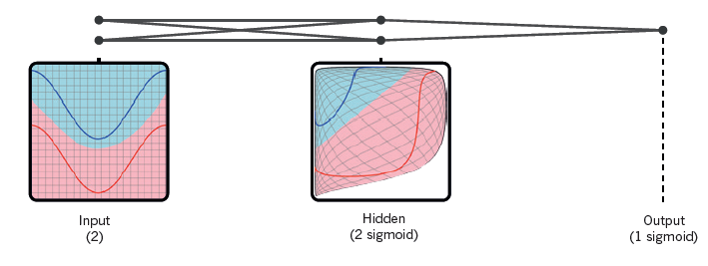
Neuron layer
layer {
name: "relu1"
type: "ReLU"
bottom: "pool1"
top: "pool1"
}
For each value x in the blob, return f(x).
Size of input == Size of output
Computation done in place.
ReLU, sigmoid, tanh…

Slide 35
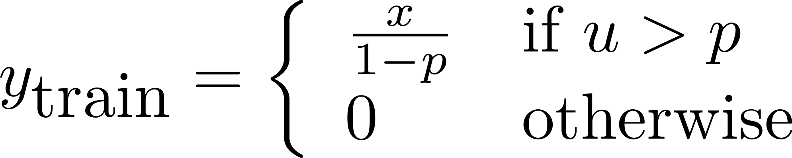

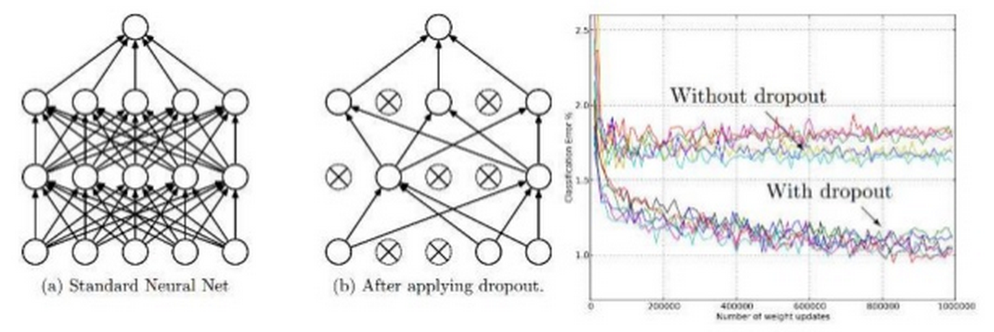
Neuron layer - Dropout
During training only, sets a random portion of x to 0, adjusting the rest of the vector accordingly.
At test – do noting.
Helps by reducing overfitting.
layer {
name: "drop6"
type: "Dropout"
bottom: "fc6"
top: "fc6"
dropout_param {
dropout_ratio: 0.5
}
}

Slide 36
Loss Layer
Learning is driven by a loss function (also known as an error, cost, or objective function).
A loss function specifies the goal of learning by mapping parameter settings (i.e., the current network weights) to a scalar value specifying the “badness” of these parameter settings. Hence, the goal of learning is to find a setting of the weights that minimizes the loss function.
The loss is computed by the Forward pass of the network. Each layer takes a set of input (bottom) blobs and produces a set of output (top) blobs.
For nets with multiple layers producing a loss (e.g., a network that both classifies the input using a SoftmaxWithLoss layer and reconstructs it using a EuclideanLoss layer), loss weights can be used to specify their relative importance.

Slide 37
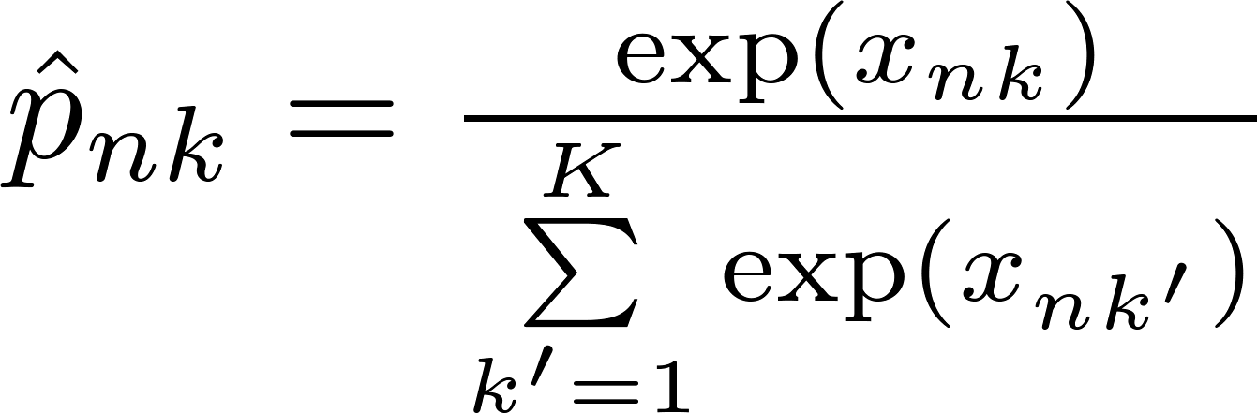
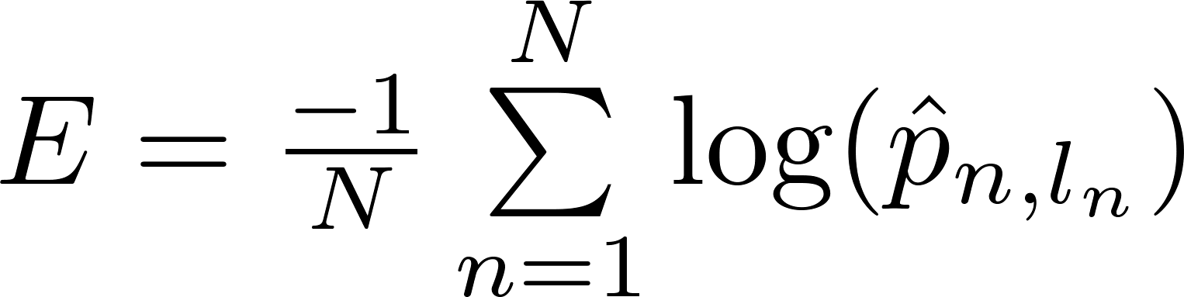
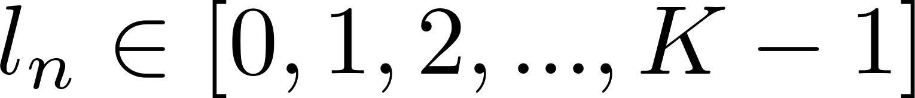
Loss layers – SoftmaxWithLoss
layer {
name: "loss"
type: "SoftmaxWithLoss"
bottom: "pred"
bottom: "label"
top: "loss"
loss_weight: 1
loss_param {
ignore_label: 255
}
}
Used for K-class Classification
Predictions Input blob of size (N,K,1,1)
Labels Input blob of size (N,1,1,1)
Output size (1,1,1,1)
ignore_label (optional) Specify a label value that should be ignored when computing the loss.
First preforms softmax then computes the multinomial logistic loss (-log likelihood)

Slide 38
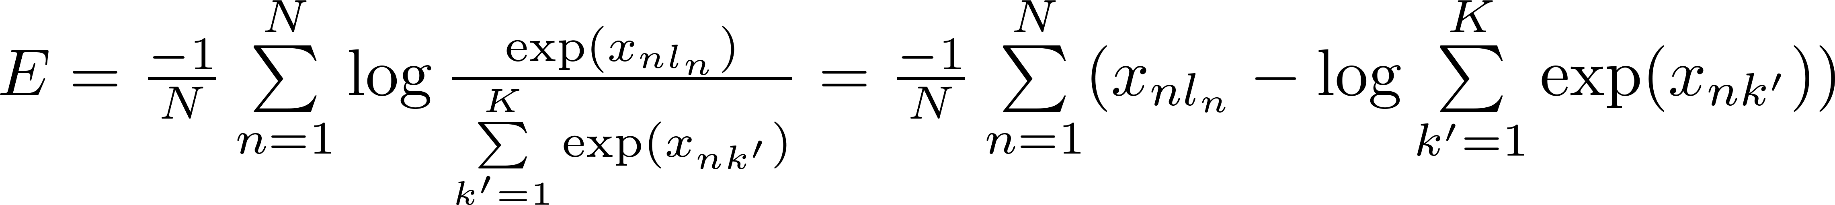
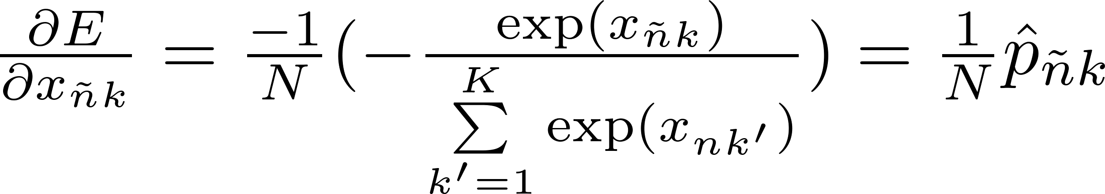
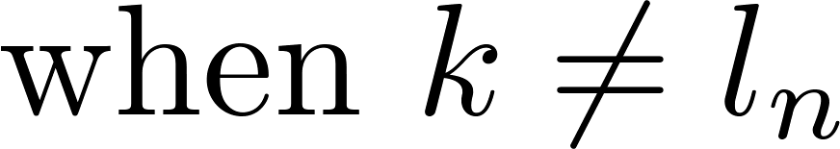
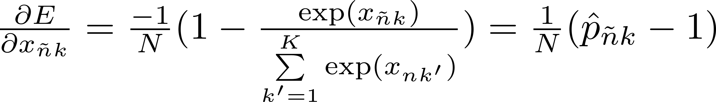
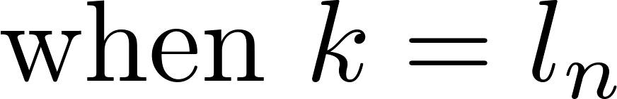
Loss layers – SoftmaxWithLoss

Slide 39
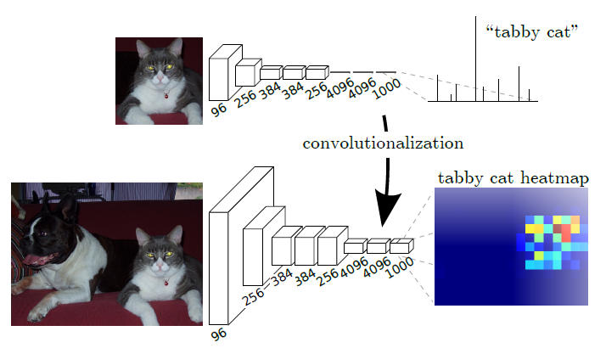
Fully Convolutional Networks
Running on an input image larger than the network’s field of view will be equivalent to running the network in a sliding window across the image
Make sure to replace inner product layers with convolutions

Slide 40
Solver prototxt – network run parameters
net: "models/bvlc_alexnet/train_val.prototxt"
test_iter: 1000
test_interval: 1000
base_lr: 0.01
lr_policy: "step"
gamma: 0.1
stepsize: 100000
display: 20
max_iter: 450000
momentum: 0.9
weight_decay: 0.0005
snapshot: 10000
snapshot_prefix: "models/bvlc_alexnet/caffe_alexnet_train"
solver_mode: GPU
net: Proto filename for the train net, possibly combined with test net
display: the number of iterations between displaying info
max_iter : The maximum number of iterations
Solver_mode: the mode solver will use: CPU or GPU

Slide 41
Solver prototxt – test set parameters
net: "models/bvlc_alexnet/train_val.prototxt"
test_iter: 1000
test_interval: 1000
base_lr: 0.01
lr_policy: "step"
gamma: 0.1
stepsize: 100000
display: 20
max_iter: 450000
momentum: 0.9
weight_decay: 0.0005
snapshot: 10000
snapshot_prefix: "models/bvlc_alexnet/caffe_alexnet_train"
solver_mode: GPU
test_iter: The number of iterations for each test net
test_interval: The number of iterations between two testing phases

Slide 42
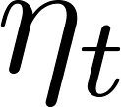
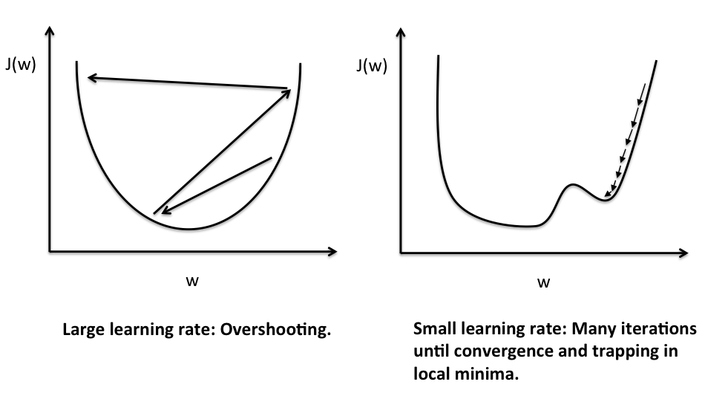
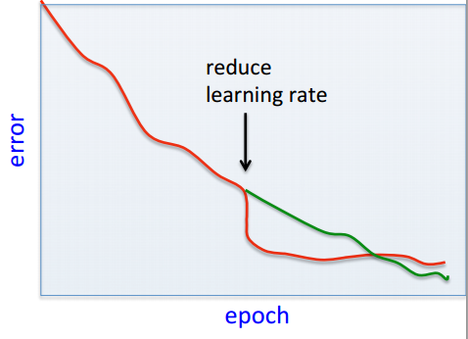
Learning rate
Don’t start too big, and not too small.
Start as big as you can without diverging, then when getting to a plateau start reducing the learning rate. Be careful not to reduce the learning rate too early.

Slide 43
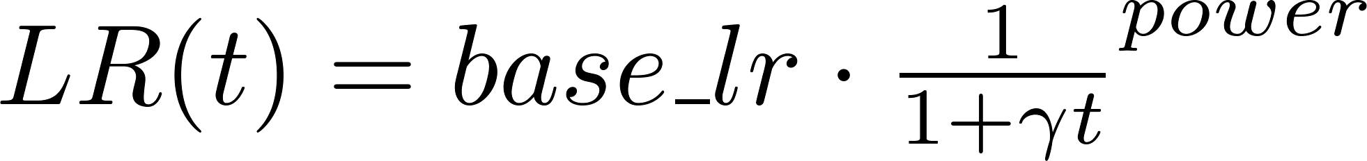
Learning rate policies
base_lr: 0.01
lr_policy: “fixed"
Fixed: Always base_lr
Step: Start at base_lr and after each stepsize iterations reduce learning rate by gamma.
Inv: Start at base_lr and after each iteration reduce learning rate
If you get NaN/Inf loss values try to reduce base_lr
base_lr: 0.01
lr_policy: "step"
gamma: 0.1
stepsize: 100000
base_lr: 0.01
lr_policy: "inv"
gamma: 0.0001
power: 0.75

Slide 44
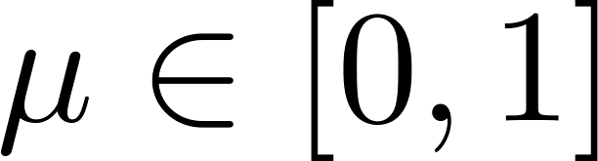
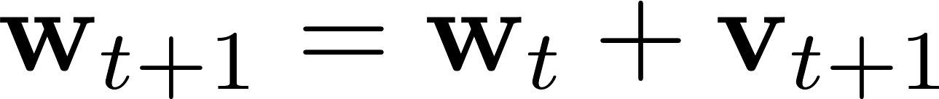
Momentum
The momentum method is a technique for accelerating gradient descent that accumulates a velocity vector in directions of persistent reduction in the objective across iterations.
The momentum is the weight of the previous update.
The update value Vt+1 and the updated weights Wt+1 at iteration t+1:

Slide 45

The intuition behind the momentum method
Imagine a ball on the error surface.
The ball starts off by following the gradient, but once it has velocity, it no longer does steepest descent.
Its momentum makes it keep going in the previous direction.
It damps oscillations in directions of high curvature by combining gradients with opposite signs.
It builds up speed in directions with a gentle but consistent gradient
Taken from: http://www.cs.toronto.edu/~tijmen/csc321/slides/lecture_slides_lec6.pdf

Slide 46
Solver prototxt – momentum parameter
net: "models/bvlc_alexnet/train_val.prototxt"
test_iter: 1000
test_interval: 1000
base_lr: 0.01
lr_policy: "step"
gamma: 0.1
stepsize: 100000
display: 20
max_iter: 450000
momentum: 0.9
weight_decay: 0.0005
snapshot: 10000
snapshot_prefix: "models/bvlc_alexnet/caffe_alexnet_train"
solver_mode: GPU

Slide 47



Weight Decay
To avoid over-fitting, it is possible to regularize the cost function.
Here we use L2 regularization, by changing the cost function to:
In practice this penalizes large weights and effectively limits the freedom in the model.
The regularization parameter λ determines how you trade off the original loss L with the large weights penalization.
Applying gradient descent to this new cost function we obtain:
The new term coming from the regularization causes the weight to decay in proportion to its size.

Slide 48
Solver prototxt – weight_decay parameter
net: "models/bvlc_alexnet/train_val.prototxt"
test_iter: 1000
test_interval: 1000
base_lr: 0.01
lr_policy: "step"
gamma: 0.1
stepsize: 100000
display: 20
max_iter: 450000
momentum: 0.9
weight_decay: 0.0005
snapshot: 10000
snapshot_prefix: "models/bvlc_alexnet/caffe_alexnet_train"
solver_mode: GPU

Slide 49
Solver prototxt - snapshot
net: "models/bvlc_alexnet/train_val.prototxt"
test_iter: 1000
test_interval: 1000
base_lr: 0.01
lr_policy: "step"
gamma: 0.1
stepsize: 100000
display: 20
max_iter: 450000
momentum: 0.9
weight_decay: 0.0005
snapshot: 10000
snapshot_prefix: "models/bvlc_alexnet/caffe_alexnet_train"
solver_mode: GPU
The snapshot interval in iterations.
snapshot: 10000
File path prefix for snapshotting model weights and solver state.
Note: this is relative to the invocation of the `caffe` utility, not the solver definition file.
Can use full path:
snapshot_prefix: "/path/to/model“

Slide 50
Transfer Learning
Training entire Convolutional Network from scratch (with random initialization) is not always possible, because it is relatively rare to have a dataset of sufficient size.
Use the Net as fixed feature extractor
Take a pre-trained Net, remove the last fully-connected layer, treat the rest of the Net as a fixed feature extractor for the new dataset, then train a linear classifier (e.g. Linear SVM) for the new dataset
Do Fine-tuning of the Net
In addition to replacing the last fully-connected layer, fine-tune the weights of the pre-trained network by continuing the backpropagation and retrain the classifier on top of the Net on the new dataset.
It is possible to fine-tune all the layers of the Net, or it's possible to keep some of the earlier layers fixed (due to overfitting concerns) and only fine-tune some higher-level portion of the network.
To Fine-tune a layer, initially set param lr_mult: 0, train new added layers. After that set param lr_mult: 1 and train all layers.

Slide 51

General Tips
Randomly shuffle the training examples
Monitor both the training cost and the validation error
If you build new layers check the gradients using finite differences
Experiment with the learning rates using a small sample of the training set.
Start with no regularization, see that you can over-fit the training, then add regularization.
Accuracy:
#correct labels/#samples

Slide 52
Running Caffe from command line
Training LeNet:
caffe train -solver examples/mnist/lenet_solver.prototxt
Train on GPU 1, solver_mode in solver.prototxt is ignored if –gpu is used.
caffe train -solver examples/mnist/lenet_solver.prototxt -gpu 1
Resume training from the half-way point snapshot
caffe train -solver examples/mnist/lenet_solver.prototxt -snapshot examples/mnist/lenet_iter_5000.solverstate
Fine-tune CaffeNet model weights for style recognition
caffe train -solver examples/finetuning_on_flickr_style/solver.prototxt -weights models/bvlc_reference_caffenet/bvlc_reference_caffenet.caffemodel
Score the learned LeNet model on the validation set as defined in the model architeture lenet_train_test.prototxt
caffe test -model examples/mnist/lenet_train_test.prototxt -weights examples/mnist/lenet_iter_10000.caffemodel -gpu 0 -iterations 100

Slide 53
Deploy prototxt
layer {
name: "data"
type: "Data"
top: "data"
top: "label"
…
}
Remove input data layer and replace with a description of input data dimension
Remove “loss” and “accuracy” layers and replace with an appropriate layer
input_shape {
dim: 10
dim: 3
dim: 227
dim: 227
}
layer {
name: "loss"
type: "SoftmaxWithLoss"
bottom: "fc8"
bottom: "label"
top: "loss"
}
layer {
name: "prob"
type: "Softmax"
bottom: "fc8"
top: "prob"
}

Slide 54
Saving output to file
Redirect the output of someCommand to outputfile.txt:
someCommand > outputfile.txt
Or if you want to append data:
someCommand >> outputfile.txt
If you want stderr too use this:
someCommand &> outputfile.txt
Or this to append:
someCommand &>> outputfile.txt
You can also use tee to see the output and send it to a file:
someCommand | tee outputfile.txt
A slight modification will catch stderr as well:
someCommand |& tee outputfile.txt

Slide 55
Finding data for yourself
Examples in caffe
Caffe.proto
Caffe api documentation
google

