Slide 1
Employee Leave Module
Documentation

Slide 2
USE cASES

Slide 3
Use Case #1
Use Case ID | UC#1
Use Case Name | apply_for_leave
Description | This use case represent the interaction of an employee with the system to apply for a leave. For this, the employee has to fill up a form specifying the types and number of leaves requested along with station leave, if required as well as name of the employee(s) for substituting her/his work during absence. The system should assist her/his to specify the applicable and available leaves. (Use UC#2)
Actor | Employee
Precondition | The Employee Must be logged into the dashboard
Main Flow | 1 | The employee chose the option to apply for leave
 | 2 | The system present a form to be filled the required details like type(s) of leave, number of leaves, duration, and names of the person coordinating her/his academic as well as administrative responsibilities
 | 3 | The employee fills-in the details [A1]
 | 4 | The employee submits the form
 | 5 | The system asks for the confirmation
 | 6 | The employee confirm for submission [A2]
 | 7 | The system present an acknowledgement including all the furnished details of the leave request
 | 8 | The system returns to the Dashboard
Post Conditions | The application is successfuly recieved by the system and reflected in the database.
Alternate Flow | A1 | The system check for the balance leaves and ensure if the employee has sufficient leaves in his account
 |  | Post Condition: a message is displayed stating insufficent leaves.
 | A2 | The employee chose not to confirm (Cancel)
 |  | Post Condition: The system displays the form with the data filled in so far.
Sub Flow |  | NA
Global Alternate Flow | GA 1 | The employee can ‘cancel’ the procedure at any time by clicking on dashboard option
 |  | Post-condition – The system returns to the employee ‘Dashboard’ – initial screen.
 | GA 2 | The employee can exercise UC#2 at any time during this use case by going to the dashboard
 |  | Post-condition – same as that of UC#2

Slide 4
Use Case #2
Use Case ID | UC#2
Use Case Name | check_leave_balance
Description | This use case represent the interaction of an employee with the system to check for available leaves. For this, the employee has to click on Apply for Leave. The screen thus generated displays a counter to check for available leaves.
Actor | Employee
Precondition | The Employee Must be logged into the dashboard
Main Flow | 1 | The employee chose the option to apply for leave
 | 2 | The system presents a screen which displays a counter for all the type of leaves.
Post Conditions | The user can check his available leave balance and reserve leaves according to this.
Alternate Flow | NA
Sub Flow | UC#1
Global Alternate Flow | GA 1 | The employee can ‘apply for leave’ procedure at any time by filling out the form below.
 |  | Post-condition – The system registers employee's leave details

Slide 5
Use Case #3
Use Case ID | UC#3
Use Case Name | check_leave_status
Description | This use case represent the interaction of an employee with the system to check his previous and on-hold leaves. For this, the employee has to go to the view leaves section. This is the screen where the system shows employee's past and current (On-Hold) Leaves.
Actor | Employee
Precondition | The Employee Must be logged into the dashboard
Main Flow | 1 | The employee chose the option to view leaves
 | 2 | The system presents a screen which shows two panels - Past Leaves and On-hold leaves.
 | 3 | The employee can check his previous leaves in the Past Leaves Panel.
 | 4 | The employee can see the status of the current leaves (Approved/Denied) in the On-Hold Section.
 | 5 | If the application is rejected by the head, user can check the reason by clicking on the 'Rejected' button. [S1]
 | 6 | Once the user has checked the leaves, he/she can return to the dashboard by clicking on Dashboard
 | 7 | The system returns to the Dashboard
Post Conditions | NA
Alternate Flow | NA
Sub Flow | S1 | When the user clicks on the Rejected Button, A screen opens which shows the reason of rejection of leave. The user can go back to the Dashboard after this.
Global Alternate Flow | NA

Slide 6
Use Case #4
Use Case ID | UC#4
Use Case Name | Process_Leaves
Description | This use case represent the interaction of the Head of the Section/Department/Office of the applicant employee to process the leave request. For this, the Head can sanction the leaves (in case of RH, CL along with Station leaves) or forward the leave request with her/his remarks to the person representing Higher Authority.
Actor | Head (Section/Department/Office)
Precondition | The Head must be logged into the dashboard
Main Flow | 1 | The head chose the option to 'Sanction Leaves' on the dashboard.
 | 2 | The system present a list of unsanctioned leave requests.
 | 3 | The head select one of the unsanctioned leave to view details
 | 4 | A report containing the details of the leave request gets displayed along with options for actions to be taken (‘approve’ or ‘forward’ depending on the type of leaves along with ‘reject’ option)
 | 5 | The head chooses an action [A1]
 | 6 | The System asks for a confirmation
 | 7 | The head confirms for the action [A2]
 | 8 | The system returns to the head ‘Dashboard’ – initial screen
Post Conditions | The application is processed by the Head and corresponding data is reflected in the database.
Alternate Flow | A1 | In case of the ‘reject’ option, the system seeks for the reason/comments from head Head provides the comments and conform.
 |  | Post Condition: The system returns to the employee ‘Dashboard’ – initial screen.
 | A2 | The head chose not to confirm.
 |  | Post Condition:The system display the form with the data filled in so far
Sub Flow |  | The employee is notified with the head’s action as the status update of the application
Global Alternate Flow | GA 1 | The employee can ‘cancel’ the procedure at any time by clicking on dashboard option
 |  | Post-condition – The system returns to the employee ‘Dashboard’ – initial screen.

Slide 7
Er dIAGRAM

Slide 8
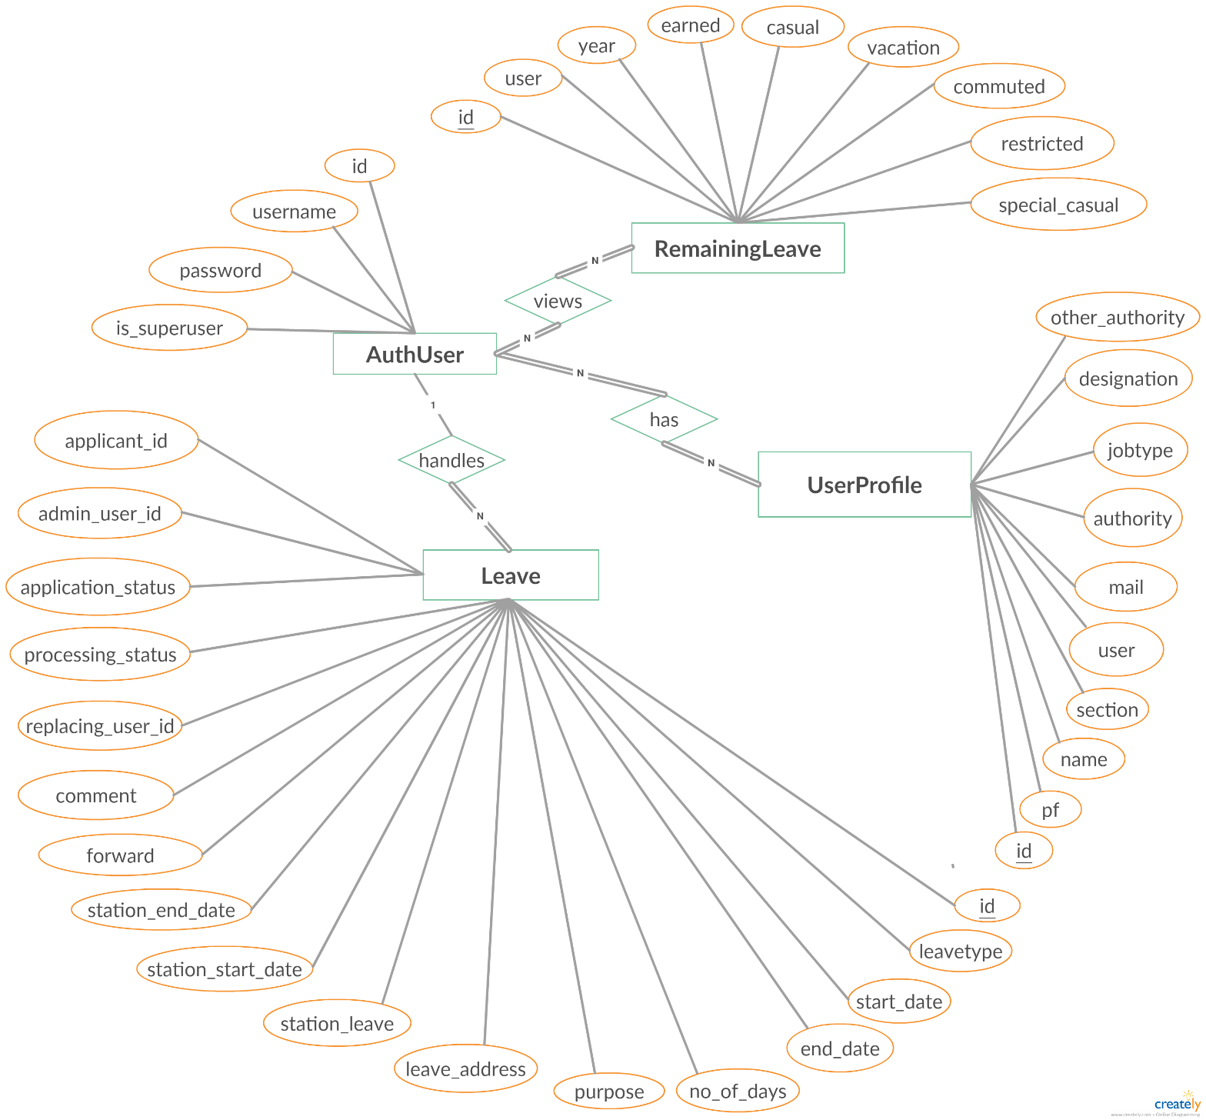
Smart Like a Brain

Slide 9
USER INTERFACE (Ui)

Slide 10
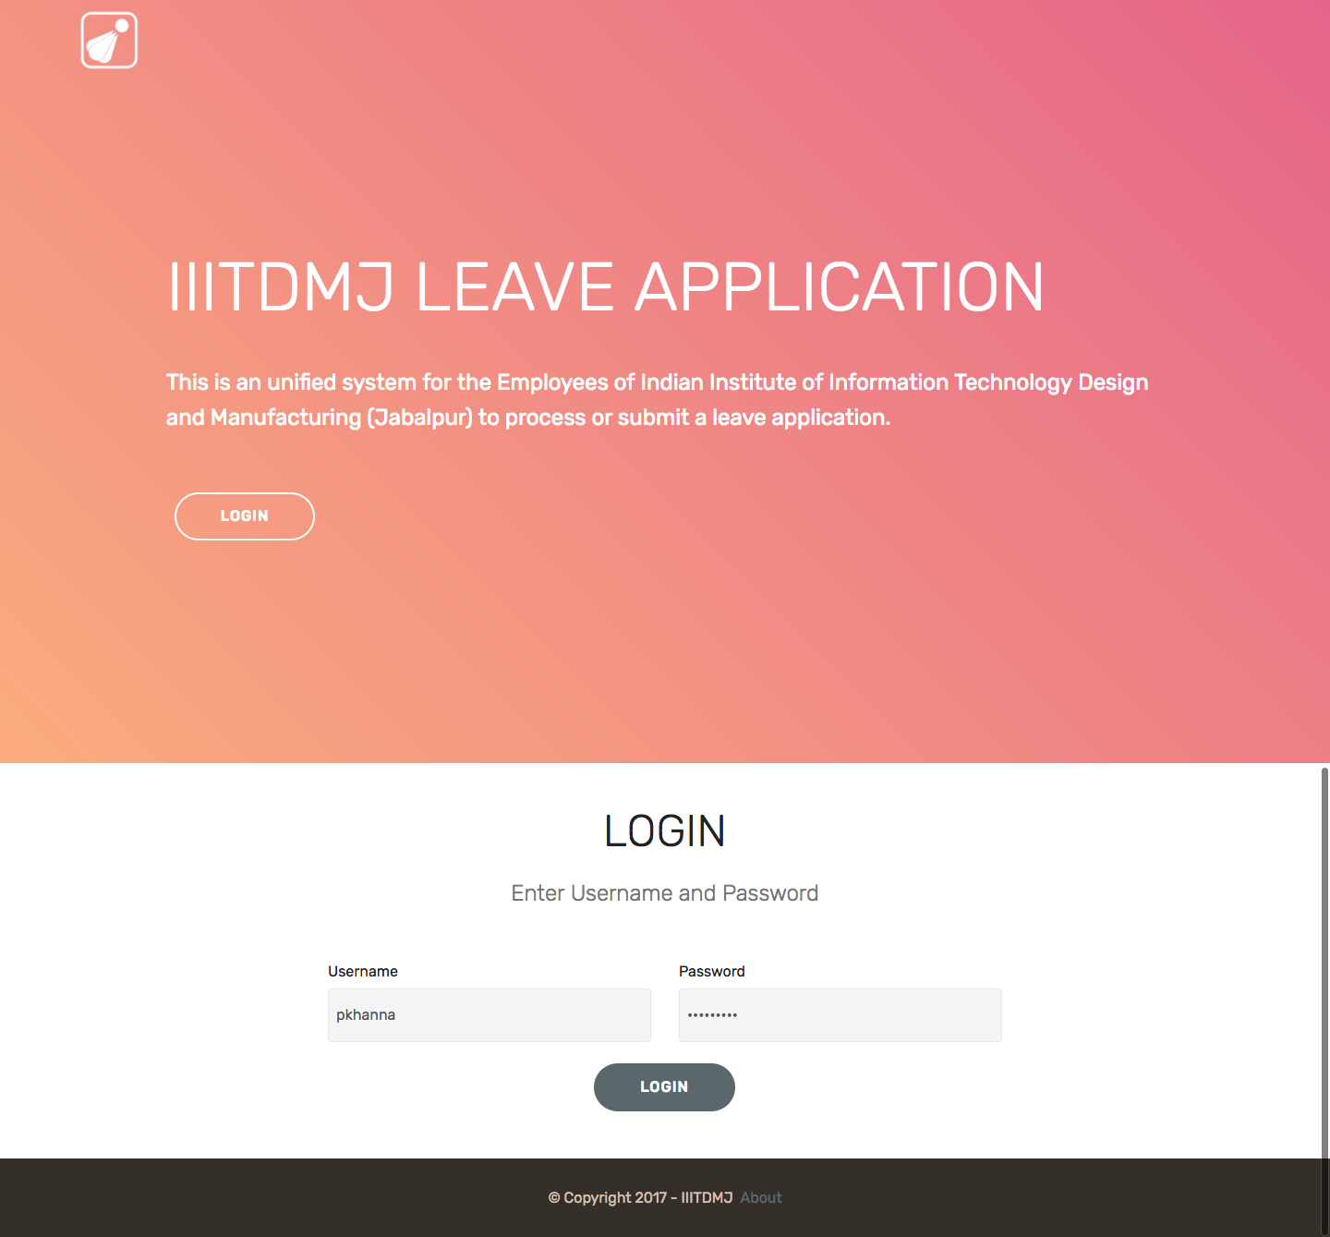
Home / Login
HEAD AND EMPLOYEE

Slide 11

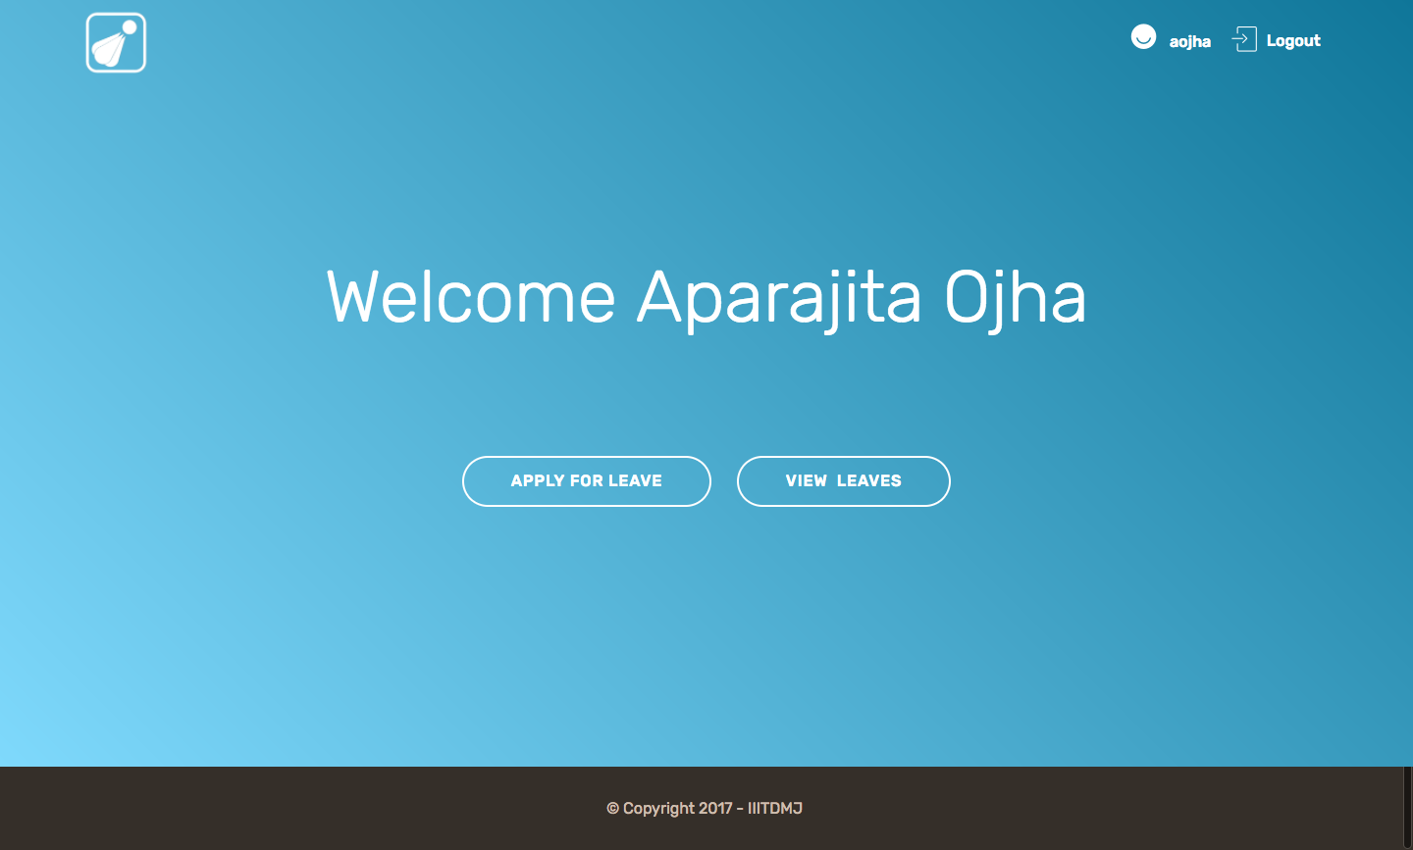
Dashboard
HEAD
EMPLOYEE

Slide 12
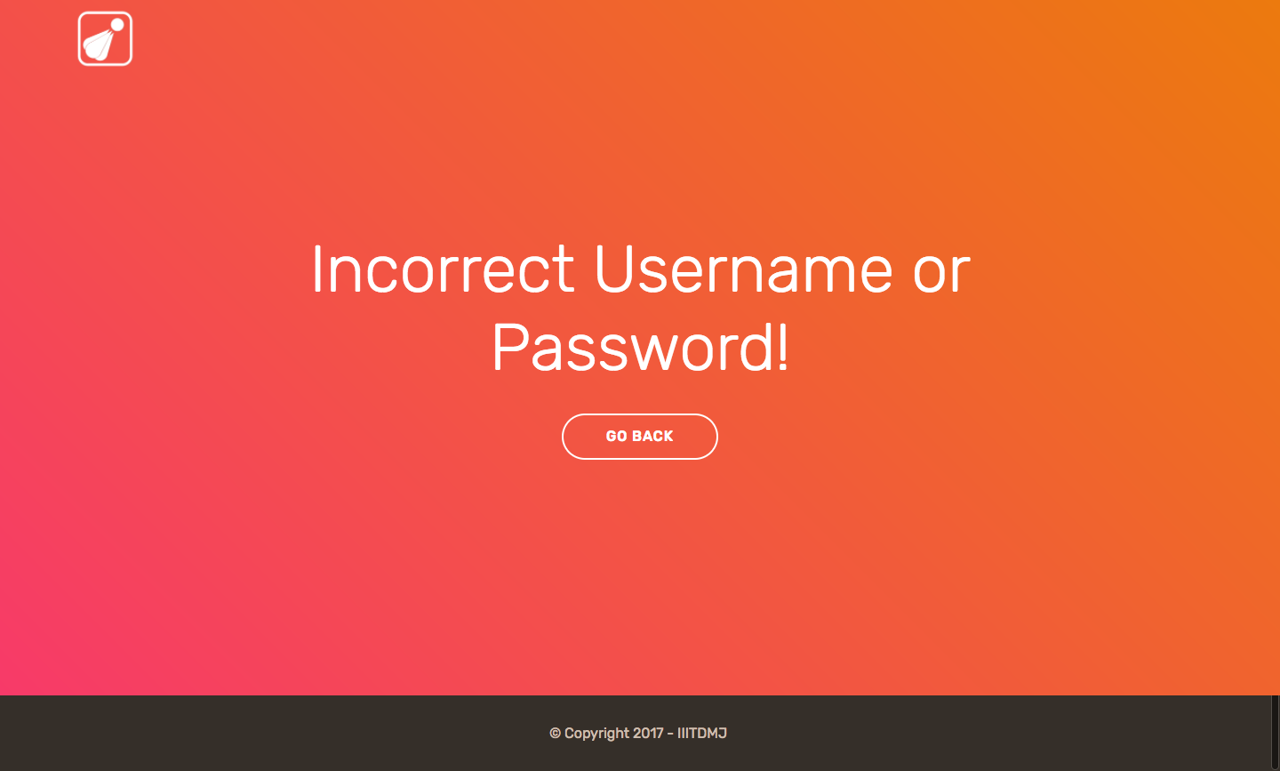
Incorrect Credentials

Slide 13
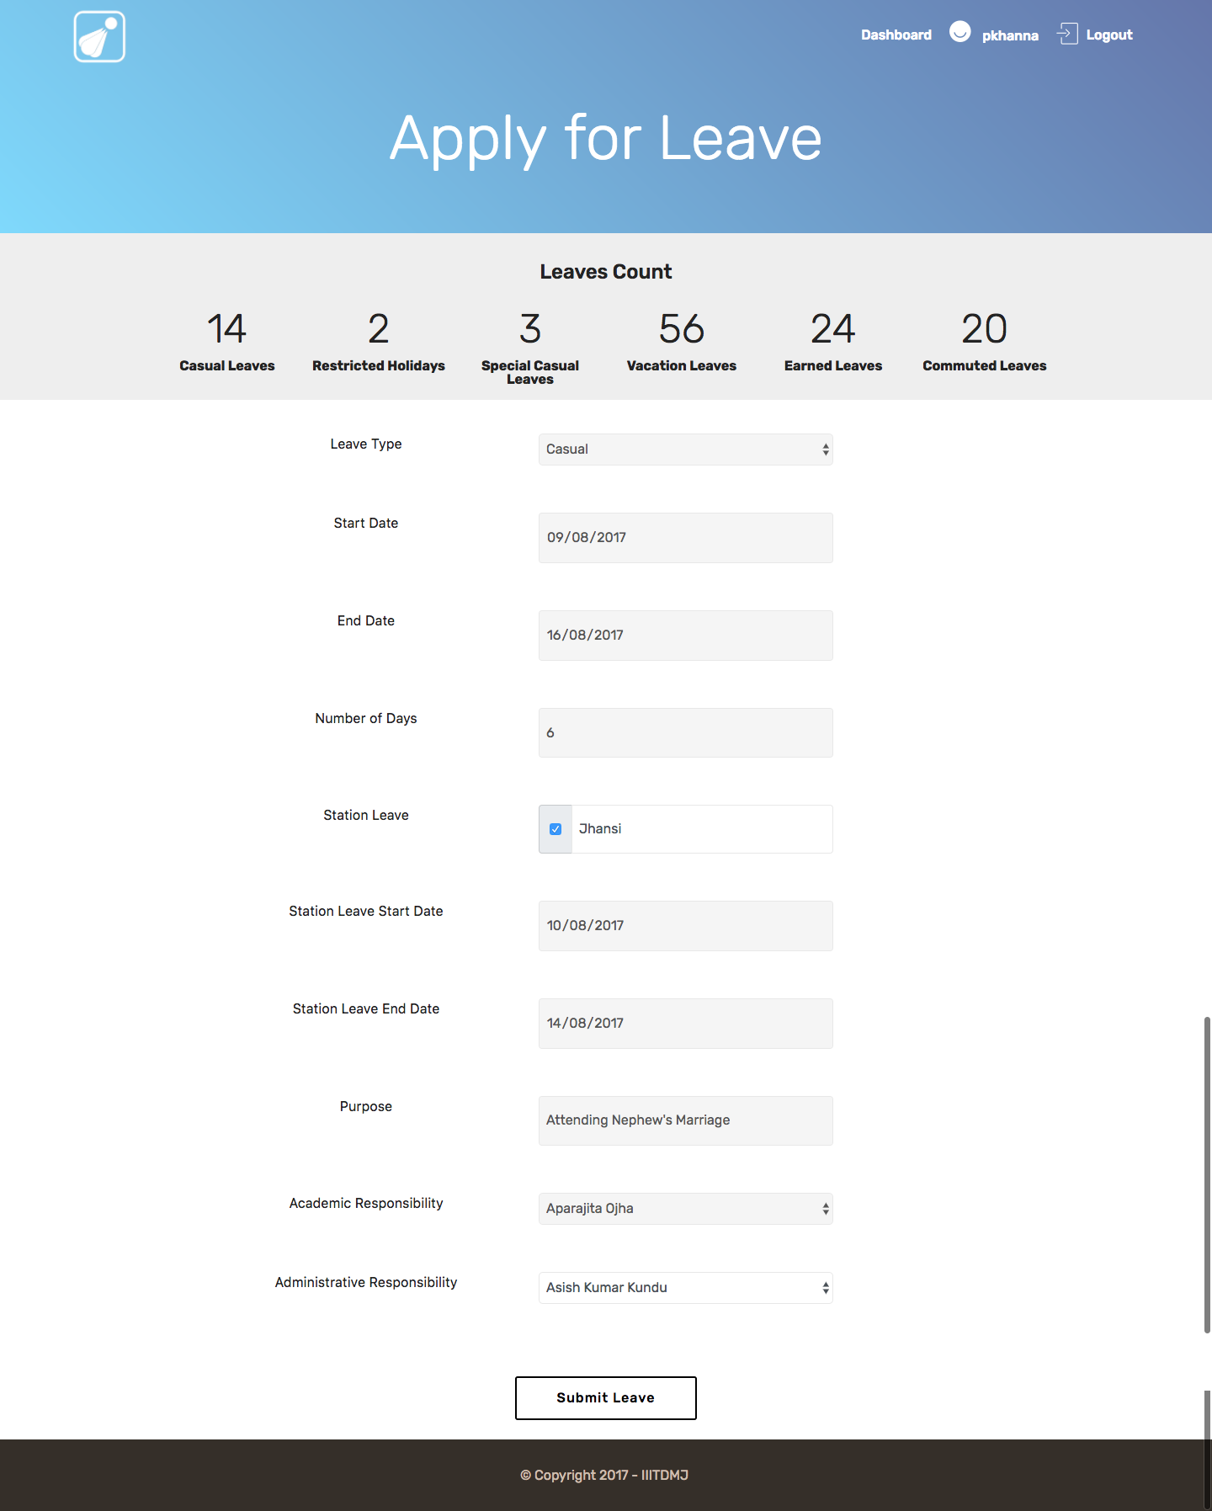
Apply for Leave
HEAD AND EMPLOYEE

Slide 14
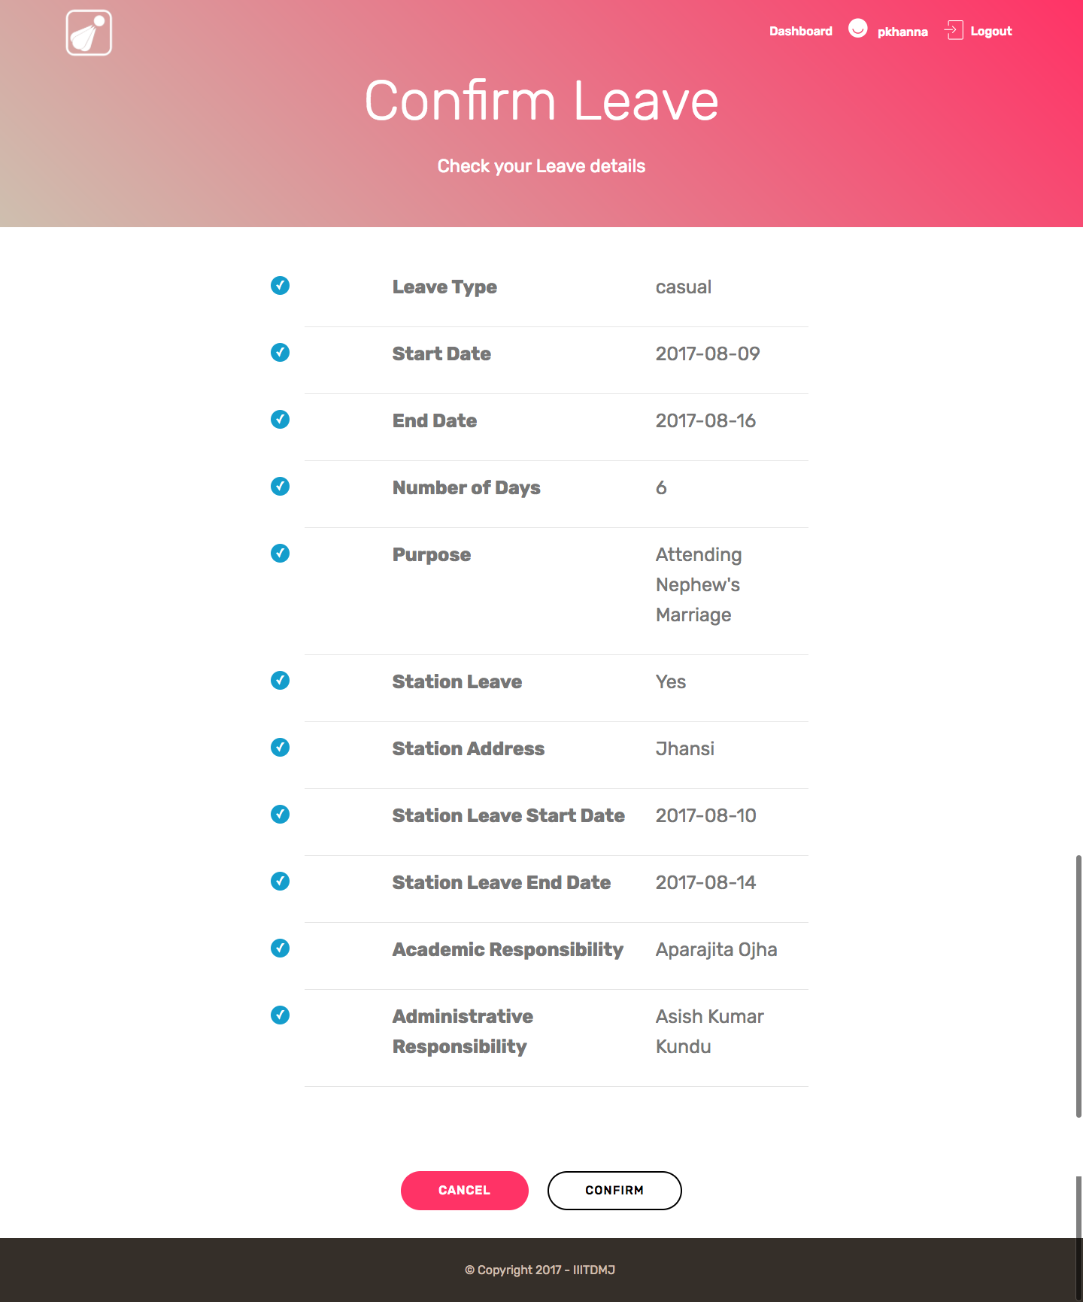
Confirm Leave
HEAD AND EMPLOYEE

Slide 15
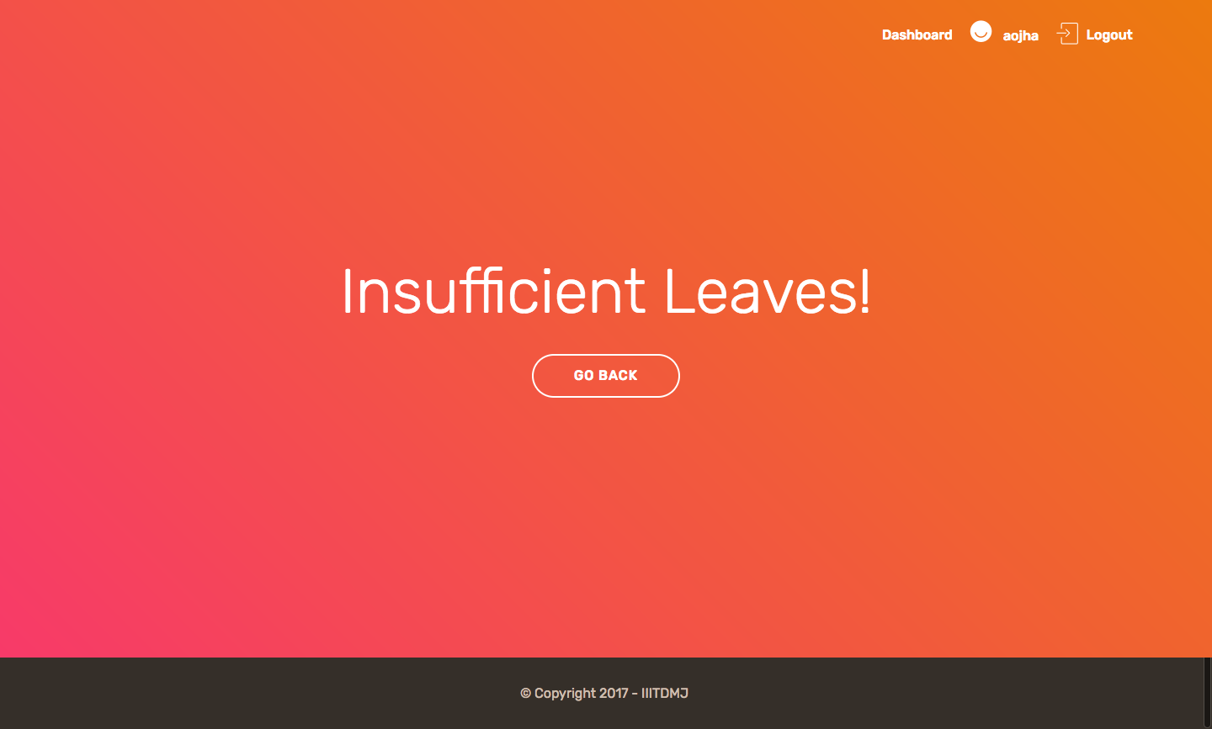
Insufficient Leaves
HEAD AND EMPLOYEE

Slide 16
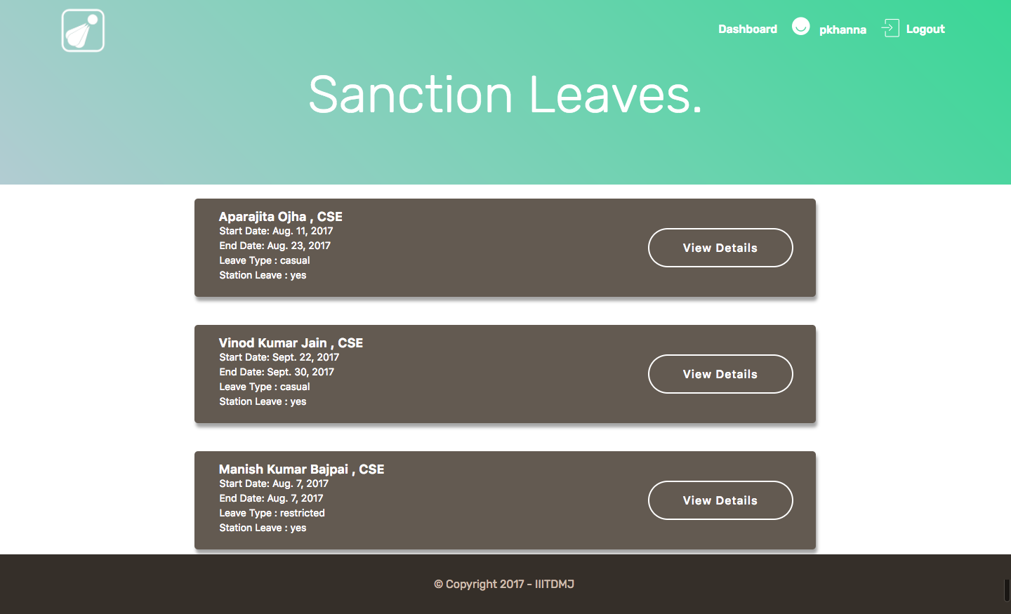
Sanction Leaves
HEAD

Slide 17
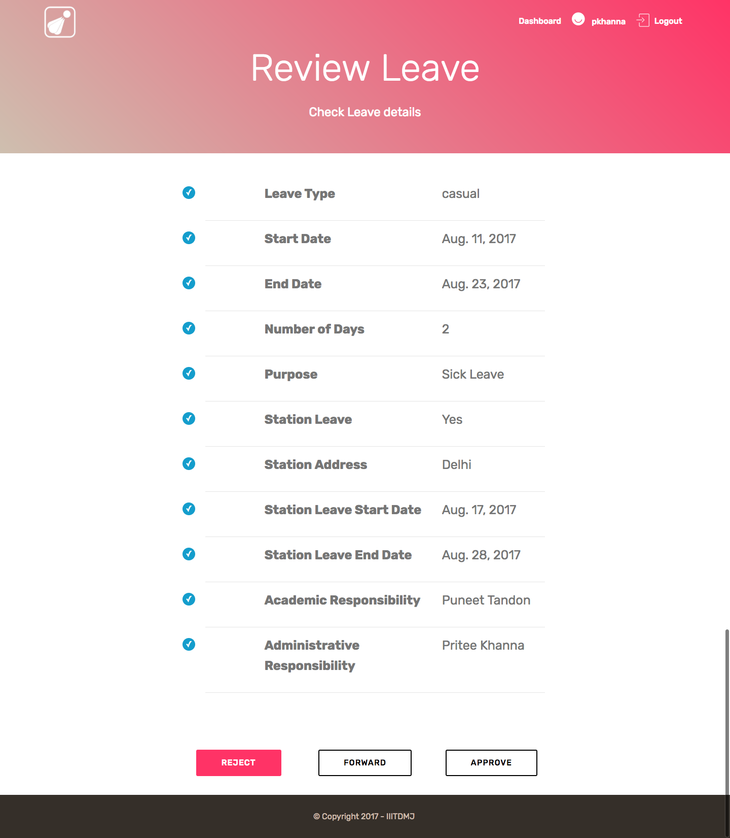
Review Leave
HEAD

Slide 18
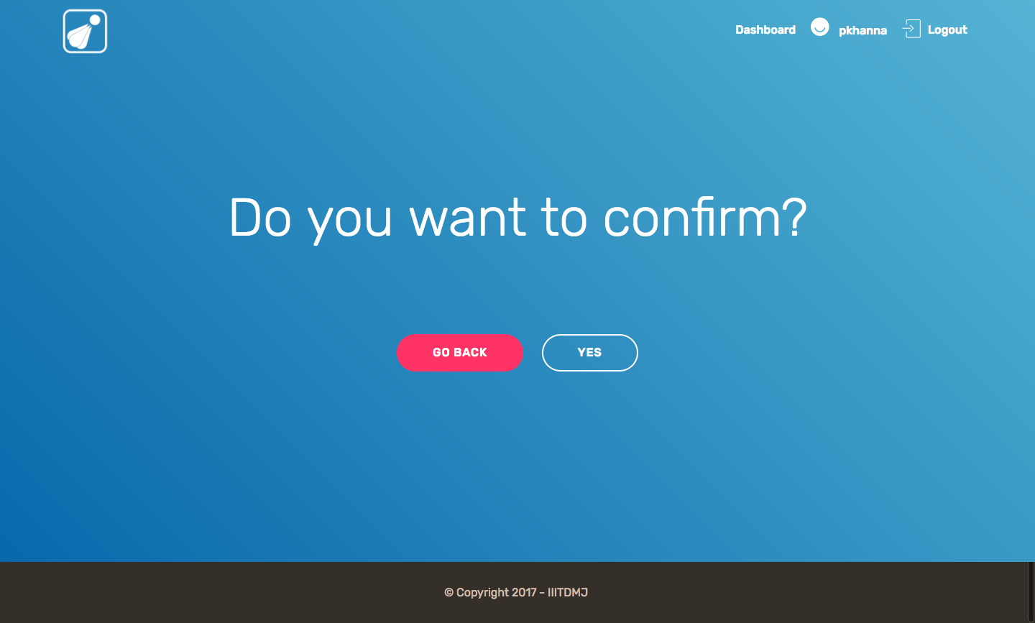
Confirm sanction
HEAD

Slide 19
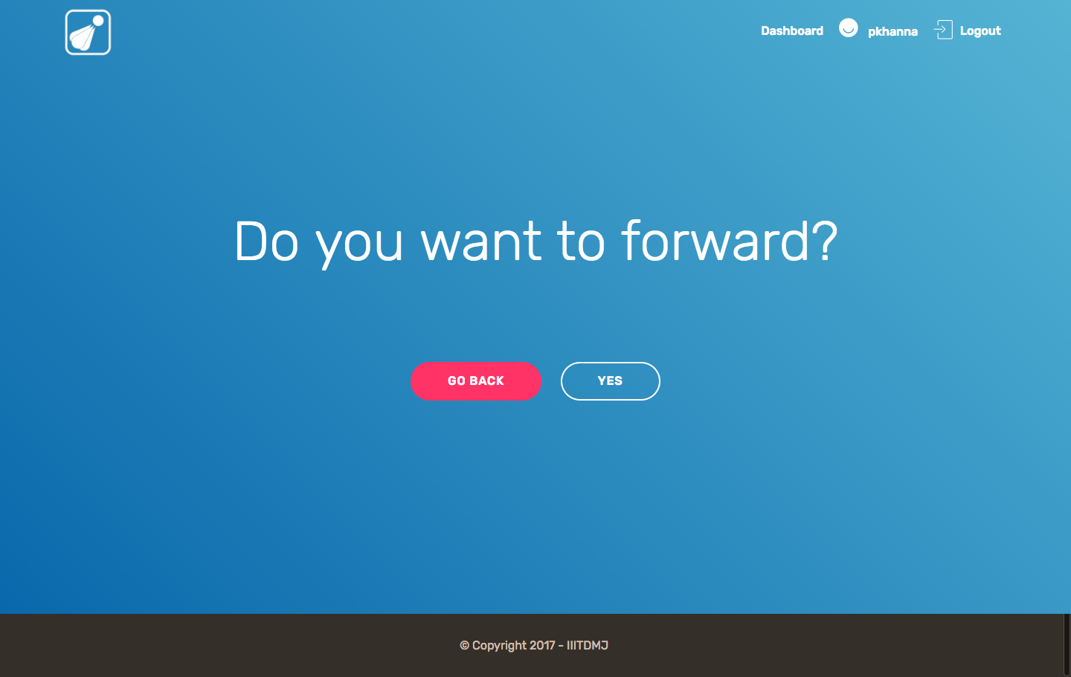
Forward Leave
HEAD

Slide 20
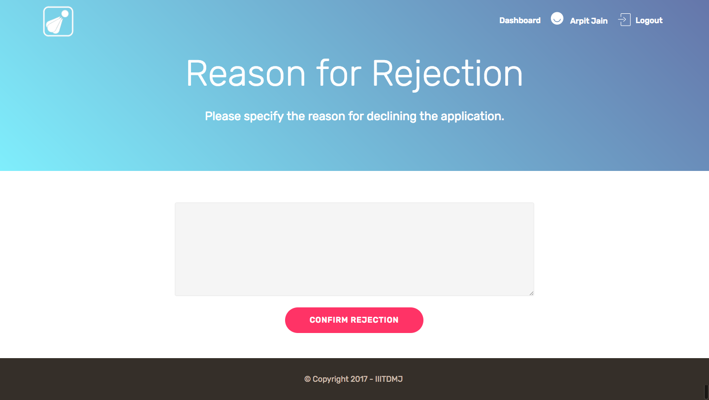
Reject Leave Application
HEAD

Slide 21
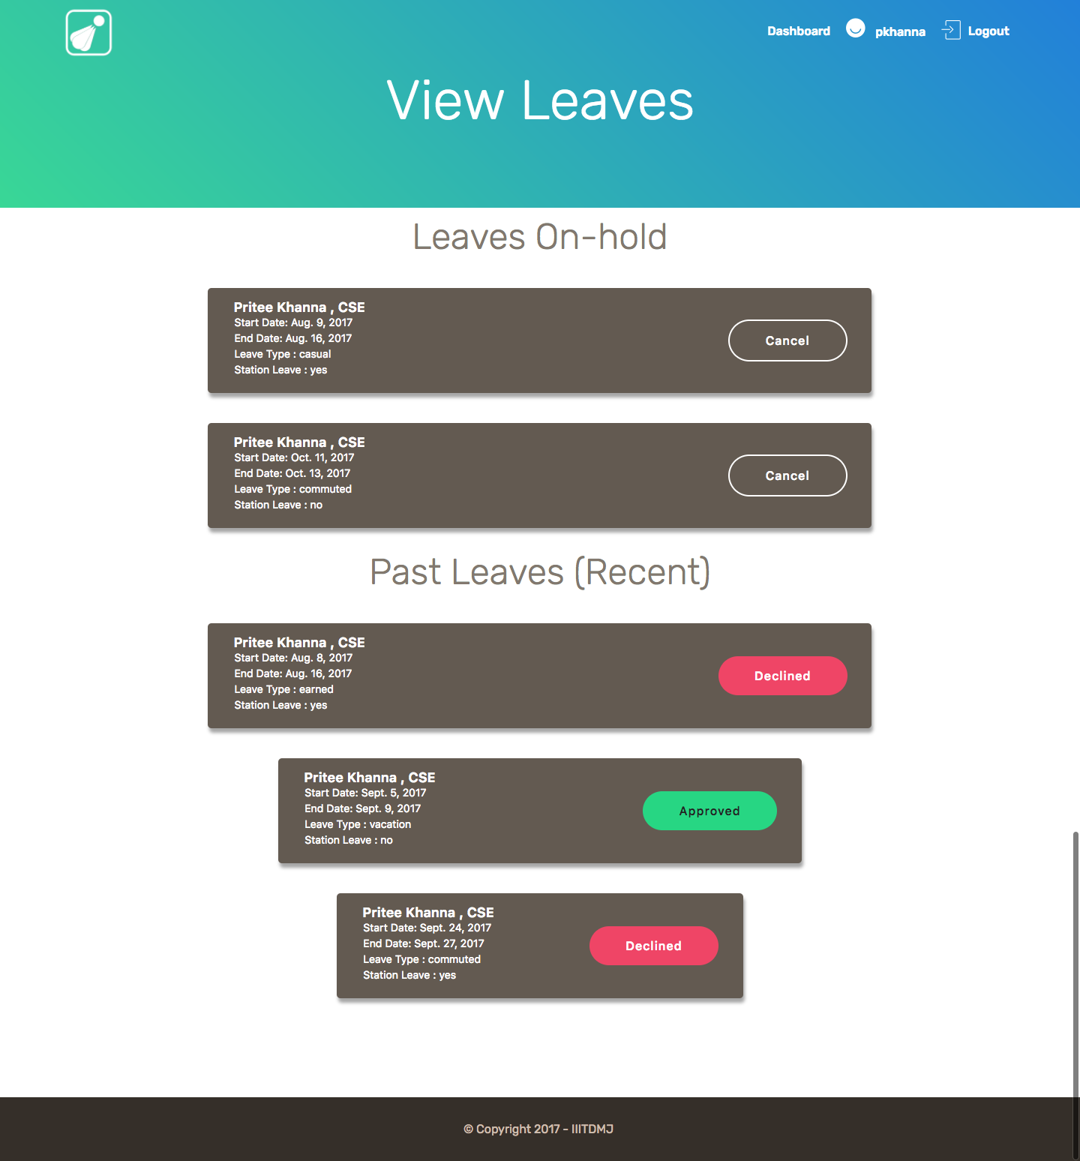
View Leaves
HEAD AND EMPLOYEE

Slide 22
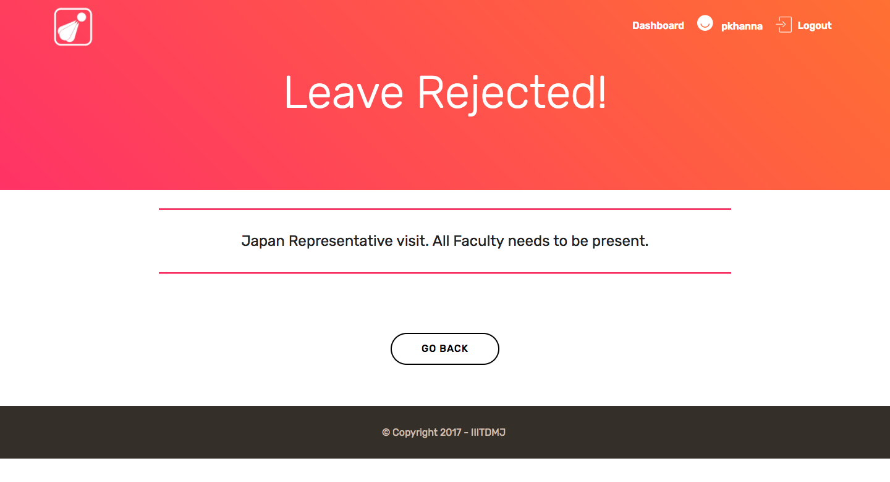
Reason for Rejection
HEAD AND EMPLOYEE

Slide 23
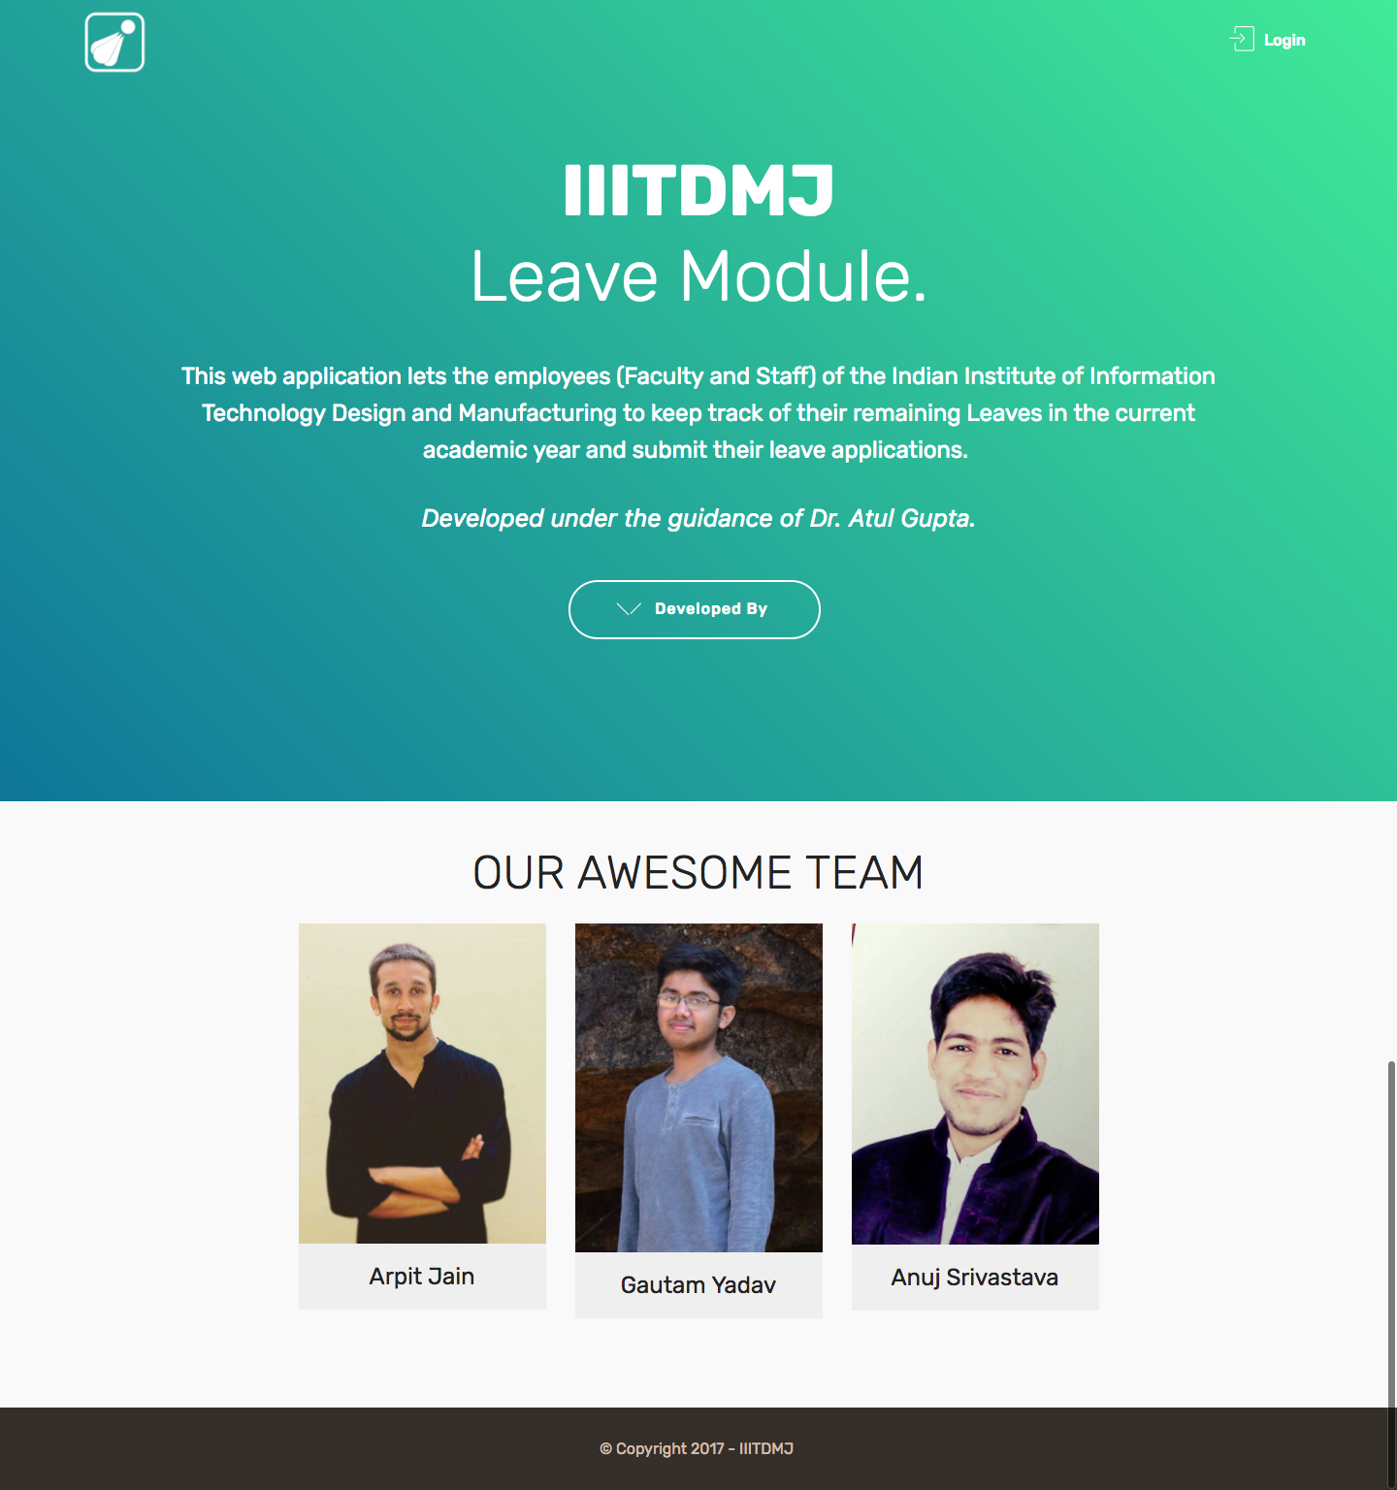
About Page
HEAD AND EMPLOYEE

