Slide 1
CS617
Deep Learning Project
(Text Summarization)
Group 06
Arpit Jain | 2015047
Gautam Yadav | 2015093
Narosenla Longkumer | 2015165

Slide 2
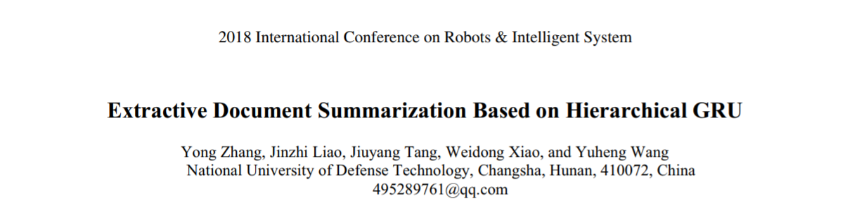
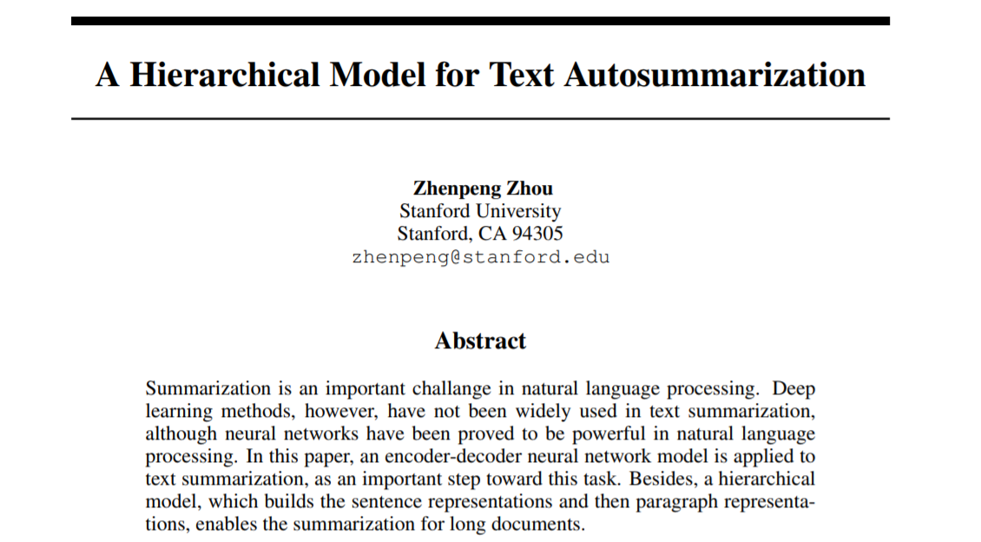
https://machinelearningmastery.com/gentle-introduction-text-summarization/

Slide 3
Dataset
News Article Data
The data we will use here is the 'all-the-news'-dataset from Kaggle. It contains about 200000 news articles and the headlines of those articles. The headlines will serve as our summaries in this case. The articles are from several big news corporations.
https://www.kaggle.com/snapcrack/all-the-news
Content
articles1.csv - 50,000 news articles (Articles 1-50,000)
articles2.csv - 49,999 news articles (Articles 50,001-100,00)
articles3.csv - Articles 100,001+

Slide 4
Pre-processing
Lowercasing the entire text.
Collapsing the text into a single line.
Fixing the presence of back-slash escape characters.
Substituting special characters and numeral with spaces.
Reducing multiple spaces into a single space.
Removing single letter words.
Tokenization

Slide 5
Word Embeddings
Pre-trained tensor flow hub embeddings.
Token based text embedding trained on English Wikipedia corpus.
https://tfhub.dev/google/Wiki-words-250/1

Slide 6
Model
Model
Sequence to Sequence Model
The basic RNN model we are going to use is seq2seq with LSTM celled layers.
(Basic Structure)
Encoder-Decoder
Attention Mechanism
Cyclic Learning rate
Beam Search (Using Beam size = 5)
Model Reference: thomasschmied (GitHub)

Slide 7
Parameters
Model hyperparameters
num_layers_encoder = 4
num_layers_decoder = 4
rnn_size_encoder = 300
rnn_size_decoder = 300
batch_size = 32
epochs = 100
clip = 5 (Gradient Clip)
keep_probability = 0.8
learning_rate = 0.0005
max_lr=0.005
learning_rate_decay_steps = 100
learning_rate_decay = 0.90
Sequence to Sequence Model

Slide 8
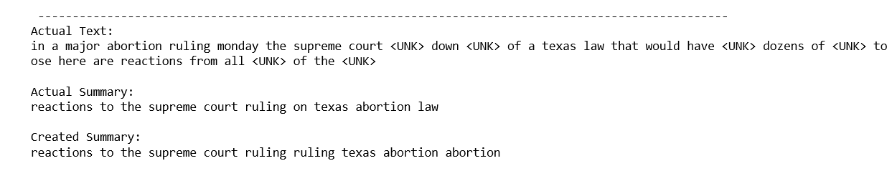
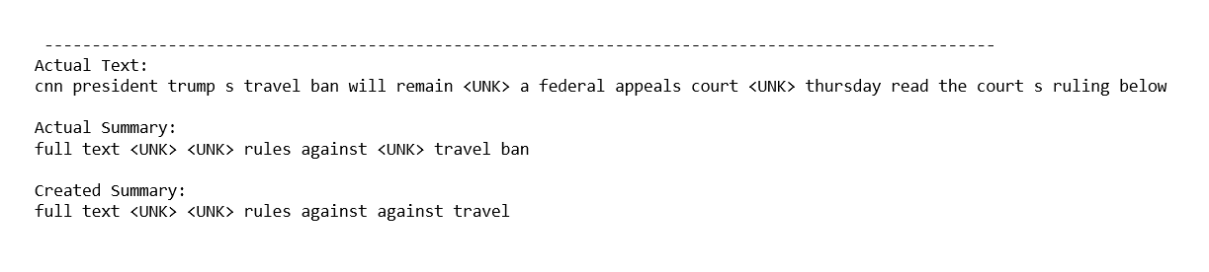
Results (Our Model until Mid-Sem evaluation)
25 Epochs
Problems:
Repetitive Terms.
Large number of Unknowns <UNK>.
Rouge Metric not implemented.
Very poor summaries.

Slide 9
How we fixed these problems?
Changes
Trained for increased number of Epochs (20,100)
We were initializing our dictionary based on Minimum Occurrences of that particular word being 2 and labeling rest of the words as unknown in order to make our dictionary more generalized. We changed the Minimum occurrences to 1.
Used Rouge Metric of Evaluation (Rouge-1, Rouge-2, Rouge-L)

Slide 10
Rouge Metric
ROUGE stands for Recall-Oriented Understudy for Gisting Evaluation.
It works by comparing an automatically produced summary or translation against a set of reference summaries (typically human-produced). It works by matching overlap of n-grams of the generated and reference summary.
Rouge 1 : Refers to the overlap of 1 word (1-gram)
Rouge 2 : Refers to the overlap of 2 word (Bigram)
Rouge L : Longest Common Subsequence (LCS) based statistics. (Almost sentence structure level)
To determine prediction accuracy

Slide 11
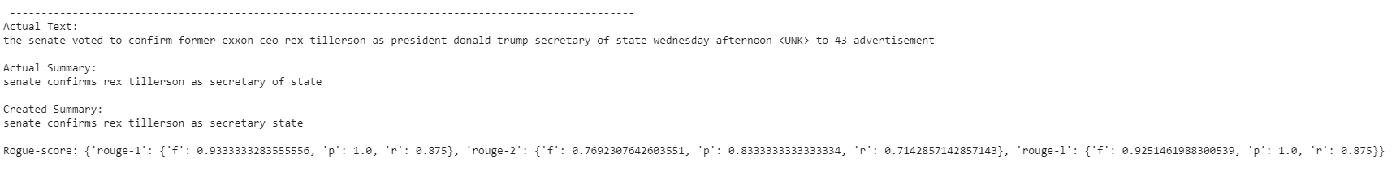
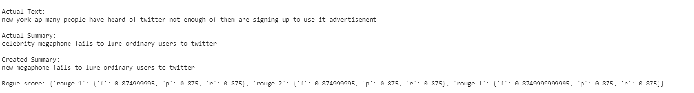
Results
100 Epochs
Early Stopping at around 85 Epochs

Slide 12
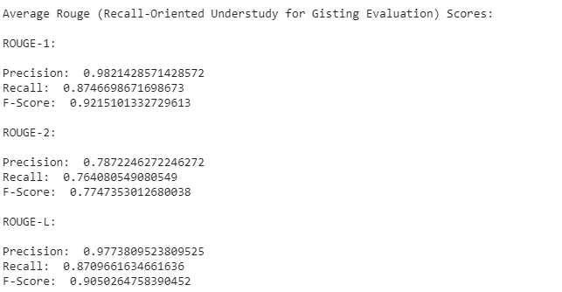
Results
100 Epochs
Early Stopping at around 76 Epochs

Slide 13
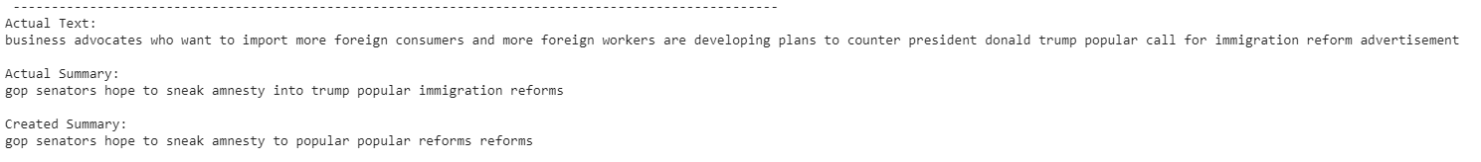
Some Challenges
(Which still persist)
Some terms are still repeating.

