Slide 1
Application of Microservice Architecture in B2B Processes
Software Development Intern at IBM ISL, Bangalore
Arpit Jain
Roll Number: 2015047
Supervisors and Mentors
INTERNAL SUPERVISOR
Prof. Aparajita Ojha
EXTERNAL SUPERVISOR
Mr. Atul A. Gohad
MENTOR
Ms. Rashmi Acharya

Slide 2
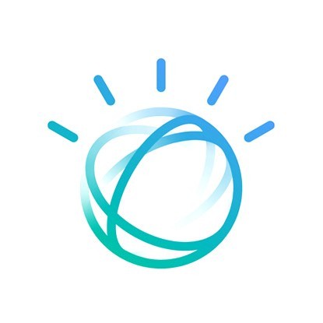

IBM ISL is India Software Labs, where majority of the IBM products are developed and maintained. India Software Labs (ISL) is one of the largest development and innovation centers located across multiple cities.
IBM
My Role at IBM
I was an intern in the Watson Supply Chain team of IBM Watson Customer Engagement Department.
My team dealt with the Product called Sterling Integrator.

Slide 3
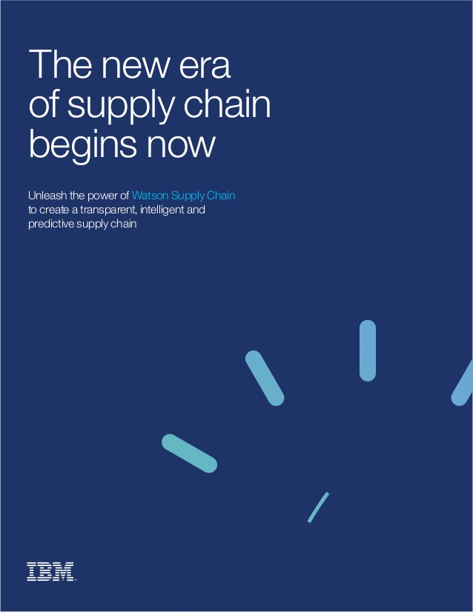
What did I do in these last 6 months?
Major Tasks
Research about the Microservice Architecture, REST APIs and Business-to-Business processes.
Microservice Architecture Demo to pitch the idea.
Deployment of B2B-APIs on the Sterling Integrator Server
Developed and Installed a REST-API Client service and Business workflow for Sterling Integrator.
Worked on yet another service for Sterling Integrator called XML-JSON-Transformer for Data-conversion needs of customers.
Converted Business APIs to Spring-Boot framework and demonstrated the performance improvements.
Added Angular Modern UI and Documentation to these new APIs.
Developed a new Automated IBM Deployment Framework.
Developed a Pre-disaster Human Resource Tracking system.

Slide 4

The Results
Set of my Complete End to End Projects

Slide 5
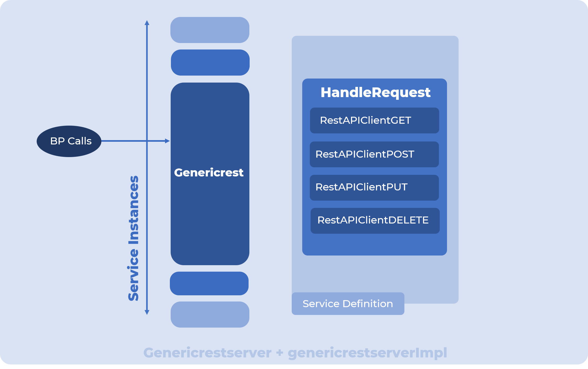
B2B REST Client Adapter

Slide 6
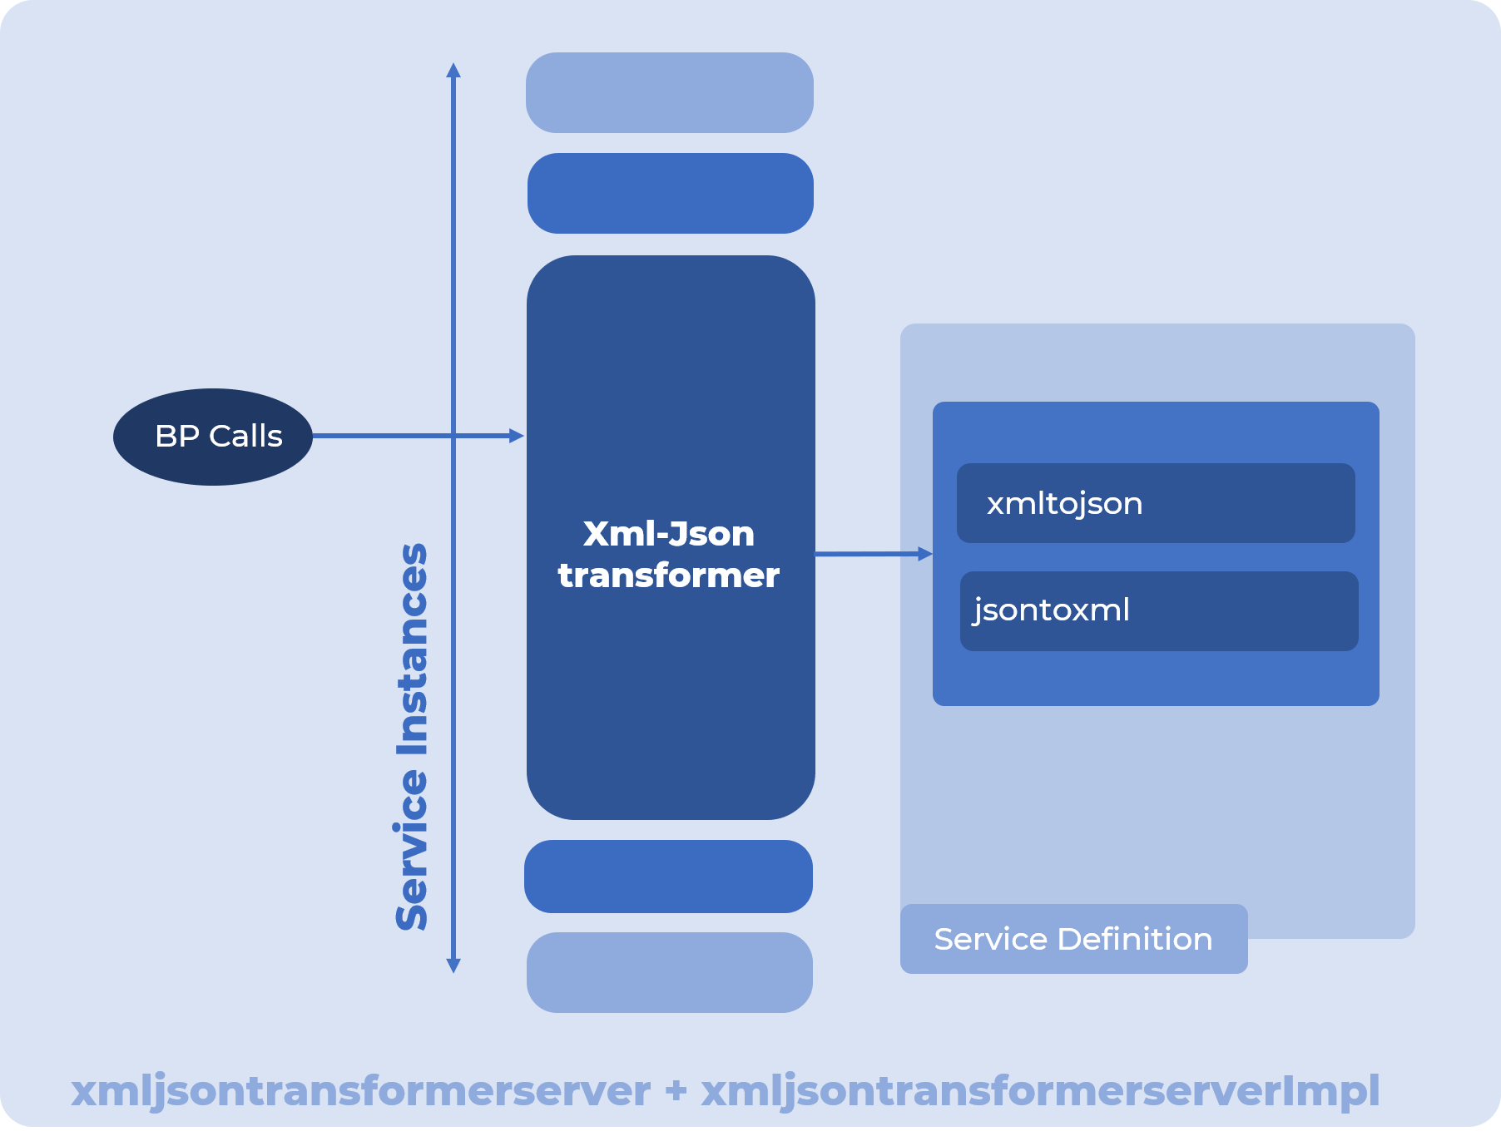
XML JSON Transformer

Slide 7
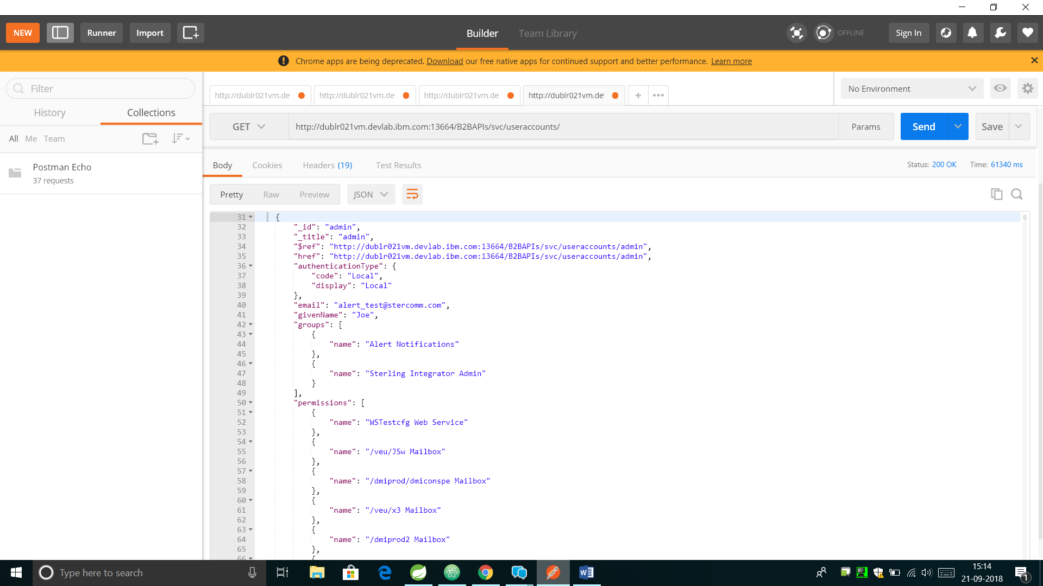
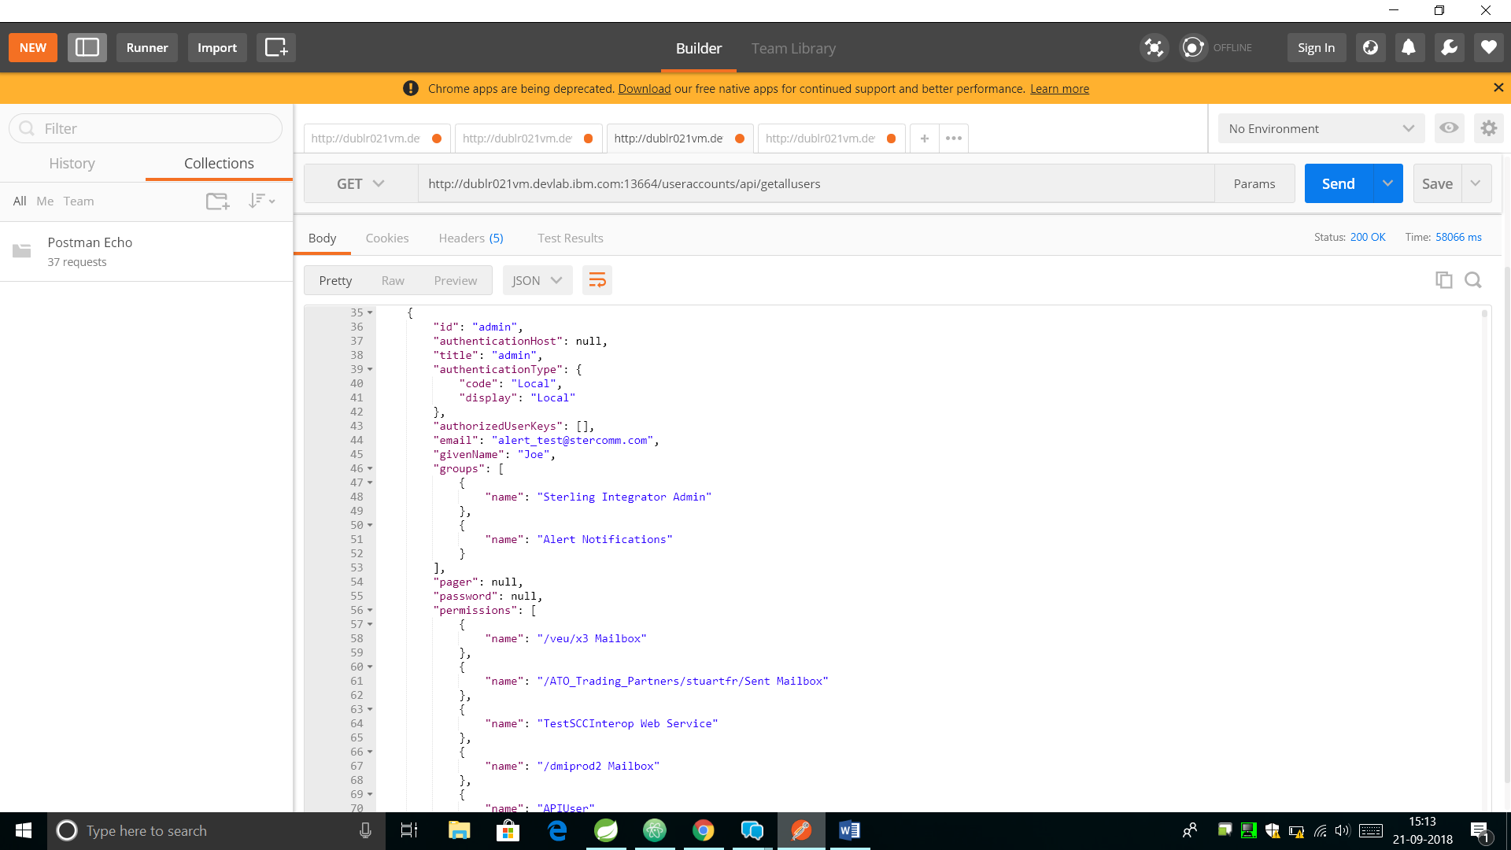
IBM Business REST APIs (TenX to SpringBoot)
Read-All Request using TenX.
(61340ms, This Request fetches nearly 1000 records)
Read-All Request using Spring-Boot.
(58066ms, This Request fetches 10000 records)

Slide 8
Speaking holistically, on an average, Spring-Boot is nearly ~10-12 times faster than IBM TenX.
 | TenX | Spring-Boot | Performance Ratio
Single GET Request | 12 seconds | 1 second | ~12 times Faster !
Bulk GET Request | 68 seconds | 6 seconds

Slide 9
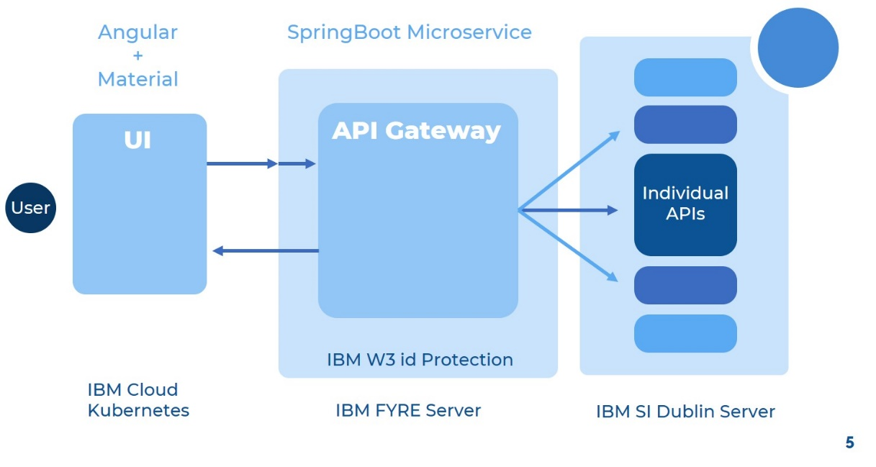
UI For B2B Spring Boot Based APIs

Slide 10
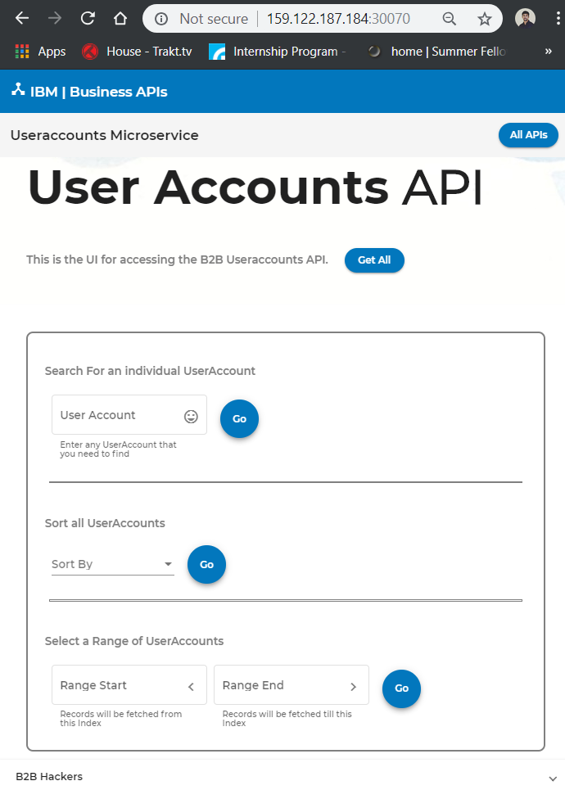
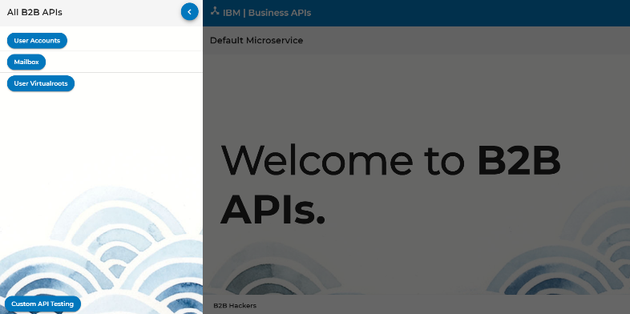
UI For B2B Spring Boot Based APIs

Slide 11
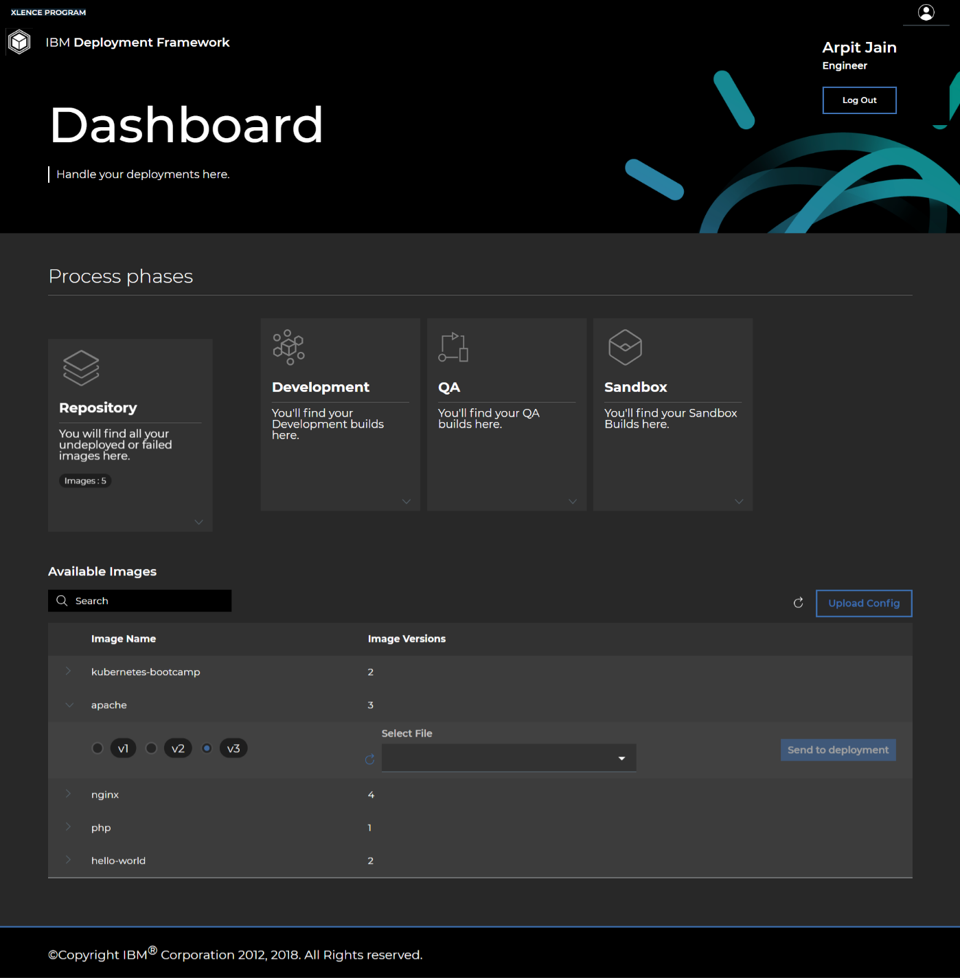
DFRAME : Automated Deployment Framework

Slide 12
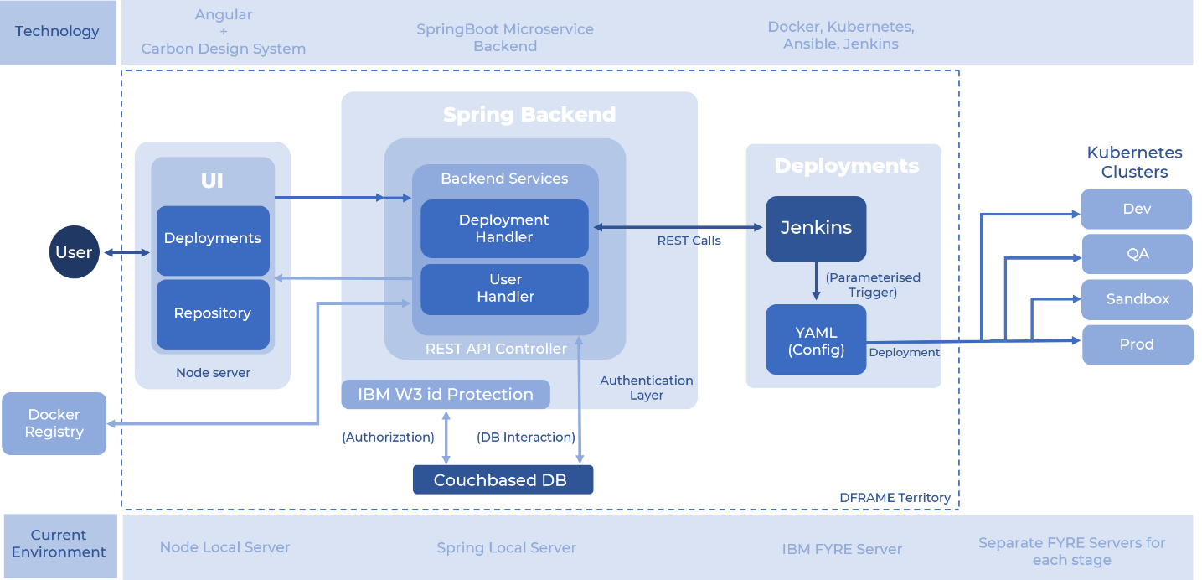
DFRAME : Automated Deployment Framework

Slide 13
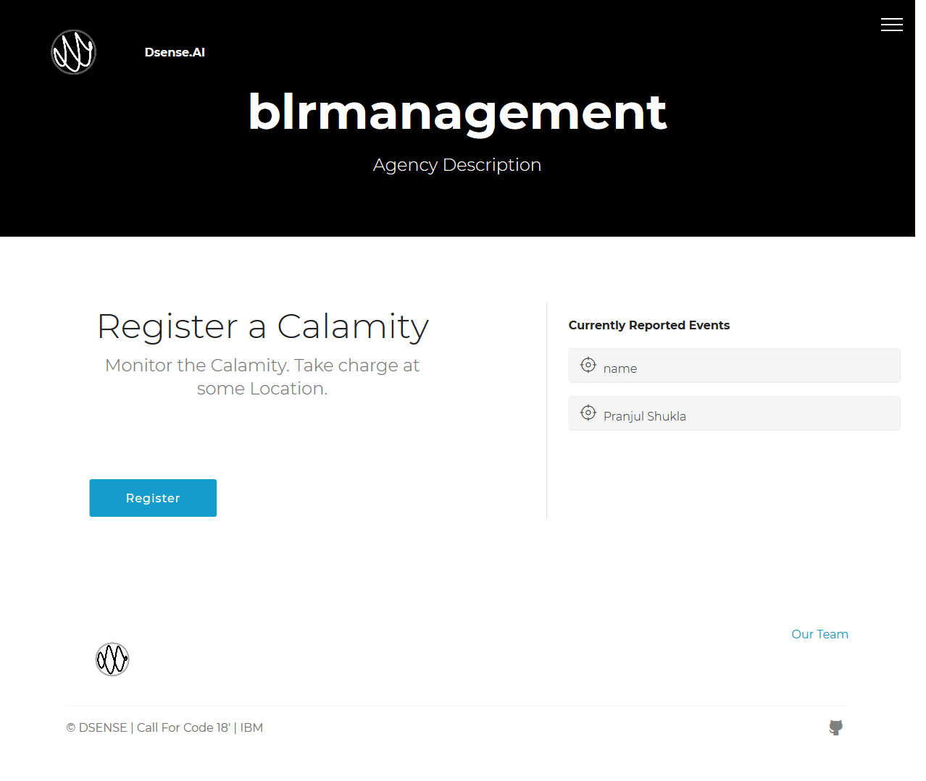
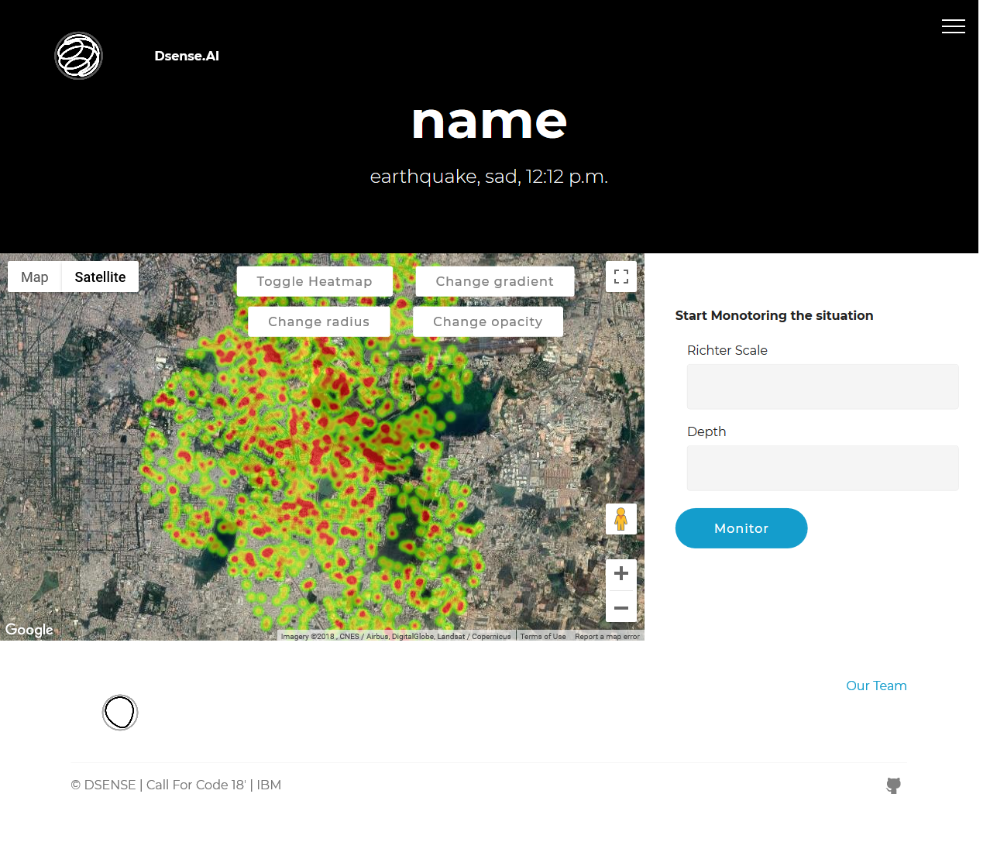
DSENSE : Pre-disaster human resource tracking

Slide 14
Final Word About Internship Experience
During this period of 6 Full Months, I came across various technologies that are being used in the industry and especially in IBM Watson Customer Engagement department.
I have learnt quite a few new technologies and tools like Microservices, Service Oriented Architecture, Maven, Java Spring, DevOps, REST APIs, IBM Cloud cognitive service offerings; etc.
I got to understand that how important is User Interface for any product.
Above all, I learnt from my mentor how to plan. I learnt small things like how to code efficiently and cleanly. I learnt how maintain the positivity of the Team even in the Hard-times.

Slide 15
Thanks!
Any questions?

