Slide 1
PREDICTIVE
Data Analysis
^{Presented By:}
^{Arpit Jha}

Slide 2
PLOT INCLUDED
Avg Amount of Pay per Gender & Age
Avg Balance per Gender & Age
Avg Amount of Sales per Age
Analysis

Slide 3
Insights From Plots

Slide 4
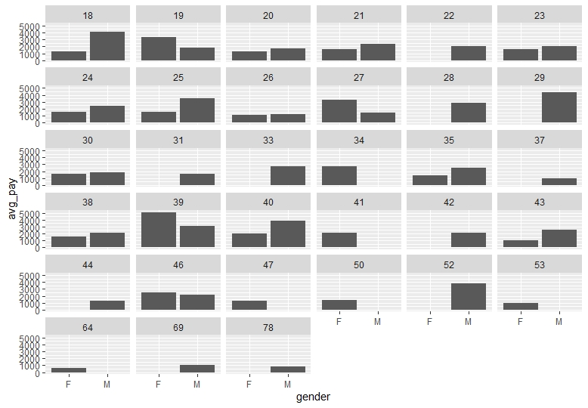
Avg Pay for Female is $1860.52 while that of Male is $2307.38 irrespective of age
Women of age 34,41,46 are paid highest while men of 24,37,52 are paid highest
Most of the Females are paid less than Male
Women with higher age are paid more than women with lower age

Slide 5
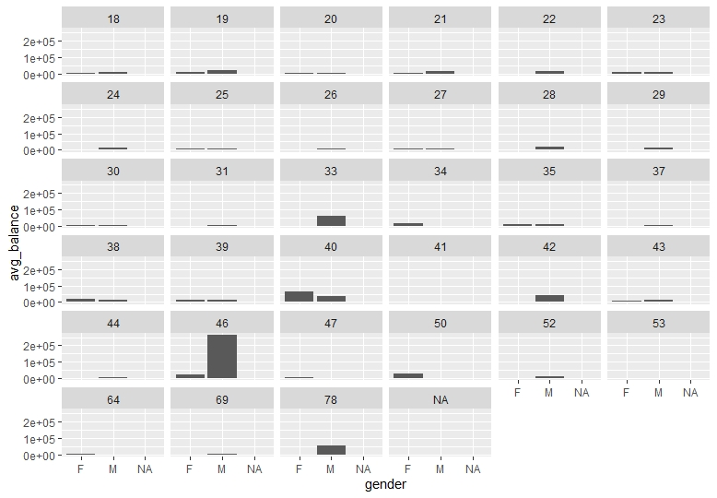
Avg Balance Per Gender & Age
Avg Balance of Female $11096.86 and that of Male $25251.26
Most of People with high Avg Balance are from 30 to 50 age group
Most of People with low Avg Balance are in 20 to 30 age group
Account balance of Females are less than Males
Most of the high balance accounts are of Middle age people
Most of the low balance accounts are of people in there twenties

Slide 6
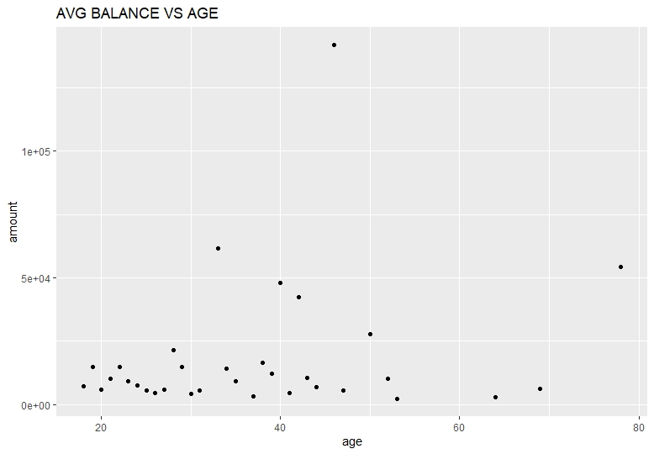

Slide 7
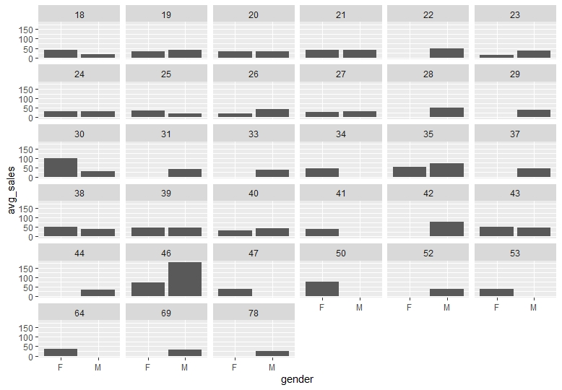
Avg Amount per sale for Male is $76.812 and for Female is $97.79
Total number of sales for Males is 3855 and that for Female is 3862
Most of the high amount sales transactions are done from 30 to 50 age group
High frequency but of low sales amount of age group 20 to 30
Females spend more per sale than Males
Twenties persons purchase a lot but of low amount

Slide 8
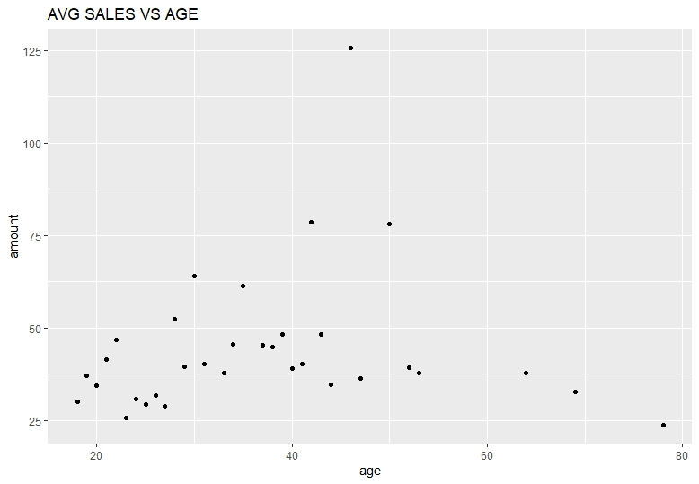

Slide 9
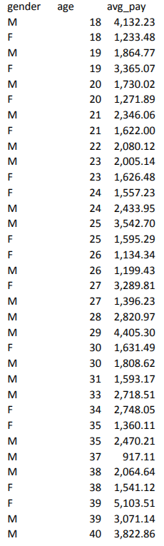
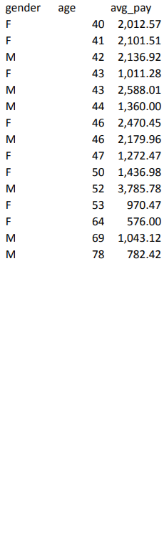
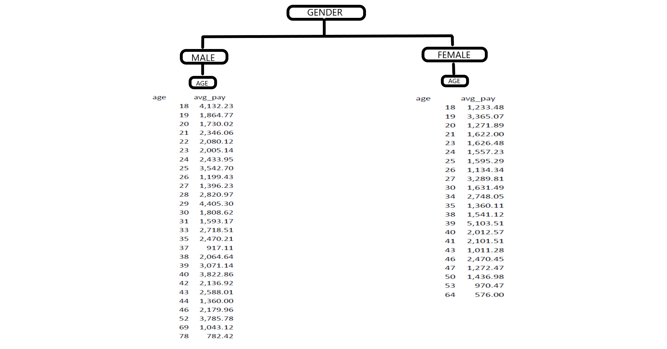
Predicting Salary
DATA

Slide 10
CONCLUSION
Females are less paid than Males.
Balance in Female account is less than that os Males.
Females tend to spend more in a purchase than Males.
Women with higher age are paid more than that with lower age.

