Slide 1
Exploratory
Data Analysis
^{Presented By:}
^{Arpit Jha}

Slide 2
PLOT INCLUDED
Location Vs Amount of Transaction
Month Vs Avg Amount of Transaction(per month)
Type of Transaction Vs Avg Amount of Transaction(per transaction type)
Analysis

Slide 3
Insights From Plots

Slide 4
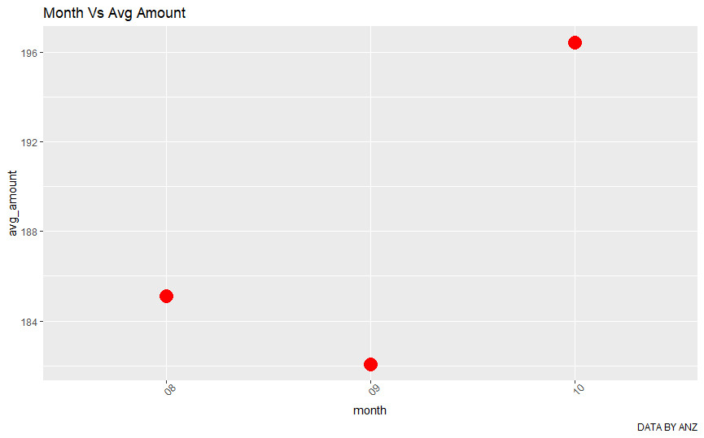
The Highest Avg Amount of transaction is in the month of October $ 196.4273
The lowest is of $ 182.0459 in the month of September
Most of the high amount transactions happens in October.
Low amount transactions happens in September.

Slide 5
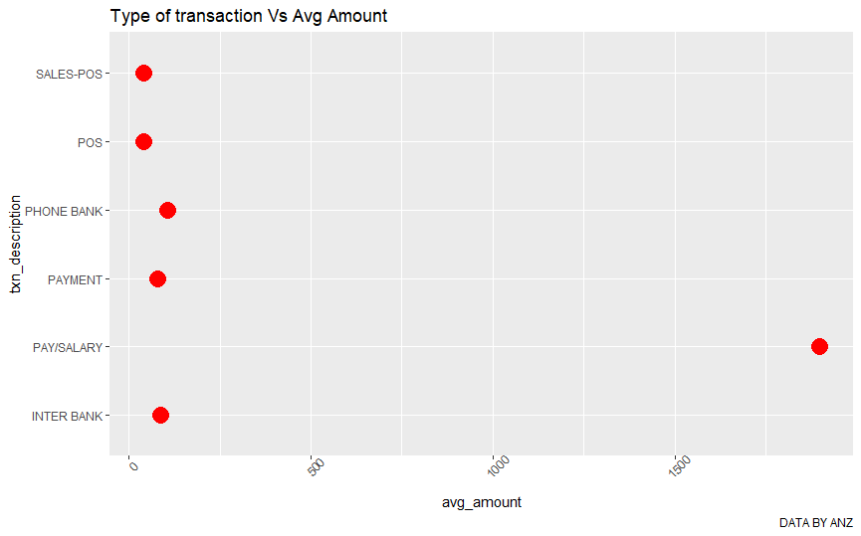
Pay/Salary is the highest Avg Amount in the Type of transaction ( $ 1898.72)
Sales/POS is the lowest with Avg Transaction of $ 39.97
And the Avg Amount for all type is $ 374.90.
So we can say that Pay/Salary transactions are big in amount

Slide 6
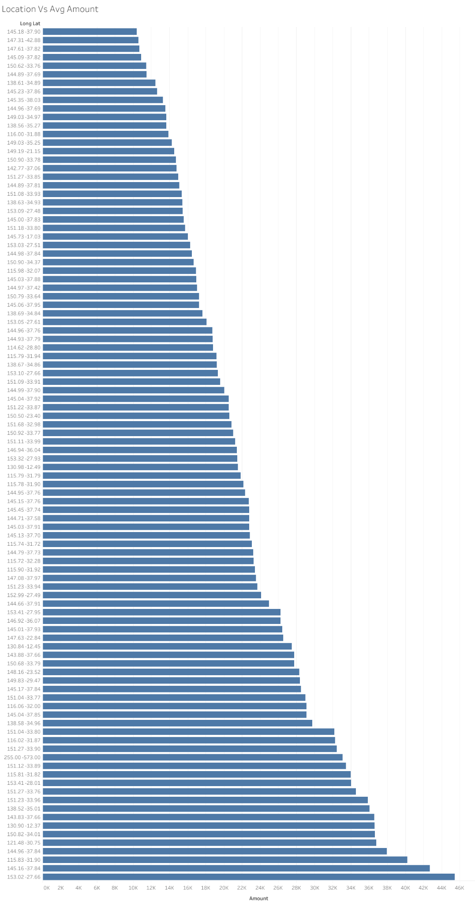
High Amount Transactions:
1. 115.83 -31.90 of $ 8835.98 (Tim/Pay)
2. 145.73 -17.03 of $ 6107.23 (Ronald/Pay)
3. 152.99 -27.49 of $ 6024.49 (Richard /Pay)
Lowest Amount Transactions:
1. 138.63 -34.93 of $ 0.01(Jacqueline/POS)
2. 145.00 -37.83 of $ 0.01(jeffery/POS)
3. 151.27 -33.85 of $ 0.01(catherine/POS)
Salary/Pay Transaction’s locations are constant and the amount are also constant.
Sales/POS Transactions mostly contribute to low amount and they are spread in different location and involve various persons.

Slide 7
CONCLUSION
Big transactions occurs in the month of October , and low in September.
Pay/Salary transactions contribute to High amount of transaction.
For Pay/Salary transactions the location are constant , while for the Sales/POS ,Payment , Phone Bank transactions are scattered in various locations and persons.
Most of the people with High Bank Balance are of age above 40.
Most transactions involving small amounts are debited while that of Big Amounts are credited.

