Slide 1

Expense Approval System using Azure Serverless
Arpit Patel
Student ID: 41159097
Course: CST8917 — Serverless Applications

Slide 2
Introduction (Workflow + Business Rules)
Expense Approval Workflow
Employees submit expense requests with required details
System validates input (amount, category, required fields)
Requests are processed based on predefined business rules
Notifications are sent to employee and manager
Business Rules
Amount < $100 → Automatically Approved
Amount ≥ $100 → Requires Manager Review
No manager response → Request is Escalated
Invalid requests → Rejected with error message
Expected Output
Final decision (Approved / Rejected / Escalated)
Reason for decision
Email notification to employee and manager

Slide 3
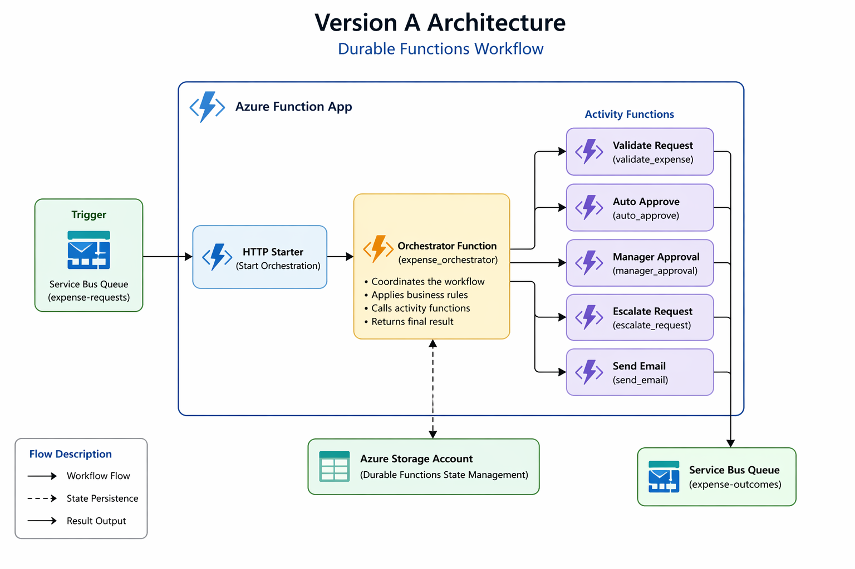
Version A - Architecture (Durable Functions)

Slide 4
Version A Key Design Decisions
Used Azure Durable Functions to manage long-running workflows
Implemented Orchestrator Function to control the entire approval process
Separated logic into Activity Functions (validation, email, status updates)
Used Durable Timer to handle manager response timeout
Maintained workflow state automatically using Durable Function state management

Slide 5
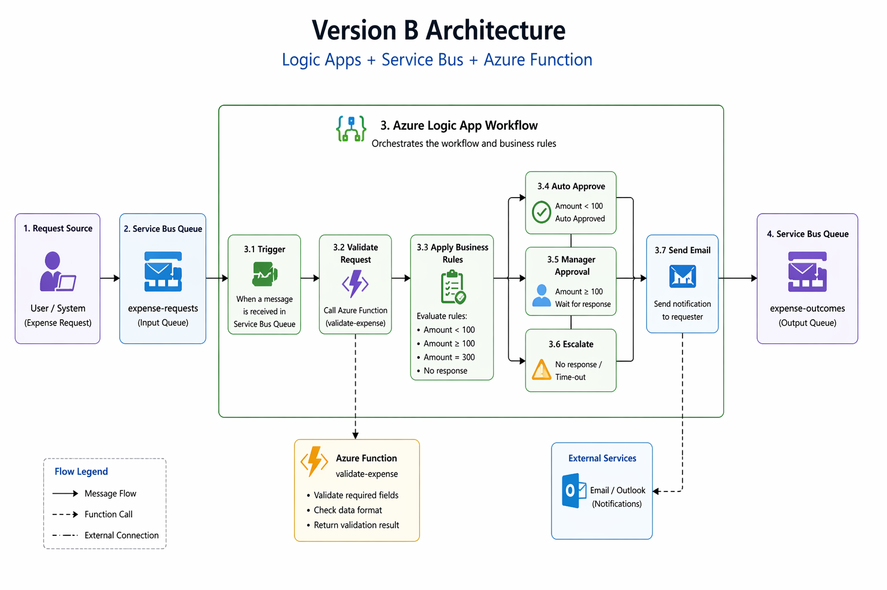
Version B Architecture (Logic Apps + Service Bus)

Slide 6
Version B Key Design Decisions
Used Azure Logic Apps for workflow orchestration
Integrated Azure Service Bus (Queue & Topic) for message handling
Used Azure Function for input validation and business logic
Implemented Condition blocks in Logic Apps for decision-making
Used built-in connectors (Outlook) for sending email notifications
Applied timeout-based escalation logic within the workflow

Slide 7
Comparison Summary (Version A vs Version B)
Dimension | Version A — Durable Functions | Version B — Logic Apps + Service Bus
Development Experience | Code-heavy, slower to build | Visual, faster and easier to design
Testability | Easy to test locally using code | Limited local testing, mostly cloud-based
Error Handling | Fine control using try/catch logic | Built-in retry and error handling
Human Interaction | Complex to implement waiting logic | Natural and easy with built-in connectors
Observability | Logs and Application Insights | Visual run history and step tracking
Cost | More efficient at large scale | Slightly higher due to connectors and executions

Slide 8
Recommendation
Use Azure Logic Apps for workflow orchestration and approval processes
Use Azure Functions for validation and complex business logic
Best approach is a hybrid architecture combining both
Logic Apps provide faster development and easier monitoring
Functions offer better control, scalability, and performance

Slide 9
Lessons Learned
Logic Apps simplify building event-driven workflows
Service Bus improves scalability and decoupling of components
Separating validation into Functions improves modularity and reusability
Debugging Logic Apps using run history is very effective
Real-world systems often use a combination of services instead of a single solution

Slide 10
