Slide 1
Programming in Oracle with PL/SQL

Slide 2
PL/SQL Blocks
PL/SQL code is built of Blocks, with a unique structure.
There are two types of blocks in PL/SQL:
  Anonymous Blocks: have no name (like scripts)
    can be written and executed immediately in SQLPLUS
  2. Named Blocks:
    Procedures
    Functions

Slide 3
Anonymous Block Structure:
DECLARE (optional)
  /* Here you declare the variables you will use in this block */
BEGIN (mandatory)
  /* Here you define the executable statements (what the block DOES!)*/
EXCEPTION (optional)
  /* Here you define the actions that take place if an exception is thrown during the run of this block */
END; (mandatory)
/
A correct completion of a block will generate the following message:
PL/SQL procedure successfully completed
Always put a new line with only a / at the end of a block! (This tells Oracle to run the block)

Slide 4
DECLARE
Syntax
Examples
identifier [CONSTANT] datatype [NOT NULL]
[:= | DEFAULT expr];
Notice that PL/SQL includes all SQL types, and more…
Declare
birthday DATE;
age NUMBER(2) NOT NULL := 27;
name VARCHAR2(13) := 'Levi';
magic CONSTANT NUMBER := 77;
valid BOOLEAN NOT NULL := TRUE;

Slide 5
Declaring Variables with the
%TYPE Attribute
Examples
Accessing column sname in table Sailors
DECLARE
sname Sailors.sname%TYPE;
fav_boat VARCHAR2(30);
my_fav_boat fav_boat%TYPE := 'Pinta';
...
Accessing another variable

Slide 6
Declaring Variables with the
%ROWTYPE Attribute
Declare a variable with the type of a ROW of a table.
And how do we access the fields in reserves_record?
Accessing table Reserves
reserves_record Reserves%ROWTYPE;
reserves_record.sid:=9;
Reserves_record.bid:=877;

Slide 7
Creating a PL/SQL Record
A record is a type of variable which we can define (like ‘struct’ in C or ‘object’ in Java)
DECLARE
TYPE sailor_record_type IS RECORD
(sname VARCHAR2(10),
sid VARCHAR2(9),
age NUMBER(3),
rating NUMBER(3));
sailor_record sailor_record_type;
...
BEGIN
Sailor_record.sname:=‘peter’;
Sailor_record.age:=45;
…

Slide 8
SELECT Statements
DECLARE
v_sname VARCHAR2(10);
v_rating NUMBER(3);
BEGIN
SELECT sname, rating
INTO v_sname, v_rating
FROM Sailors
WHERE sid = '112';
END;
/
INTO clause is required.
Query must return exactly one row.
Otherwise, a NO_DATA_FOUND or TOO_MANY_ROWS exception is thrown

Slide 9
Conditional logic
Condition:
Nested conditions:
If <cond>
then <command>
elsif <cond2>
then <command2>
else
<command3>
end if;
If <cond>
then
if <cond2>
then
<command1>
end if;
else <command2>
end if;

Slide 10
IF-THEN-ELSIF Statements
. . .
IF rating > 7 THEN
v_message := 'You are great';
ELSIF rating >= 5 THEN
v_message := 'Not bad';
ELSE
v_message := 'Pretty bad';
END IF;
. . .
Notes:
IF-THEN-ELSIF Statements
When possible, use the ELSIF clause instead of nesting IF statements. The code is easier to read and understand, and the logic is clearly identified. If the action in the ELSE clause consists purely of another IF statement, it is more convenient to use the ELSIF clause. This makes the code clearer by removing the need for nested END IFs at the end of each further set of conditions and actions.
Example
IF condition1 THEN
statement1;
ELSIF condition2 THEN
statement2;
ELSIF condition3 THEN
statement3;
END IF;
The example IF-THEN-ELSIF statement above is further defined as follows:
For a given value entered, return a calculated value. If the entered value is over 100, then the calculated value is two times the entered value. If the entered value is between 50 and 100, then the calculated value is 50% of the starting value. If the entered value is less than 50, then the calculated value is 10% of the starting value.
Note: Any arithmetic expression containing null values evaluates to null.

Slide 11
Loops: Simple Loop
create table number_table(
num NUMBER(10)
);
DECLARE
i number_table.num%TYPE := 1;
BEGIN
LOOP
INSERT INTO number_table
VALUES(i);
i := i + 1;
EXIT WHEN i > 10;
END LOOP;
END;
Notes:
Basic Loop
The basic loop example shown in the slide is defined as follows: insert the first 10 new line items for order number 101.
Note: A basic loop allows execution of its statements at least once, even if the condition has been met upon entering the loop.

Slide 12
Loops: FOR Loop
DECLARE
i number_table.num%TYPE;
BEGIN
FOR i IN 1..10 LOOP
INSERT INTO number_table VALUES(i);
END LOOP;
END;
Notice that i is incremented only by 1 automatically

Slide 13
Loops: For Cursor Loops
DECLARE
cursor c is select * from number_table;
BEGIN
for num_row in c loop
insert into doubles_table
values(num_row.num*2);
end loop;
END;
/
Notice that a lot is being done implicitly: declaration of num_row, open cursor, fetch cursor, the exit condition
Notes:
Cursor FOR Loops
A cursor FOR loop processes rows in an explicit cursor. The cursor is opened, rows are fetched once for each iteration in the loop, and the cursor is closed automatically when all rows have ben processed. The loop itself is terminated automatically at the end of the iteration where the last row was fetched.

Slide 14
Loops: WHILE Loop
DECLARE
TEN number:=10;
i number_table.num%TYPE:=1;
BEGIN
WHILE i <= TEN LOOP
INSERT INTO number_table
VALUES(i);
i := i + 1;
END LOOP;
END;
Notes:
WHILE Loop
In the example in the slide, the quantity increases with each iteration of the loop until the quantity is no longer less than the maximum price allowed for spending on the item.

Slide 15
Printing Output
You need to use a function in the DBMS_OUTPUT package in order to print to the output
If you want to see the output on the screen, you must type the following (before starting):
  set serveroutput on format wrapped size 1000000
Then print using
  dbms_output. put_line(your_string);
  dbms_output.put(your_string);

Slide 16
Handling Exceptions
Notes:
Schedule: Timing Topic
45 minutes Lecture
20 minutes Practice
65 minutes Total

Slide 17
Handling Exceptions with PL/SQL
An exception is an identifier in PL/SQL that is raised during execution.
How is it raised?
  An Oracle error occurs.
  You raise it explicitly.
How do you handle it?
  Trap it with a handler.
  Propagate it to the calling environment.
Notes:
Overview
An exception is an identifier in PL/SQL that is raised during the execution of a block that terminates its main body of actions. A block always terminates when PL/SQL raises an exception, but can you specify an exception handler to perform final actions.
Two Methods for Raising an Exception
An Oracle error occurs and the associated exception is raised automatically. For example, if the error ORA-01403 occurs when no rows are retrieved from the database in a SELECT statement, then PL/SQL raises the exception NO_DATA_FOUND.
You raise an exception explicitly by issuing the RAISE statement within the block. The exception being raised may be either user-defined or predefined.

Slide 18
Handling Exceptions
Trap the exception
Propagate the exception
DECLARE
DECLARE
BEGIN
BEGIN
Exception
is raised
Exception
is raised
EXCEPTION
EXCEPTION
Exception
is trapped
Exception is not trapped
END;
END;
Exception propagates to calling environment
Notes:
Trapping an Exception
If the exception is raised in the executable section of the block, processing branches to the corresponding exception handler in the exception section of the block. If PL/SQL successfully handles the exception, then the exception does not propagate to the enclosing block or environment. The PL/SQL block terminates successfully.
Propagating an Exception
If the exception is raised in the executable section of the block and there is no corresponding exception handler, the PL/SQL block terminates with failure and the exception is propagated to the calling environment.

Slide 19
Exception Types
Predefined Oracle Server
Nonpredefined Oracle Server
User-defined
Notes:
Exception Types
You can program for exceptions to avoid disruption at run time. There are three types of exceptions.
Note: Some application tools with client-side PL/SQL, such as Oracle Developer Forms, have their own exceptions.

Slide 20
Trapping Exceptions
Syntax:
EXCEPTION
WHEN exception1 [OR exception2 . . .] THEN
statement1;
statement2;
. . .
[WHEN exception3 [OR exception4 . . .] THEN
statement1;
statement2;
. . .]
[WHEN OTHERS THEN
statement1;
statement2;
. . .]
Notes:
Trapping Exceptions
You can trap any error by including a corresponding routine within the exception handling section of the PL/SQL block. Each handler consists of a WHEN clause, which specifies an exception, followed by a sequence of statements to be executed when that exception is raised.
In the syntax:
WHEN OTHERS Exception Handler
The exception-handling section traps only those exceptions that are specified; any other exceptions are not trapped unless you use the OTHERS exception handler. This traps any exception not yet handled. For this reason, OTHERS is the last exception handler that is defined.
The OTHERS handler traps all exceptions not already trapped. Some Oracle tools have their own predefined exceptions that you can raise to cause events in the application. The OTHERS handler also traps these exceptions.

Slide 21
Trapping Exceptions Guidelines
The EXCEPTION keyword starts exception-handling section.
Several exception handlers are allowed.
Only one handler is processed before leaving the block.
WHEN OTHERS is the last clause.
Notes:
Guidelines
Begin the exception-handling section of the block with the EXCEPTION keyword.
Define several exception handlers, each with its own set of actions, for the block.
When an exception occurs, PL/SQL processes only one handler before leaving the block.
Place the OTHERS clause after all other exception-handling clauses.
You can have only one OTHERS clause.
Exceptions cannot appear in assignment statements or SQL statements.

Slide 22
Trapping Predefined Oracle Server Errors
Reference the standard name in the exception-handling routine.
Sample predefined exceptions:
  NO_DATA_FOUND
  TOO_MANY_ROWS
  INVALID_CURSOR
  ZERO_DIVIDE
  DUP_VAL_ON_INDEX
Notes:
Trapping Predefined Oracle Server Errors
Trap a predefined Oracle Server error by referencing its standard name within the corresponding exception-handling routine.
For a complete list of predefined exceptions, see PL/SQL User’s Guide and Reference, “Error Handling.”
Note: PL/SQL declares predefined exceptions in the STANDARD package.
It is a good idea to always handle the NO_DATA_FOUND and TOO_MANY_ROWS exceptions, which are the most common.
Instructor Note
The NO_DATA_FOUND exception is not propagated when used inside a function.

Slide 23
Predefined Exceptions
Syntax:
BEGIN
. . .
EXCEPTION
WHEN NO_DATA_FOUND THEN
statement1;
statement2;
WHEN TOO_MANY_ROWS THEN
statement1;
WHEN OTHERS THEN
statement1;
statement2;
statement3;
END;
Notes:
Trapping Predefined Oracle Server Exceptions
When an exception is raised, normal execution of your PL/SQL block or subprogram stops and control transfers to its exception-handling part, which is formatted as shown on the slide.
To catch raised exceptions, you write exception handlers. Each handler consists of a WHEN clause, which specifies an exception, followed by a sequence of statements to be executed when that exception is raised. These statements complete execution of the block or subprogram; control does not return to where the exception was raised. In other words, you cannot resume processing where you left off.
The optional OTHERS exception handler, which, if present, is always the last handler in a block or subprogram, acts as the handler for all exceptions that are not named specifically. Thus, a block or subprogram can have only one OTHERS handler. As the following example shows, use of the OTHERS handler guarantees that no exception will go unhandled:
EXCEPTION
WHEN ... THEN
-- handle the error
WHEN ... THEN
-- handle the error
WHEN OTHERS THEN
-- handle all other errors
END;

Slide 24
Trapping Nonpredefined Oracle
Server Errors
Declare
Associate
Reference
Declarative section
Exception-handling
section
Name the exception
Code the PRAGMA EXCEPTION_INIT
Handle the raised exception
Notes:
Trapping Nonpredefined Oracle Server Errors
You trap a nonpredefined Oracle server error by declaring it first, or by using the OTHERS handler. The declared exception is raised implicitly. In PL/SQL, the PRAGMA EXCEPTION_INIT tells the compiler to associate an exception name with an Oracle error number. That allows you to refer to any internal exception by name and to write a specific handler for it.
Note: PRAGMA (also called pseudoinstructions) is the keyword that signifies that the statement is a compiler directive, which is not processed when the PL/SQL block is executed. Rather, it directs the PL/SQL compiler to interpret all occurrences of the exception name within the block as the associated Oracle server error number.

Slide 25
Nonpredefined Error
DEFINE p_deptno = 10
DECLARE
e_emps_remaining EXCEPTION;
PRAGMA EXCEPTION_INIT
(e_emps_remaining, -2292);
BEGIN
DELETE FROM departments
WHERE department_id = &p_deptno;
COMMIT;
EXCEPTION
WHEN e_emps_remaining THEN
DBMS_OUTPUT.PUT_LINE ('Cannot remove dept ' ||
TO_CHAR(&p_deptno) || '. Employees exist. ');
END;
1
2
3
Notes:
Trapping a Nonpredefined Oracle Server Exception
1. Declare the name for the exception within the declarative section.
Syntax
exception EXCEPTION;
where: exception is the name of the exception.
2. Associate the declared exception with the standard Oracle server error number using the PRAGMA EXCEPTION_INIT statement.
Syntax
PRAGMA EXCEPTION_INIT(exception, error_number);
where: exception is the previously declared exception.
error_number is a standard Oracle Server error number.
3. Reference the declared exception within the corresponding exception-handling routine.
Example
If there are employees in a department, print a message to the user that the department cannot be removed.
Instructor Note
After explaining the example, you can go back to the previous slide to recap the steps.

Slide 26
Functions for Trapping Exceptions
SQLCODE: Returns the numeric value for the error code
SQLERRM: Returns the message associated with the error number
Notes:
Error-Trapping Functions
When an exception occurs, you can identify the associated error code or error message by using two functions. Based on the values of the code or message, you can decide which subsequent action to take based on the error.
SQLCODE returns the number of the Oracle error for internal exceptions. You can pass an error number to SQLERRM, which then returns the message associated with the error number.
Example SQLCODE Values

Slide 27
Functions for Trapping Exceptions
Example:
DECLARE
v_error_code NUMBER;
v_error_message VARCHAR2(255);
BEGIN
...
EXCEPTION
...
WHEN OTHERS THEN
ROLLBACK;
v_error_code := SQLCODE ;
v_error_message := SQLERRM ;
INSERT INTO errors
VALUES(v_error_code, v_error_message);
END;
Notes:
Error-Trapping Functions (continued)
When an exception is trapped in the WHEN OTHERS exception handler, you can use a set of generic functions to identify those errors. The example on the slide illustrates the values of SQLCODE and SQLERRM being assigned to variables and then those variables being used in a SQL statement.
You cannot use SQLCODE or SQLERRM directly in a SQL statement. Instead, you must assign their values to local variables, then use the variables in the SQL statement, as shown in the following example:
DECLARE
err_num NUMBER;
err_msg VARCHAR2(100);
BEGIN
...
EXCEPTION
...
WHEN OTHERS THEN
err_num := SQLCODE;
err_msg := SUBSTR(SQLERRM, 1, 100);
INSERT INTO errors VALUES (err_num, err_msg);
END;
Instructor Note
Please look at the note on page 8-16

Slide 28
User-Defined Exceptions
DEFINE p_department_desc = 'Information Technology '
DEFINE P_department_number = 300
DECLARE
e_invalid_department EXCEPTION;
BEGIN
UPDATE departments
SET department_name = '&p_department_desc'
WHERE department_id = &p_department_number;
IF SQL%NOTFOUND THEN
RAISE e_invalid_department;
END IF;
COMMIT;
EXCEPTION
WHEN e_invalid_department THEN
DBMS_OUTPUT.PUT_LINE('No such department id.');
END;
1
2
3
Notes:
Trapping User-Defined Exceptions (continued)
You trap a user-defined exception by declaring it and raising it explicitly.
1. Declare the name for the user-defined exception within the declarative section.
Syntax:
exception EXCEPTION;
where: exception is the name of the exception
2. Use the RAISE statement to raise the exception explicitly within the executable section.
Syntax:
RAISE exception;
where: exception is the previously declared exception
3. Reference the declared exception within the corresponding exception-handling routine.
Example
This block updates the description of a department. The user supplies the department number and the new name. If the user enters a department number that does not exist, no rows will be updated in the DEPARTMENTS table. Raise an exception and print a message for the user that an invalid department number was entered.
Note: Use the RAISE statement by itself within an exception handler to raise the same exception back to the calling environment.

Slide 29
The RAISE_APPLICATION_ERROR
Procedure
Syntax:
You can use this procedure to issue user-defined error messages from stored subprograms.
You can report errors to your application and avoid returning unhandled exceptions.
raise_application_error (error_number,
message[, {TRUE | FALSE}]);
Notes:
The RAISE_APPLICATION_ERROR Procedure
Use the RAISE_APPLICATION_ERROR procedure to communicate a predefined exception interactively by returning a nonstandard error code and error message. With RAISE_APPLICATION_ERROR, you can report errors to your application and avoid returning unhandled exceptions.
In the syntax:
error_number is a user-specified number for the exception between –20000 and –20999.
message is the user-specified message for the exception. It is a character string up to 2,048 bytes long.
TRUE | FALSE is an optional Boolean parameter (If TRUE, the error is placed on the stack of previous errors. If FALSE, the default, the error replaces all previous errors.)
Instructor Note
A main use of RAISE_APPLICATION_ERROR is to populate the return of the SQLCODE and SQLERRM functions. This provides a consistent method of recording errors in a log table as was illustrated earlier in this lesson.
Mention that RAISE_APPLICATION_ERROR stops the further execution of the PL/SQL block.

Slide 30
The RAISE_APPLICATION_ERROR
Procedure
Used in two different places:
  Executable section
  Exception section
Returns error conditions to the user in a manner consistent with other Oracle server errors
Notes:
The RAISE_APPLICATION_ERROR Procedure (continued)
RAISE_APPLICATION_ERROR can be used in either (or both) the executable section and the exception section of a PL/SQL program. The returned error is consistent with how the Oracle server produces a predefined, nonpredefined, or user-defined error. The error number and message is displayed to the user.

Slide 31
RAISE_APPLICATION_ERROR
Executable section:
BEGIN
...
DELETE FROM employees
WHERE manager_id = v_mgr;
IF SQL%NOTFOUND THEN
RAISE_APPLICATION_ERROR(-20202,
'This is not a valid manager');
END IF;
...
  Exception section:
...
EXCEPTION
WHEN NO_DATA_FOUND THEN
RAISE_APPLICATION_ERROR (-20201,
'Manager is not a valid employee.');
END;
Notes:
Example
The slide shows that the RAISE_APPLICATION_ERROR procedure can be used in both the executable and exception sections of a PL/SQL program.
Here is another example of a RAISE_APPLICATION_ERROR procedure that can be used in both the executable and exception sections of a PL/SQL program:
DECLARE
e_name EXCEPTION;
PRAGMA EXCEPTION_INIT (e_name, -20999);
BEGIN
...
DELETE FROM employees
WHERE last_name = 'Higgins';
IF SQL%NOTFOUND THEN
RAISE_APPLICATION_ERROR(-20999,'This is not a valid last name');
END IF;
EXCEPTION
WHEN e_name THEN
-- handle the error
...
END;
/

Slide 32

It is a temporary work area created in the system memory
It contains information on a select statement and the rows of data accessed by it
It can hold more than one row, but can process only one row at a time
19 February 2010

Slide 33

Implicit Cursor -> for any DML statement & select statement that returns single row
Explicit cursors → select statement that returns more than one row
19 February 2010

Slide 34

It has SELECT statements that are
declared explicitly
Use OPEN, FETCH, and CLOSE in the execution or exception sections
19 February 2010

Slide 35

Cursor without parameters :
  CURSOR company_cur IS SELECT company_id FROM company;
A cursor that accepts arguments through a parameter list :
  CURSOR company_cur (id_in IN NUMBER) IS SELECT name FROM company WHERE company_id = id_in;
19 February 2010

Slide 36
A cursor header that contains a RETURN clause in place of the SELECT statement:
  CURSOR company_cur (id_in IN NUMBER) RETURN company%ROWTYPE IS SELECT * FROM company;
19 February 2010

Slide 37

To open a cursor, use the following syntax:
  OPEN cursor_name [(argument [,argument ...])];
19 February 2010

Slide 38

It places the contents of the current row into local variables
Syntax :
  FETCH cursor_name INTO record_or_variable_list;
19 February 2010

Slide 39

The syntax of the CLOSE statement is:
  CLOSE cursor_name;
19 February 2010

Slide 40

Syntax : cursor_name%attribute
The attributes are :
  %ISOPEN
  %FOUND
  %NOTFOUND
  %ROWCOUNT
19 February 2010

Slide 41

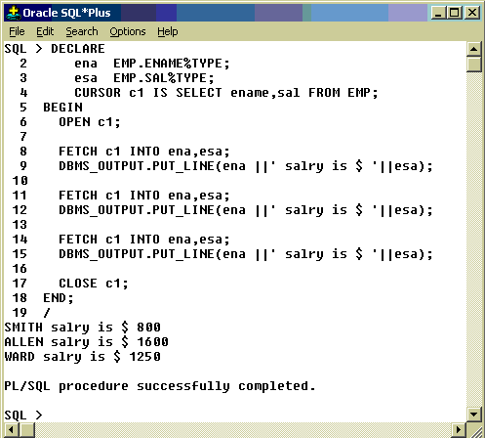
19 February 2010

Slide 42

These statements include INSERT, UPDATE, DELETE, and SELECT INTO statements
No need to be declared, OPENed, FETCHed, or CLOSEd
19 February 2010

Slide 43

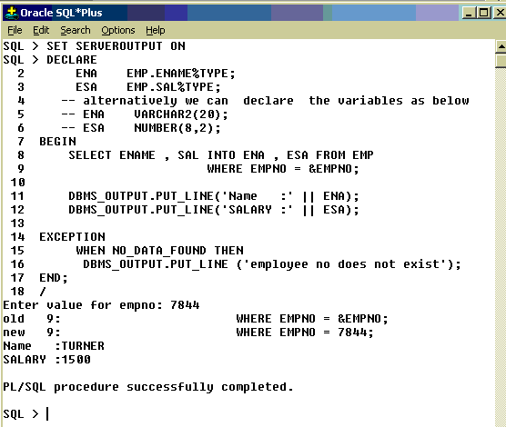
19 February 2010

Slide 44

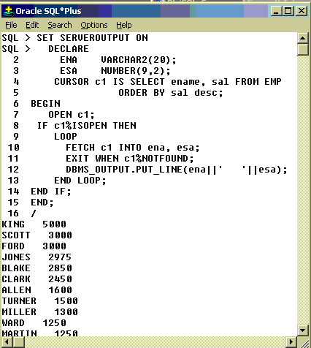
19 February 2010

Slide 45

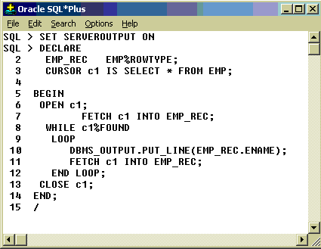
19 February 2010

Slide 46

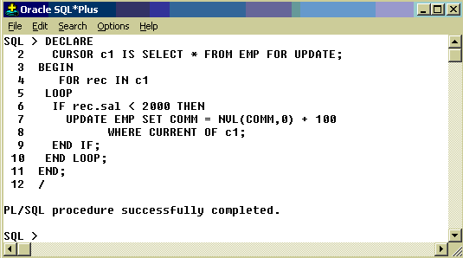
19 February 2010

Slide 47
Functions and Procedures
Up until now, our code was in an anonymous block
It was run immediately
It is useful to put code in a function or procedure so it can be called several times
Once we create a procedure or function in a Database, it will remain until deleted (like a table).

Slide 48
Creating Procedures
CREATE [OR REPLACE] PROCEDURE procedure_name
[(parameter1 [mode1] datatype1,
parameter2 [mode2] datatype2,
. . .)]
IS|AS
PL/SQL Block;
Modes:
  IN: procedure must be called with a value for the parameter. Value cannot be changed
  OUT: procedure must be called with a variable for the parameter. Changes to the parameter are seen by the user (i.e., call by reference)
  IN OUT: value can be sent, and changes to the parameter are seen by the user
Default Mode is: IN

Slide 49
Example- what does this do?
Table mylog
create or replace procedure
num_logged
(person IN mylog.who%TYPE,
num OUT mylog.logon_num%TYPE)
IS
BEGIN
select logon_num
into num
from mylog
where who = person;
END;
/
who | logon_ num
Pete | 3
John | 4
Joe | 2

Slide 50
Calling the Procedure
declare
howmany mylog.logon_num%TYPE;
begin
num_logged(‘John',howmany);
dbms_output.put_line(howmany);
end;
/

Slide 51
Errors in a Procedure
When creating the procedure, if there are errors in its definition, they will not be shown
To see the errors of a procedure
SHOW ERRORS PROCEDURE myProcedure
in the SQLPLUS prompt
For functions, type
  SHOW ERRORS FUNCTION myFunction

Slide 52
Creating a Function
Almost exactly like creating a procedure, but you supply a return type
CREATE [OR REPLACE] FUNCTION
function_name
[(parameter1 [mode1] datatype1,
parameter2 [mode2] datatype2,
. . .)]
RETURN datatype
IS|AS
PL/SQL Block;

Slide 53
A Function
create or replace function
rating_message(rating IN NUMBER)
return VARCHAR2
AS
BEGIN
IF rating > 7 THEN
return 'You are great';
ELSIF rating >= 5 THEN
return 'Not bad';
ELSE
return 'Pretty bad';
END IF;
END;
/
NOTE THAT YOU DON'T SPECIFY THE SIZE

Slide 54
Calling the function
declare
paulRate:=9;
Begin dbms_output.put_line(ratingMessage(paulRate));
end;
/

Slide 55
Creating a function:
create or replace function squareFunc(num in number)
return number
is
BEGIN
return num*num;
End;
/
Using the function:
BEGIN
dbms_output.put_line(squareFunc(3.5));
END;
/

Slide 56
Packages

Slide 57
Triggers

