Slide 1
Prepared for: [company name]
Month Date, 2023

Slide 2
End-to-End CI/CD Pipeline Implementation on AWS Leveraging Jenkins, GitHub, Maven, Docker, AWS ECR, and AWS EKS for Java Web Application Automation
Prajval Byahatti

Slide 3
Table Of Contents
Project overview
Technologies and tools used
System Design
Implementation Phases
Phase 1: CI/CD with Git-hub, Jenkins, Maven and Tomcat
Phase 2: Docker Integration
Phase 3: ECR and EKS Deployment
Phase 4Testing and Validation
Results and Insights

Slide 4
Project Overview
The objective is to design a fully automated CI/CD pipeline on AWS to streamline build, test, and deployment processes for Java-based web applications.
The pipeline integrates:
Jenkins as the automation and orchestration server
GitHub for source code management and version control
Maven for project build and dependency handling
Docker to containerize the application
AWS ECR for secure image storage
AWS EKS for deploying and managing containers using Kubernetes
A sample Java web application demonstrates continuous integration and automated delivery across cloud environments.

Slide 5

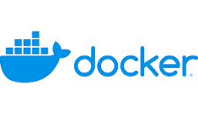


Technologies and Tools used
Git: Local version control system for tracking and managing code changes
GitHub: Cloud-based repository for hosting and collaboration
Jenkins: Automates build, test, and deployment processes via pipelines
Maven: Handles Java project builds and dependency management
Apache Tomcat: Lightweight server for deploying Java web applications
Docker: Containerization platform ensuring consistent runtime environments
AWS Elastic Container Registry (ECR): Stores and manages Docker images
AWS Elastic Kubernetes Service (EKS): Automates container orchestration and scaling

Slide 6
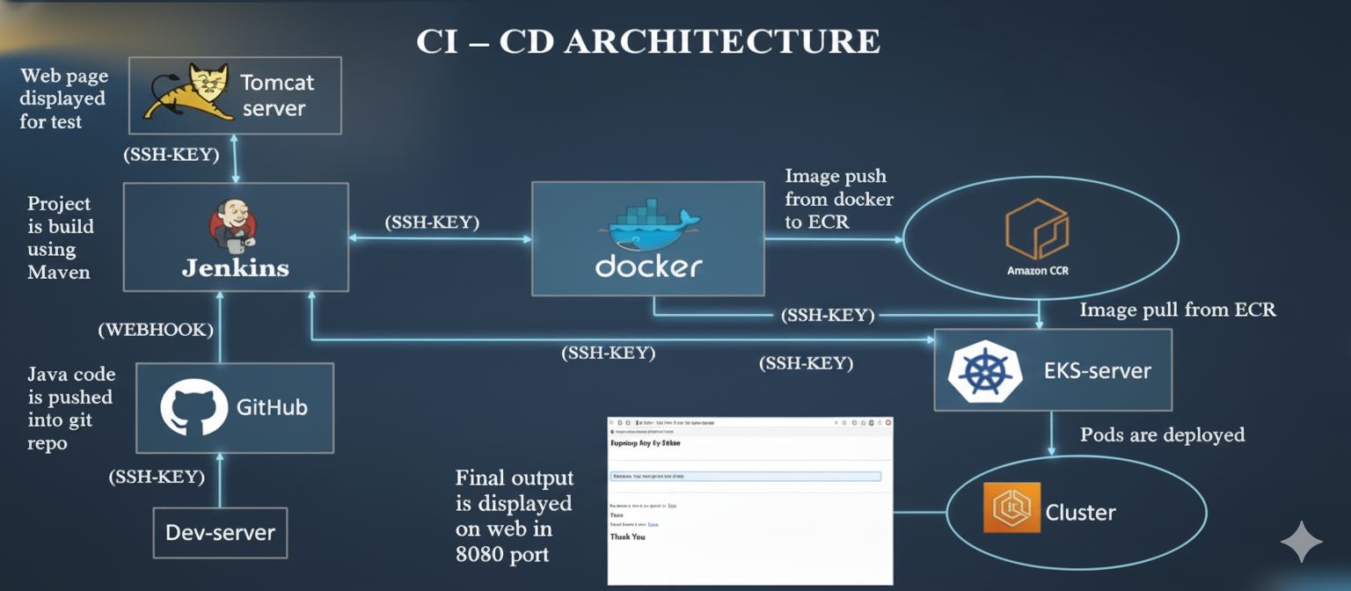
System Architecture

Slide 7
CI/CD Architecture Flow
Code Commit & Trigger:
Java code is pushed into the GitHub repository by a developer, potentially from a Dev-server.
GitHub triggers Jenkins via a WEBHOOK.
Build & Test Stage (Continuous Integration - CI):
Jenkins picks up the code and the Project is built using Maven.
The build artifact is deployed to a Tomcat server for testing, where the Web page is displayed for test.
Image Creation & Push:
Once the build/test is successful, Jenkins interacts with Docker.
Docker builds the application image.
The Docker image is then pushed to Amazon ECR (Elastic Container Registry).
Deployment Stage (Continuous Delivery/Deployment - CD):
The EKS-server (Elastic Kubernetes Service) pulls the application Image from ECR.
The Pods are deployed onto the Cluster managed by EKS.
Final Output:
The Final output is displayed on web in 8080 port, confirming the successful deployment and functionality.

Slide 8
Phase-1
To establish a Continuous Integration and Continuous Deployment (CI/CD) workflow using Jenkins, Maven, and Tomcat — ensuring that every code commit triggers an automated build and deployment process.
Jenkins Setup: Install Jenkins on the server and configure essential plugins such as Git, Maven Integration, and Deploy to Container. Set up credentials for GitHub and Tomcat to enable secure communication .
Source Code Management (GitHub): Host the Java web application on GitHub. Configure a webhook in GitHub to trigger Jenkins automatically on every code commit or pull request.
Build Configuration with Maven: Integrate Maven within Jenkins for automated builds. Define the pom.xml file to handle dependencies, compilation, and packaging of the Java project into a .war file.
Automated Deployment to Tomcat Server: Use Jenkins to deploy the generated .war file to a remote or local Apache Tomcat server using SSH credentials. Tomcat hosts the web application for testing and verification.
Validation of Deployment: Access the deployed application on the Tomcat server (port 8080) through a browser. Confirm that the build, deployment, and test process runs successfully end-to-end.

Slide 9
Phase 2
Install and configure Docker on the Jenkins host
Create a Docker file to containerize the Java web application
Automate Docker image creation and deployment through Jenkins pipeline
Launch and test the running container
Incorporate Docker processes within the CI/CD workflow

Slide 10
Phase 3
Create an AWS ECR repository to store container images
Authenticate Docker with AWS CLI credentials
Push the Docker image to the ECR repository
Set up an AWS EKS cluster for managing container workloads
Develop Kubernetes Deployment and Service YAML manifests
Deploy the application on EKS using the stored image from ECR

Slide 11
PHASE 4
Trigger the Jenkins pipeline to initiate the complete workflow
Validate successful pod creation with the EKS cluster
Retrieve the external service IP using kubectl get svc
Access the deployed application through the exposed IP
Confirm seamless end-to-end integration .

Slide 12
Results and Insights
Implemented a robust, scalable, and fully automated CI/CD pipeline on AWS.
Streamlined the entire build, testing, and deployment process through end-to-end automation.
Integrated Jenkins, Docker, and AWS services seamlessly to ensure continuous delivery and scalability.
Improved deployment reliability, speed, and operational efficiency for Java-based web applications

Slide 13
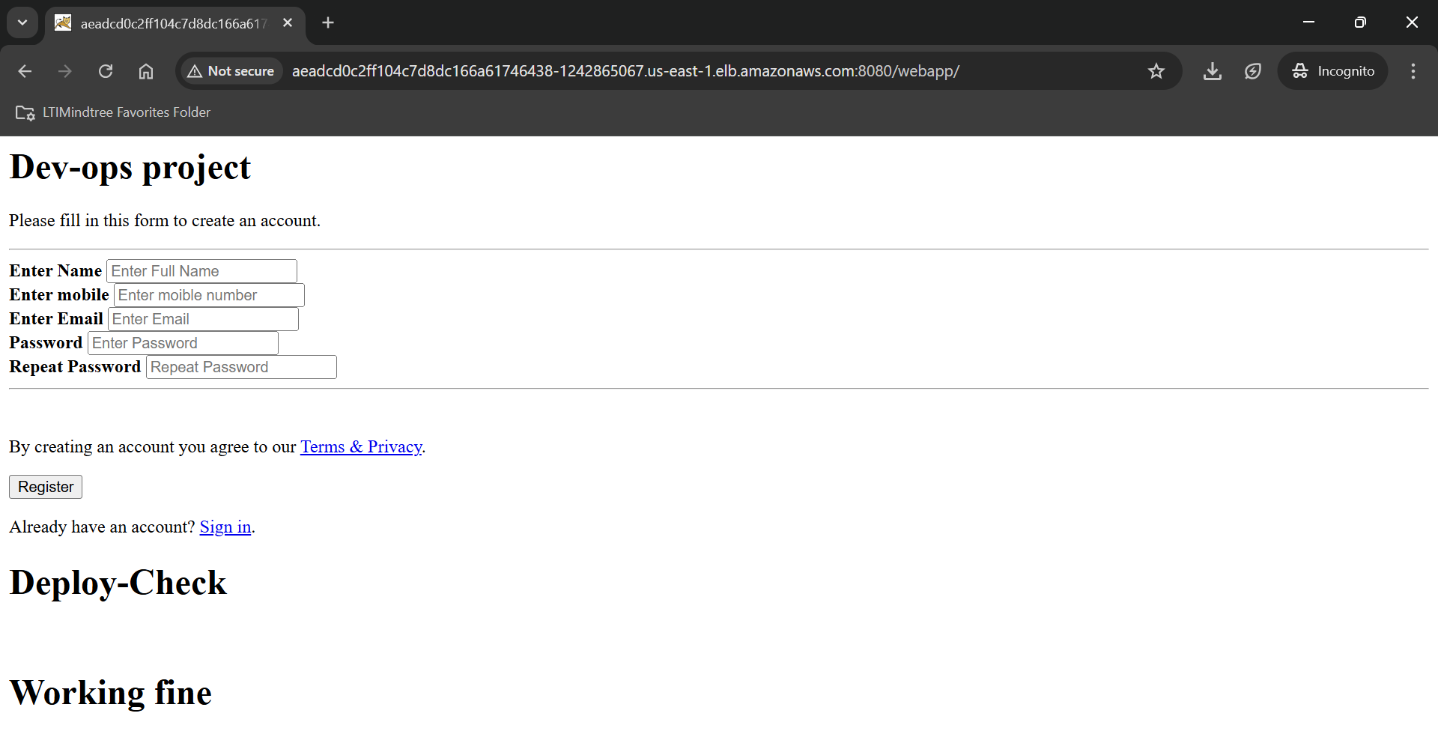
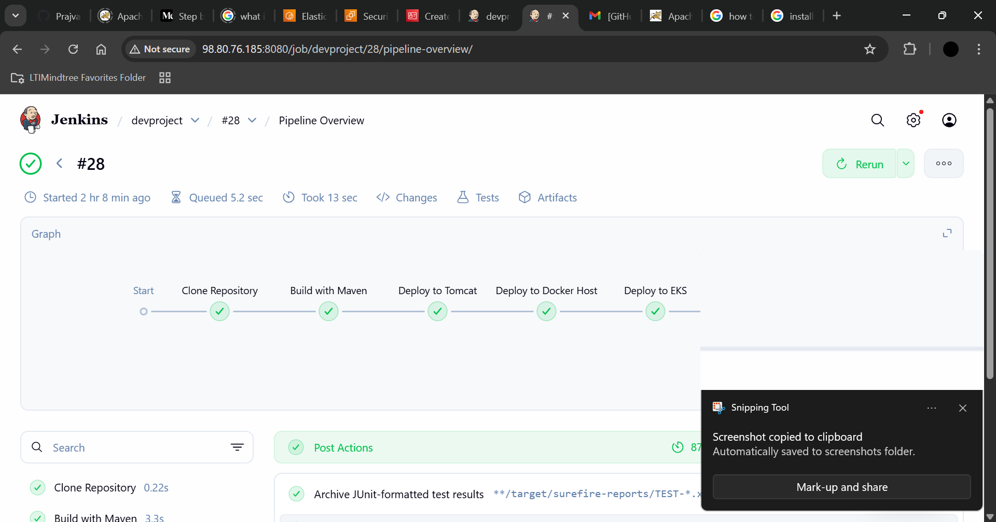
OUTPUT

