Slide 1
CONFIDENTIAL · GROWTH AUDIT
05.2026
FOR: ARPIT MAHESHWARI · ARPITMAHESHWARI.COM
What's keeping a senior designer from getting hired.
A strategic audit of the site that should be doing the most expensive job in his career — converting founders to a 30-minute call — and is instead recycling portfolio defaults. Eight findings. Five original home formats. One recommendation.
PRIMARY GOAL
Land founding-designer role · Series Seed–B · AI products
8 FINDINGS · 5 FORMATS · 1 PATH

Slide 2
02 · STRATEGIC AUDIT
EIGHT FINDINGS
Eight frictions keeping Arpit from getting hired.
From a growth lens: content, conversion, mobile, SEO, accessibility, positioning. Ordered by impact on founding-designer-role conversion.
01
CONVERSION
02
PORTFOLIO
Five "Book intro call" buttons dilute urgency
The NDA wall kills first-visit conversion
The CTA repeats 5× saying the same thing. By the third appearance it becomes wallpaper. Replace with contextual micro-CTAs.
"NDA Protected" appears 5×. Visitors see no actual work. Replace screenshots with downloadable artefacts.
03
HIERARCHY
04
VISUAL
Social proof is buried at scroll-depth 60%
Text-only design feels generic for a designer
Testimonials from Sahaj, Telefónica, PTC sit halfway down. Hiring managers bounce before reaching them.
No confidence meters, schematics, pattern callouts. For someone who designs AI surfaces, the form should embody the practice.
05
MOBILE
06
SEO
Mobile is desktop-shrunk, not mobile-first
Substack siloed; domain loses authority
Stats stack awkwardly. Case studies become tall text walls. No fast-scroll to CTA. Recruiters bounce in seconds.
Newsletter lives off-domain. No FAQ schema, no Person structured data. Recruiters Googling find LinkedIn first.
07
POSITIONING
08
TRUST
"15 years" reads as overqualified for founding roles
Accessibility claim with no observable proof
Founders fear senior designers who won't roll up sleeves. Counter-message: "I code, I read SQL, I ship."
Footer says "Dyslexia-friendly" but typography doesn't reflect it. Either show the work or remove the claim.

Slide 3
ELEMENT 15
v15.2.0
DIRECTION 01
GRAPHITE · URANIUM · MERCURY
Am
2026-05
● HOT
The Model Card.
arpit · maheshwari
Designer treated as a deployable model.
A structured datasheet for hiring a senior product designer for an intelligent system. Modeled on the cards founders already write for the things they ship.
§01
Identity
Arpit treated as a deployable model. Latency p50, context window, temperature, refusals. He uses the same document type his founders use to spec the things they ship.
model_id
arpit-maheshwari-15-staff
checkpoint
2026.05 · 1,847 days since last burnout
weights
open · references on demand
serving_region
GMT+5:30 · cold-starts in 4h US-East
PALETTE
status
● AVAILABLE
§02
Inference characteristics
latency_p50
14h waking · 0h sleeping · ¹
context_window
8 stakeholders before degradation · ²
temperature
0.9 before lunch · 0.3 after · 0.0 in crit
top_k_inputs
design crits, SQL, model perf, real users
streaming
prefers to · ships drafts at 60%
max_tokens
ships at week 6 · iterates to week 12
SOLVES FINDINGS
BEST AS
04 · 07 · 08
Home page · / route
§03
Intended use
primary
designer #1 or #2 · Series Seed–B · AI-product
best_paired_with
technical founder · 2-7 engineers · 1 PM · no design org
downstream_tasks
end-to-end product UX · prototype-to-ship · pattern systems · accessibility scaffolding · design ops
§04
Out-of-distribution · will refuse
will_not_serve
pure brand sprints · marketing graphics · "make our AI feel more human" · investor-deck-driven roadmaps · NDA-signed-after-pitch
declines
black-box products without explainability surface
hallucinates_when
given a deadline before a problem statement
§05
Evaluation · n=5 deployments
workflow_throughput
screening_latency
+3.0×
±0.2
−60%
±5%
adtech-us-uk
pe-screening-2024
support_volume
accessible_reach
−40%
±3%
550k
wcag-aa
o2-priority-1m
ptc-11-locale
§06
Training run · 2010–2026
2010_2013
screen-readers · 11 locales · accessibility-as-foundation
2014_2017
multi-tenant SaaS · enterprise IA · design system v0
2018_2020
telecom @ 1M+ · self-service over call-center
2021_2023
adtech ML · confidence UIs · org-OS shipped sole
2024_2026
PE screening · explainability layers · the pattern lib
§07
Known limitations
latency_us_east
portfolio_access
weak_at
§08
[1] sahaj.eng-lead
[2] sahaj.data
[3] telefonica.po
[4] ptc.locale-pm
§09
¹ measured over 90 days, slack + email, weighted by sender priority.
² degradation = produces a slide deck instead of a decision.
§10
cite as: maheshwari_am_2026
$ deploy --intro=30m --warm
$ cat /etc/availability
Citations · n=4
Footnotes
Deploy
4–5h overlap · async-first 6 yr · no calls before 4pm IST
past work NDA-protected · cite §08 for verifiable peer attestation
infrastructure UX · pure data viz tools · markets that reward maximalism
" Reads the model card before he reads the design brief. "
" First designer who asked which feature I weighted least. "
" Removed thirty four screens. Nobody noticed they were gone. "
" Localized a design system to Mandarin and Arabic on the same sprint. "
arpitmaheshwari.com
→
↵

Slide 4
CHART NO.AM-407
ATTENDING
DIRECTION 02
WINE · SODIUM · CYAN
400 nm
500
600
700 nm
The Patient Chart.
ATTENDING DESIGNER · 15 YR PRACTICE
I read the chart before I sketch the cure.
A clinic for intelligent products that have lost the trust of their users. 4 patient files below. All under doctor-patient privilege; outcomes verified by peer attestation.
Book the first consult — 30 min
℞
Past clients as patients. Each case: Symptoms, Diagnosis, Treatment, Discharge metric. Bypasses the NDA wall through medical-record discretion — clients are diagnoses, not screenshots.
PRACTITIONER · ABSORPTION SPECTRUM
15
1M+
94%
0
YRS
USERS
RECOVERY
MALPRACTICE
Case files · 4 recent
PALETTE
by severity
AM-2024-PE
◆ACUTE
CARDIOLOGY · FINTECH
A model the team owned but no analyst would defer to.
ƒ
PRESENTATION
Deal teams re-screened every recommendation by hand. The CEO had paid for the AI; the analysts had not.
Δ
DIAGNOSIS
Algorithmic stranger-anxiety. The model's outputs arrived without source, weight, or method — so the team treated it as a colleague who had skipped the meeting.
℞
TREATMENT
Built the reasoning trail into the surface: every ranking opened to its data sources, its weights, and one sentence on what would have flipped it.
SOLVES FINDINGS
BEST AS
02 · 03 · 05
/cases · case studies route
↳ DISCHARGE ·screening cycle, 100+ deals
−60%
AM-2022-AD
◆CHRONIC
NEUROLOGY · ADTECH
A planner that demanded technical literacy the buyers had stopped pretending to have.
ƒ
PRESENTATION
Media buyers built campaigns in Excel and pasted them in. Adoption was 8% three quarters after launch.
Δ
DIAGNOSIS
The UI treated ML confidence as a number to be respected; the buyers treated it as a riddle to be ignored.
℞
TREATMENT
Converted scores into actions: a confidence band drove a recommended inventory tier; the algorithm became a co-planner, not an oracle.
↳ DISCHARGE ·workflow throughput, US + UK
3×
AM-2018-O2
◆CHRONIC
ER · TELECOM
A million users phoning support to ask questions the app could answer.
ƒ
PRESENTATION
40% of inbound calls were already documented in-app, three taps away. NPS bleeding.
Δ
DIAGNOSIS
The information architecture had been optimized for the org chart, not for the question.
℞
TREATMENT
Rebuilt billing, plan management, and rewards around the question the user came to ask — surfaced the answer before the call-to-call.
↳ DISCHARGE ·support volume, 1M+ subscribers
−40%
AM-2016-PTC
◆REFERRED
PEDIATRICS · EDTECH
A platform that was inaccessible in 11 languages and intelligible in 0.
ƒ
PRESENTATION
Screen readers couldn't parse it. Right-to-left was broken. The team didn't read any of the locale languages.
Δ
DIAGNOSIS
Accessibility had been treated as a final-sprint retrofit. So had localization. Both compounded.
℞
TREATMENT
PRIVILEGED REVIEW
"First designer I've worked with who asked which feature I had weighted least, then redesigned around that answer."
DATA SCIENTIST · SAHAJ SOFTWARE
↳ DISCHARGE ·reach, all-locale users
Authored team-wide WCAG-AA guidelines. Rebuilt content patterns to localize without rework.
550k

Slide 5
A·M / SPECIMEN ZINE
NO. 01 · MMXXVI
DIRECTION 03
CORAL · COBALT · MUSTARD · BONE
Things I won't do.
The Specimen Zine.
SUBTITLE
A specimen book printed in two colors, by a designer who has been asked to. Six plates, each a thing other senior designers will quietly do and I will not.
Riso-punk type specimen. Six plates, each titled "Things I won't do" — opens with I REFUSE before I DO . The differentiation is in what he turns down, not what he claims.
15
1M+
0
●
YR
USERS
BRAND DECKS
AVAIL
PLATEI
ON DEMOS
PALETTE
Thedemo my mother could see.
SOLVES FINDINGS
BEST AS
I REFUSE
I won't ship a happy-path demo and call it the product. The demo is for fundraising; the product runs in the 70% of cases the demo skipped.
04 · 07
/principles · philosophy route
I DO
I prototype the case that breaks the model first. The screen for confidence below 0.6. The screen for no internet. The screen for the user who didn't read the onboarding.
EVIDENCE
pe-screening · the first three weeks built nothing but rejection states
PLATEII
ON EXPLAINABILITY
Show your working.
I REFUSE
I won't ship an AI surface that hides why it said what it said. A black box is not a product. It is a coin flip with a UI.
I DO
Every ranking opens to its sources. Every confidence number shows the threshold it crossed. Every recommendation can be inspected, doubted, and overruled, with the model losing nothing in the process.
EVIDENCE
adtech-ml · confidence band → recommended inventory tier → 3× workflow
PLATEIII
ON CONFIRMATION
Don't ask if youknow.
I REFUSE
I won't put an 'Are you sure?' on top of a model that is correct 99% of the time. That isn't safety — it's the design refusing to take a position.
I DO
EVIDENCE
PLATEIV
All users. Sprint one.
I REFUSE
I DO
EVIDENCE
PLATEV
I write theCSS.
I REFUSE
I DO
EVIDENCE
PLATEVI
The system is the screen.
I REFUSE
I DO
EVIDENCE
COLOPHON
Set inInstrument Serif& JetBrains Mono. Printed incobalt&coral by Arpit Maheshwari, Indore.
Subscribe to issue 02 →
Confirm only when confidence is low or impact is irreversible. Earn the right to be trusted by default; require friction only where the model itself is unsure.
o2-priority · cancellation flow lost two confirmations, gained reversibility, lost zero customers
I won't backlog accessibility. WCAG-AA in week eight is twelve weeks of rework dressed as virtue. Same with localization. Same with right-to-left.
The screen reader, the keyboard, the contrast, the locale — these are constraints on the first sketch, not the last commit. They make the design better at every stage, not just the audited one.
ptc-11-locale · 550k users · zero retrofit sprints
I won't deliver a Figma file and call my work done. I won't argue from a mockup that the engineer hasn't been allowed to read. I won't review work that someone built from my drawing without me.
HTML, CSS, JS in production for the components I designed. React for prototypes. SQL for reading data architectures. PRs reviewed by engineers, not approved by them.
patterns-lib · 24 components, all open-source · no Figma without code beside it
I won't design a screen that doesn't know what state it's a slice of. I won't ship a feature without telling you the three you'd cut to keep it.
Standardize the process, sense the signal, then design the decision surface. The intelligent decision is the smallest layer; the two layers below carry the trust.
org-os · 8 modules · designed sole · zero managers in the org chart
ON ACCESSIBILITY
30 MIN · BOOK
ON HANDOFF
ON SCREENS

Slide 6

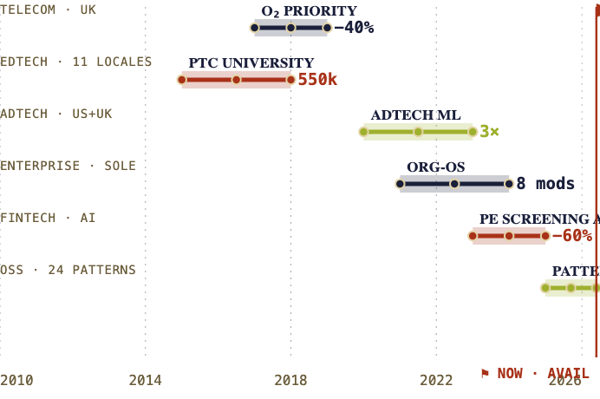




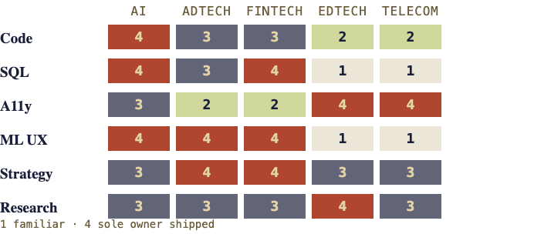
SURVEY · ARPIT MAHESHWARI
QUAD AM-15
DIRECTION 04
TOBACCO · RUST · COBALT · CHARTREUSE
PLATE 1 — TRAVERSE · 2010 → NOW
The Field Survey.
A surveyor's notebook after fifteen years in the field.
Every project plotted to scale on one chart. Bands by sector, contour by sole-ownership depth, trail markers where I camped longest.
Fifteen years plotted as one USGS-style traverse. Sectoral lane bars, contour lines, scale bar, surveyor's flag at "NOW." Optimized for recruiters who skim — they see the whole career in five seconds.
PALETTE
LEGEND
SCALE BAR
sole-own
co-lead
0
4y
8y
16y
⚑
open work
available now
Mark the next coordinate — 30 min
⚑ Q2 '26
PLATE 2 — OUTCOMES · BEFORE / AFTER
Workflow throughput
Screening cycle
adtech / programmatic
fintech / PE
Support volume
WCAG-AA reach
telecom / O₂
edtech / 11 loc.
SOLVES FINDINGS
BEST AS
03 · 05 · 06
/career · resume route
PLATE 3 — TERRAIN · DEPTH × SECTOR
PLATE 4 — FIELD JOURNAL ENTRY
"Removed thirty four screens. Nobody noticed they were gone. The product got faster, the team got smaller, and the CSAT went up four points."
PRODUCT OWNER · TELEFÓNICA UK
STATUS
DATUM
⚑ AVAIL · 2W NTC
22.7196° N · 75.8577° E
Plot the next coordinate →

Slide 7
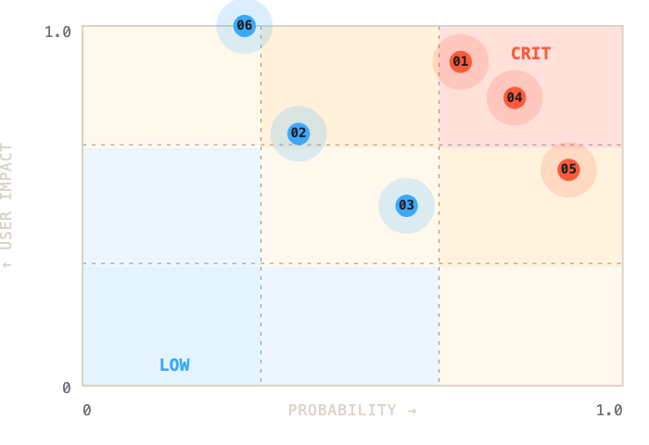
FORM AM-7 · REV. 2026.05
OFFICER
DIRECTION 05
CHARCOAL · AMBER · CHERENKOV
DESIGN RISK REGISTER
A. MAHESHWARI
The Risk Register.
§ 1.0 — SCOPE
A register of the failures I've already paid for, so you don't have to.
Six hazards specific to intelligent products. Each priced from a deployed system, mitigated with a pattern, attested by peer. Open for inspection.
EFFECTIVE
COVERAGE
PRACTICE
STATUS
AI failure modes named like industrial hazards — Phantom Confidence, Anchoring Bias, Stale Weight Drift, Trust Collapse. Each priced with P×I and mitigated with a shipped design pattern. Reads like a senior IC's brain.
2W NTC
GLOBAL
15 YR
● ACTIVE
§ 2.0 — RISK MATRIX
n=6 priced
PALETTE
§ 3.0 — REGISTER · MITIGATIONS SHIPPED
ID
HAZARD
SEV
R-01
PHANTOM CONFIDENCE
CRIT
Model reports a score the model has not earned.
Calibration strip. Confidence band tied to sample size & freshness; warns when both are low.
↳ MITIGATED ·
shipped:pe-screening
R-02
ANCHORING ON FIRST OUTPUT
HIGH
User defers to whatever the model returned first, regardless of quality.
SOLVES FINDINGS
BEST AS
02 · 04 · 07
/risks · expertise route
Conditional confirm. Threshold gate before final action when confidence is low.
↳ MITIGATED ·
shipped:adtech-ml
R-03
STALE WEIGHT DRIFT
HIGH
Model still serving prediction long after the world it was trained on stopped existing.
Last-trained chip + freshness chrome. Forces visible expiry on every recommendation surface.
↳ MITIGATED ·
shipped:patterns-lib
R-04
BLACK-BOX REJECTION
CRIT
User cannot interrogate why the algorithm ranked X over Y. So they ignore the algorithm.
Why-card explainability drawer. Sources, weights, "one fact that would flip this".
↳ MITIGATED ·
shipped:pe-screening
R-05
ACCESS RETROFIT
HIGH
WCAG-AA backlogged to sprint 8. Discovers at audit that 35% of UI is unreachable.
Sprint-one patterns. Screen reader, keyboard, contrast, locale — constraints on first sketch.
↳ MITIGATED ·
shipped:ptc-11-locale
R-06
TRUST COLLAPSE
CRIT
A single visible failure resets the team's relationship with the model.
Graceful fallback + edit history. The model can be wrong; it cannot be unaccountable.
↳ MITIGATED ·
shipped:o2-priority
§ 4.0 — COVERAGE SCHEDULE
POLICY-A
FULL-TIME · EQUITY
Founding
Designer #1, embedded
PRIMARY
POLICY-B
3–6MO · 20–30 HR/WK
0-to-1
Prototype-to-launch ownership
POLICY-C
4–8 HR/MO
Advisory
ML UX audit + design crit
§ 5.0 — ENDORSEMENT
"Reads the model card before he reads the design brief. Asks which feature you weighted least, then redesigns around that answer."
ENG.LEAD + DATA SCIENTIST · SAHAJ SOFTWARE
§ 6.0 — BIND COVERAGE
Quote in 30 minutes.
No premium. No pitch. We'll talk specifics.
BIND →
CALENDLY · 30M

Slide 8
08 · RECOMMENDATION
FINAL
Lead with Model Card. Use the rest as destination pages.
Each format borrows authority from a document type the visitor already knows — AI papers, EMRs, type specimens, USGS surveys, insurance docs. That recognition does in five seconds what bespoke portfolio language can't.
/
HOME
/CASES
CASE STUDIES
/PRINCIPLES
PHILOSOPHY
Model Card
Patient Chart
Specimen Zine
Spec sheet for hiring Arpit. Founders read it in 60 seconds.
Past clients as patients. Bypasses NDA with format.
Six "I refuse" plates. Pure craft proof through restraint.
/CAREER
RESUME
/RISKS
EXPERTISE
/HIRE
PRIMARY GOAL
Field Survey
Risk Register
Calendly + availability
15 years on one chart. Recruiter-skim optimized.
Failure-mode inventory. The brain of a senior IC.
One job: convert to booked meeting.
Why these work: they demonstrate the practice instead of describing it. A designer who frames her own career as a model card has, in that gesture, already proven she thinks in failure modes, confidence intervals, and intended-use.
READY TO BUILD

