Slide 1
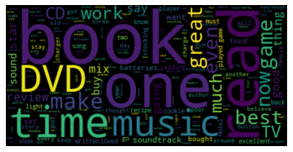
Natural Language Processing:
Applications
Notes:
Artificial Languages are consciously devised, usually by a single creator. They are also sometimes called planned languages, constructed languages, or invented languages. Specific types of artificial languages may be called fictional languages, auxiliary languages, or interlanguages.
[https://www.oxfordbibliographies.com/view/document/obo-9780199772810/obo-9780199772810-0164.xml#:~:text=Artificial%20languages%20are%20languages%20that,%2C%20auxiliary%20languages%2C%20or%20interlanguages.]

Slide 2

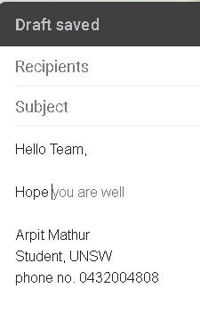
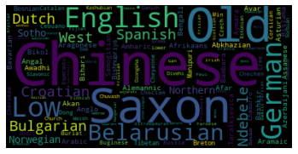
Applications
Email filters
Predictive text
Language translation
Urgency detection
Targeted Advertising
Social Media Monitoring
Text Generation
Sentiment analysis
Text Summarization
Voice To Text

Slide 3

Sentiment analysis

Slide 4
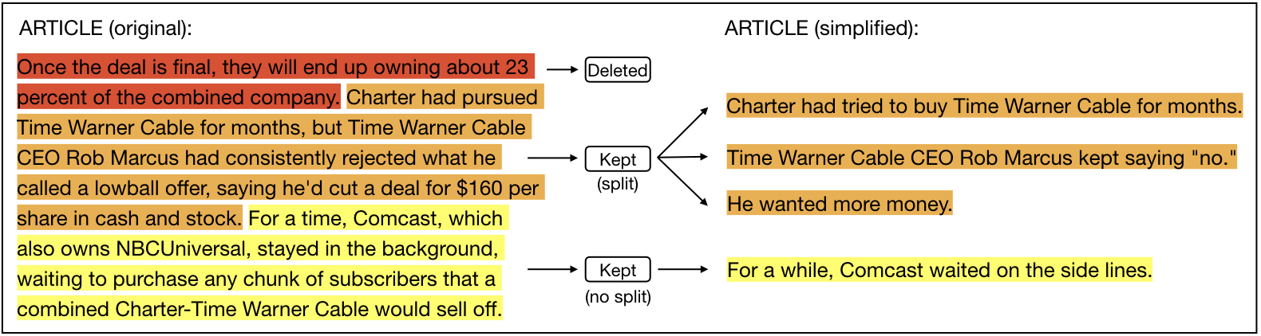
Text Summarization
Notes:
https://www.google.com/url?sa=i&url=https%3A%2F%2Fwww.groundai.com%2Fproject%2Fdiscourse-level-factors-for-sentence-deletion-in-text-simplification%2F1&psig=AOvVaw1vtaLe9NG4ikzWziLRampq&ust=1607937487942000&source=images&cd=vfe&ved=0CA0QjhxqFwoTCLDGzonQyu0CFQAAAAAdAAAAABAD

Slide 5
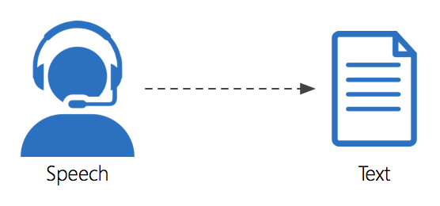
Voice To Text

Slide 6
Making your own models is better!

Slide 7
An NLP software of our own!
Sentiment
Speech to Text
Summarizer

Slide 8
Links for reference

