Slide 1
CS744 DECS KEY VALUE SERVER PROJECT
Arpit Meher (25m0813)

Slide 2
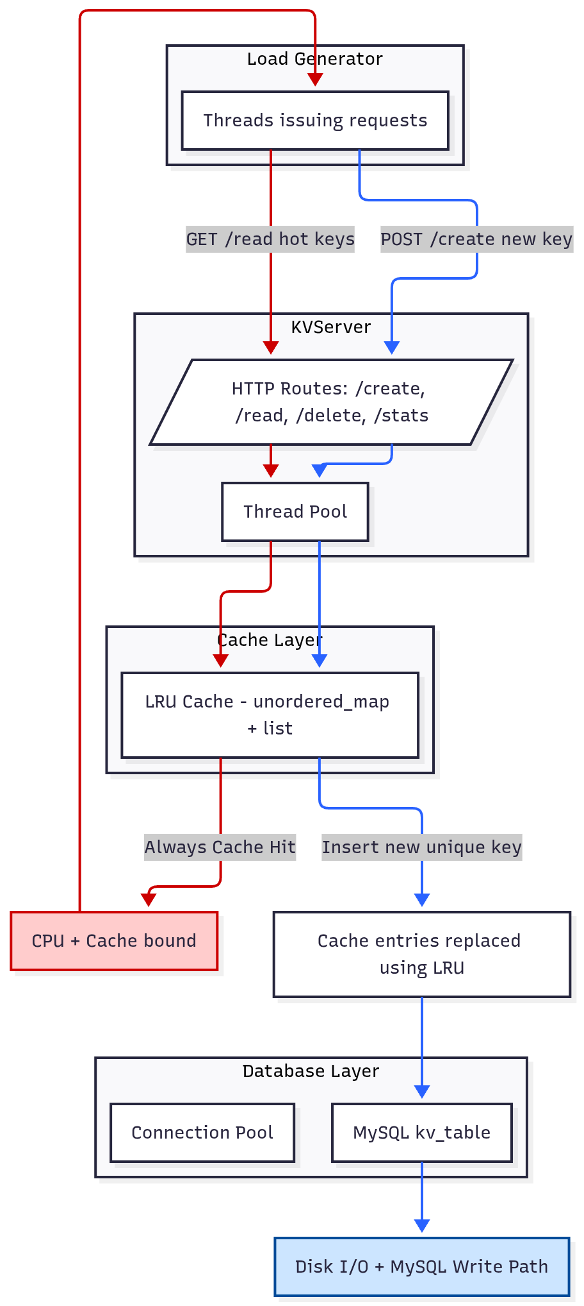
System Architecture Diagram
Red- cache bound workload path
Blue - disk bound workload path

Slide 3
DEVELOPMENT PROCESS
Wrote most of the code for server and load generator using “httplib.h”.
Used leetcode implementation of LRU cache.
Wrote code using prepare statement for sql queries used .
Took help of chatgpt to do database connection pooling and resolve errors encountered using unique ptr.
Third party software used - cmake, libmysqlcppconn-dev, libssl-dev, mysql-server, httplib.h, mermaid

Slide 4
LOAD GENERATOR DESIGN
Implement putall, getall, getpopular and default mixed workload using “httplib.h”.
Uses atomic variables to calculate throughput and avg response time.
But only used putall (disk-bound) and getpopular (cpu-bound) for testing.
Closed loop design uses cli.get() and cli.post() blocking calls to ensure its closed loop and wait for response before sending another request using same thread.
Pinning loadgenerator on cores 3-15 (13 cores) while using 2 cores for server and 1 for mysql. Use increasing number of threads to test bottlenecks in cpu and disk io

Slide 5
LOAD TEST SETUP
Kv_server pinned on core 1 and 2, Mysql on 0 and loadgenerator on 3-15.
8 experiments used 180s duration and both 360s and 180s were giving almost similar results
Parameters measured:
Avg response time and Throughput for both.
CPU usage (htop) for Workload 1 - getpopular.
Disk usage(iostat -d -x 2) for Workload 2 -putall.

Slide 6
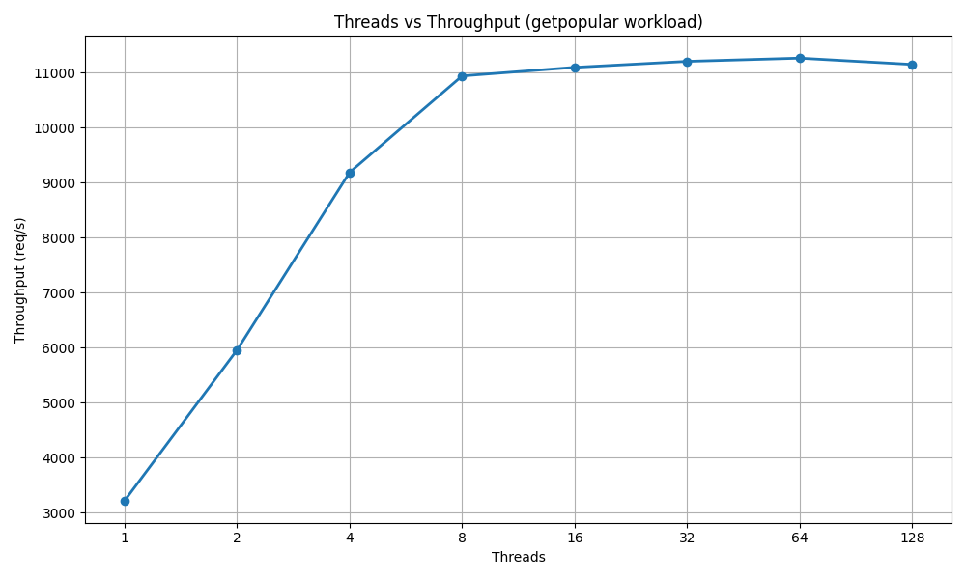
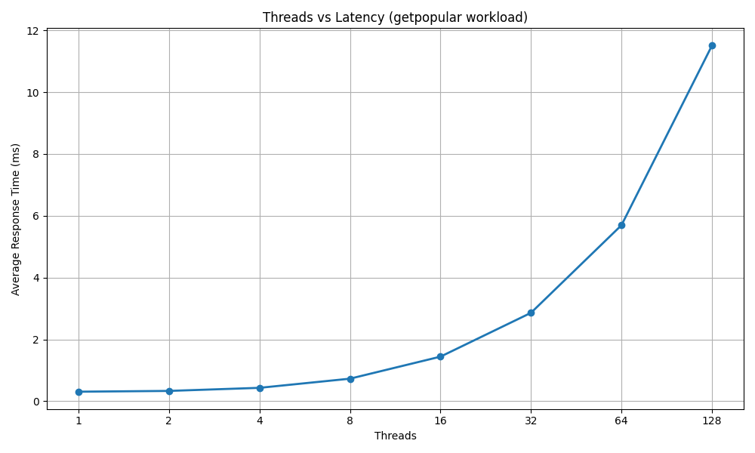
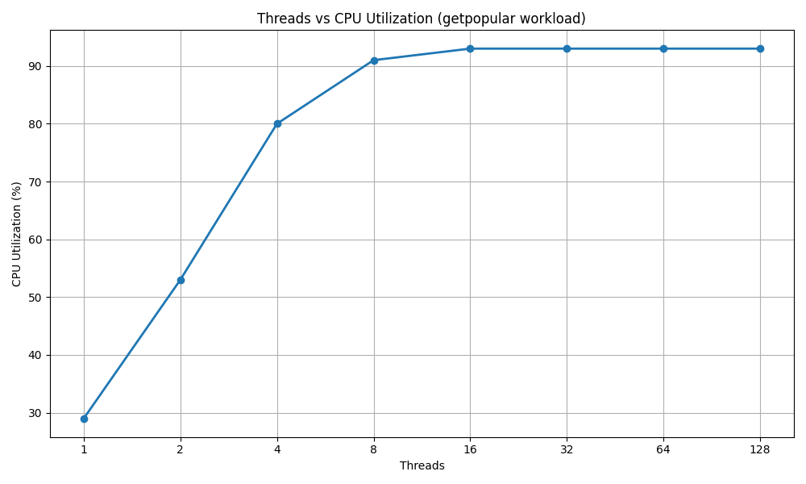
Getpopular workload - cpu bound
cpu% use - appprox 93%
Throughput after hitting bottleneck - approx 11200 req/sec

Slide 7
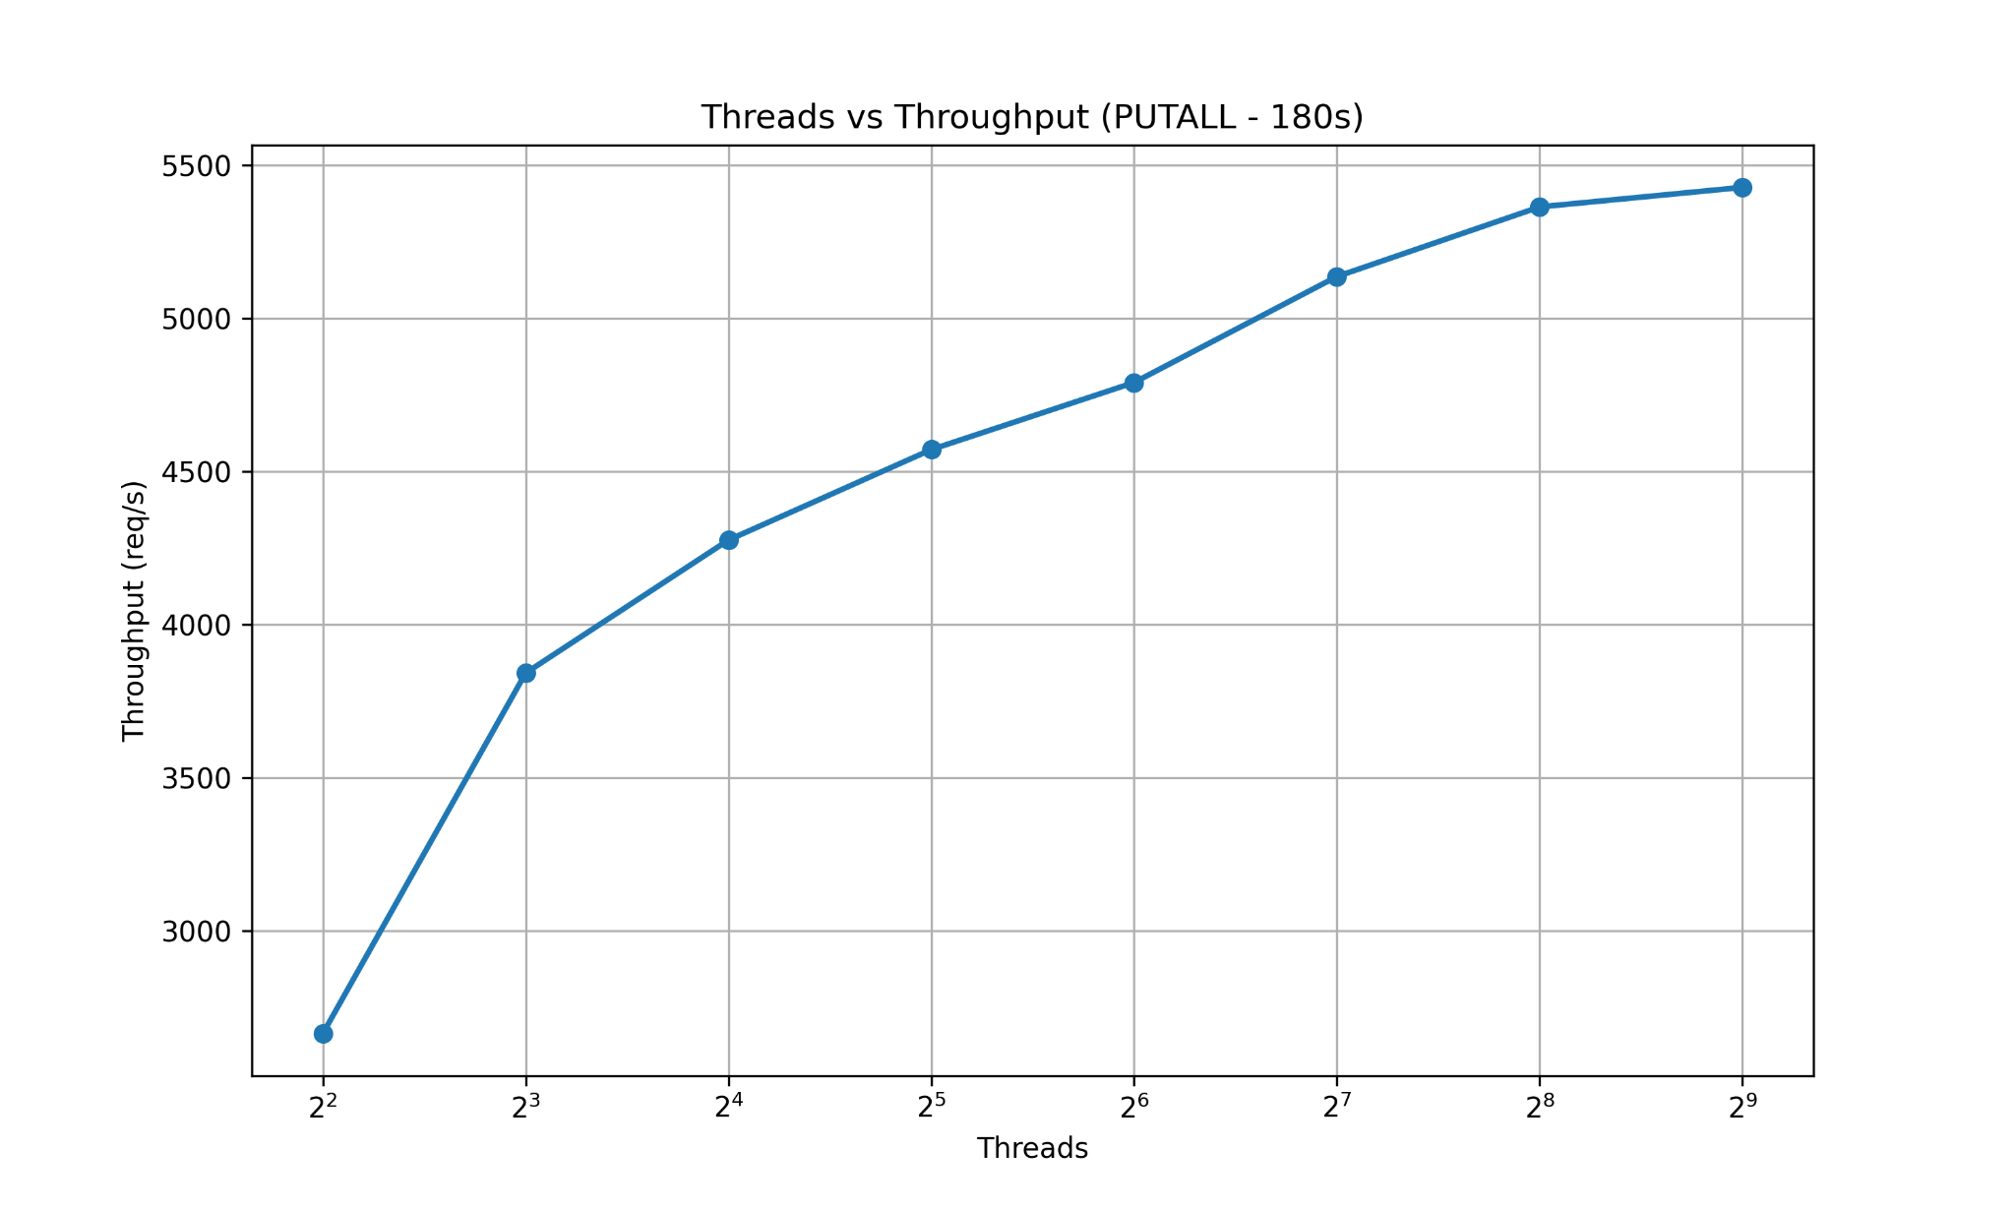
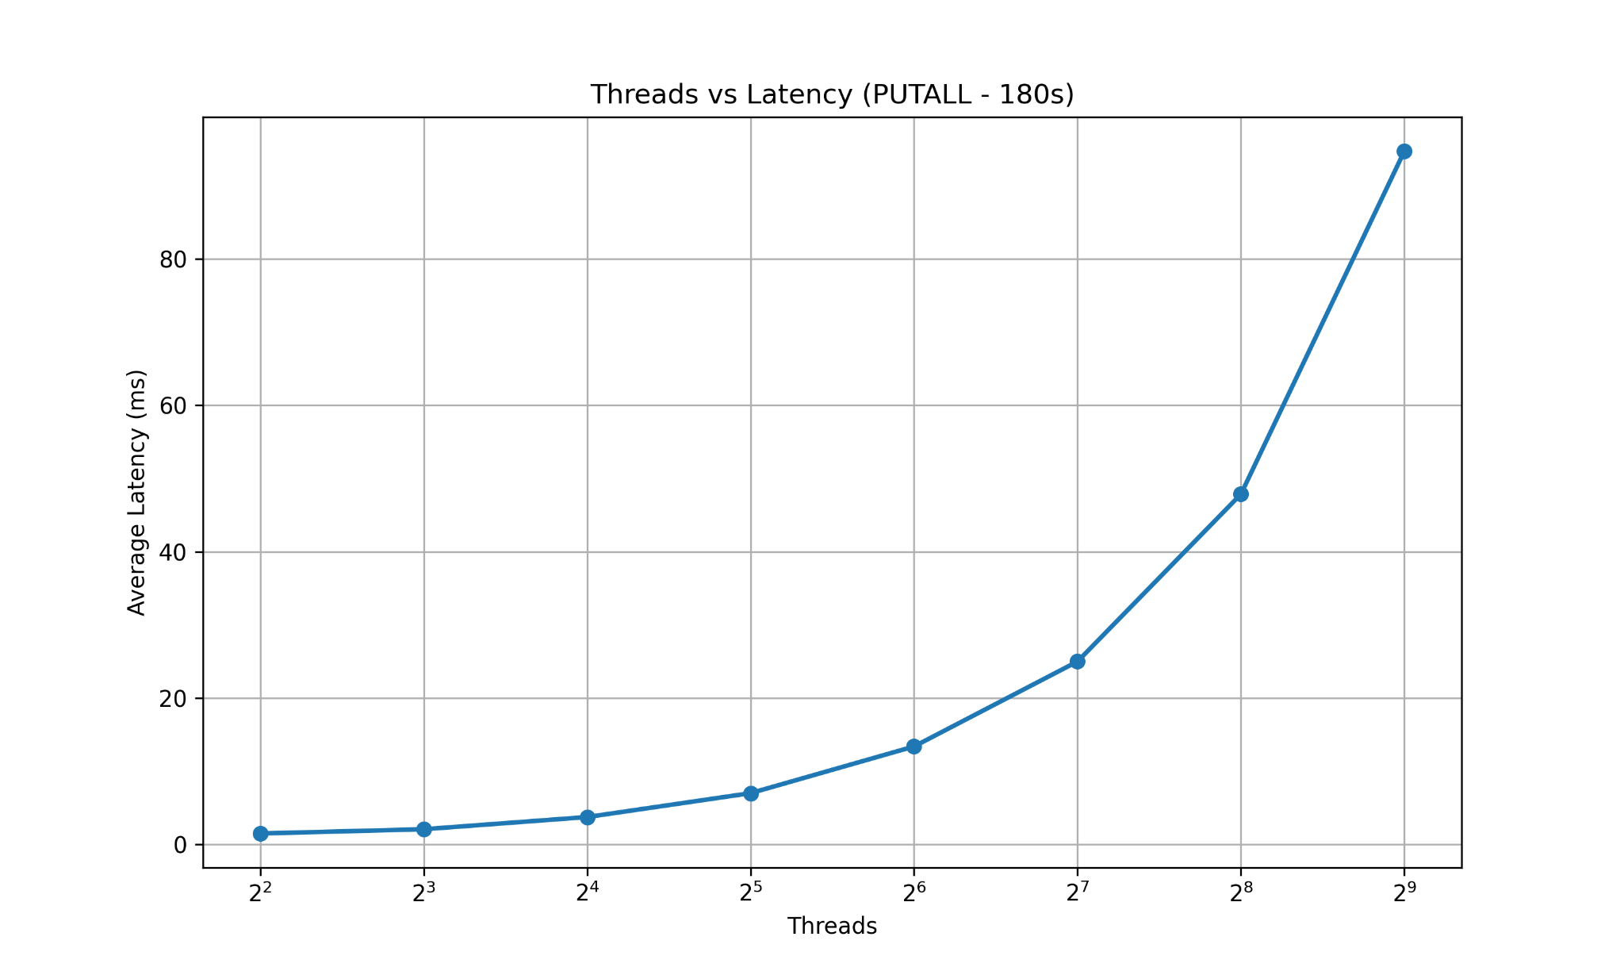
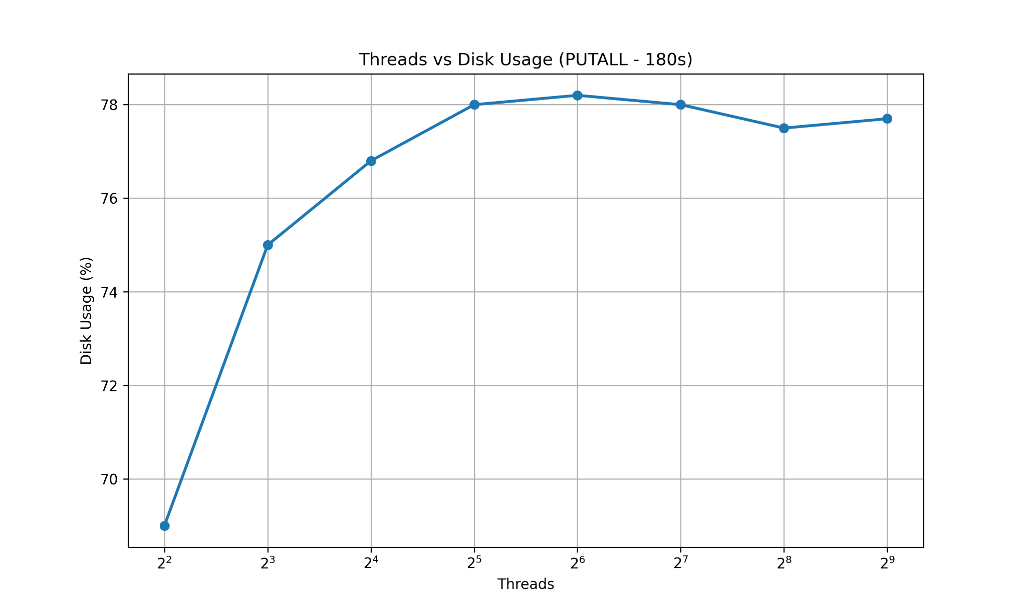
putall workload - disk bound
disk% use - appprox 78%
Throughput after hitting bottleneck - approx 5300 req/sec

Slide 8
THANK YOU!

