Slide 1
5G & BEYOND
Qualitative and Quantitative Comparative Analysis of
Open-Source 5G Core Networks
Open5GS | free5GC | OAI 5GC
Arpit Metrey • Mohit Kumar • Rakesh Kumar
M.Tech (Artificial Intelligence) | IIT Gandhinagar
01

Slide 2
What the comparison shows
Deployment success
Shared baseline
Different outcomes
All three 5G Core implementations were successfully deployed and brought to an operational state.
All used UERANSIM v3.3.0, PLMN 001/01, TAC 1, SST 1, DNN internet and 4 vCPUs / 8 GB RAM per VM.
Open5GS - For stable deployment
free5GC – For Flexibity
OAI - For high TCP throughput
The central distinction
1
Deployment
2
Procedures
3
Workload
4
Operations
Operational state
Registration + PDU sessions
Throughput, RTT, loss
Stability + recovery
02

Slide 3
Evaluation scope and questions
Qualitative Analysis
Quantitative Analysis
Load Test
Registration, authentication, PDU sessions, slicing and advanced-feature availability verification.
.
TCP/UDP throughput, latency, packet loss and resource utilisation.
UE cohorts of 1, 5, 10 and 20 where exercised; stress and fixed-duration tests.
Protocol Analysis
Selection Matrix
Packet-level analysis of NAS, NGAP,
GTP-U, PFCP and SBI interactions.
Evidence-based recommendations for deployment, research and performance use cases.
03

Slide 4
Tech Concept: 5G SA Path
N1
UE
gNB
N2
AMF
UPF
N6
Data
Network
SMF
N3
04

Slide 5
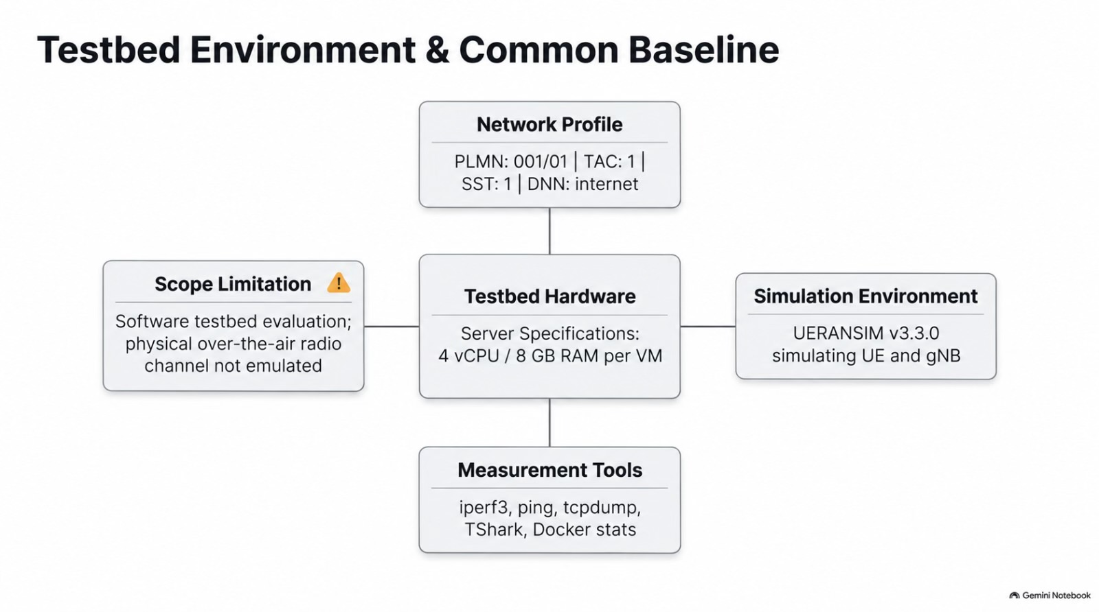
Testbed Environment & Common Baseline
05

Slide 6
Measurement methodology
Common test scenarios and evidence collection were used; platform-specific stress and advanced tests were recorded separately.
01
Deploy
Operational core + UERANSIM gNB/UE
Traffic and connectivity
iperf3: TCP/UDP throughput, loss and jitter.
ping: RTT and UE-to-data-network reachability.
02
Registration and PDU-session procedures (using scripts)
Exercise
Instrumentation
UE / NF logs, iperf3 JSON, ping output, resource samples, packet captures and run metadata.
03
iperf3, ping, resource samples
Measure
Workload envelope
04
tcpdump, Wireshark / TShark, logs
Inspect
UE cohorts: 1, 5, 10 and 20 where available. Test duration, endpoints and repetitions were not fully identical.
06

Slide 7
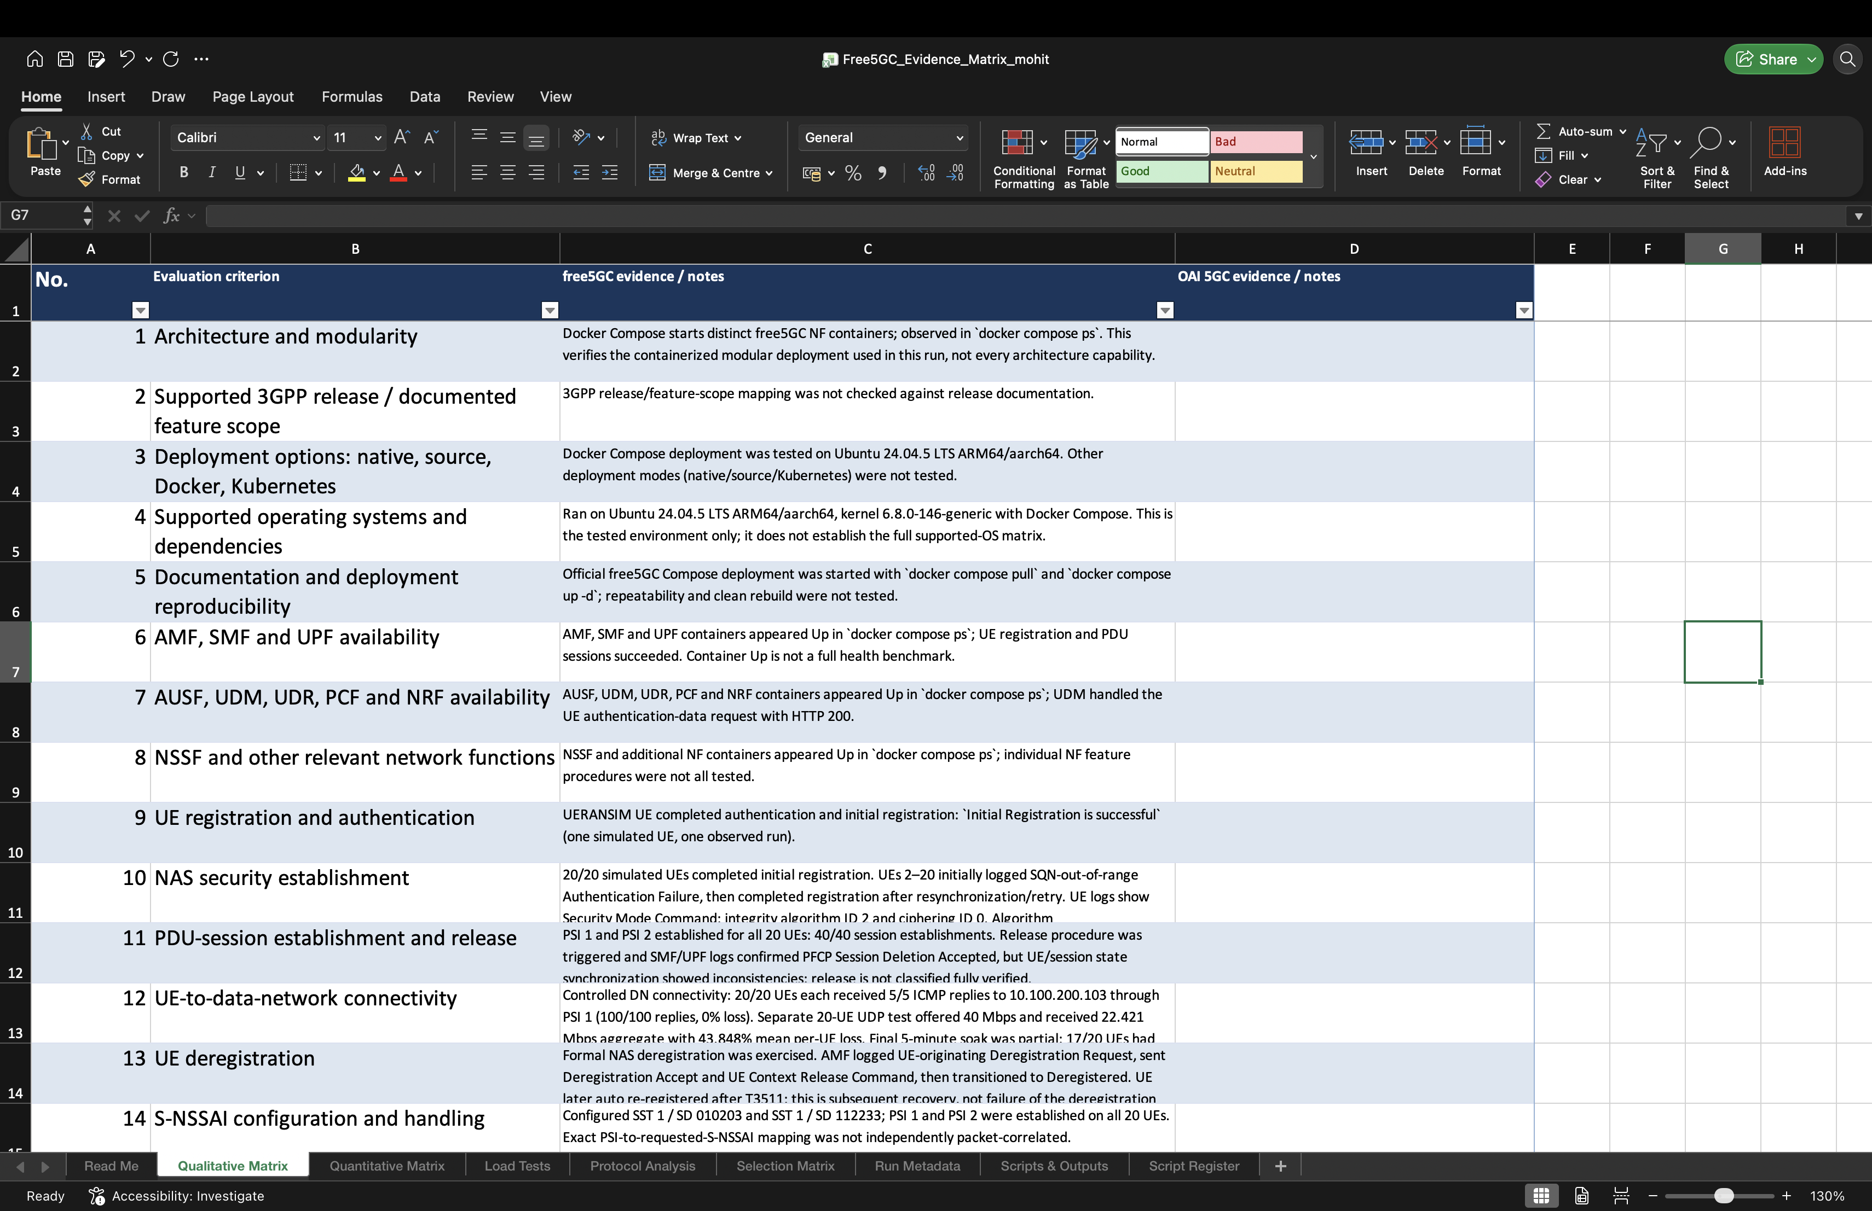
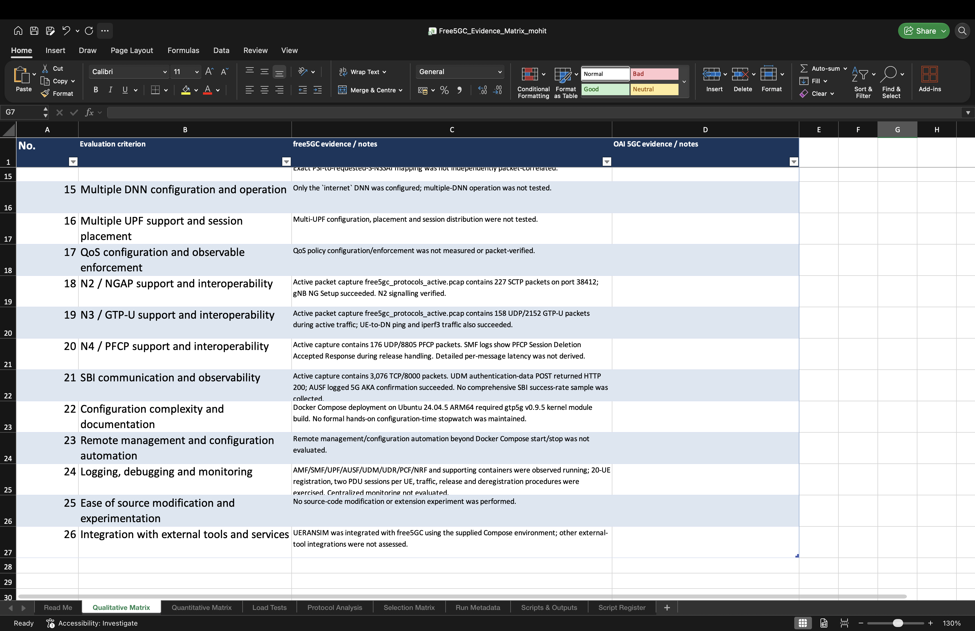
Qualitative Analysis
07

Slide 8
5G Core Networks | Qualitative Comparison
Documentation-based comparison of Open5GS, free5GC and OAI 5GC.
No.
Assessment Criterion
Open5GS
free5GC
OAI 5GC
1
3GPP Release Baseline
Documented compliance
YES
Release 19
YES
Release 17
YES
Release 16
2
Core Network-Function Coverage
Essential 5G SA NFs
YES
YES
YES
3
SBA Architecture / Modularity
Service-Based Architecture and modular NFs
YES
YES
YES
4
Deployment Options
Native / Containers / Kubernetes
PARTIAL
Native & Docker; K8s via community charts/operator
YES
Native, Docker, Kubernetes
YES
Bare metal, Docker, Kubernetes/Helm
5
Multiple UPFs / Session Placement
Distributed UPF, ULCL / traffic steering
YES
Multiple UPF; select by DNN/S-NSSAI
YES
Multiple UPF, ULCL supported
YES
Multiple UPF, ULCL & N9
6
Network Slicing / S-NSSAI
NSSF and slice handling
YES
NSSF, S-NSSAI, slice selection
YES
NSSF, multi-slice
YES
NSSF, slicing profiles
7
QoS Configuration and Enforcement
5QI, ARP, GBR/MBR, user-plane enforcement
PARTIAL
QoS configuration & PFCP QER; end-to-end enforcement not fully verified
PARTIAL
Control-plane QoS: 5QI, ARP, GBR, MBR, Session-AMBR
YES
Control- & user-plane QoS, PCF + UPF enforcement
8
Multiple DNN Operation
Support for multiple data networks
YES
Multiple PDU sessions / DNN
YES
Multiple DNN explicitly supported
PARTIAL
No clear official documentation; limited evidence
9
N2 / N3 / N4 / SBI Interfaces
Key 5G interfaces support
YES
YES
YES
10
Logging / Debugging / Monitoring
NF logs, metrics and operational visibility
YES
YES
YES
YES
Supported / documented
PARTIAL
Limited / qualified / version-dependent
NO
Not supported / not documented
08

Slide 9
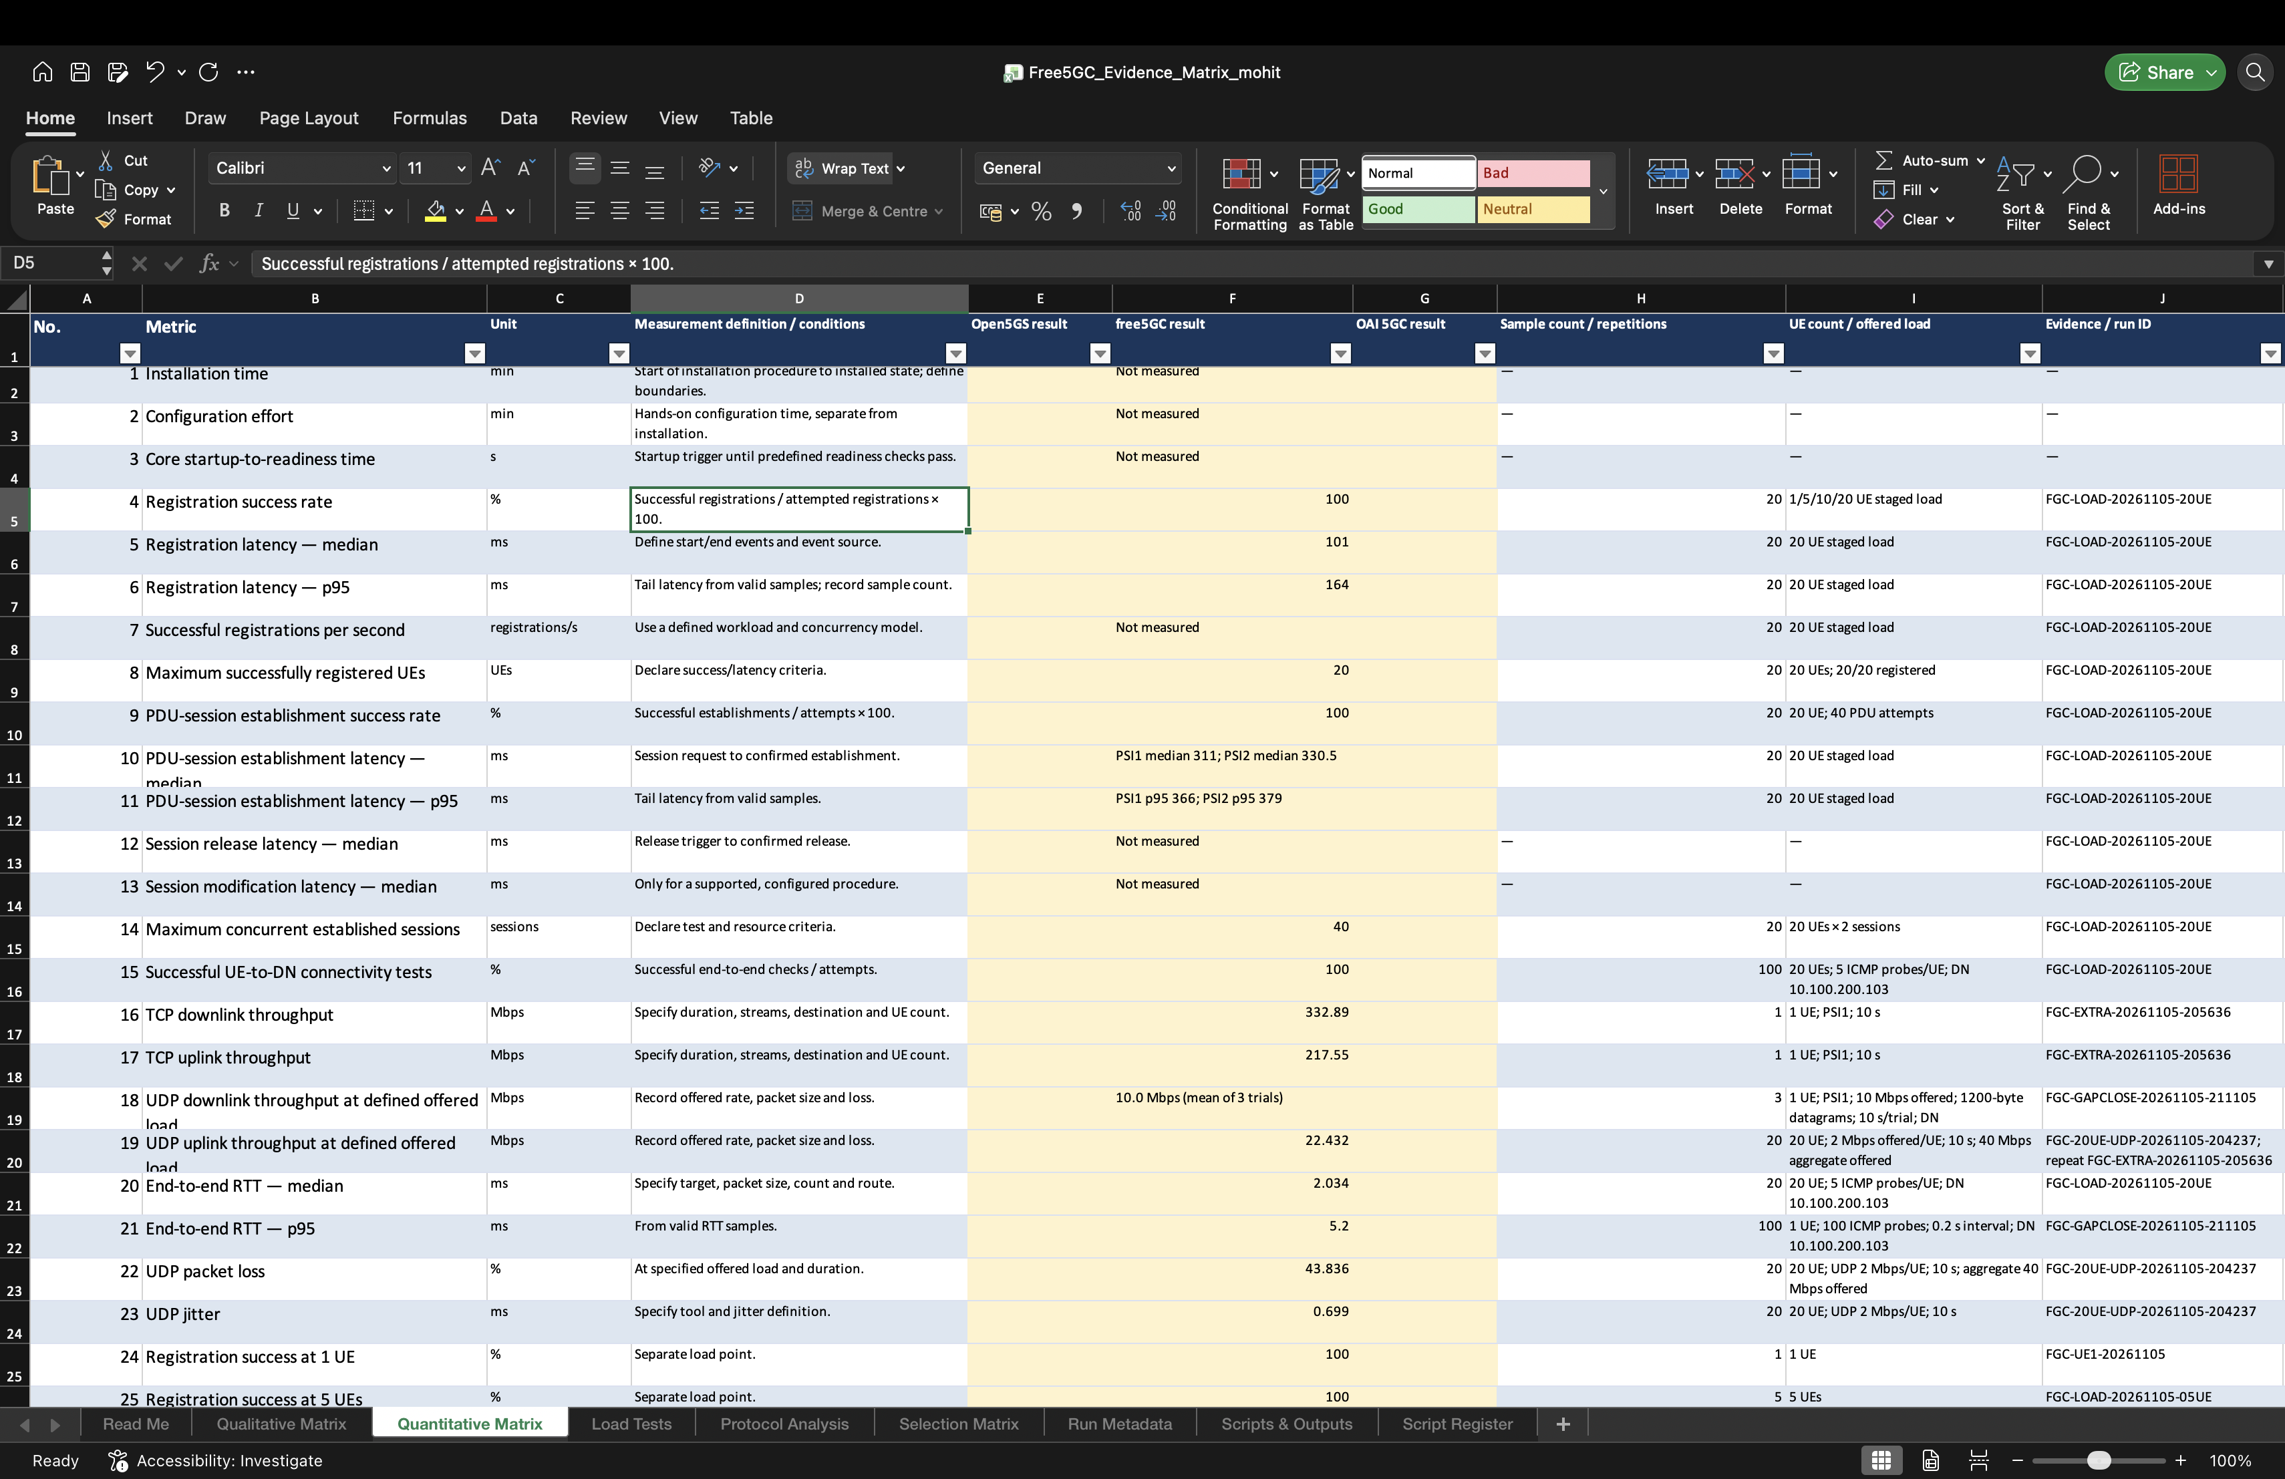
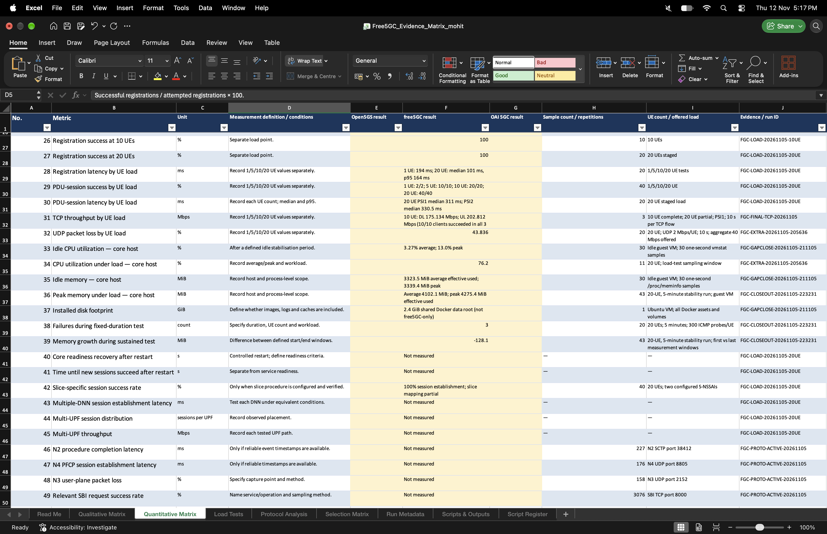
Quantitative Analysis
09

Slide 10
5G Core Networks | Quantitative Comparison
Category
Metric
Open5GS
open5GC (free5GC)
OAI 5GC
Single-UE TCP
Throughput
DL Throughput (Mbps)
241.7
332.9
522.2
UL Throughput (Mbps)
276.0
217.6
481.0
Offered Load
40 Mbps
40 Mbps
40 Mbps
UDP Load
Outcomes
Received Throughput
23.892 Mbps
22.421 Mbps
28.564 Mbps
Mean per-UE Packet Loss
0.076% (DL), 0% (UL)
0.134% (DL), 0% (UL)
0% (DL), 0% (UL)
Median (ms)
p95 (ms)
Median (ms)
p95 (ms)
Median (ms)
p95 (ms)
PDU-session establishment
(at 20 UEs)
72
100
311
366
200.5
364
Latency
Observations
Median (ms)
p95 (ms)
Median (ms)
p95 (ms)
Median (ms)
p95 (ms)
Round-trip time (RTT)
3.09
5.08
3.565
5.2
3.19
5.9
Probe Success Rate
100%
85%
100%
Stability
(Connectivity
& Recovery)
Test Duration
~30 min
~30 min
~30 min
Recovery / Close-out
Release & restart: 20 / 20 successful
Release & restart: 17 / 20 successful
Release & restart: 19 / 20 successful
Resource
Observations
CPU Usage (avg; peak)
57–63% avg; 95–99% peak
≈76.2% avg; 83% peak
19.3% avg; 26.1% peak
Memory Usage
1768.5 MB
4,275.4 MB
2,857 MB

Slide 11
Advanced-feature evidence
Slicing / S-NSSAI
DNN handling
UPF selection
Bandwidth
Session functionality
10

Slide 12
Choosing a core for the use case
Use case
Recommended implementation
Reason from the paper
Lightweight deployment and basic testing
Open5GS
Straightforward native deployment and broad verified baseline functionality
Core-protocol and session-management research
free5GC
Service-based architecture and flexible network-function interactions
Cloud-native experiments
free5GC / OAI 5GC
Container and Kubernetes options are documented; Kubernetes was not benchmarked here
User-plane throughput studies
OAI 5GC
Highest observed controlled single-UE TCP throughput in this testbed
Advanced-feature validation
Open5GS
Broadest experimentally verified advanced-feature coverage in the evaluated configurations
11

Slide 13
What the results mean
Open5GS
Strong baseline stability and mature feature support, ideal for reliable 5G deployment.
free5GC
Flexible, modular architecture, ideal for multi-UE.
OAI 5GC
High throughput data plane performance and RAN integration.
12

Slide 14
Challenges and Way Ahead
Challenges
Hardware resource limitations.
UE failure on restart.
Extension Possible to existing project
Integration with actual UE using radios.
MEC implementation to study its effect on latency (for uRLLC use cases).
13

Slide 15
Team contributions
Three implementation workstreams with a shared evaluation and interpretation effort.
AM
MK
RK
Arpit Metrey
Mohit Kumar
Rakesh Kumar
Open5GS workstream
free5GC workstream
OAI 5GC workstream
The authors jointly defined evaluation dimensions, integrated UERANSIM, conducted functional verification, executed traffic tests, collected evidence, reviewed qualitative and quantitative matrices, interpreted cross-platform limitations, and prepared the report.
14

Slide 16
References and evidence base
[1] 3GPP, System Architecture for the 5G System (5GS), TS 23.501.
[8] OpenAirInterface, OAI 5G Core Network: Features, UPF Options and Deployment Modes.
[2] 3GPP, Procedures for the 5G System (5GS), TS 23.502.
[9] A. Güngör, UERANSIM: Open Source 5G UE and RAN (gNodeB) Implementation.
[3] 3GPP, NG-RAN; NG Application Protocol (NGAP), TS 38.413.
[10] T. Mukute et al., Control Plane Performance Benchmarking and Feature Analysis of Popular Open-Source 5G Core Networks, IEEE Access, 2024.
[4] 3GPP, Interface between the Control Plane and User Plane Nodes, TS 29.244.
[11] M. Barbosa et al., Open-Source 5G Core Platforms: A Low-Cost Solution and Performance Evaluation, ICOIN, 2025.
[5] 3GPP, GPRS Tunnelling Protocol User Plane (GTPv1-U), TS 29.281.
[12] M. Rouili et al., Evaluating Open-Source 5G SA Testbeds, IEEE/IFIP NOMS, 2024.
[6] Open5GS Project, Open5GS Documentation and Source Code.
[13] Project team, 5G-CoreBench evaluation matrices, logs, captures and iperf3 JSON records, Nov. 2026.
[7] free5GC Project, Supported Features and Helm Deployment Documentation.
[14] ESnet, iperf3: Network bandwidth measurement tool documentation.
15

